Slide 1
Project: IEEE P802.15 Working Group for Wireless Personal Area Networks (WPANs)
Submission Title: AI Built-in VLC Link Using LED Lighting System for Warehouse Automation
Date Submitted: May 2019
Source: Jaesang Cha (VTASK Co., Ltd), Daeyoon Cha (VTASK Co., Ltd), YoungMin Kim (SNUST), Kaewon Choi (SKKU), Deokgun Woo (SNUST), Vinayagam Mariappan(SNUST)
Address: Contact Information: +82-2-970-6431, FAX: +82-2-970-6123, E-Mail: chajs@seoultech.ac.kr
Re:
Abstract: This documents introduce the V2I VLC Link design consideration for warehouse automation VAT services. This proposed VLC Link uses the warehouse lighting system to automate with AI technologies. This VAT solution can be used to operate on the application services like ITS, ADAS, etc. on road condition.
Purpose: To provided concept models of VLC Link solution through Warehouse lighting for Vehicular Assistant Technology (VAT) Interest Group
Notice: This document has been prepared to assist the IEEE P802.15. It is offered as a basis for discussion and is not binding on the contributing individual(s) or organization(s). The material in this document is subject to change in form and content after further study. The contributor(s) reserve(s) the right to add, amend or withdraw material contained herein.
Release: The contributor acknowledges and accepts that this contribution becomes the property of IEEE and may be made publicly available by P802.15.
Slide 1

Slide 2
Contents
Needs of VLC in Warehouse Automation
AI Built-In VLC Link through Lighting System for Warehouse Automation
Conclusion
Slide 2

Slide 3
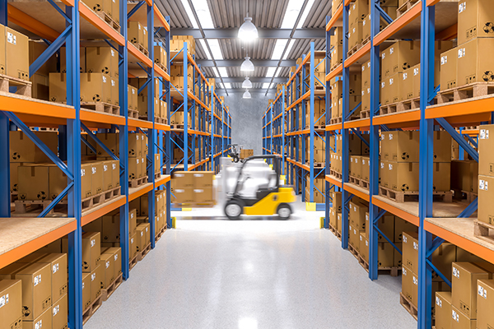
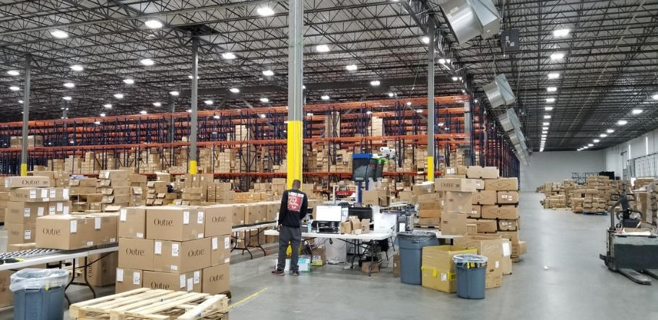
Needs of VLC in Warehouse Automation
Needs
The retail and e-commerce industries are driving the adoption of automation using robotics and indoor automated vehicles with AI technology in warehousing applications.
Longer onboarding and training, rising benefit and compensation rates, and shortages in labor are driving more and more warehousing facilities to invest in automated solutions for operations.
Needs to build additional network infrastructure to automate the operations of the warehouse
Basic Concept
There is the possibility to build network infrastructure using warehouse lighting infrastructure to automate warehouse operations without adding any additional NW infrastructures.
VLC Link between warehouse lighting system and Camera in the Indoor Vehicles or Robotics / Human handheld Smart Devices enables warehouse automation using AI technologies
Google
< Warehouse With Fully Lightened Scenario >
Slide 3

Slide 4
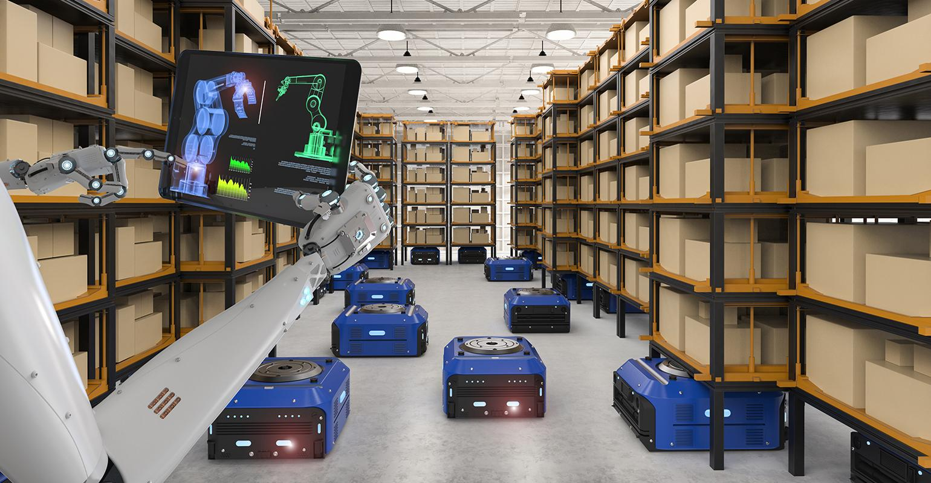
AI Built-In VLC Link through Lighting System for Warehouse Automation
VLC Link through LED Lighting System for Warehouse Using AI Technology
Tx : Warehouse Lighting Systems
Rx : Camera Built on the Indoor Vehicles or Robotics / Human handheld Smart Devices
Day-Night Communication Mode
Modulations :
OOK, Offset-VPWM, Multilevel PPM, Inverted PPM, Subcarrier PPM, DSSS SIK etc.
Data Rate : 1K ~ 1Mb/s
Supported LoS (Line of Sight)
Available Distance : 2m ~ 200m
VLC Link
VLC Link
VLC Link
< AI Built-In VLC Link through LED Lighting System for Warehouse Automation >
※ AI based Automation through VLC Link using Warehouse Lighting System
※ VLC link provides precise location information and flexible location based services (LBS) to automate warehouse operations using AI Technologies
Slide 4

Slide 5
Conclusion
Proposed the AI Built-in VLC Link Using LED Lighting System for Warehouse Automation.
Use the Lighting System installed in the warehouse to enable AI Built-in VLC Link for VAT Services to automate the warehouse operations and does not required additional infrastructures to be installed to have connectivity
Improve the warehouse automation operations through VLC Link with AI technologies and become wider and more flexible are being adopted by a greater number of warehouse operations.
Slide 5

