Slide 1
Project: IEEE P802.15 Working Group for Wireless Personal Area Networks (WPANs)
Submission Title: OCC Link for VAT Services Using Solar-Powered Movable Smart House Signage
Date Submitted: May 2019
Source: Jaesang Cha (VTASK Co., Ltd), Daeyoon Cha (VTASK Co., Ltd), YoungMin Kim (SNUST), Kaewon Choi (SKKU), Deokgun Woo (SNUST), Vinayagam Mariappan(SNUST)
Address: Contact Information: +82-2-970-6431, FAX: +82-2-970-6123, E-Mail: chajs@seoultech.ac.kr
Re:
Abstract: This documents introduce the V2V OCC Link design consideration for VAT. This proposed OCC link technology uses the signage system build-in on the solar-powerd movable smart home to establish optical wireless link with other vehicles. This VAT solution can be used to operate on the application services like ITS, ADAS, etc. on road condition.
Purpose: To provided concept models of OCC Link solution through movable smart home (Smart Living Vehicles) for Vehicular Assistant Technology (VAT) Interest Group
Notice: This document has been prepared to assist the IEEE P802.15. It is offered as a basis for discussion and is not binding on the contributing individual(s) or organization(s). The material in this document is subject to change in form and content after further study. The contributor(s) reserve(s) the right to add, amend or withdraw material contained herein.
Release: The contributor acknowledges and accepts that this contribution becomes the property of IEEE and may be made publicly available by P802.15.
Slide 1

Slide 2
Contents
Needs of VAT Services in Movable Smart House
OCC Link through Solar-Powered Movable Smart Houses Signage for VAT
Conclusion
Slide 2

Slide 3
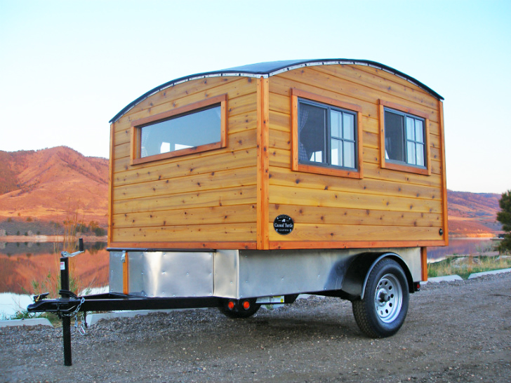
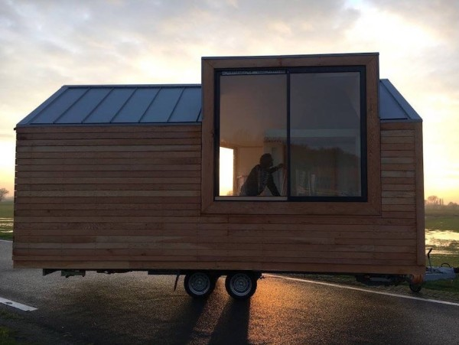
Needs of VAT Services in Movable Smart House
Needs
Wheel Houses design advanced towards modernizing with Smart house features to save resources like water , energy, and need to be connected with Sewage System.
All Movable Smart needs to hooked up to the city’s water and sewage systems, self powered using solar energy is considered living on the grid.
In addition to living featured and need to built-in road safety features to avoid road accidents and safe travel.
Basic Concept
Based on this situation, the movable smart house can implement on-road VAT services through optical camera communication (OCC) using Visible Lights.
OOC Link between movable smart homes and other on-road vehicles through moving smart homes built-in lighting Systems and Signage and Camera installed in the vehicles.
< Movable Smart Homes Usage Model >
Google
Slide 3

Slide 4
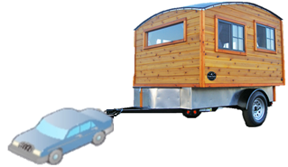
OCC Link through Solar-Powered Movable Smart Houses Signage for VAT
OCC Link through Solar-Powered Movable Smart Houses Signage System
Tx : Movable Smart Houses Signage and Lighting Systems
Rx : Camera Built on the Vehicles
Day-Night Communication Mode
Modulations :
VTASC, SS2DC, OOK, Offset-VPWM, Multilevel PPM, Inverted PPM, Subcarrier PPM, DSSS SIK etc.
Data Rate : 1K ~ 1Mb/s
Supported LoS (Line of Sight)
Available Distance : 2m ~ 200m
Solar Roof
OCC Link
Window Signage
< OCC Link through Solar-Powered Movable Smart House Signage >
※ Establish VAT Services through OCC Link using Movable Smart Houses Window Signage and Lighting System
※ Energized through solar roof and provide road safety informations on road ways for safe journey
Slide 4

Slide 5
Conclusion
Proposed the OCC Link for VAT Services Using Solar-Powered Movable Smart House Signage.
Utilize the Signage and Lighting System connected installed in the solar-powered smart house to enable IoT/IoL Link for VAT Services
Forward the road conditions and emergency warning signal like accidental situation, fire on tunnels, etc. on road ways.
Avoids the vehicle accidents, traffic condition management and provide safe journey on road ways.
Slide 5

