Slide 1
Project: IEEE P802.15 Working Group for Wireless Personal Area Networks (WPANs)
Submission Title: Transparent LED Display Panel based OWC Technology for Wildlife Protection
Date Submitted: May 2019
Source: Jaesang Cha (SNUST), Minwoo Lee (SNUST), Hyoungkyu Song (Sejong Univ.), Seoungkyun Kim (SNUST), Sooyoung Chang (SYCA), Vinayagam Mariappan (SNUST)
Address: Contact Information: +82-2-970-6431, FAX: +82-2-970-6123, E-Mail: chajs@seoultech.ac.kr
Re:
Abstract: This documents introduce the V2I OWC Link design consideration for VAT. This proposed OWC technology used to develop the wildlife protection solution using transparent LED display panels and camera connected on vehicles. This VAT solution can be used to operate on the application services like ITS, ADAS, IoT/IoL, etc. on road condition. Also this can be used for LEDIT, Digital Signage with connected information services etc.
Purpose: To provided concept models of OWC technology solution for Vehicular Assistant Technology (VAT) Interest Group
Notice: This document has been prepared to assist the IEEE P802.15. It is offered as a basis for discussion and is not binding on the contributing individual(s) or organization(s). The material in this document is subject to change in form and content after further study. The contributor(s) reserve(s) the right to add, amend or withdraw material contained herein.
Release: The contributor acknowledges and accepts that this contribution becomes the property of IEEE and may be made publicly available by P802.15.
Slide 1

Slide 2
Contents
Needs for Wildlife Protection System
LED Display Panels based OWC Link for Wildlife Protection
Conclusion
Slide 2

Slide 3
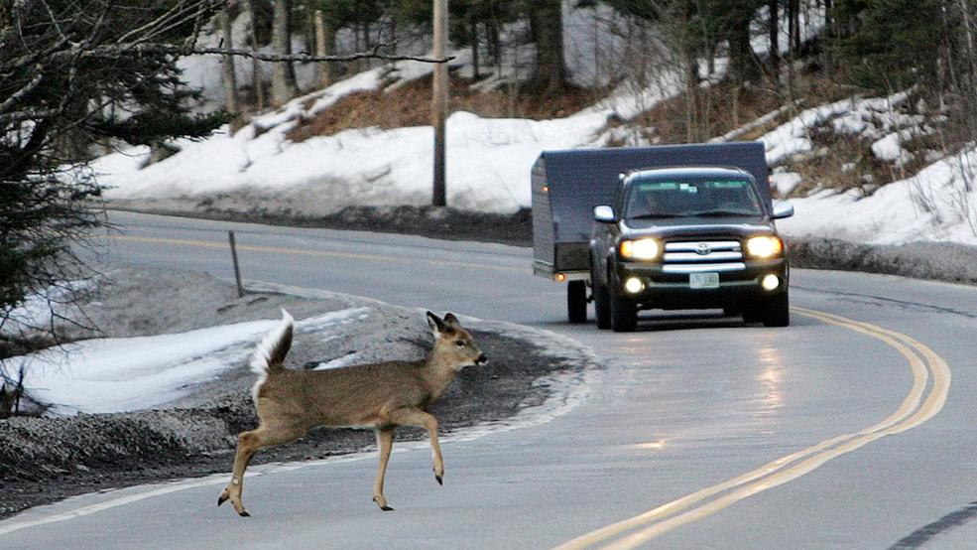
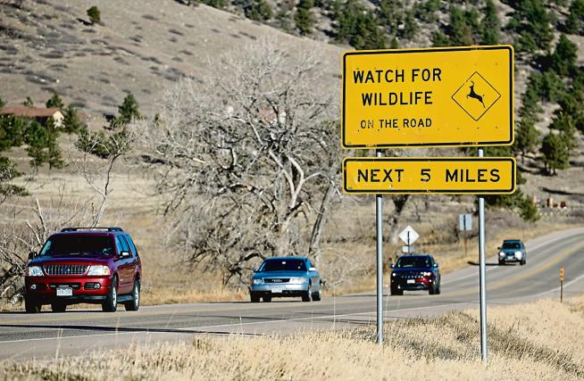
Needs for Wildlife Protection System
Needs
The highway is convenient mode of road way travel for moving long distance places. But to construct the highways, the more wildlife's habitat are destroyed.
The way the highways are constructed can increase in rate of Roadkill in wildlife's habitat zone.
While driving a car, it is difficult for drivers to react right when the animal appears suddenly. So it is necessary to make a new system to solve this problem.
To protect wildlife from Roadkill, the government has implemented several ways such as install signs to notify the wildlife's area but this approach not effective to protect the Roadkills.
Needs effective method to indicate the driver or control the automatically the vehicle to avoid Roadkills.
Basic Concept
Use the LED display panel to transmit the data of animal existence and chances for accidents
Color code can be installed on LED display panels to transmit data of animal existence
The camera installed on a car used as a receiver for OWC so the drivers can get enough time to control the speed of the vehicle.
Google
< Wildlife Roadkill and Signboard Scenario >
Slide 3

Slide 4
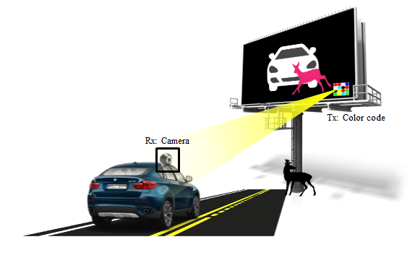
LED Display Panels based OWC Link for Wildlife Protection
OWC Link for Wildlife Habitat
Tx : LED Display Panels
Rx : Camera Built on a Car
Day-Night Communication Mode
Modulations :
VTASC, SS2DC, OOK, VPPM, Offset-VPWM, Multilevel PPM, Inverted PPM, Subcarrier PPM, DSSS SIK etc.
Data Rate : 1K ~ 1Mb/s
Supported LoS (Line of Sight)
Available Distance : 2m ~ 20m
< OWC Link for Wildlife Protect System in Highways >
※ OWC technology is used in LED display panel for communication with a camera built in a car.
※ This technology enable to protect wildlife from danger of crashing with a car.
Slide 4

Slide 5
Conclusion
Proposed Transparent LED Display Panel based OWC Technology for Wildlife Protection .
Utilize the OWC links between LED display panel and camera built on a car.
The proposed technology uses established display board in the highways so that there's no need to install additional infrastructure.
This proposed solution to decrease the occurrence rate of Roadkills.
Slide 5

