Slide 1
Project: IEEE P802.15 Working Group for Wireless Personal Area Networks (WPANs)
Submission Title: Optical Wireless Radio Link Enabled Drone for Dynamic Loading-Unloading Data Collection in Smart Warehouse
Date Submitted: May 2019
Source: Jaesang Cha (VTASK Co., Ltd), Daeyoon Cha (VTASK Co., Ltd), YoungMin Kim (SNUST), Sooung Kang(SNUST), Kaewon Choi (SKKU), Deokgun Woo (SNUST), Vinayagam Mariappan (SNUST)
Address: Contact Information: +82-2-970-6431, FAX: +82-2-970-6123, E-Mail: chajaesang@gmail.com
Re:
Abstract: This document introduces design considerations of VAT optical wireless radio links between vehicles and drones for smart warehouse automation. This proposed optical wireless radio link used to collect loading and unloading data between the lighting in the vehicle and the camera installed in the drones for effective automation using artificial intelligence (AI) techniques in warehouse automation.
Purpose: To provided concept models of optical wireless radio link for Vehicular Assistant Technology (VAT) Interest Group
Notice: This document has been prepared to assist the IEEE P802.15. It is offered as a basis for discussion and is not binding on the contributing individual(s) or organization(s). The material in this document is subject to change in form and content after further study. The contributor(s) reserve(s) the right to add, amend or withdraw material contained herein.
Release: The contributor acknowledges and accepts that this contribution becomes the property of IEEE and may be made publicly available by P802.15.
Slide 1

Slide 2
Contents
Needs for Dynamic Loading/Unloading Data Collection in Warehouse
Optical Wireless Radio Link for Dynamic Data Collection
Conclusion
Slide 2

Slide 3
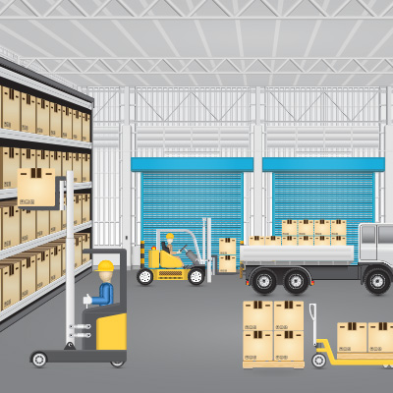
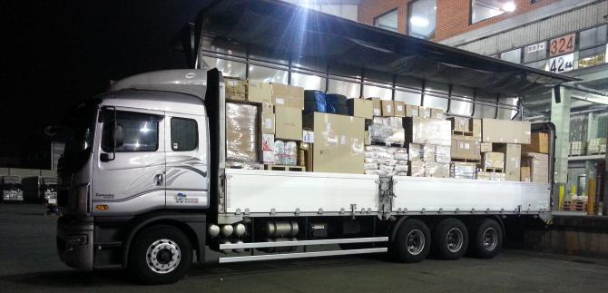
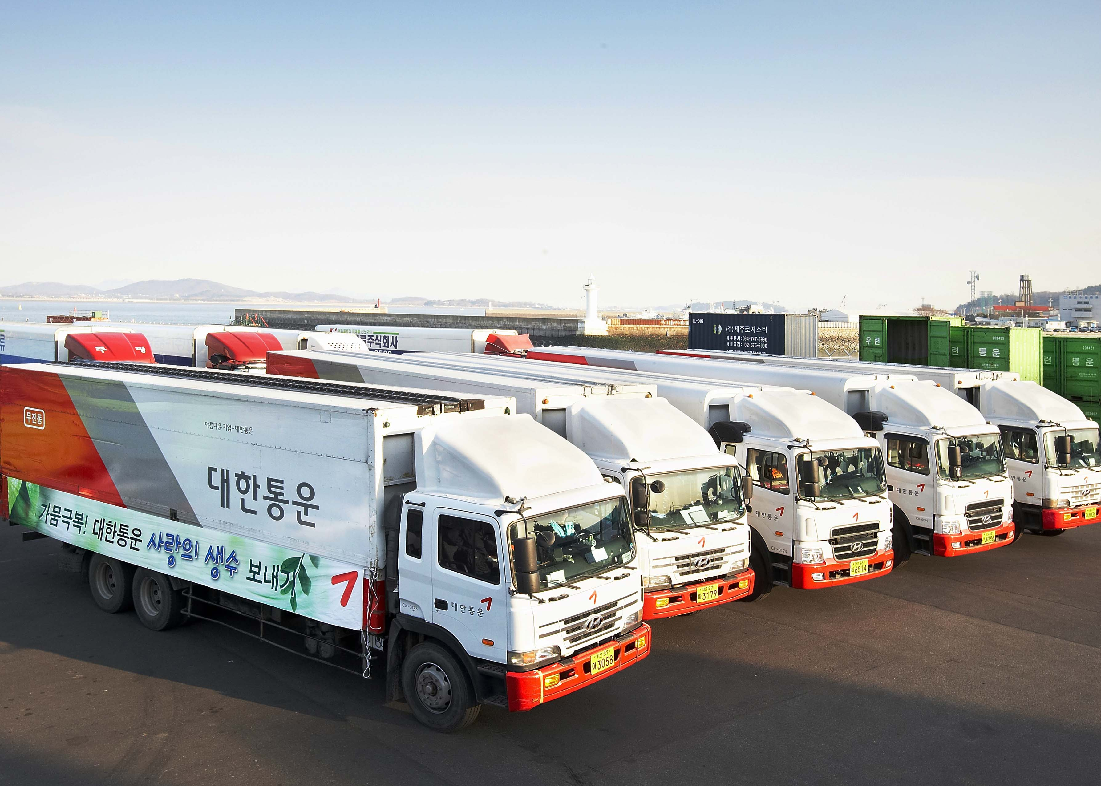
Needs for Loading/Unloading Data Collection in Warehouse
Needs
Smart warehouses are in the process of simplifying the process of stocking, storing, inventory, labeling, packing, and dispatching.
Need interconnection technologies work together to streamline warehouse operation automation in the transportation and logistics supply chain management to increase productivity and efficiency.
To optimize the operation of transportation and logistics, its necessary to confirm the logistics loading/unloading packages details before start the loading/unloading activity
Basic Concept
Proposed Optical Wireless Link between Drone and Logistics Vehicle for Loading/Unloading Data Collection
Use the lighting system in the vehicle and the camera installed in the drones to collect loading/unloading data dynamically.
< Warehouse Logistics Loading / Unloading Scenario >
Google
Slide 3

Slide 4
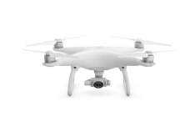
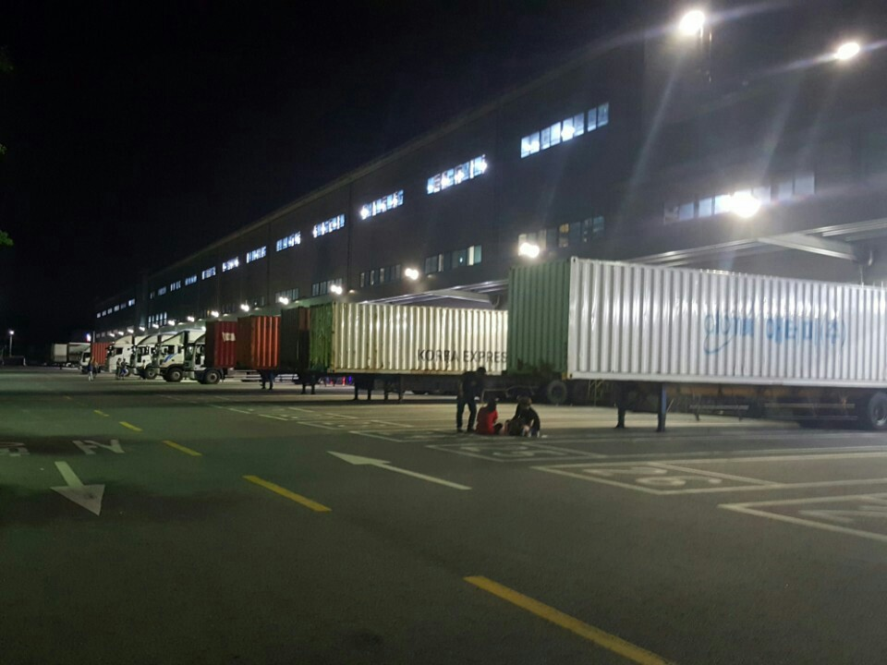
Optical Wireless Radio Link for Dynamic Data Collection
Optical Wireless Radio Link between Logistics Vehicle and Drones for Loading / Unloading Data Collection
Tx: Logistics Vehicle and Drone light
Rx: Drone and Vehicle CMOS Camera
Day-Night Communication Mode
Modulations
OOK, VPPM, Offset-VPWM, Multilevel PPM, Inverted PPM, Subcarrier PPM, DSSS SIK etc.
Data Rate : 1K ~ 1Mb/s
Supported LoS (Line of Sight)
Available Distance : 5m ~ 200m
Up-Link
Down-Link
< Optical Wireless Radio Link for Loading/Unloading Data Collection in Warehouse >
※ Logistics Vehicle LED Indicator Light is used to transmit vehicle information, the type and quantity of the baggage, and the camera installed in the Drone will be receive the data using image sensor communication techniques.
※ Drone LED Indicator Light is used to transmit loading information, the type and quantity of the baggage, and the camera installed in the Logistics Vehicle will be receive the data using image sensor communication techniques.
Slide 4

Slide 5
Conclusion
Proposed the Optical Wireless Radio link for interconnection connection between Logistics Vehicles and Drones.
In the proposed optical wireless link between the vehicle and the drone, the light mounted on Logistics Vehicle/Drone is used as a transmitter and the CMOS camera installed in the Logistics Vehicle/Drone is used as a receiver.
The proposed technology optimize the operation of transportation and logistics, its necessary to confirm the logistics loading/unloading packages details before start the loading/unloading activity.
Slide 5

