Slide 1
Project: IEEE P802.15 Working Group for Wireless Personal Area Networks (WPANs)
Submission Title: IoT Security Light with VLC Link for Illegal Drone Localization and Tracking in Prohibited Zone
Date Submitted: May 2019
Source: Vinayagam Mariappan (SNUST) , Soonho Jung (Sunil Elecomm Co.,LTd), Sooung Kang (SNUST), Donghoon Hyun (Korea Polytechnic Univ.), Minwoo Lee (SNUST), Sooyoung Chang (SYCA)
Address: Contact Information: +82-2-970-6431, FAX: +82-2-970-6123, E-Mail: vinayagam@ieee.org
Re:
Abstract: This documents introduce the V2X VLC Link design consideration for VAT. This proposed VLC link is used in IoT security lighting devices to localize and track the illegal drones flying in prohibited zone such as country borders, military camps, nuclear power plants, etc. This VAT solution can be used to operate on the application services like IoT/IoL, Surveillance Drones for security services, etc.
Purpose: To provided concept models of VLC technology solution for Vehicular Assistant Technology (VAT) Interest Group
Notice: This document has been prepared to assist the IEEE P802.15. It is offered as a basis for discussion and is not binding on the contributing individual(s) or organization(s). The material in this document is subject to change in form and content after further study. The contributor(s) reserve(s) the right to add, amend or withdraw material contained herein.
Release: The contributor acknowledges and accepts that this contribution becomes the property of IEEE and may be made publicly available by P802.15.
Slide 1

Slide 2
Contents
Need for Illegal Drone Localization and Tracking Solution
IoT Security Light based VLC Link for Patrol Service
Conclusion
Slide 2

Slide 3
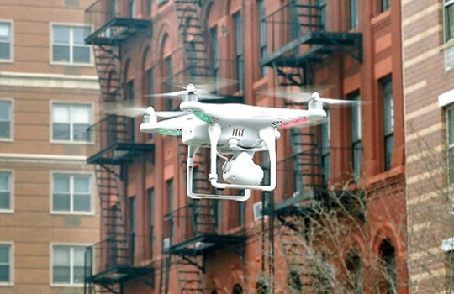
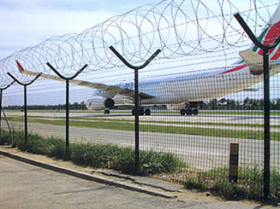
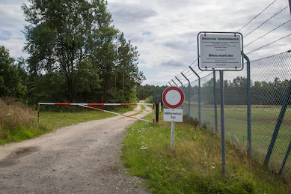
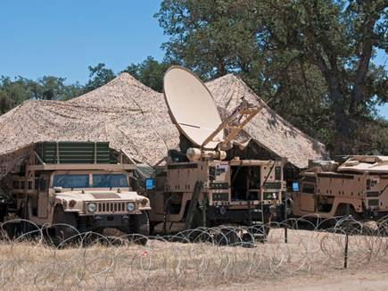
Need for Illegal Drone Localization and Tracking Solution
Needs
Nowadays drones are used for many kind of services in many spheres like paly, security, patrol, delivery, public crowd monitoring etc.
As drones have become commercially available to uses by civilians, increases the crimes that illegally shoots by cameras attached in the drones.
To prevent crimes, automatic security patrol services are needed because there are some civilians captures video/image in the restricted areas.
Basic Concept
The patrol drones and outdoor security lights can be used to localize the precise location of the illegal drones using a lighting system installed in the barbed wire.
The position information is obtained by using the VLC link of the camera and lighting system connected to the drone and IoT security lights.
Google
< Prohibited Zone for Private Drones Fly >
Slide 3

Slide 4
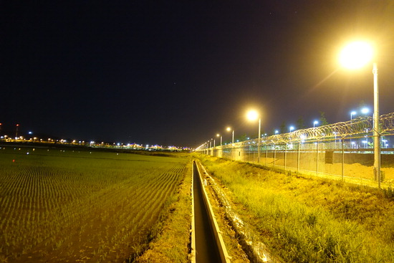
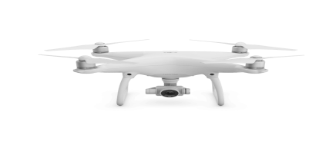
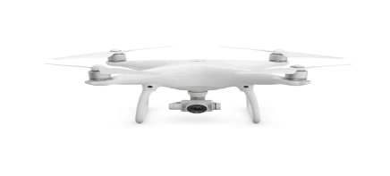
IoT Security Light based VLC Link for Patrol Service
Bi-Directional VLC Link
Bi-Directional VLC Link
Illegal Drone
Bi-Directional VLC Link
Patrol Drone
< IoT Security Light based VLC Link for Patrol Service >
IoT Security Lighting System based VLC Link for Patrol Service
Tx : Outdoor Street Light and Drone Light System
Rx : PD / CMOS Image Sensor
Day-Night Communication Mode
Modulations :
OOK, VPPM, Offset-VPWM, Multilevel PPM, Inverted PPM, Subcarrier PPM, DSSS SIK etc.
Data Rate : 1K ~ 1Mb/s and Distance : 2m ~ 100m
※ Provides precise location of illegal drones to patrol service for tracking
※ The position information is obtained by using the VLC link of the camera and illumination system connected to the IoT Security Light and Drone.
Slide 4

Slide 5
Conclusion
To detect drones that illegally film confidential facilities using IoT security lighting system to patrol and alert about the illegal unmanned aircraft through VLC Link about precise location and navigation information
The proposed solution enables the VLC Link to acquire the position information of the illegal drone appearing at the prohibited zone by using the camera connected with the IoT security lighting system.
This proposed solution makes it easy for patrol drones to locate the exact illegal drones without GPS action.
Slide 5

