Slide 1
Project: IEEE P802.15 Working Group for Wireless Personal Area Networks (WPANs)
Submission Title: Drone based Delivery Service Authentication using IoT/IoL Link
Date Submitted: May 2019
Source: Jaesang Cha (SNUST), Nugmanov Said (SNUST), Minwoo Lee (SNUST), Seongjhin Choi (SNUST), Jaesoo Kim (SNUST), Jonghoon Lee (SNUST), Jintae Kim (Fivetek Co., Ltd.), Sungdoo Kang (Feelux Co., Ltd.), Changsoo Lee (L&S LED Co., Ltd.), Sangil Lim (Signtelecom Co. Ltd.), Sooyoung Chang (SYCA), Vinayagam Mariappan (SNUST)
Address: Contact Information: +82-2-970-6431, FAX: +82-2-970-6123, E-Mail: chajs@seoultech.ac.kr
Re:
Abstract: This documents introduce the V2X IoT/IoL Link design consideration for VAT. This proposed IoT/IoL Link used for authenticating remote user for drone based delivery service. This VAT solution can be used to operate on the application services like ITS, ADAS, etc. on road condition. The proposed solution prevent the wrong delivery of packages.
Purpose: To provided concept models of IoT/IoL relay link solution for Vehicular Assistant Technology (VAT) Interest Group
Notice: This document has been prepared to assist the IEEE P802.15. It is offered as a basis for discussion and is not binding on the contributing individual(s) or organization(s). The material in this document is subject to change in form and content after further study. The contributor(s) reserve(s) the right to add, amend or withdraw material contained herein.
Release: The contributor acknowledges and accepts that this contribution becomes the property of IEEE and may be made publicly available by P802.15.
Slide 1

Slide 2
Contents
Needs for Drone Delivery Service Authentication
IoT/IoL Link for Delivery Service Authentication
Conclusion
Slide 2

Slide 3
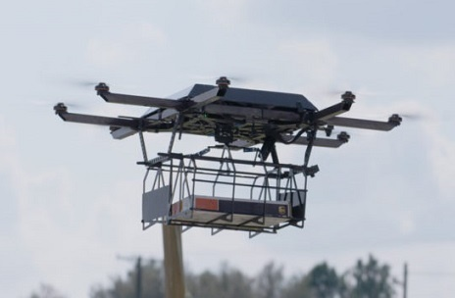
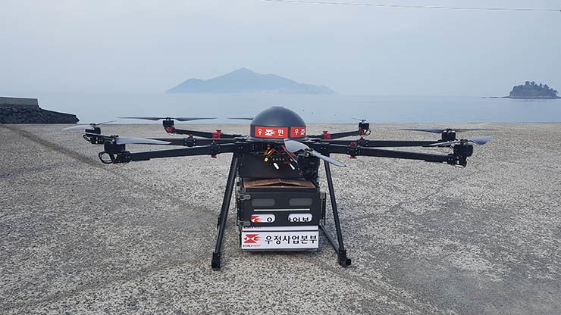
Needs for Drone Delivery Service Authentication
Needs
In future drone based delivery service will play major role in delivery service system
Delivery service drone is an autonomous vehicle, often a UAV, used to transport packages, food or other goods.
South Korea’s national postal service completed the country’s first successful drone delivery last November 2018, and firmly stated its intentions to expand operations in the near future.
The most obvious disadvantage of delivery drone is that it should be autonomous and the delivery address will be various, so some places maybe out of range of connection, that means that the ID verification of receiver should be done by drone itself.
Basic Concept
Uses the Lighting System and Camera Connected and the Camera to enable IoT/IoL Link with User Smart devices to authenticate the user.
Delivery Service Drone Request User ID of receiver for verification and User should send their ID for authenticating delivery using smart devices.
This is secure ID verification system model where there is no connection to the system for hackers to hack the delivery system.
Google
< Drone for Delivery Service >
Slide 3

Slide 4
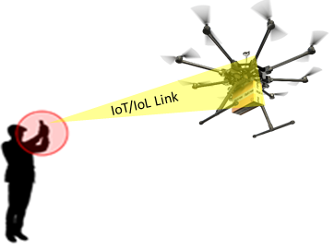
IoT/IoL Link for Delivery Service Authentication
IoT/IoL Link for Drone Delivery Service Authentication
Tx : Drone Lighting System and Smart Device Flash Light / LED Light
Rx : Camera Built in the Smart Devices and Drone
Day-Night Communication Mode
Modulations :
OOK, Offset-VPWM, Multilevel PPM, Inverted PPM, Subcarrier PPM, DSSS SIK etc.
Data Rate : 1K ~ 1Mb/s
Supported LoS (Line of Sight)
Available Distance : 2m ~ 200m
< IoT/IoL Link for Delivery Service Authentication through Drones >
※ Due to Light Communication security, the proposed authentication technology maybe used as the main way of receiver identification even when the drone is in the range of connection to the system.
※ Avoids Wrong delivery and reduces complexity returning the packages and then re-delivery the package orders.
Slide 4

Slide 5
Conclusion
Proposed the Drone based Delivery Service Authentication using IoT/IoL Link.
Utilize the Lighting System connected and Camera Installed in the drone to enable IoT/IoL Link to do authentication with user through smart devices build-in camera and Flash / LED lights.
No need additional communication channel between vehicle and operator or server and this this is more secured, due to the line of sight connection.
Avoids wrong delivery and reduces the complexity re-delivering the user specific ordered packages
Slide 5

