Slide 1
Project: IEEE P802.15 Working Group for Wireless Personal Area Networks (WPANs)
Submission Title: Automatic Mobility Guiding Solution Using LiFi / CamCom Technology for Wheel-Chaired Mobility Impaired Persons
Date Submitted: May 2019
Source: Jaesang Cha (SNUST), Pham Minh Trung (SNUST), Sangwoon Lee (Namseoul Univ.), Jinyoung Kim (Kwangwoon Univ.), Jeonggon Kim (Korea Polytechnic Univ.), Chanhyeong Chung (RAPA), Sooyoung Chang (SYCA),Vinayagam Mariappan (SNUST)
Address: Contact Information: +82-2-970-6431, FAX: +82-2-970-6123, E-Mail: chajs@seoultech.ac.kr
Re:
Abstract: This document introduces the LiFi/Camcom technology by using light to guide wheelchair mobility for people with disabilities in buildings and hospitals. The proposed LiFi / CamCom solution provides the functionality to be applied in worldwide to support people with disabilities who are unable to move on their own but must rely on improved wheelchairs. In addition, we can use this technology in automatic navigation of indoor vehicles.
Purpose: To provided concept models of Light Communication based LiFi/CamCom solution for Vehicular Assistant Technology (VAT) Interest Group
Notice: This document has been prepared to assist the IEEE P802.15. It is offered as a basis for discussion and is not binding on the contributing individual(s) or organization(s). The material in this document is subject to change in form and content after further study. The contributor(s) reserve(s) the right to add, amend or withdraw material contained herein.
Release: The contributor acknowledges and accepts that this contribution becomes the property of IEEE and may be made publicly available by P802.15.
Slide 1

Slide 2
Contents
Need to Mobility Guiding Feature in Wheelchair
LiFi/CamCom Link based Mobility Guide for Wheel-Chaired Persons
Conclusion
Slide 2

Slide 3
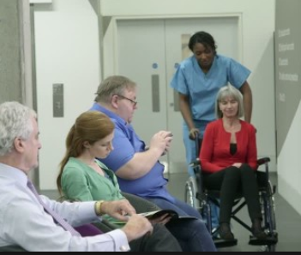
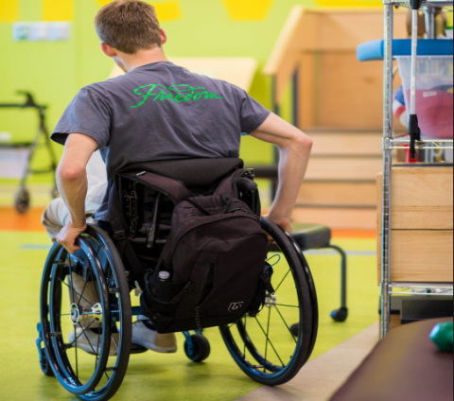
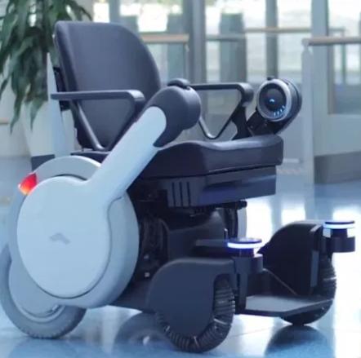
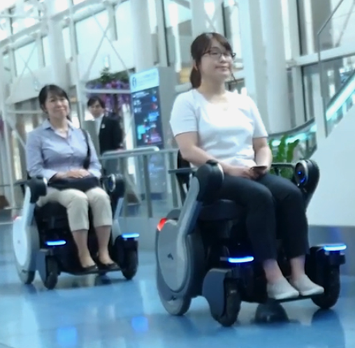
Need to Mobility Guiding Feature in Wheelchair
Needs
Currently, wheel-chaired persons mobility controlled by using human power such as someone to push or directly by hand to move
In order to reduce the dependency of others when navigating one place to other place, it is necessary to practice the automatic wheelchair system.
To navigate to the final destination accurately in a narrow space, a wheelchair needs to provide with precise path way information
Light ID broadcasting solution in indoor environment is an method to precise location information
Basic Concept
LiFi / CamCom Link solution is an optimum solution to provide precise location information to control wheelchairs mobility accurately in realtime.
Uses the LED lights installed in the ceiling to transmit corresponding coordinate information
Use the cameras installed on the wheelchair body as an receiver to decode LED Light transmitting information.
Supports Mobility control of self-driving wheelchairs.
< Disabled People with Wheelchairs Scenario >
Google
Google
< Self-driving Wheelchairs >
Slide 3

Slide 4
LiFi/CamCom Link based Mobility Guide for Wheel-Chaired Persons
LED lamp
LED lamp
LiFi/CamCom Link for Mobility Guidance in the Wheelchairs
Tx : Building Lighting System
Rx : Camera Built on Wheelchairs
Day-Night Communication Mode
Modulations :
OOK, VPPM, Offset-VPWM, Multilevel PPM, Inverted PPM, Subcarrier PPM, DSSS SIK etc.
Data Rate : 1K ~ 1Mb/s
Supported LoS (Line of Sight)
Available Distance : 2m~200m
Signal required to stop the wheelchairs, position signal,….
Signal required to stop the wheelchairs, position signal,….
1001001010101010
1001001010101010
Camera
Camera
Move
< LiFi/CamCom Technology for Self-driving Wheelchairs Mobility Control >
※ Use the LED light to transmit location informations to the Wheelchairs and decode using Camera
※ The Wheelchairs keep track the location information and move towards destination location without any human intervention
Slide 4

Slide 5
Conclusion
Proposed the solution of LiFi/CamCom Technology for Automatic Mobility Guiding Solution for Wheel-Chaired Mobility Impaired Persons
Proposed system uses the building lighting system and the camera built in the wheelchairs to enable LiFi/CamCom Link for communication.
Used to provide indoor location information of the building by using LiFi/CamCom technology, which can give the automatic mobility guidance for the for Wheel-Chaired Mobility Impaired Persons.
Reduce dependence on people with disabilities and build a modern automation society.
Slide 5

