Slide 1
Project: IEEE P802.15 Interest Group for Wireless Personal Area Networks (WPANs)
Submission Title: Optical V2X to High-speed Railway (HSR) Communication Systems
Date Submitted: March 2019
Source: Minh Duc Thieu, Huy Nguyen, Yeong Min Jang [Kookmin University].
Contact: +82-2-910-5068 E-Mail: yjang@kookmin.ac.kr
Re:
Abstract: Considerations of applying optical V2X to high-speed railway communication systems
Purpose: To discuss about the need for applying optical V2X communication system on high-speed railway communications
Notice: This document has been prepared to assist the IEEE P802.15. It is offered as a basis for discussion and is not binding on the contributing individual(s) or organization(s). The material in this document is subject to change in form and content after further study. The contributor(s) reserve(s) the right to add, amend or withdraw material contained herein.
Release: The contributor acknowledges and accepts that this contribution becomes the property of IEEE and may be made publicly available by P802.15.

Slide 2
Optical V2X to High-speed Railway (HSR) Communication Systems

Slide 3
Introduction
High-speed railway (HSR) has been developed rapidly as a fast, convenient and green public transportation system.
E.g. High speed rail plan has been outlined in America and the length of HSR lines in China will reach 18,000 km by 2020 [1].
E.g. Spain has a Strategic Plan for Infrastructure and Transport for the period 2005-2020. 44% of the total spending in the Plan is for railways, primarily for increasing the size of the high speed rail network to 6,200 miles by the year 2020 [2].
It has the potential to become the future trend of railway transportation worldwide.

Slide 4
Characteristics of high-speed railway (HSR) scenario (1)
High mobility: The dramatic increase of train speed will cause frequent handover. Given a cell size of 1-2km, a high-speed train of 350 km/h experiments one handover every 10-20 seconds. The maximum speed of HSR in China is currently 486 km/h [3].
Unique channel characteristics: The moving train encounters diverse scenarios (e.g. cuttings, viaducts and tunnels) with different channel propagation characteristics, which causes that a single channel model could not depict features of HSR channels accurately

Slide 5
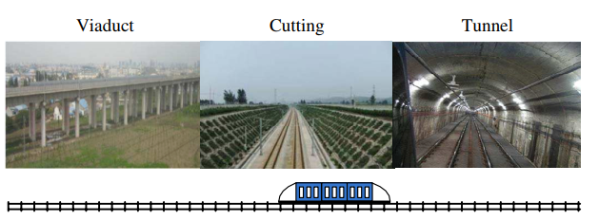
Characteristics of high-speed railway (HSR) scenario (2)
Unique channel characteristics: the line-of-sight (LOS) component is much stronger than the multipath components especially in viaduct scenario [2]. LOS is one of the main properties of communication systems using visible light (OCC/VLC).
Fig. 1. Multiple scenarios in HSR communications

Slide 6
Estimation of bit rate requirement for high-speed railway (HSR) communication
An example of estimating bit rate using in HSR communications:
• IPv6 address: 128 bits.
Assume 100% overhead and FEC: 128 bits … round up to 300 bits.
• Max. Train speed: 350km/h = 97.22m/s
• Current distance between Tx infrastructure and Rx: 50 m.
• Communication distance: 100 m.
If an urgent message to the Rx train.
• Time to travel before the Rx train approaches the communication distance (Max. Range –Min. Range):
(100m-10m) / 97.22 m/s ≈ 0.93 s.
• Assume modulated lights blockage 75 % of the observation time.
• Assume 0.2 s are used for modulated lights detection.
• If T is the time we have to extract data from the modulated lights, then: T = 0.93*0.25- 0.2 ≈ 0.0325 s.
• 300 bits sent in T = 0.0325 s (3.25 millisecond) yields bit rate of 9.23 kbps.

Slide 7
References
[1] J. Wang, H. Zhu, and N. J. Gomes, “Distributed antenna systems for mobile communications in high speed trains,” IEEE Journal on Selected Areas in Communications, vol. 30, no. 4, pp. 675–683, 2012.
[2] David Randall Peterman et. al, “High Speed Rail (HSR) in the United States” [Online], 2009. Available: https://fas.org/sgp/crs/misc/R40973.pdf.
[3] Shengfeng Xu, Gang Zhu, Bo Ai, Zhangdui Zhong, “A Survey on High-Speed Railway Communications: A Radio Resource Management Perspective”, March 2016.

