Slide 1
Project: IEEE P802.15 Interest Group for Wireless Personal Area Networks (WPANs)
Submission Title: AI-based High-rate OCC System
Date Submitted: March 2019
Source: Pham Tung Lam, Minh Duc Thieu and Yeong Min Jang [Kookmin University].
Contact: +82-2-910-5068 E-Mail: yjang@kookmin.ac.kr
Re:
Abstract : Introduce AI-based PHY layer for Optical Camera Communication System
Purpose: To Introduce application of AI in designing PHY layer for Optical Camera Communication System.
Notice: This document has been prepared to assist the IEEE P802.15. It is offered as a basis for discussion and is not binding on the contributing individual(s) or organization(s). The material in this document is subject to change in form and content after further study. The contributor(s) reserve(s) the right to add, amend or withdraw material contained herein.
Release: The contributor acknowledges and accepts that this contribution becomes the property of IEEE and may be made publicly available by P802.15.

Slide 2
AI-based PHY layer for Optical Camera Communication system

Slide 3
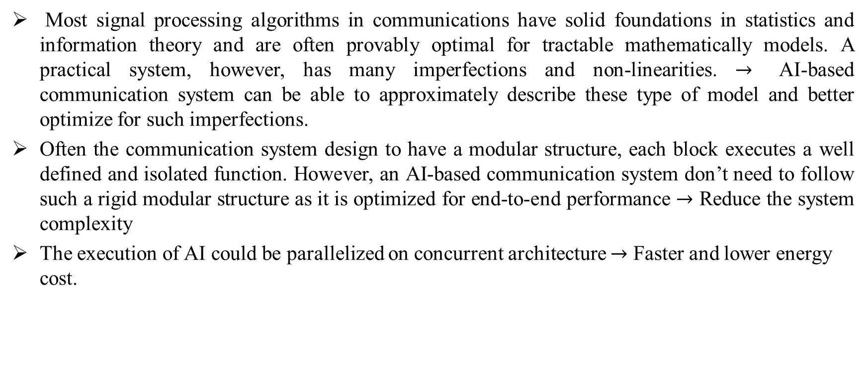
Potential of AI for PHY layer
Most signal processing algorithms in communications have solid foundations in statistics and information theory and are often provably optimal for tractable mathematically models. A practical system, however, has many imperfections and non-linearities. $→$ AI-based communication system can be able to approximately describe these type of model and better optimize for such imperfections.
Often the communication system design to have a modular structure, each block executes a well defined and isolated function. However, an AI-based communication system don’t need to follow such a rigid modular structure as it is optimized for end-to-end performance $→$ Reduce the system complexity
The execution of AI could be parallelized on concurrent architecture $→$ Faster and lower energy cost.
Kookmin University

Slide 4
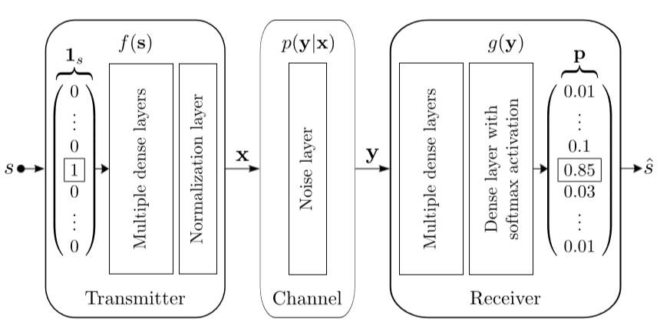
Autoencoders
A communications system over an AWGN channel represented as an autoencoder. The input s is encoded as a one-hot vector, the output is a probability distribution over all possible messages from which the most likely is picked as output $\hat{s}$.
Kookmin University

Slide 5
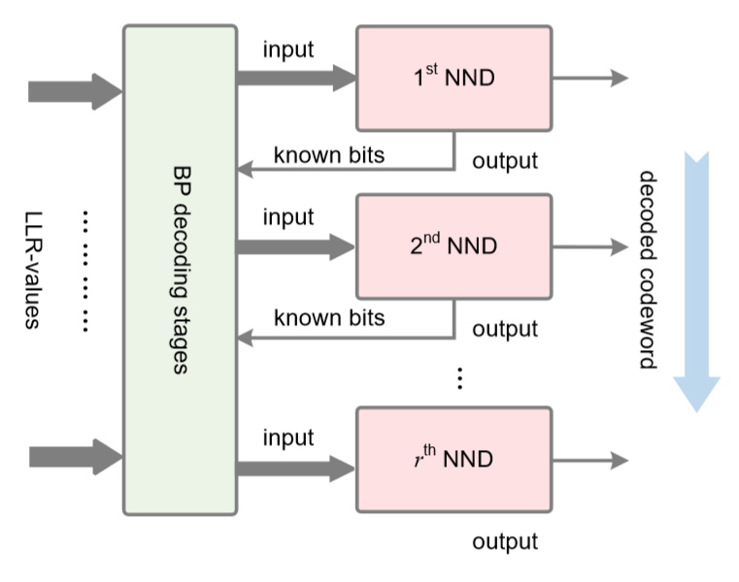
Channel decoding
LLR: Log-likelihood ratio
BP: Belief Propagation
NND: Neural Network Decoder
A patitioned NN decoding architecture for polar codes with each Neural Network Decoder decoding a sub-codeword $→$ Decoding process is parallel and faster.
Kookmin University

Slide 6
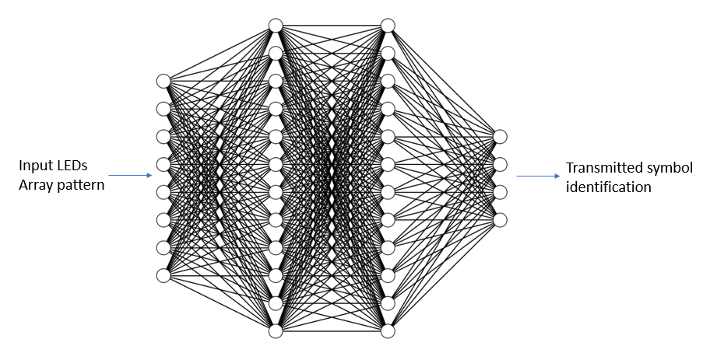
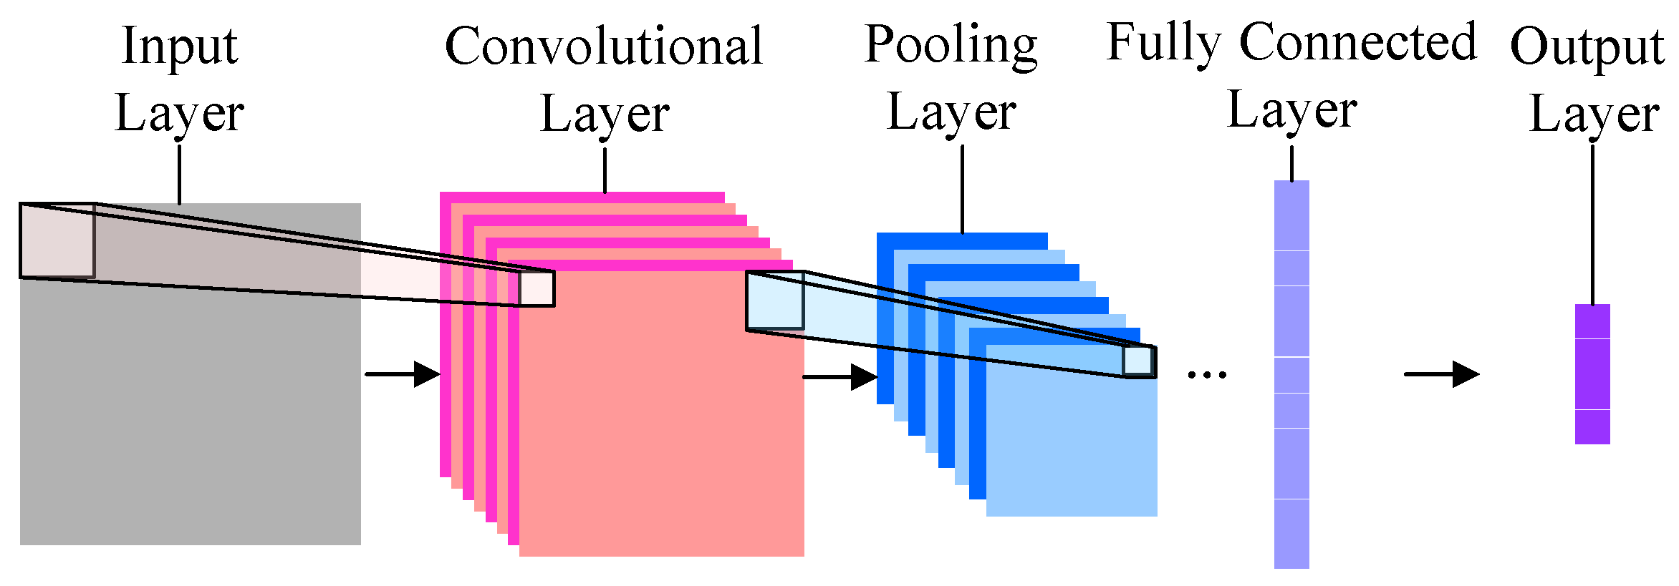
Neural network architecture for OCC
CNN architecture for RoI extracting in OCC system
Neural network decoder architecture in OCC system
Mostly in OCC system, from RoI extracting to data decoding task can be referred to classification problem, so we can use a convolutional neural network and multilayer fully-connected neural network for OCC system
Kookmin University

Slide 7
References
[1] T. Nguyen, Amirul Islam and Yeong Min Jang, "Region-of-Interest Signaling Vehicular System Using Optical Camera Communications" IEEE Access, 2017.
[2] T. Wang, C. Wen, H. Wang, F. Gao, T. Jiang and S. Jin, "Deep learning for wireless physical layer: Opportunities and challenges," in China Communications, vol. 14, no. 11, pp. 92-111, Nov. 2017.
[3] T. O’Shea and J. Hoydis, "An Introduction to Deep Learning for the Physical Layer," in IEEE Transactions on Cognitive Communications and Networking, vol. 3, no. 4, pp. 563-575, Dec. 2017.

