Slide 1
Project: IEEE P802.15 Working Group for Wireless Personal Area Networks (WPANs)
Submission Title: BAS Monitoring System based Delivery Drones Solution using Color Grid and OWC
Date Submitted: March 2019
Source: Jaesang Cha (VTASK Co., Ltd), Beomhee Lee (SNUST), Jinyoung Kim (Kwangwoon Univ.), Sunghoon Yoon (Kogen Co., Ltd) , Vinayagam Mariappan (SNUST)
Address: Contact Information: +82-2-970-6431, FAX: +82-2-979-7903, E-Mail: chajaesang@gmail.com
Re:
Abstract: This documents introduce the V2I OWC Link design consideration for VAT. This OWC technology proposed for delivery drones interaction with BAS monitoring system in buildings for delivery drone solutions. This VAT solution is to operate on the application services like ITS, ADAS, IoL, etc. on road condition connected information services etc.
Purpose: To provided concept models of OWC for Vehicular Assistant Technology (VAT) Interest Group
Notice: This document has been prepared to assist the IEEE P802.15. It is offered as a basis for discussion and is not binding on the contributing individual(s) or organization(s). The material in this document is subject to change in form and content after further study. The contributor(s) reserve(s) the right to add, amend or withdraw material contained herein.
Release: The contributor acknowledges and accepts that this contribution becomes the property of IEEE and may be made publicly available by P802.15.
Slide 1

Slide 2
Contents
Need for BAS Monitoring System based Delivery Drones Solution
BAS Monitoring System based Drone Delivery using Color Grid and OWC
Conclusion
Slide 2

Slide 3
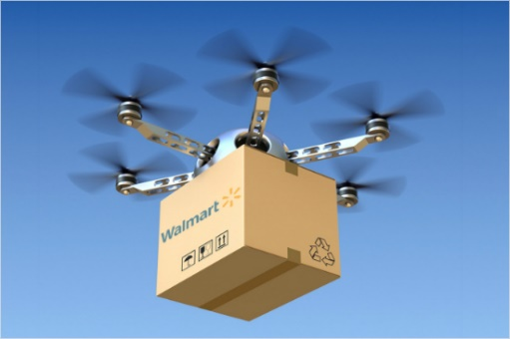
Need for BAS Monitoring System based Delivery Drones Solution
Needs
Due to recent developments in drone technology, many companies are making active use of courier drones.
However, with regard to the delivery drones, there is no way to transmit information about the goods or necessary information to the recipient.
Therefore, information providing technology such as a drone-linked monitoring technology is needed.
Basic Concept
This technology is OWC between the light source of the delivery drones and the building camera, and it provides the BAS monitoring necessary to deliver the goods by utilizing the light source based OWC
In addition to the building area, it is a technology applicable to various places such as factories and smart houses.
< Delivery Drone and Building >
< Drone Delivery Concept Model >
Slide 3

Slide 4
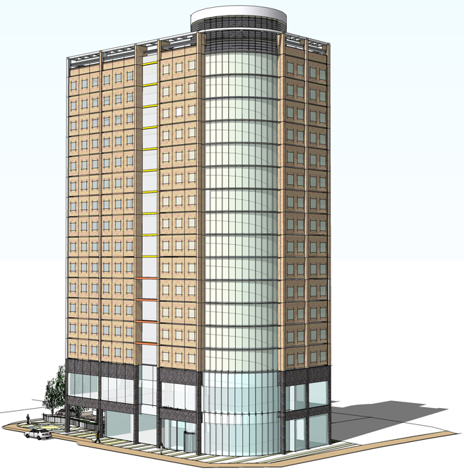
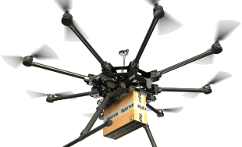
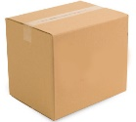
BAS Monitoring System based Drone Delivery using Color Grid and OWC
Camera
Delivery Drone and Building OWC Link
Tx : Building Light
Rx : Drone Camera
Day-Night Communication Mode
Modulations :
2D Color Code, QR Code, VTASC, OOK, VPPM, Offset-VPWM, Multilevel PPM, Inverted PPM, Subcarrier PPM, DSSS SIK etc.
Data Rate : 1K ~ 1Mb/s
Supported LoS (Line of Sight)
Available Distance : 10m ~ 50m
Building
BAS Monitoring Data
Light Source
Monitoring
Delivery Drone(Vehicle)
BAS Monitoring Data
Delivery Area Location
Item Information
Payment
Notification Information
Monitoring Information
BOX
< BAS Monitoring System based Delivery Drone OWC Link >
This technology is an optical wireless communication technology between a light source attached to a delivery drone and a camera attached to a building.
Provide OWC for delivery acceptance through BAS Monitoring information
Slide 4

Slide 5
Conclusion
Proposed the BAS Monitoring System based Delivery Drones Solution using Color Grid and OWCC
This proposed solution is an optical wireless communication technology between a light source attached to a delivery drone and a camera attached to a building
Provides BAS monitoring information by using OWC for drone delivery interaction with Drones and Building Delivery address .
Based on this proposed technology, it is possible to provide information that can be helpful to the recipient when delivering the package and can be used in various places such as factories and smart houses applications.
Slide 5

