Slide 1
Project: IEEE P802.15 Working Group for Wireless Personal Area Networks (WPANs)
Submission Title: OWC based Unmanned Logistics Storage Technology Using IoT Open Source Controller Panel
Date Submitted: March 2019
Source: Jaesang Cha (VTASK Co., Ltd), Jungdo Han (SNUST), Jinyoung Kim (Kwangwoon Univ.), Sunghoon Yoon (Kogen Co., Ltd) , Vinayagam Mariappan (SNUST)
Address: Contact Information: +82-2-970-6431, FAX: +82-2-979-7903, E-Mail: chajaesang@gmail.com
Re:
Abstract: This documents introduce the optical wireless communications link model proposed to introduce the possibility of using light communication for IoT door-lock technology for unmanned logistics vehicles. This proposed solution can be used as a part of a unmanned logistics vehicle
Purpose: To provided concept models of the high speed optical wireless/light communications solution for Vehicular Assistant Technology
Notice: This document has been prepared to assist the IEEE P802.15. It is offered as a basis for discussion and is not binding on the contributing individual(s) or organization(s). The material in this document is subject to change in form and content after further study. The contributor(s) reserve(s) the right to add, amend or withdraw material contained herein.
Release: The contributor acknowledges and accepts that this contribution becomes the property of IEEE and may be made publicly available by P802.15.
Slide 1

Slide 2
Contents
Needs for Unmanned Logistics Storage Technology Using Open Source Controller Panel
OWC Link for Unmanned Logistics Storage Technology Using Open Source Controller Panel
Conclusion
Slide 2

Slide 3
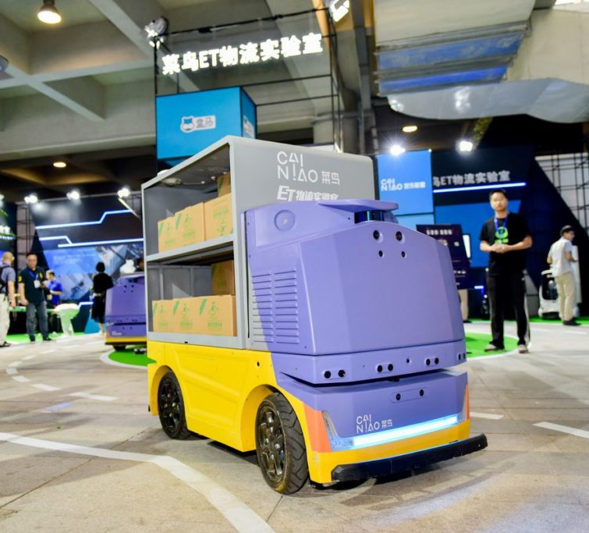
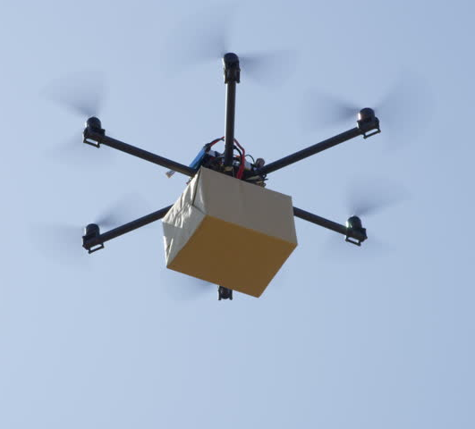
Needs for Unmanned Logistics Storage Technology Using Open Source Controller Panel
Needs
In recent years, researches on unmanned logistics delivery systems using drone, unmanned carriage, etc. have been actively carried out, starting with global large companies such as Amazon.
However, in addition to the apartments that have to enter the interior, concerns about the loss of logistics delivered from open residential facilities such as single-family homes are increasing.
GOOGLE
< Unmanned Logistics System >
Slide 3

Slide 4
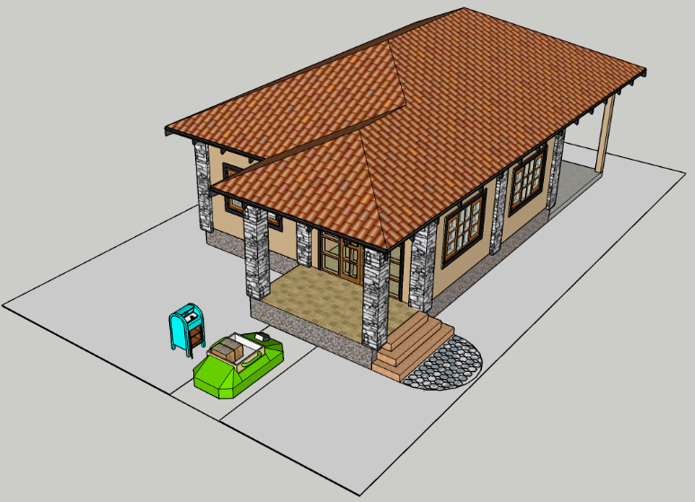
OWC Link for Unmanned Logistics Storage Technology Using Open Source Controller Panel
OWC based unmanned logistics storage technology using open source controller panel
Modulations :
VTASC, QR-Code, Color Code and etc.
Day-Night Communication Mode
Rx : Camera in open source controller panel of facilities
Tx : LED lamp or Display of Unmanned vehicle
Data Rate : 1K ~ 1Mb/s
Tx : LED lamp or Display of Unmanned vehicle
By connecting the camera to the open source controller panel installed in the unmanned logistics storage, only authenticated unmanned logistics vehicle can put the logistics item.
This OWC based technology can prevent loss of courier, unintentional garbage and terrorism.
Rx : Camera in open source Controller
< OWC Link based unmanned logistics storage technology using open source controller panel >
Slide 4

Slide 5
Conclusion
Proposed the OWC based unmanned logistics storage technology using open source controller panel
With OWC technology, unmanned home delivery technology can significantly reduce loss concerns.
Based on proposed technology, it can be effectively applied to unmanned logistics system which is spreading recently.
Slide 5

