Slide 1
Project: IEEE P802.15 Working Group for Wireless Personal Area Networks (WPANs)
Submission Title: Optical Wireless Interconnection Link for V2V in Camping Trailer
Date Submitted: March 2019
Source: Jaesang Cha(VTASK Co., Ltd), Youngmin Kim (Ire front Co., Ltd.), Timur Khudaybergenov (SNUST), Sooyoung Chang (SYCA) , Vinayagam Mariappan (SNUST)
Address: Contact Information: +82-2-970-6431, FAX: +82-2-970-6123, E-Mail: chajaesang@gmail.com
Re:
Abstract: This documents introduce the V2V Optical Wireless Link design consideration for VAT. This proposed Optical Wireless Interconnection Communication links enables V2V optical wireless communication between Living vehicles with other onroad vehicles. This uses the back lights of living vehicles for optical wireless link with following onroad vehicles.
Purpose: To provided concept models of optical wireless link for Vehicular Assistant Technology (VAT) Interest Group
Notice: This document has been prepared to assist the IEEE P802.15. It is offered as a basis for discussion and is not binding on the contributing individual(s) or organization(s). The material in this document is subject to change in form and content after further study. The contributor(s) reserve(s) the right to add, amend or withdraw material contained herein.
Release: The contributor acknowledges and accepts that this contribution becomes the property of IEEE and may be made publicly available by P802.15.
Slide 1

Slide 2
Contents
Needs of Optical Wireless interconnection between Living Vehicles
Optical Wireless Interconnection Link for Living Vehicle in Onroad
Conclusion
Slide 2

Slide 3
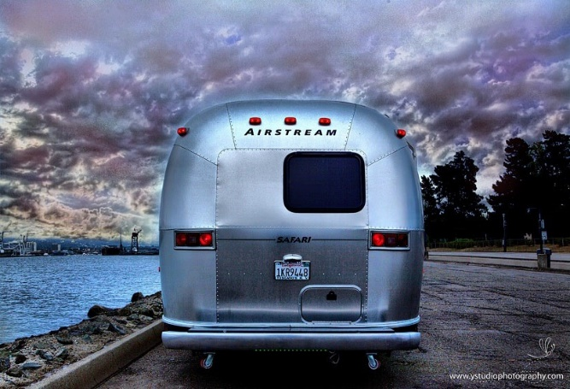
Needs of Optical Wireless interconnection between Living Vehicles
Needs
Camping, and full time living in tiny “Living Vehicles” is a renewed trend of modern society.
While moving “Living Vehicles” are closing sight of view for following cars due their dimensions and can be a reason of car crash.
Need to know about road side information especially at night time is need more attention.
Basic Concept
Uses the Back light of the “Living Vehicle” as a Transmitter and Backside Installed CMOS Camera as a Receiver for Optical Camera Communication between V2V Link.
Use the lifting vehicle backlight and front side CMOS Camera on the “Living Vehicle” used as optical wireless interconnection link.
Google
< “Living Vehicles” on the Road >
Slide 3

Slide 4
Optical Wireless Interconnection Link for Living Vehicle in Onroad
Optical Wireless Interconnection Link for Living Vehicle
Tx : Living Vehicle and Pickup Truck Back Lights
Rx : Front and Back side mounter CMOS Camera
Day-Night Communication Mode
Modulations
OOK, VPPM, Offset-VPWM, Multilevel PPM, Inverted PPM, Subcarrier PPM, DSSS SIK etc.
Data Rate : 1K ~ 1Mb/s
Supported LoS (Line of Sight)
Available Distance : 5m ~ 200m
< Optical Wireless Interconnection Link for “Living Vehicle-Vehicle” Connectivity >
※ Use the LED light to transmit Living Vehicle information, Vehicle Speed, forward direction traffic informations, Roadway Conditions, and Any accidents or unusual conditions encountered, etc.
Slide 4

Slide 5
Conclusion
Proposed the Optical Wireless Interconnection Link between Living Vehicles and Pickup Truck for onroad V2V connectivity
Uses the back light of Pickup Trucks and Living Vehicles as a transmitter and CMOS camera as a receiver for interconnection between Civilian Living Vehicles and following transport in motion on the road.
The proposed technology allows to provide information about Living Vehicle and road condition to the “wheel house” following transport on the road, during motion.
Slide 5

