Slide 1
Project: IEEE P802.15 Working Group for Wireless Personal Area Networks (WPANs)
Submission Title: OWC for Maritime Information Gathering Solution Between Buoy and Window Signage of Sea Side Vehicles
Date Submitted: March 2019
Source: Jaesang Cha (SNUST), Beomhee Lee (SNUST), Minwoo Lee(SNUST), Hyoungkyu Song (Sejong Univ.),Sooyoung Chang (SYCA) , Vinayagam Mariappan (SNUST)
Address: Contact Information: +82-2-970-6431, FAX: +82-2-970-6123, E-Mail: chajs@seoultech.ac.kr
Re:
Abstract: This documents introduce the V2I OWC Link design consideration for VAT. This proposed OWC technology used for maritime information gathering by buoy from the sea side vehicles through windows signage. This VAT solution also can be operate on the application services like ITS, ADAS, IoT/IoL, etc. on road condition and can be used for digital signage with connected information services etc.
Purpose: To provided concept models of VLC technology solution for Vehicular Assistant Technology (VAT) Interest Group
Notice: This document has been prepared to assist the IEEE P802.15. It is offered as a basis for discussion and is not binding on the contributing individual(s) or organization(s). The material in this document is subject to change in form and content after further study. The contributor(s) reserve(s) the right to add, amend or withdraw material contained herein.
Release: The contributor acknowledges and accepts that this contribution becomes the property of IEEE and may be made publicly available by P802.15.
Slide 1

Slide 2
Contents
Need for Maritime Information Broadcasting Solution
OWC Link for Maritime Information Gathering for Broadcasting
Conclusion
Slide 2

Slide 3
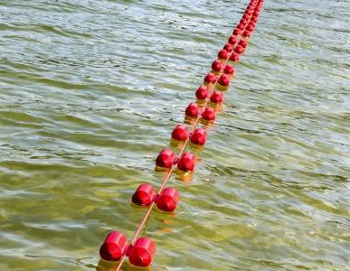
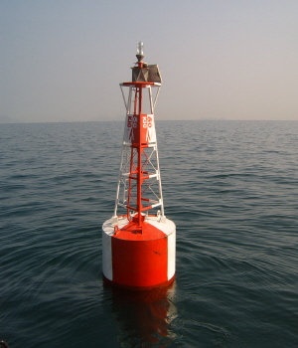
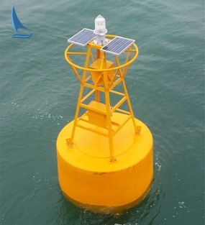
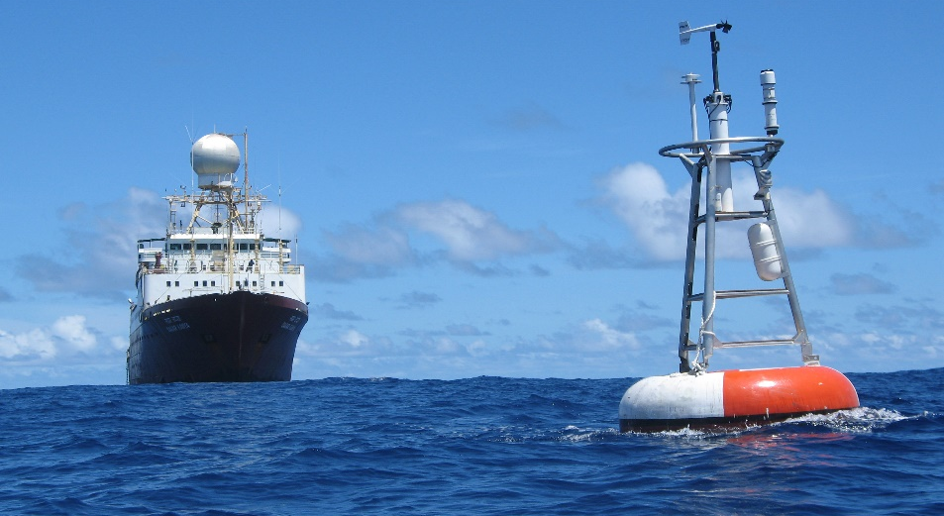
Need for Maritime Information Broadcasting Solution
Needs
The buoys on the sea serve to inform the position of the marine vehicle and the boundaries of the adjacent structures, but there are no other additional functions.
buoys can be utilize more effectively to broadcast sea specific informations to the sea side vehicles
Need to add functions such as wireless communication function for broadcasting and LED equipment to the buoy.
Basic Concept
Introduce the OWC technology using window signage and sea buoy with camera for sea side gathering from port in vehicles
Used to transmit the information acquired from the marine vehicle (fish quantity, weather, etc.) to the buoy.
Buoys helps to maintain conditions around the buoy by using the information received from the marine vehicle.
Google
< Sea Side Buoy >
Google
< Marine Vehicle and Buoy on the Sea >
Slide 3

Slide 4
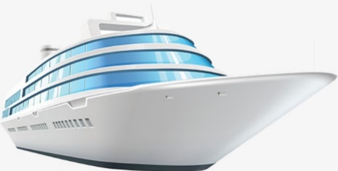
OWC Link for Maritime Information Gathering for Broadcasting
Window Signage
OWC Link between Sea Side Buoy and Vehicles
Tx : Marine Vehicle Window Signage
Rx : Sea Buoy Camera
Day-Night Communication Mode
Modulations :
2D Color Code, QR-Code, OOK, VPPM, Offset-VPWM, etc.
Data Rate : 1K ~ 1Mb/s
Supported LoS (Line of Sight)
Available Distance : 10m ~ 100m
Fish quantity, Sea environment And so on..
Buoy #3
Marin Vehicle
1001001010101010
Wi-Fi
Buoy #1
Environmental Management
Buoy #2
< OWC Link Sea Side Buoy and Window Signage for Maritime Data Broadcasting >
※ Used for Maritime Informations like Sea weather, Wave conditions, Fishes level, etc. Gathering by Buy through Window Signage of a Marine Vehicle to broadcast the Sea side information around a buoy.
Slide 4

Slide 5
Conclusion
Proposed the OWC solution for maritime information gathering solution between buy and sea side vehicles window signage to broadcast around seaside area.
Uses the Window signage of the marine vehicle and seaside buoy attached with camera to create optical wireless link and uses the buoy’s LED lighting system to broadcast the seaside informations.
Based on this proposed solution, it is possible to provide maritime specific information to preserve the marine ecosystem, such as the movement amount of the marine vehicle, information acquisition by the exploration area, etc..
Slide 5

