Slide 1
Project: IEEE P802.15 Working Group for Wireless Personal Area Networks (WPANs)
Submission Title: VLC Connectivity Enabled Logistics Automation Solution for Smart Warehouse System
Date Submitted: March 2019
Source: Jaesang Cha (SNUST), Shokhrukh (SNUST), Minwoo Lee(SNUST), Deokgun Woo (SNUST), Sooyoung Chang (SYCA) , Vinayagam Mariappan (SNUST)
Address: Contact Information: +82-2-970-6431, FAX: +82-2-970-6123, E-Mail: chajs@seoultech.ac.kr
Re:
Abstract: This documents introduce V2X IoT/IoL connectivity link design considerations for VAT in the smart warehouse system. This proposed IoT/IoL connectivity link used for logistic automation in the smart warehouse based visible light communication method using color code modulation schemes like CSK, VTASC, etc. Also this VAT solutions can used to operate on the application services like ITS, ADAS, etc. on road condition
Purpose: To provided concept models of the high speed optical wireless/light communications solution for Vehicular Assistant Technology
Notice: This document has been prepared to assist the IEEE P802.15. It is offered as a basis for discussion and is not binding on the contributing individual(s) or organization(s). The material in this document is subject to change in form and content after further study. The contributor(s) reserve(s) the right to add, amend or withdraw material contained herein.
Release: The contributor acknowledges and accepts that this contribution becomes the property of IEEE and may be made publicly available by P802.15.
Slide 1

Slide 2
Contents
Need for Logistics Automation Solution in Warehouse
IoT/IoL Connectivity Link for Logistics Automation Solution in Warehouse
Conclusion
Slide 2

Slide 3
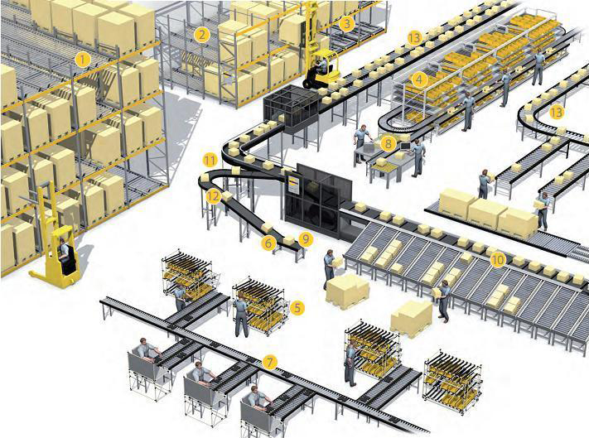
Need for Logistics Automation Solution in Warehouse
Needs
The extensive growth of the Amazon, Alibaba and etc. in the e-commerce sector has pushed new ideas and innovation forward in warehouses since required to handle wide range of products, different order sizes, short lead times, fast deliveries.
Large amount of returns makes the business-critical function
E-commerce businesses demand for fast processes, single item picking, individualization, handling of seasonal products and extensive return flows.
Needs to automate the inventory logistics in Warehouses
Basic Concept
Proposed IoT/IoL Connectivity link for logistics automation solution
Uses the 2D Color code techniques on product packages to transmit the packages related informations and Camera installed in conveyor belts work as a receiver to decode the product informations.
Logistics Automation Solution for managing the products in the distribution site uses decoded information with connected cloud server.
Google
< Warehouse Logistics Solution Model >
Slide 3

Slide 4
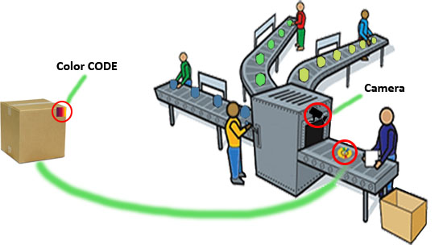
IoT/IoL Connectivity Link for Logistics Automation Solution in Warehouse
IoT/IoL Link for Logistics Automation Solution
Tx : 2D Color Coded Package Distribution LED Labels
Rx : CMOS Camera Connected in the conveyor belts
Day-Night Communication Mode
Modulations
Color Code, QR-Code, VTASC, and etc.
Data Rate : 1K ~ 5Mb/s
Supported LoS (Line of Sight)
Available Distance : 5m ~ 200m
< IoT/IoL Link for Logistics Automation >
※ Use the LED Labels to transmit location information of Package with ID, Customer Informations, Products in Package, Delivery times, and etc.
Slide 4

Slide 5
Conclusion
Proposed the IoT/IoL linked Logistics Automation Solution for Smart Warehouse.
Uses the 2D Color coded LED Labels attached on packages as a Transmitter and CMOS Camera installed in the conveyor belts as a receiver.
The propose method provides efficient logistic distribution in real time through Cloud Connected camera communication method which is attached to the conveyor and LED labeled things.
Slide 5

