Slide 1
Project: IEEE P802.15 Working Group for Wireless Personal Area Networks (WPANs)
Submission Title: High-Speed IoT/IoL Data Link Consideration for V2V Connectivity
Date Submitted: March 2019
Source: Jaesang Cha (SNUST), Minwoo Lee (SNUST), Jinyeong Choi (SNUST), Seongjhin Choi(SNUST), Jaesoo Kim (SNUST), Jonghoon Lee (SNUST), Hyeongho Lee (Netvision Telecom Inc., Korea Univ.), Jintae Kim (Fivetek Co., Ltd.), Sungdoo Kang (Feelux Co., Ltd.), Changsoo Lee (L&S LED Co., Ltd.), Sangil Lim (Signtelecom Co. Ltd.), Sooyoung Chang (SYCA), Vinayagam Mariappan (SNUST)
Address: Contact Information: +82-2-970-6431, FAX: +82-2-970-6123, E-Mail: chajs@seoultech.ac.kr
Re:
Abstract: This documents introduce the high bandwidth IoT/IoL Data Link design consideration for VAT. This proposed high-speed IoT/IoL data link consideration focuses to provide effective ITS solutions. This VAT solution also can be used to operate on the application services like ITS, ADAS, etc.
Purpose: To provide concept models of light communication based IoT/IoL solution for Vehicular Assistant Technology (VAT) Interest Group.
Notice: This document has been prepared to assist the IEEE P802.15. It is offered as a basis for discussion and is not binding on the contributing individual(s) or organization(s). The material in this document is subject to change in form and content after further study. The contributor(s) reserve(s) the right to add, amend or withdraw material contained herein.
Release: The contributor acknowledges and accepts that this contribution becomes the property of IEEE and may be made publicly available by P802.15.
Slide 1

Slide 2
Contents
Need for V2V IoT/IoL High Speed Data Link
High-Speed IoT/IoL Data Link Design Consideration for V2V Connectivity
Conclusion
Slide 2

Slide 3
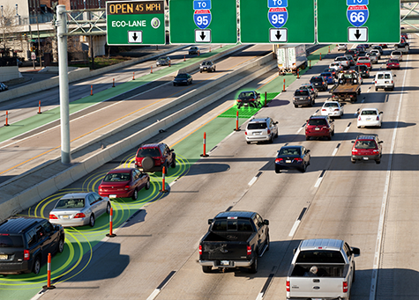
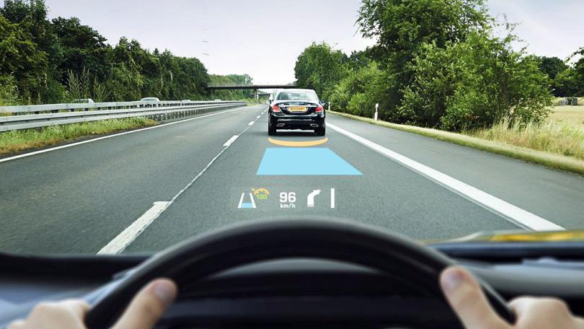
Need for V2V IoT/IoL High Speed Data Link
Receive IoT/IoL Data
For Vehicle Assistance
< V2V Connectivity for Connected Cars >
< High Speed Data Rate based V2V IoT/IoL Link >
Needs
Vehicle to Vehicle Technology that supports safe driving by sharing information between vehicles.
Currently, V2V technology uses various wireless communication to share information among vehicles.
For detect IoT/IoL support Light, camera need high speed detect algorithm.
During driving, the car wobbles and distortion occurs in the image.
For High Speed Data Rate, Camera have to support High FPS and Processing time have to satisfy below FPS time.
Slide 3

Slide 4
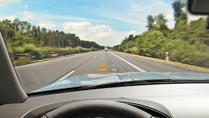
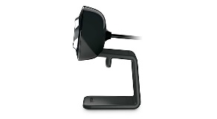
High-Speed IoT/IoL Data Link Design Consideration for V2V Connectivity
O
O
O
X
O
X
< Line Tracking Based IoT/IoL Region Segmentation >
< Multi-Camera based IoT/IoL Link Region Segmentation >
High-Speed Data Rate Consideration
Reducing processing time(Algorithm, HW Enhancement, etc.) and High performance camera(more then 60FPS or Burst Mode supported)
Multi-Camera & Multi-Processor(It need to image stitching method)
Single-Camera & Multi-Processor(It need to reduce processing time)
Line Tracking/RoI Segmentation(Hough, AdjustThresold, etc.)
Key point Extraction Algorithm(FAST, SURF, etc.)
Modulations :
OOK, VPPM, Offset-VPWM, Multilevel PPM, Inverted PPM, Subcarrier PPM, DSSS SIK etc..
Day-Night Communication Mode
Supported LoS (Line of Sight), Shake correction
Available Distance : 2m ~ 20m
Vehicle Backlight and Back-side camera based support to back-side network
Slide 4

Slide 5
Conclusion
Proposed High-Speed Data Link based IoT/IoL Technology Consideration for V2V Connectivity.
High-Speed IoT/IoL Links need to consider the Single-Camera & Multi-Processors or Multi-Camera & Multi-Processor, High FPS Camera, Shake correction and etc.
Slide 5

