Slide 1
Project: IEEE P802.15 Working Group for Wireless Personal Area Networks (WPANs)
Submission Title: Automatic Payment System for In-Flight Duty-Free Shopping Using Blockchain and IoT/IoL Technology
Date Submitted: March 2019
Source: Jaesang Cha (SNUST), Minwoo Lee (SNUST), Jungdo Han (SNUST), Seongjhin Choi (SNUST), Jaesoo Kim (SNUST), Jonghoon Lee (SNUST), Hyeongho Lee (Netvision Telecom Inc., Korea Univ.), Jintae Kim (Fivetek Co., Ltd.), Sungdoo Kang (Feelux Co., Ltd.), Changsoo Lee (L&S LED Co., Ltd.), Sangil Lim (Signtelecom Co. Ltd.), Sooyoung Chang (SYCA) , Vinayagam Mariappan (SNUST)
Address: Contact Information: +82-2-970-6431, FAX: +82-2-970-6123, E-Mail: chajs@seoultech.ac.kr
Re:
Abstract: This documents introduce the V2X IoT/IoL link design consideration for In-flight duty-free shopping system payment method. This proposed IoT/IoL data link with Blockchain technology provides the possibility of using light communication for in-flight duty-free shopping system. This proposed solution can be utilized as a part of a complex of monitoring, logistics and scheduling.
Purpose: To provided concept models of IoT/IoL with Blockchain based light communication solution for Vehicular Assistant Technology (VAT) Interest Group
Notice: This document has been prepared to assist the IEEE P802.15. It is offered as a basis for discussion and is not binding on the contributing individual(s) or organization(s). The material in this document is subject to change in form and content after further study. The contributor(s) reserve(s) the right to add, amend or withdraw material contained herein.
Release: The contributor acknowledges and accepts that this contribution becomes the property of IEEE and may be made publicly available by P802.15.
Slide 1

Slide 2
Contents
Needs for Blockchain based In-Flight Shopping Solution
IoT/IoL Link with Blockchain for In-Flight Duty-Free Shopping System
Conclusion
Slide 2

Slide 3
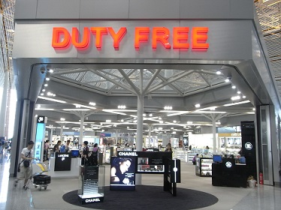
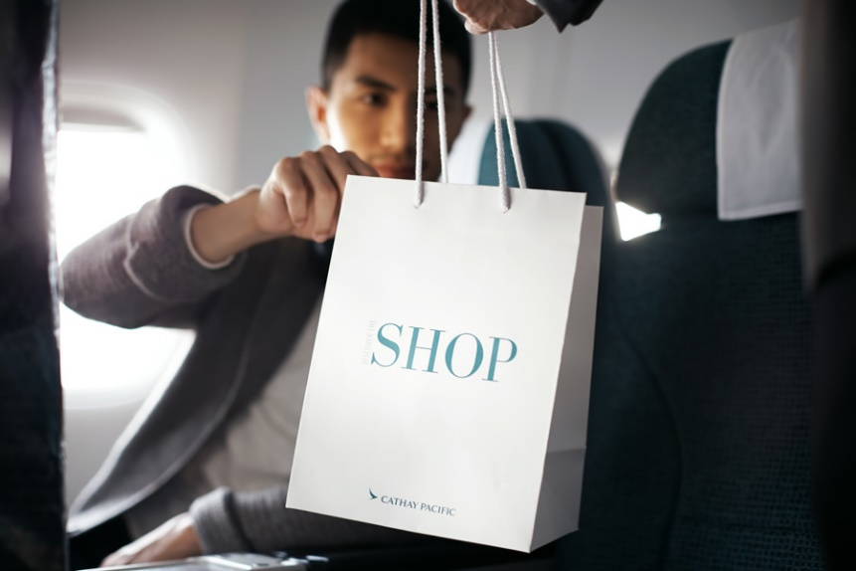
Needs for Blockchain based In-Flight Shopping Solution
Google
< In-Flight Duty-Free Shopping System >
Needs
Currently, duty free products can be purchased only with credit cards or local currency due to security issues.
Even if passengers want to purchase duty-free item, cannot do shopping because above the issues.
Need an smart payment method for in-flight duty-free shopping system.
Basic Concept
Passengers can use IoT/IoL pay link with Blockchain connected credit bank system as a payment method, by utilizing a smart device storing user's own Blockchain account code.
Flash Light/Display of smart devices used as Transmitter and Camera attached on passenger seat used as receiver connected on credit bank system.
Slide 3

Slide 4
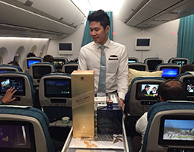
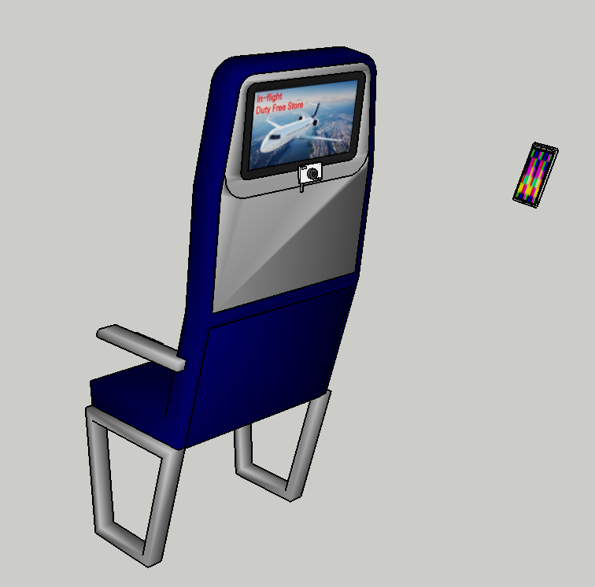
IoT/IoL Link with Blockchain for In-Flight Duty-Free Shopping System
Tx : IoT/IoL Based Blockchain Code
Rx : Camera
attached in Seat
< IoT/IoL Link with Blockchain for In-Flight Duty-Free Shopping System >
Blockchain Connected IoT/IoL based Data Link for Bank Payment Credit System
Tx : Smart Device Display
Rx : Camera Image Sensor in airplane
Modulations :
2D Color Code, VTASC, QR-Code, OOK, VPPM, Offset-VPWM, Multilevel PPM, Inverted PPM, Subcarrier PPM, DSSS SIK etc.
Data Rate : 32 ~ 128kb/s
Supported LoS (Line of Sight)
Available Distance : More than 30cm in general camera module
Slide 4

Slide 5
Conclusion
Proposed the In-flight duty-free shopping system using Block chain and IoT/IoL
The Flash Light / Display of the smart devices as a transmitter and camera module attached to the airplane seat can be used as a receiver for IoT/IoL with Blockchain based payment system.
Proposed solution possible to conduct safe transactions without credit cards or banknotes and the payment system can be efficiently used for In-flight duty-free store.
Slide 5

