Slide 1
Project: IEEE P802.15 Working Group for Wireless Personal Area Networks (WPANs)
Submission Title: LiFi/CamCom Technology Solutions for Underwater Marine and Diving Operations
Date Submitted: March 2019
Source: Jaesang Cha (SNUST), Pham Minh Trung (SNUST), Sangwoon Lee (Namseoul Univ.), Jinyoung Kim (Kwangwoon Univ.), Jeonggon Kim (Korea Polytechnic Univ.), Chanhyeong Chung (RAPA), Sooyoung Chang (SYCA), Vinayagam Mariappan (SNUST)
Address: Contact Information: +82-2-970-6431, FAX: +82-2-970-6123, E-Mail: chajs@seoultech.ac.kr
Re:
Abstract: This documents introduce the V2X LiFi / CamCom Link design consideration for VAT. This proposed LiFi / CamCom technology provides the optical communication between the divers and Sea vehicles to helps divers avoid disorientation when moving under the sea and reach the target location quickly. This solution useful in the rescue work at sea and saving time is extremely valuable in the rescue time. This VAT solution also useful in the application services like ITS, ADAS, IoT/IoL, etc. on road condition for connected vehicle services etc.
Purpose: To provided concept models of LiFi / CamCom technology solution for Vehicular Assistant Technology (VAT) Interest Group
Notice: This document has been prepared to assist the IEEE P802.15. It is offered as a basis for discussion and is not binding on the contributing individual(s) or organization(s). The material in this document is subject to change in form and content after further study. The contributor(s) reserve(s) the right to add, amend or withdraw material contained herein.
Release: The contributor acknowledges and accepts that this contribution becomes the property of IEEE and may be made publicly available by P802.15.
Slide 1

Slide 2
Contents
Need for Divers Connectivity for Under Sea Operations
LiFi / CamCom Link for Underwater Marine and Diving Operations
Conclusion
Slide 2

Slide 3
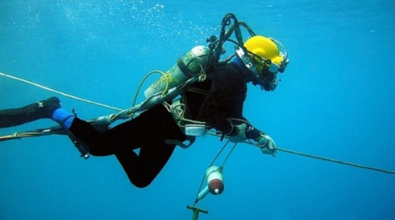
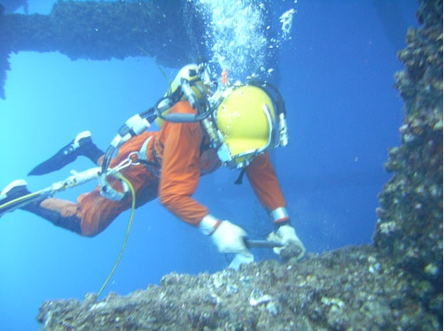
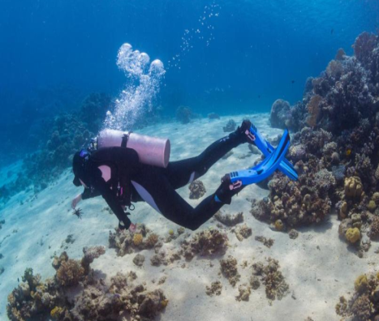
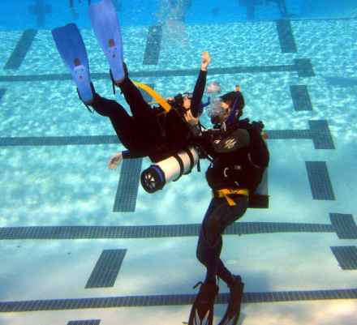
Need for Divers Connectivity for Under Sea Operations
Needs
The diver has lost their life in the marine and diving operations when they are disoriented in underwater and loss the control center connection to ask for help.
Some divers operate in the deep water uses the wires connected to ships to lead the way to avoid disorientation.
To avoid disorientation, need an easy and effective connectivity method for under the sea operations for divers
Basic Concept
Proposed LiFi/CamCom Light Communication solution for under sea operations helps to localize the divers and connection between the divers and control centers.
Uses the led light installed on the bottom of the sea vehicles or mounted on equipment connected to the sea vehicles.
Divers uses the head mounted Camera with LED light used to establish connectivity with control centers.
Google
< Divers with Directional Cables >
Google
< Divers Sea Explore and rescue the sea >
Slide 3

Slide 4
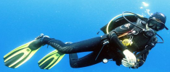
LiFi/CamCom Link for Marine and Diving Operations
Control Room
LiFi/CamCom Link for Under Sea Operations
Tx : Sea Vehicle Bottom Lights and Divers Head Lights
Rx : Head Mounted Camera and Sea Vehicle Bottom Mounted Camera
Day-Night Communication Mode
Modulations
OOK, VPPM, Offset-VPWM, Multilevel PPM, Inverted PPM, Subcarrier PPM, DSSS SIK etc.
Data Rate : 1K ~ 1Mb/s
Supported LoS (Line of Sight)
Available Distance : 5m ~ 200m
Directional
Moves
Request Signal , position signal, ...
LED Lamp
10010010100
Camera
Directional
Moves
< Divers LiFi/CamCom Link for Marine and Diving Operations >
※ Use the LED light to transmit location information of Divers with ID, Sea vehicle vessel ID, Appropriate surface and underwater conditions, Maximum depth and bottom times, and Any accidents or unusual conditions encountered, etc.
Slide 4

Slide 5
Conclusion
Proposed the LiFi / CamCom connectivity Solutions between sea vehicles and divers for Underwater Marine and Diving Operations
Uses the lighting systems installed at the bottom of the sea vehicles and divers head mounted lights for Transmitter
Uses the Camera installed at the bottom of the sea vehicles and head mounted camera for Receiver.
Support divers to operate effectively under the sea, especially in rescue work time
Slide 5

