Slide 1
Project: IEEE P802.15 Working Group for Wireless Personal Area Networks (WPANs)
Submission Title: LiFi/CAMCOM Technology Based Electric Charging Solution for Autonomous Electric Vehicles
Date Submitted: March 2019
Source: Jaesang Cha (SNUST), Vadim Li (SNUST), Sangwoon Lee (Namseoul Univ.), Jinyoung Kim (Kwangwoon Univ.), Jeonggon Kim (Korea Polytechnic Univ.), Chanhyeong Chung (RAPA), Sooyoung Chang (SYCA), Vinayagam Mariappan (SNUST)
Address: Contact Information: +82-2-970-6431, FAX: +82-2-970-6123, E-Mail: chajs@seoultech.ac.kr
Re:
Abstract: This documents introduce the V2I LiFi/CAMCOM link design consideration for VAT. This proposed V2I LiFi/CAMCOM link solution used for electric vehicles charging automation. This VAT solution also can be used to operate the application services like ITS, ADAS, IoT/IoL, etc. on road condition for connected information services.
Purpose: To provided concept models of Light Communication based LiFi/CAMCOM technology solution for Vehicular Assistant Technology (VAT) Interest Group.
Notice: This document has been prepared to assist the IEEE P802.15. It is offered as a basis for discussion and is not binding on the contributing individual(s) or organization(s). The material in this document is subject to change in form and content after further study. The contributor(s) reserve(s) the right to add, amend or withdraw material contained herein.
Release: The contributor acknowledges and accepts that this contribution becomes the property of IEEE and may be made publicly available by P802.15.
Slide 1

Slide 2
Contents
Need for Electric Vehicles Charging Automation Solution
LiFi/CamCom Link for Autonomous Electric Vehicles Charging Solution
Conclusion
Slide 2

Slide 3
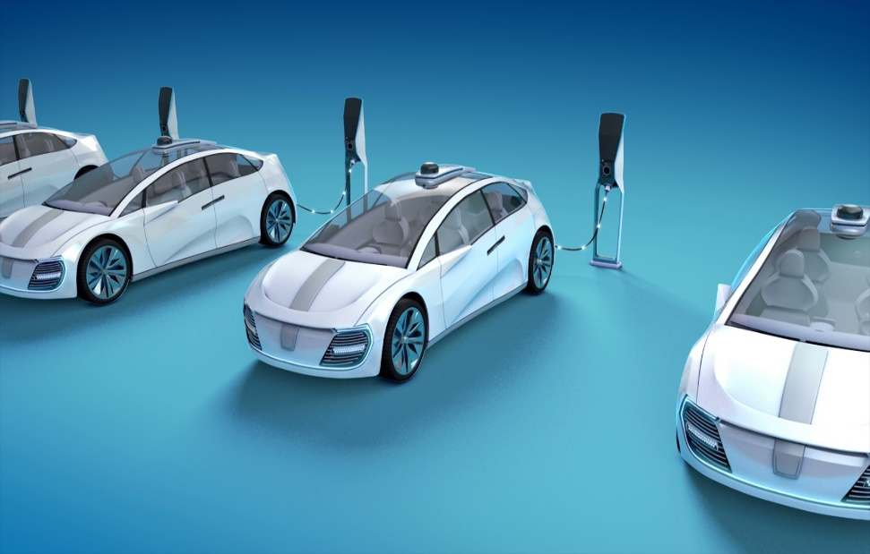
Need for Electric Vehicles Charging Automation Solution
Needs
In the future, the self-driving electric vehicles (EVs) joint the evaluation from conventional vehicle for transport system.
EVs uses the charging station or charging points and use the cutting-edge hardware technology that’s safe and reliable
Technology advanced development in IoT and light communication technologies make smart charging stations with Ultra-fast and scalable smart electric charging point on major roadways to charge EVs.
Needs safe and reliable connectivity to automate the EVs charging points
Basic Concept
Proposed LiFi/CamCom Light Communication solution for EVs charging automation in electric charging stations
Use the Lighting System and Camera Systems installed in the EVs and Charging points for light communication
Google
< EVs Charging Stations >
Slide 3

Slide 4
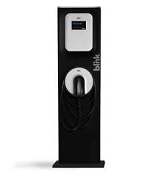
LiFi/CamCom Link for Autonomous Electric Vehicles Charging Solution
LiFi/CamCom Link for EVs Charging Solutions
Tx : EVs and EVs Charging point Lighting System
Rx : CMOS Camera Head Mounted Camera and Sea Vehicle Bottom Mounted Camera
Day-Night Communication Mode
Modulations
OOK, VPPM, Offset-VPWM, Multilevel PPM, Inverted PPM, Subcarrier PPM, DSSS SIK etc.
Data Rate : 1K ~ 1Mb/s
Supported LoS (Line of Sight)
Available Distance : 5m ~ 100m
Charging Station
Request for Charging
Charging fee
10010010100
< LiFi/CamCom Link for EVs Charging Solutions >
※ Uses the Lighting System and the Camera connected on EVs and EVs Charging points to enable LiFi/CamCom technology for communication between EVs and EVs charging point Infrastructure.
Slide 4

Slide 5
Conclusion
Proposed the LiFi / CamCom connectivity Solutions between EVs and EVs charging points for Autonomous Electric Vehicles Charging Solution.
Uses the Lighting System and the Camera connected on EVs and EVs Charging points to enable LiFi/CamCom technology for communication between EVs and EVs charging point Infrastructure.
Provides safe and reliable EVs charging automation solution for smart charging stations.
Slide 5

