Slide 1
Project: IEEE P802.15 Working Group for Wireless Personal Area Networks (WPANs)
Submission Title: [Security vs. Sequence Length Considerations]
Date Submitted: [12 March, 2019]
Source: [Jaroslaw Niewczas (Decawave), Billy Verso (Decawave), Tony Fagan (Decawave), Frank Leong (NXP Semiconductors), Jochen Hammerschmidt (Apple), Brima Ibrahim (NXP Semiconductors), Eren Sasoglu (Apple), Daniel Knobloch (BMW), Thomas Reisinger (Continental)]
Re: [Input to the Task Group]
Abstract: [Presentation, HRP, PHY, STS, Channel Sounding, Enhanced Impulse Radio]
Purpose: []
Notice: This document has been prepared to assist the IEEE P802.15. It is offered as a basis for discussion and is not binding on the contributing individual(s) or organization(s). The material in this document is subject to change in form and content after further study. The contributor(s) reserve(s) the right to add, amend or withdraw material contained herein.
Release: The contributor acknowledges and accepts that this contribution becomes the property of IEEE and may be made publicly available by P802.15.

Slide 2
Security vs. Sequence Length Considerations

Slide 3
EXECUTIVE SUMMARY
A desired security level (e.g., equivalent to 32 bits, 64 bits, 128 bits) can be obtained using varying cipher sequence lengths, from short to long, by selecting the acceptance threshold at the receiver appropriately

Slide 4
INTRODUCTION
The “secure ranging” signalling feature of the 802.15.4z UWB PHYs is based on:
Transmission of very short-lasting (~2ns) pulses (carrying bit-information), which cannot be so quickly detected and manipulated by the attacker. Due to this shortness, the exact moment of the pulse reception accurately determines the distance between the devices
Using strong cryptographic algorithms to generate a stream of encrypted, pseudo-random bits, modulating the UWB transmission
Ensuring that the entropy of the solution is large enough to achieve immunity against distance reducing attacks

Slide 5
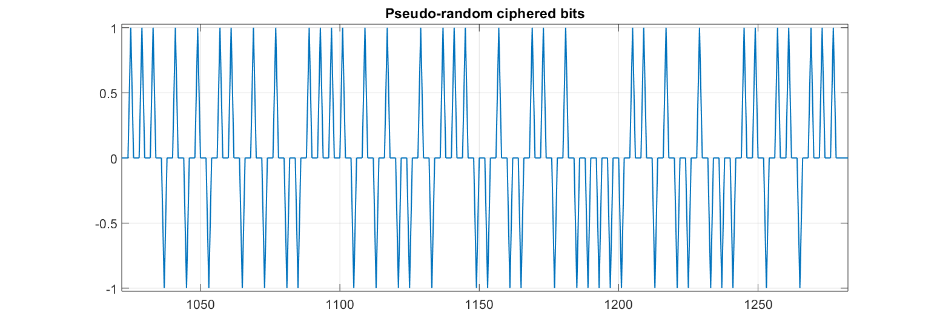
UWB SECURE EXCHANGE
Example Scenario: Transmitter/receiver both cryptographically generate local copies of the same bit-stream, based on mutually pre-agreed parameters (KEYS and NONCES).
The bit-stream shall be a sequence of +1s and -1s, mapped to pulse phases (polarities) or carrier frequencies
Example: Random sequence of pulse polarities {-1, +1}

Slide 6
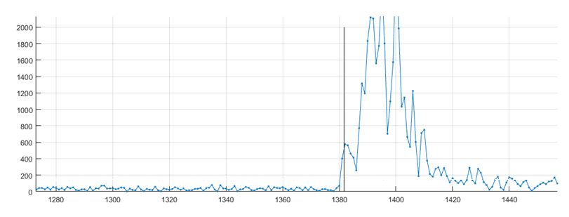
IDENTIFYING 1st PATH
Multiple approaches exist by which the 1st path in the Channel Impulse Response (CIR) may be evaluated.
Method 1 (subject of our analysis): The (periodic) preamble may be used to build up a CIR estimate, from which the first path is extracted and verified using a ciphered sequence.
Method 2: A ciphered sequence may be used to (both) build up a CIR estimate and verify the first path within this estimate.

Slide 7
DEFINITION: “MATCH LEVEL”
When receiving the transmitted bit sequence, the receiver compares it to the locally generated reference. The threshold on the “match level” between the copies will determine if the ranging message will be accepted or not.
A 100% match level means that all the received bits accurately matched the locally generated reference. A 50% match level means that half of the bits matched the reference and the other half had the opposite sign.

Slide 8
SECURITY vs. SEQUENCE LENGTH & MATCH LEVEL
The security level will depend on the length of the ciphered sequence, which determines the number of all possible bit combinations. However, security level will also depend on the number of bit combinations which will trigger the acceptance of the ranging exchange by the receiver.
Let’s assume length-32 cipher and that the receiver will only accept the 1-st path if the similarity level is 100%. There are 2³² bit combinations possible and only ONE of them can result in the acceptance. Therefore probability of false acceptance due to reception of random noise (or the attacker’s actions) is 2⁻³² = 2.3283e-10.
If the receiver sets the similarity threshold at 96.9% (accepting the ranging exchange with 31 or 32 bits matching the reference), there will be 1+32=33 bit combinations which satisfy this criterion, and the probability of a random sequence meeting the threshold is 33/2³² = 2^{-26.956} = 7.6842e-09.

Slide 9
SECURITY LEVEL TRADE-OFFS
It is clear that increasing the sequence length will increase the security and lowering the acceptance threshold will reduce it
Both the cipher sequence length and the acceptance threshold on the Match Level will determine the security (thus, the probability of false 1st-path detection)
The probabilities of false 1st path detection can be computed for any sequence length and any acceptance threshold level

Slide 10
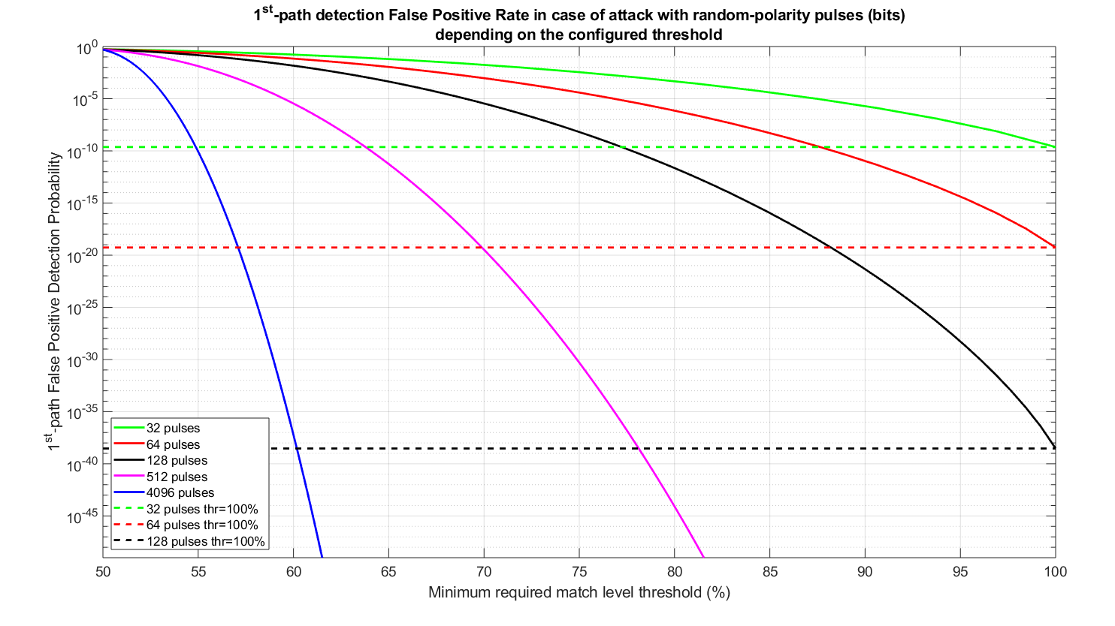
FALSE 1st PATH DETECTION PROBABILITIES

Slide 11
Guessability Consideration
The equivalence between the security level of short vs long sequence along with suitable thresholds may seem counter-intuitive. For example, it may appear impossible to predict 120 out of 128 bits (90%) while correctly choosing 2500 out of 4096 (61% of the bits) seems much more achievable with a bit of luck. In reality, the probability of the former being successful is ~10⁻²², while the success rate of the latter is ~10⁻⁴⁵.
When attempting to predict 4096 bits, in only 1% of the attempts, the number of correctly predicted bits will be above 52% and in just 0.01% attempts – above 53%.

Slide 12
CONCLUSION
Identical PHY-layer security levels can be obtained using various cipher sequence lengths with appropriate decision-making criteria at the receiver.

