Slide 1
Project: IEEE P802.15 Working Group for Wireless Personal Area Networks (WPANs)
Submission Title: [Higher bit rate for the HRP UWB PHY]
Date Submitted: [12th March 2019]
Source: [Michael McLaughlin, Tony Fagan, Billy Verso] Company [Decawave Ltd.]
Address [Peter Street, Dublin 8, Ireland]
E-Mail:[michael.mclaughlin, tony.fagan, billy.verso (at) decawave.com]
Re: [Proposed enhancements to the HRP UWB PHY]
Abstract: [Adding an option to support a higher bit rate with the HRP UWB PHY ]
Purpose: []
Notice: This document has been prepared to assist the IEEE P802.15. It is offered as a basis for discussion and is not binding on the contributing individual(s) or organization(s). The material in this document is subject to change in form and content after further study. The contributor(s) reserve(s) the right to add, amend or withdraw material contained herein.
Release: The contributor acknowledges and accepts that this contribution becomes the property of IEEE and may be made publicly available by P802.15.

Slide 2
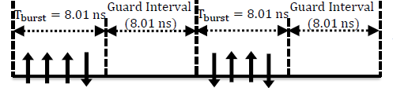
REMINDER
In November (Bangkok) we agreed this symbol format for HRP UWB data modulation at 250 MHz PRF :
Mandatory FEC: K=3+RS (~27 Mb/s)
Optional K=7 code without RS (~31.2 Mb/s)

Slide 3
4z is capable of much higher rates than 31 Mb/s:
Code Puncturing
  There have been discussions about adding a ~55 Mb/s mode using a standard puncturing pattern of the optional K=7 convolutional code
  A similar puncturing scheme could be used with the K=3 code to get a 48 Mb/s mode
Double the symbol rate
  A more straightforward scheme would be to use the current codes (i.e. unaltered) at twice the symbol rate
    62.4 Mb/s for K=7 and 54.5 Mb/s for K=3
This could be doubled again and then again
  Giving ~110 Mb/s and 220 Mb/s
The Rate ½ K=3 code could be dropped leaving just the RS code
  Gives ~440 Mb/s

Slide 4
Symbol structure for higher rates, increasing symbol rate
Note: G0 and G1 are coded bits
B0 is an uncoded bit
Boxes represent pulses.
Lines represent guard chips.
Fig 1. Symbol Structure for higher rates

Slide 5
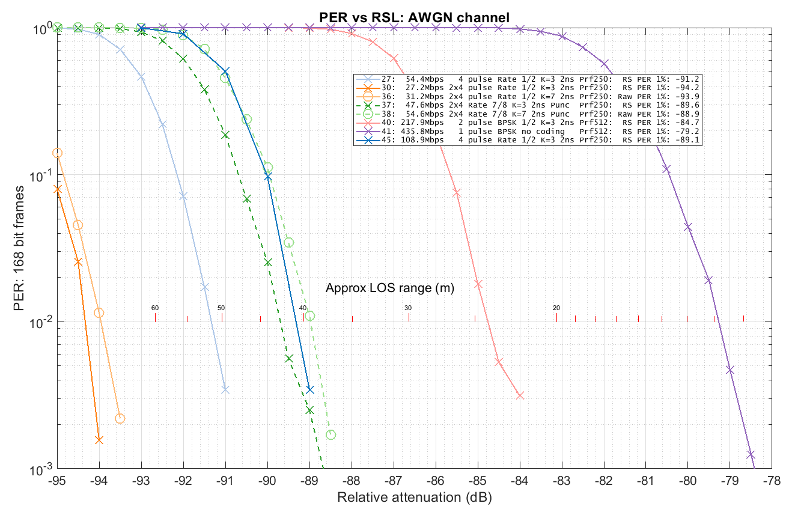
How do these schemes perform in an AWGN channel with short frames
Note 1: These results assume that the number of preamble pulses is much greater than the number of data pulses and so, assume that all the schemes use pulses of the same amplitude
Note 2: 108 Mb/s, 216 Mb/s and 436 Mb/s curves include 2 dB power back-off to avoid the peak 50 MHz limit

Slide 6
Do we really need such high rates?
Eventually any provided bandwidth will not be enough
Need to provide for the future
  It has been 12 years since 15.4a and this is its first enhancement, so we need to plan 12 years in advance
Some may be reluctant to too take the step to the higher rates, thinking more research is needed on channel models etc.
Thus, we propose to limit the bit rate extension to 54 Mb/s

Slide 7
3 ways to achieve 54 Mb/s
Double the symbol rate by coding g0,g1 coded pair onto a single 4 pulse burst using the K=3 convolutional code and the 55/63 RS code
Puncture the K=7 convolutional code g0,g1 coded bits, removing 6 out of every 14 using a standard puncturing scheme
Remove the convolutional coder and map each RS coded bit to a 4 pulse burst
Note: All three of these options maintain the underlying modulation scheme and give an identical signal structure on air (bursts of 4 pulses)

Slide 8
Pulses on the air are the same (only the mapping of coded bits is different)
Fig 3: 54.4 Mb/s with g0 g1 di-bit mapped to a single 4 pulse burst
Fig 4: 54.4 Mb/s with g0 g1 punctured and each coded bit mapped to single 4 pulse burst
Fig 5: 54.4 Mb/s with RS coded bits directly mapped to individual 4 pulse bursts
B_{i} is the i^{th} bit into the convolutional coder, G_{i 0/1} is the i^{th} g₀/g₁ bit out of the convolutional coder.

Slide 9
Only the mapping is different
The only difference between the x2 symbol rate scheme and the punctured scheme is the mapping of the convolutionally coded bits to the 4 pulse bursts
  x2 Symbol rate scheme maps each g0g1 pair to one burst
  Punctured scheme deletes 6/14 coded bits and maps each of the surviving bits to a 4 pulse burst
Convolutional coder runs at a similar rate in both cases.
  x2 uses 16 input bits for every 16 bursts
  Punctured scheme uses 14 input bits for every 16 bursts
Viterbi decoder runs at a similar rate in both cases

Slide 10
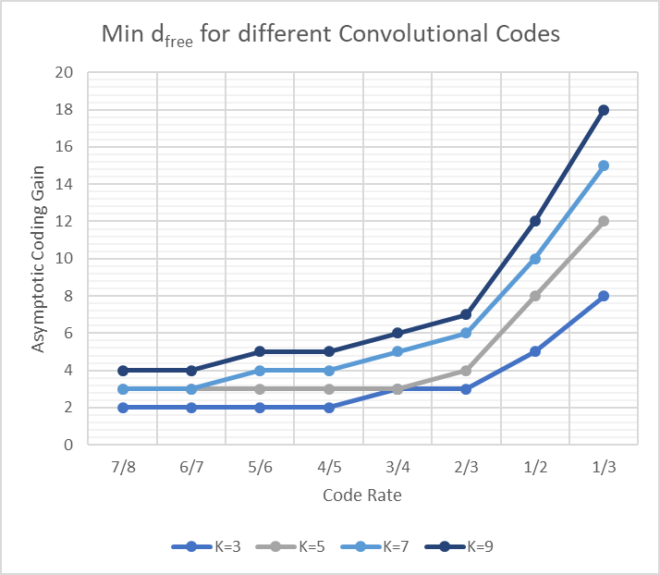
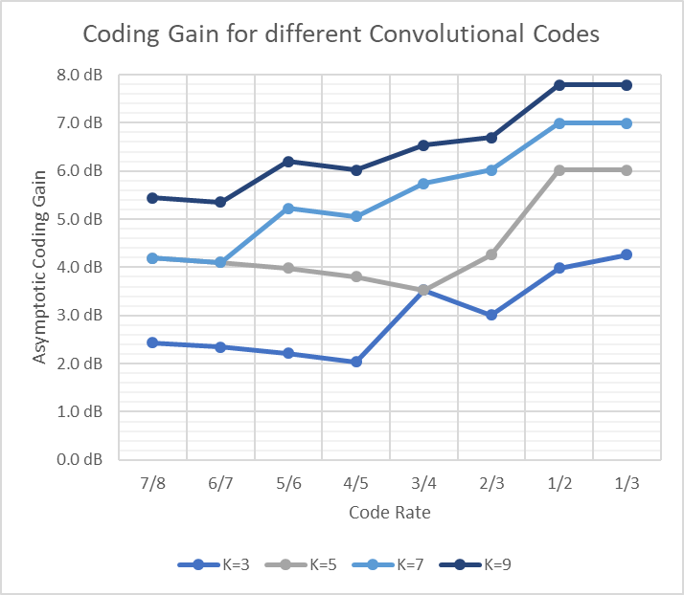
Puncturing comes at an Eb/No cost
Table 1. Puncturing from Digital Communications, Proakis, 5th Edition
Table 2. d_{free} for various constraint lengths and code rates
Puncturing vs Rate ½ code
  For K=3 Max coding gain drops from 4 dB to 2.4 dB
  For K=7 Max coding gain drops from 7 dB to 4.2 dB
  Agrees well with AWGN simulation results
Table 3. Max coding gain for various constraint lengths and code rates

Slide 11
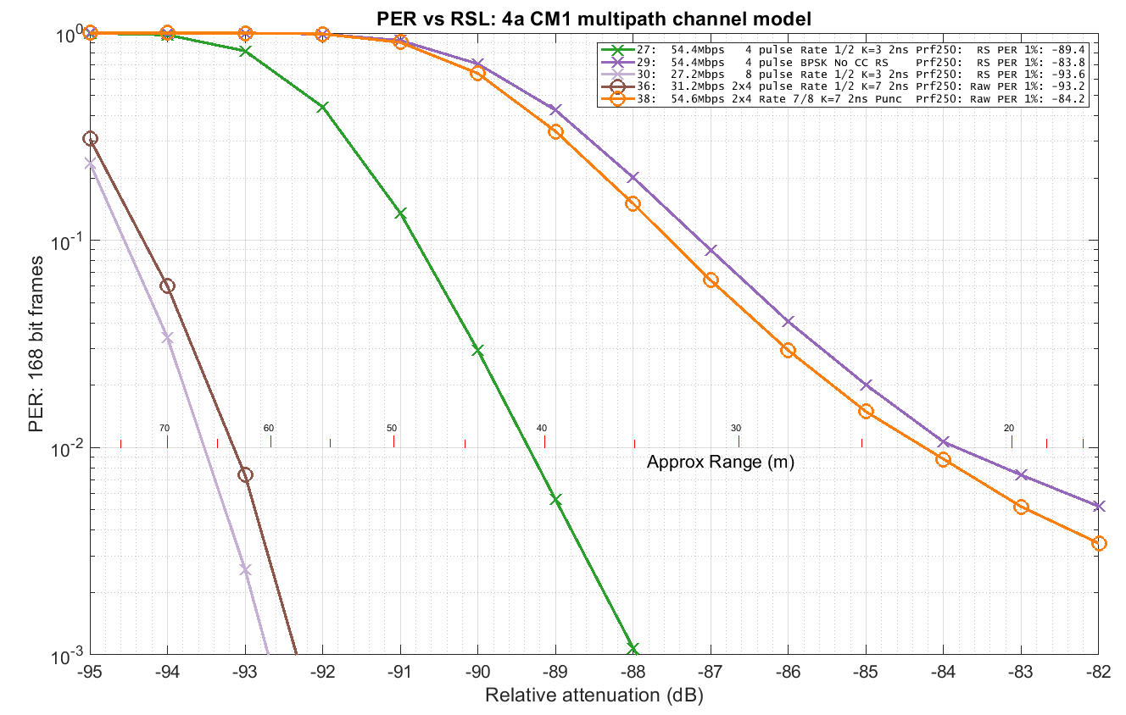
How do they perform in Multipath channel?
54.5 Mb/s using x2 symbol rate is only 4 dB worse than 27.2 Mb/s
  Range of > 40m
Puncturing scheme is 9.2 dB worse than 27.2 Mb/s
  Half the range of x2 scheme
  Almost the same performance as using no conv code, and only a RS code

Slide 12
Recommendation:
There is considerable merit to adding 50+ Mb/s to 802.15.4z
As an option, 54.5 Mb/s will strengthen the standard and future proof it to some extent
It is better to double the symbol rate rather than use puncturing
Performs very well, even in multipath
  ~40 metres LOS range in CM1 channel model 54.5 Mb/s mode
Has exactly the same on-air properties as the 27.24 Mb/s data rate
  250 MHz PRF etc.
Let’s do it!

Slide 13
Another recommendation – frame length:
With a higher data rate there is a good case for increasing the frame length and we already talked about the possibility of utilising the A0 & A1 bits in the HPRF mode PHR to extend the frame length
This option can easily be included in the 4z text, and would optionally allow the frame length field in the PHR to extend to 12-bits catering for a frame payload of up to 4095 octets
We recommend making this addition at the same time as adding a the 54.5 Mb/s data rate

Slide 14
THE END

