Slide 1
Project: IEEE P802.15 Working Group for Wireless Personal Area Networks (WPANs)
Submission Title: [DF6 Radio-burst length over PSDU size]
Date Submitted: [12 March, 2019]
Source: [Johannes Wechsler] Company [Fraunhofer Institute for Integrated Circuits IIS]
Address [Nordostpark 84, Nuremberg, 90411, Bavaria]
Voice:[ +49 911 58061-3334], FAX: [+49 911 58061-3299], E-Mail:[johannes.Wechsler@iis.fraunhofer.de]
Re: [15-19-0127-00-004w-combined-comments-against-d6]
Abstract: [Plot of radio-burst length over PSDU size]
Purpose: [Show implications of PSDU sizes to make informed decision on maximum size.]
Notice: This document has been prepared to assist the IEEE P802.15. It is offered as a basis for discussion and is not binding on the contributing individual(s) or organization(s). The material in this document is subject to change in form and content after further study. The contributor(s) reserve(s) the right to add, amend or withdraw material contained herein.
Release: The contributor acknowledges and accepts that this contribution becomes the property of IEEE and may be made publicly available by P802.15.

Slide 2
DF6 Radio-burst length over PSDU size
Johannes Wechsler
Fraunhofer IIS

Slide 3
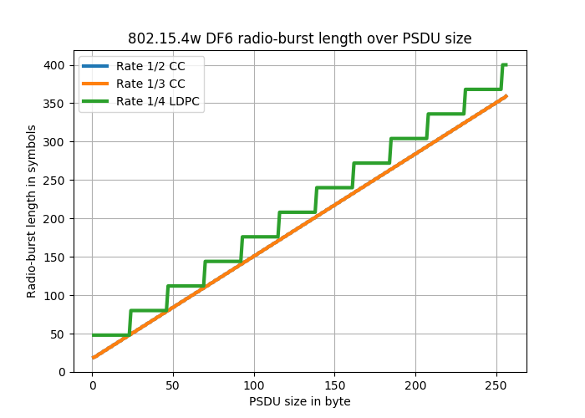
Radio-burst length over PSDU size

