Slide 1
Project: IEEE P802.15 Working Group for Wireless Personal Area Networks (WPANs)
Submission Title: [Channel bandwidth observations]
Date Submitted: [16 January, 2019]
Source: [Joerg ROBERT] Company [Friedrich-Alexander University Erlangen-Nuernberg]
Address [Am Wolfsmantel 33, 91058 Erlangen, Germany]
Voice:[+49 9131 8525373], FAX: [+49 9131 8525102], E-Mail:[joerg.robert@fau.de]
Re: []
Abstract: [This document presents the spectral characteristics of the FSK signals]
Purpose: [Discussion in TG 4w]
Notice: This document has been prepared to assist the IEEE P802.15. It is offered as a basis for discussion and is not binding on the contributing individual(s) or organization(s). The material in this document is subject to change in form and content after further study. The contributor(s) reserve(s) the right to add, amend or withdraw material contained herein.
Release: The contributor acknowledges and accepts that this contribution becomes the property of IEEE and may be made publicly available by P802.15.

Slide 2
Motivation
802.15.4 LECIM FSK PHY defines channel raster and modulation bandwidth
ETSI 300 220-1 has strong limits on adjacent channel power
Current channel raster may potentially not fulfill ETSI requirement

Slide 3
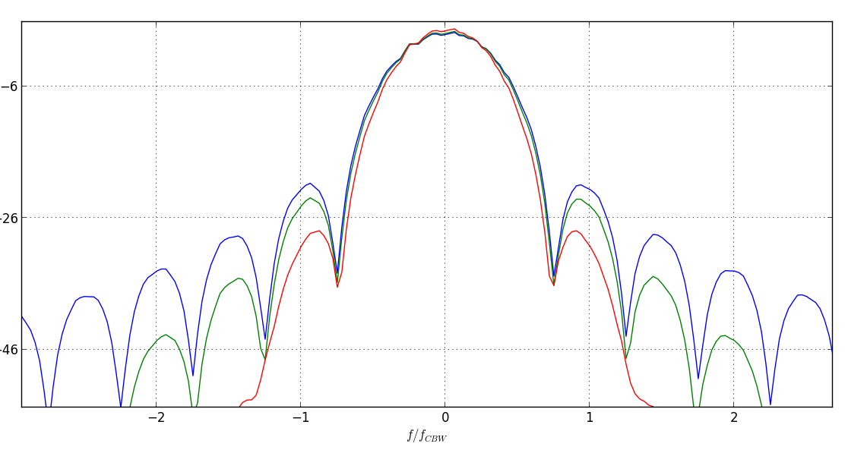

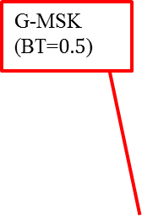
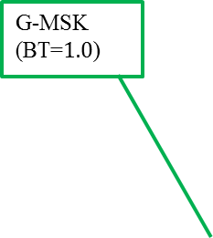
MSK Spectrum and Channel Bandwidth in 802.15.4 LECIM FSK PHY
Adjacent Channel
G-MSK (BT=$0.5$)
G-MSK (BT=$1.0$)
MSK (BT=$∞$)

Slide 4
Observations
Signals have significant leakage into adjacent channels, as symbol rate matches channel bandwidth
May not be compliant to adjacent channel power limits as defined in ETSI 300 220-1 V3.1.1(2017), section 5.11

Slide 5
Thank You for Your Attendance!

