Slide 1
Project: IEEE P802.15 Working Group for Wireless Personal Area Networks (WPANs)
Submission Title: [History and Summary of 802.15.10a]
Date Submitted: [11 March 2019]
Source: [Charlie Perkins] Company [Futurewei]
Address [2330 Central Expressway, Santa Clara Ca, USA]
Voice:[+1.408-330-4586]
E-Mail:[charlie.perkins@huawei.com]
Re: [TG10a.]
Abstract: [Brief Summary of the History of TG 802.15.10a]
Purpose: [This short history of TG 802.15.10a, along with some lessons learned, might be interesting for chairs of new Task Groups in the future]
Notice: This document has been prepared to assist the IEEE P802.15. It is offered as a basis for discussion and is not binding on the contributing individual(s) or organization(s). The material in this document is subject to change in form and content after further study. The contributor(s) reserve(s) the right to add, amend or withdraw material contained herein.
Release: The contributor acknowledges and accepts that this contribution becomes the property of IEEE and may be made publicly available by P802.15.

Slide 2
History and Summary of 802.15.10a
Problem Statement
PAR, CSD, and TG formation
Initial proposal
Evolution into “route table” formulation
Status: almost done
Some things that a Chair can do wrong

Slide 3
Problem Statement
15-17-0517-02-0mag-802-15-10-non-storing-cor (all related to non-storing)
E2E acknowledgement from mesh root
P2P routing using a combination of up/down routing
On-demand P2P routing for E2E acknowledgement
On-demand path storing when sending unicast

Slide 4
PAR, CSD, and TG formation
PAR: dcn 15-17-0565-01-0000
CSD: dcn 15-17-0566-01-0000
First meeting in January 2018
Chair: Charlie Perkins
Vice Chair: Jörg Robert

Slide 5
Problem: non-storing P2P (Up → Down)
A
DATA.ind can’t issue a data frame
From S to D
S
B
R
D
S
R(root)
DATA.req from R cannot send a frame as if S is source. It just a sends a frame from R to D.
D
NHL
NHL
NHL
L2R
L2R
L2R
MMI
..hops..
MMI
MMI
..hops..
MAC
MAC
MAC
Solution I: Let L2R have a record of the paths. Insert text specifying that the record is attached when a data is sent.
Solution II: Add a new primitive to indicate the event (up → down) and add a new primitive to send a frame so that it keeps its source address as the originator not mesh root.

Slide 6
Problem: non-storing E2E Ack
Sending Acknowledgment should be done by L2R layer (e.g. handling timeout)
A
S
B
R
D
D
R
S
DATA.req from R cannot send a L2R Ack frame
NHL
NHL
NHL
L2R
L2R
L2R
MMI
MMI
MMI
MAC
..hops..
MAC
..hops..
MAC
Solution I: Let L2R have a record of the paths. Insert text specifying that the record is attached when a data is sent.
Solution II: Add a new parameter to the DATA.indication primitive, to indicate L2R ack request. Add another to send a frame as if its source address were the originator, not themesh root.

Slide 7
Initial proposal: storing more path lists
Add an entry to the mesh table 5-1 (MT)
Path List
Consists of ‘Destination Address’ and ‘Address List’ pair
Enabled only when non-storing mode
Add new specification after the following text in 5.2.4.2
When the mesh root receives the RA IE or the SRA IE, it delivers the path and the source address therein to the next higher layer with the L2LME-INTERMEDIATE-ADDR-LIST.indication primitive, and stores them as the pair of the address list and the destination address into the ‘Path List’ in the MT.
Add to IntermediateAddrList description of L2RDATA.request (7.2.1.1):
Addresses to be inserted in the Intermediate Address List of the L2R Routing IE. When IntermediateAddrList is ‘NULL’, the ‘Address List’ in the ‘Path List’ in the MT is used, where the destination address matches to the one in this primitive. Omitted if source routing is not used.
No format change. No change of protocol between devices S, D, R.

Slide 8
Evolved proposal: storing more routes
Change the P2P path list in the mesh table 5-1 (MT) to be a Route Table
Type: Reachable destination information
Description: Information needed to route a frame to each reachable destination
Add new specification after the following text in 5.2.4.2
When the mesh root receives the RA IE or the SRA IE, it delivers the path and the source address therein to the next higher layer with the L2LME-INTERMEDIATE-ADDR-LIST.indication primitive., and stores them as the pair of the address list and the destination address into the ‘Route Table’ in the MT (Table 5-1)..
Add to IntermediateAddrList description of L2RDATA.request (7.2.1.1):
Addresses to be inserted in the IntermediateAddressList of the L2R Routing IE. When IntermediateAddrList is ‘NULL’, the ‘Address List’ in the Route Table in the MT is used, where the destination address matches to the one in this primitive. Omitted if source routing is not used.
Change all instances of path list to route entry (address list)
No format change. No change of protocol between devices S, D, R.

Slide 9
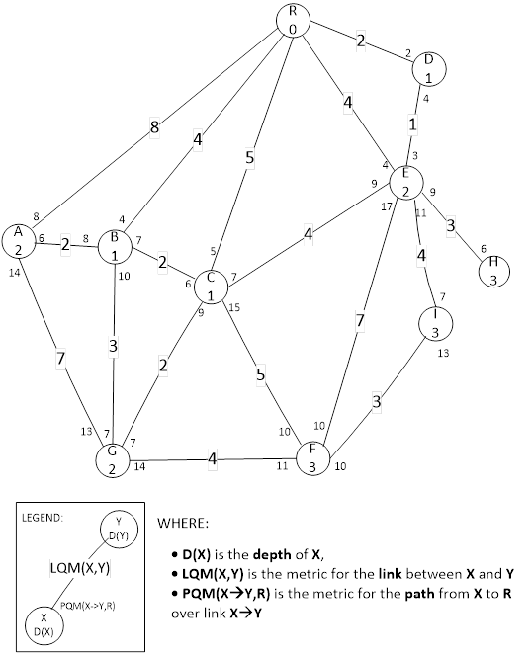
Other corrections
Corrected the arithmetic in mesh examples
Corrected equation for Expected Airtime metric
l2rBCSecurityLevel → l2rBCSecSecurityLevel

Slide 10
Schedule
TASK | Start | Completed
TG10a | Jan, 2018 | May, 2018
Problem Statement | Jan, 2018 | Jan, 2018
Agree on solution approach | Jan, 2018 | May, 2018
Draft | May, 2018 | May, 2018
TG Comment Collection | May, 2018 | July, 2018
WG Letter Ballot | July, 2018 | Sept, 2018
WG Recirculation Ballot | Sept 11, 2018 | Sept 27, 2018
BRC Conference Call | Oct 3, 2018 | Oct 3, 2018
Slide 10
Notes:
March 19
Page 10

Slide 11
Schedule, continued
TASK | Start | Completed
EC Approval for Sponsor Ballot | Oct, 2018 | Oct, 2018
Sponsor Ballot | Oct, 2018 | Nov, 2018
Resolve Sponsor Ballot Comments | Nov, 2018 | Nov, 2018
Sponsor Ballot Recirculation | Nov, 2018 | Dec, 2018
RevCom / IEEE SASB Approval | Jan 19, 2019 | March 21 8, 2019
IEEE-SA Publication | May, March, 2019 | July, April, 2019
Slide 11
Notes:
March 19
Page 11

Slide 12
Sponsor Ballot finals, Revcom submission
VOTERS | 75
VOTED | 64
YES | 58
ABSTAIN | 6
NO | 0
% VOTERS | 85%
% YES | 100%
% ABSTAIN | 9%
BRC December 19 meeting results
Minutes available: DCN 15-18-0620-01-010a
Draft approved at RevCom Jan. 19 mtg

Slide 13
What can possibly go wrong?
Make a BRC, even if you don’t think it’s needed. It’s always needed.
Pay attention to the IEEE Style Guide
Use the IEEE Add-Ins
Do NOT put draft documents on mentor
Use .pdf (not .doc) for Letter Ballot ()
Take the red out. Don’t take the red out.
What can go wrong? Everything!

Slide 14
Contributors to 802.15.10a
Kiyoshi Fukui
James Gilb
Pat Kinney
Tero Kivinen
Clint Powell
Ben Rolfe
Noriyuki Sato

Slide 15
About 802.15.10
Designed to handle thousands of devices, with topology discovery, mesh maintenance, address management, multiple metrics, and features for more robust routing
DCN 15-17-205-00-0010 has a good description of the overall protocol

