Slide 1
Project: IEEE P802.15 Working Group for Wireless Personal Area Networks (WPANs)
Submission Title: [Proposal for modulation quality in split mode]
Date Submitted: [“16 January, 2019”]
Source: [Joerg ROBERT] Company [Friedrich-Alexander University Erlangen-Nuernberg]
Address [Am Wolfsmantel 33, 91058 Erlangen, Germany]
Voice:[+49 9131 8525373], FAX: [+49 9131 8525102], E-Mail:[joerg.robert@fau.de]
Re: []
Abstract: [This document proposes a metric to measure the modulation quality in split mode]
Purpose: [Presentation in TG 4w]
Notice: This document has been prepared to assist the IEEE P802.15. It is offered as a basis for discussion and is not binding on the contributing individual(s) or organization(s). The material in this document is subject to change in form and content after further study. The contributor(s) reserve(s) the right to add, amend or withdraw material contained herein.
Release: The contributor acknowledges and accepts that this contribution becomes the property of IEEE and may be made publicly available by P802.15.

Slide 2
Motivation
Frequency deviation in current 802.15.4 FSK PHYs currently allows for very high tolerances.
State-of-the art transmitters support much tighter tolerances, which may help to increase spectral efficiency.
Proposal: Significantly reduce tolerances in case of split mode.

Slide 3
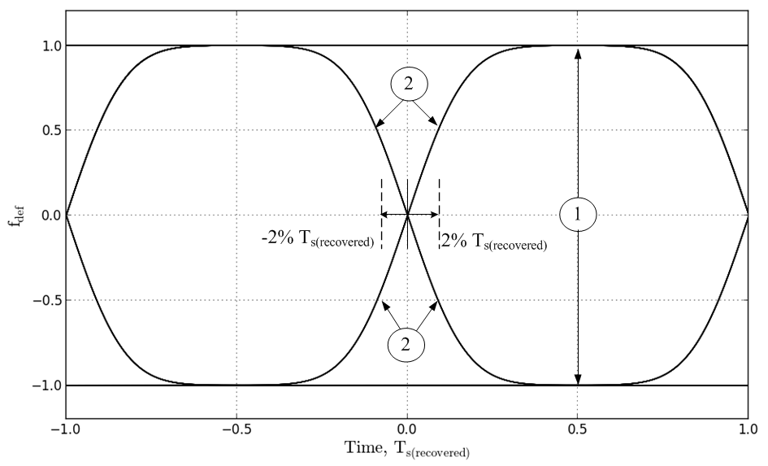
Eye Diagram

Slide 4
Frequency deviation tolerance in split mode
In split mode, modulation frequency tolerance is measured as a percentage of the frequency deviation $f_{dev}$. The measured frequency deviation at position $\left|T_{s(recovered)}\right|=0.5$ (position 1 in Figure xy) shall not exceed $90\%f_{dev}≤\left|f\right|≤110\%f_{dev}$.
In case of a bit transition, the measured frequency deviation at position $\left|T_{s(recovered)}\right|=0.09$ (position 2 in Figure xy) shall not exceed $45\%f_{dev}≤\left|f\right|≤55\%f_{dev}$.

Slide 5
Zero crossing tolerance
In slit mode, the excursion for the zero crossings for all trajectories in the eye diagram shall be constrained within $±2\%$ rms of the symbol time T_{S}, as shown in Figure xy.

Slide 6
Motion
Motion to define tighter tolerances for the split mode using the definitions presented in the previous slides.
Moved by:
Seconded by:

