Slide 1
Project: IEEE P802.15 Working Group for Wireless Personal Area Networks (WPANs)
Submission Title: [Selecting Parameter Sets in the Revised HRP UWB PHY]
Date Submitted: [16 January, 2019]
Source: [Frank Leong (NXP Semiconductors), Jochen Hammerschmidt (Apple)]
Re: [Input to the Task Group]
Abstract: [Presentation, HRP, PHY, Parameter Sets, STS, Channel Sounding, Enhanced Impulse Radio]
Purpose: []
Notice: This document has been prepared to assist the IEEE P802.15. It is offered as a basis for discussion and is not binding on the contributing individual(s) or organization(s). The material in this document is subject to change in form and content after further study. The contributor(s) reserve(s) the right to add, amend or withdraw material contained herein.
Release: The contributor acknowledges and accepts that this contribution becomes the property of IEEE and may be made publicly available by P802.15.

Slide 2
Selecting Parameter Sets in the Revised HRP UWB PHY

Slide 3
Selecting H-PRF Parameters –
Fields to Consider
SYNC
  Scalable field length
SFD
  Scalable pattern length
Payload (PHR + PSDU)
  Different agreed modulation schemes
  Different PSDU lengths (0-1023 octets defined by the length field)
Scrambled Timestamp Sequence (STS)
  Scalable segment length, number of segments

Slide 4
Key SHR Parameters
Set of 8 preamble codes
  Dense ternary codes, increased mean PRF compared to legacy HRP PHY
  Codes are of length 91, resulting in ~73 µs symbol length
Binary SFD patterns
  Focus on coherent receivers
  Increased mean PRF compared to legacy HRP PHY
  Improved SFD detection properties compared to legacy HRP PHY

Slide 5
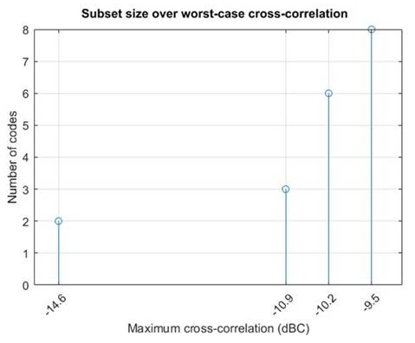
Key SHR Parameters – Preamble Codes

Slide 6
Key SHR Parameters – SFD Patterns
Agreed binary SFD patterns
  Length-4 (mandatory): --+-
  Length-8 (mandatory): ---+--+-
  Length-16 (mandatory): -----++--+-+--+-
  Length-32 (optional): -------+--+--+-+-+---++---+-++--

Slide 7
Data Modulation – Key Features
Two H-PRF data modulation schemes:
PRF128
  Increased mean PRF and guard chips (reduced peak PRF) result in reduced PA peak voltages compared to the legacy HRP PHY
  Guard chips (reduced peak PRF) result in reduced Peak EIRP
  Fairly constant (~110-125 MHz) PRF across all frame fields
PRF256
  Increased mean PRF results in reduced PA peak voltages compared to the legacy HRP PHY
  Increased mean PRF during Payload retains high energy-per-bit assignment for data rates >27 Mbit/s
  Short (4-pulse) bursts avoid violation of Peak EIRP limits

Slide 8
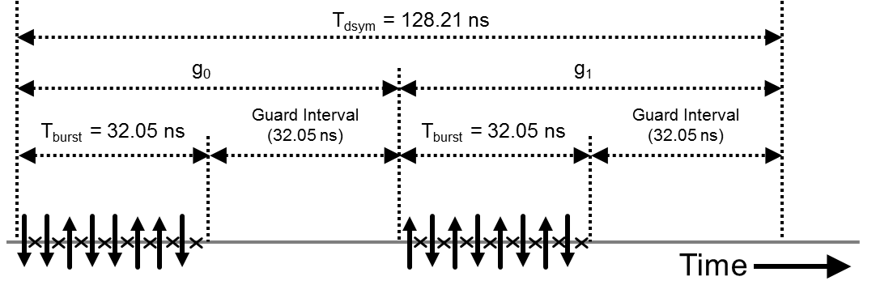
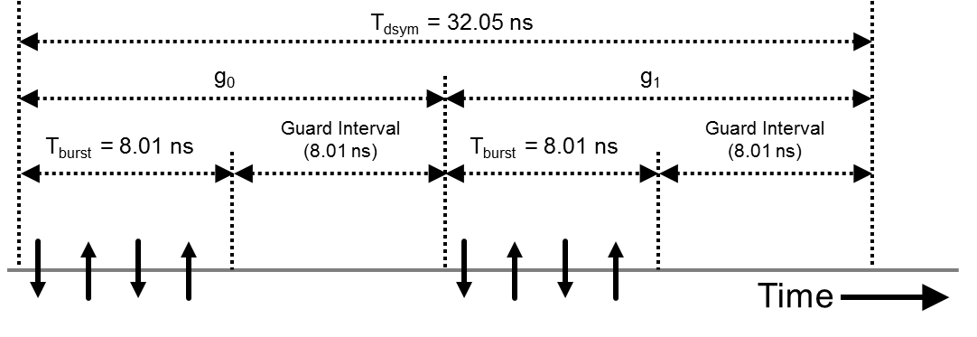
PHR and PSDU – Visual Representation
PRF128
(~7 Mbit/s)
PRF256
(~30 Mbit/s)

Slide 9
Key STS Parameters
Mean PRF of 124.8 MHz during segments
(i.e., a non-zero pulse transmitted once per 4 chips)
STS segment lengths
  Mandatory segment lengths in # of chips: 512*{32, 64, 128},
  i.e., {16384, 32768, 65536}
  Optional length in # of chips: 512*256, i.e., 131072
# of STS segments
  Mandatory: Support for 1 or 2 segments
  Optional: Support for 3 or 4 segments

Slide 10
STS:
Channel Sounding Properties

Slide 11
HRP Channel Sounding – Overall Approach
Focus on channel sounding for localization
  Maximized dynamic range
  Extending system resolution well below LSB of ADC in RX

Slide 12
Assumed Receiver Properties
In case of large FPDR, resolution of ADC in UWB RX is typically severely limited
  With pulse BW of ≥500 MHz, sampling rates of ≥1 GS/s are typical
    At ≥1 GS/s, design of multi-bit ADCs poses significant challenges
    ADCs may therefore provide ENOB < 1 for first path detection
Effective FPSens can be boosted by summation
  For reliable first-path detection, summation requires many pulses
  (i.e., high PRF and/or long frame duration)
  Huge amount of entropy available to boost FPSens:
  4096 BPSK-modulated pulses provide 1.044e1233 different realizations
  → DRBG-generated sequence is free from periodicity-related artifacts
FPDR: First Path Dynamic Range [dB]
FPSens: First Path Sensitivity [dBm]

Slide 13
Assumptions on Sampling & Noise
Assume single ADC sample at the peak of each pulse
Assume additive white thermal (Gaussian distributed) noise on each ADC sample
  For each signal (channel tap) level, there exists an associated finite probability of noise changing the quantizer output
  For a typical implementation, high FPDR may imply need for SNR boost (e.g., via summation over multiple pulses) to avoid over-levels in RX, as thermal noise may scale with the peak signal amplitude (strongest CIR tap)
[Continued on next slide]

Slide 14
LOCS – Assumptions on Sampling & Noise
[Continued from previous slide]
Assume de-spreading is aligned based on synchronization performed on strong CIR tap during SHR phase
  All incoming pulses can be considered as effectively having positive polarity
  De-spreading does not affect noise properties (i.e., AWGN remains AWGN)
  Strong paths can be used to set up the de-spreading pattern for weak paths

Slide 15
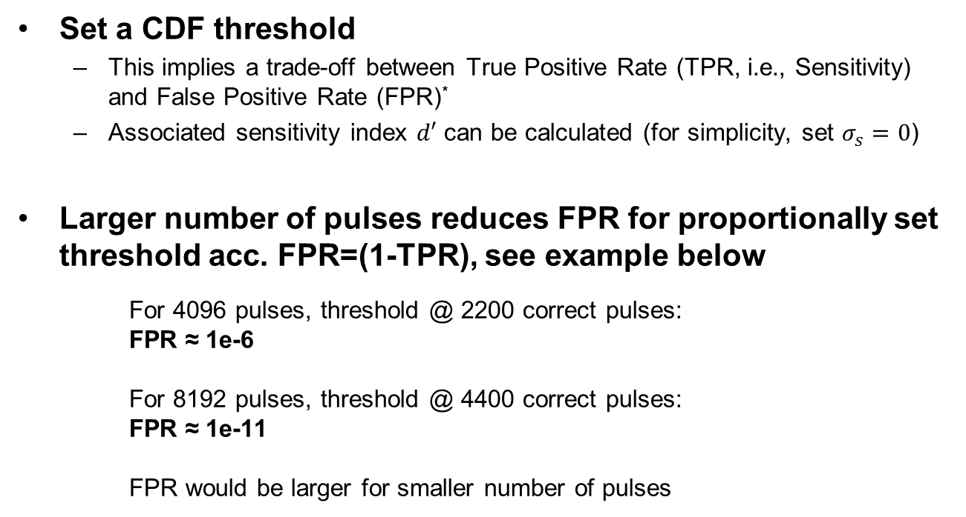
Example: FPSens for an Unbiased 1-bit ADC
Set a CDF threshold
  This implies a trade-off between True Positive Rate (TPR, i.e., Sensitivity) and False Positive Rate (FPR)*
  Associated sensitivity index $d′$ can be calculated (for simplicity, set $σ_{s}=0$)
Larger number of pulses reduces FPR for proportionally set threshold acc. FPR=(1-TPR), see example below
For 4096 pulses, threshold @ 2200 correct pulses:
FPR ≈ 1e-6
For 8192 pulses, threshold @ 4400 correct pulses:
FPR ≈ 1e-11
FPR would be larger for smaller number of pulses
*) Also known as “Hit Rate” and “False Alarm Rate”, see https://en.wikipedia.org/wiki/Receiver_operating_characteristic

Slide 16
Overall Parameter Set Selection

Slide 17
Parameter Selection – Overall Consideration
For short frames, available energy is constrained
  “Bucket-of-Energy”
  Determined by regulatory Mean EIRP measurement interval
Must select per-field parameters accordingly
  SYNC length, SFD pattern, data modulation, STS length & segmentation

Slide 18
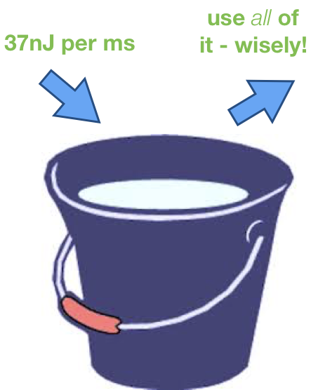
Energy/Power Considerations
Maximize Link Budget
  Optimally exploit available Regulatory“Bucket of Energy” (BOE) per 1ms (~37 nJ)
    target flat spectrum over 500 MHz bandwidth (near-0dB Spectral PAPR)
    prevent Peak EIRP violations under all relevant use cases so can “empty” the BOE
  Link Budget … for what functionality anyway?
    Data Sensitivity (N/A when non-data packet)
    SNR of derived CIRs
    Sync Sensitivity (Acquisition based on Preamble)
  it’s all about distributing the available BOE to the different fields

Slide 19
Parameter Selection – Mix & Match
# of pulses per payload bit depends on modulation scheme
  For PRF128, data is modulated using 16 pulses per uncoded bit
  For PRF256, data is modulated using 8 pulses per uncoded bit
Basic “mix & match” considerations
  Select parameters such that length of SYNC, SFD, and STS fields scale according to the # of pulses per payload bit
  Parameter selection done independently of PSDU length, as PER variation vs. PSDU length is fairly small under assumption of constant Eb/N0
  → Note: Every additional octet in the PSDU reduces the
  energy available for the other frame fields

Slide 20
H-PRF Parameter Sets

