Slide 1
IEEE 802.15.4-2015
HRP UWB PHY
Suggested Changes
Robert Golshan
Apple Inc.
15 January 2019

Slide 2
Page 447: Last paragraph
FROM: “Table 16-1 and Table 16-2 show how the SHR field, H₀-H₁₈, PHY Payload field, D₀-D_{N-1}, and Tail field, T₀-T₁, are mapped onto the symbols.”
TO: “Table 16-1 and Table 16-2 show how the PHR field, H₀-H₁₈, PHY Payload field, B₀-B_{N-1}, and Tail field, T₀-T₁, are mapped onto the symbols.”
Comments: “SHR” is a typo. Also, use “B” instead of “D” to avoid confusion with “D” used in Section 16.3.3.1 (c), page 462, which denotes input information symbols into the Reed-Solomon encoder. “B” is consistent with the notation used in Figure 16-10, page 461.

Slide 3
Page 448-9: Tables 16-1 and 16-2
Table captions:
  FROM: “Mapping of SHR field bits, ...”
  TO: “Mapping of PHR field bits, ...”
  Comments: SHR is a typo.
Table entries:
  Change all instances of “D” to “B” to avoid confusion with “D” used in Section 16.3.3.1 (c), page 462, which denotes input information symbols into the Reed-Solomon encoder. “B” is consistent with the notation used in Figure 16-10, page 461.

Slide 4
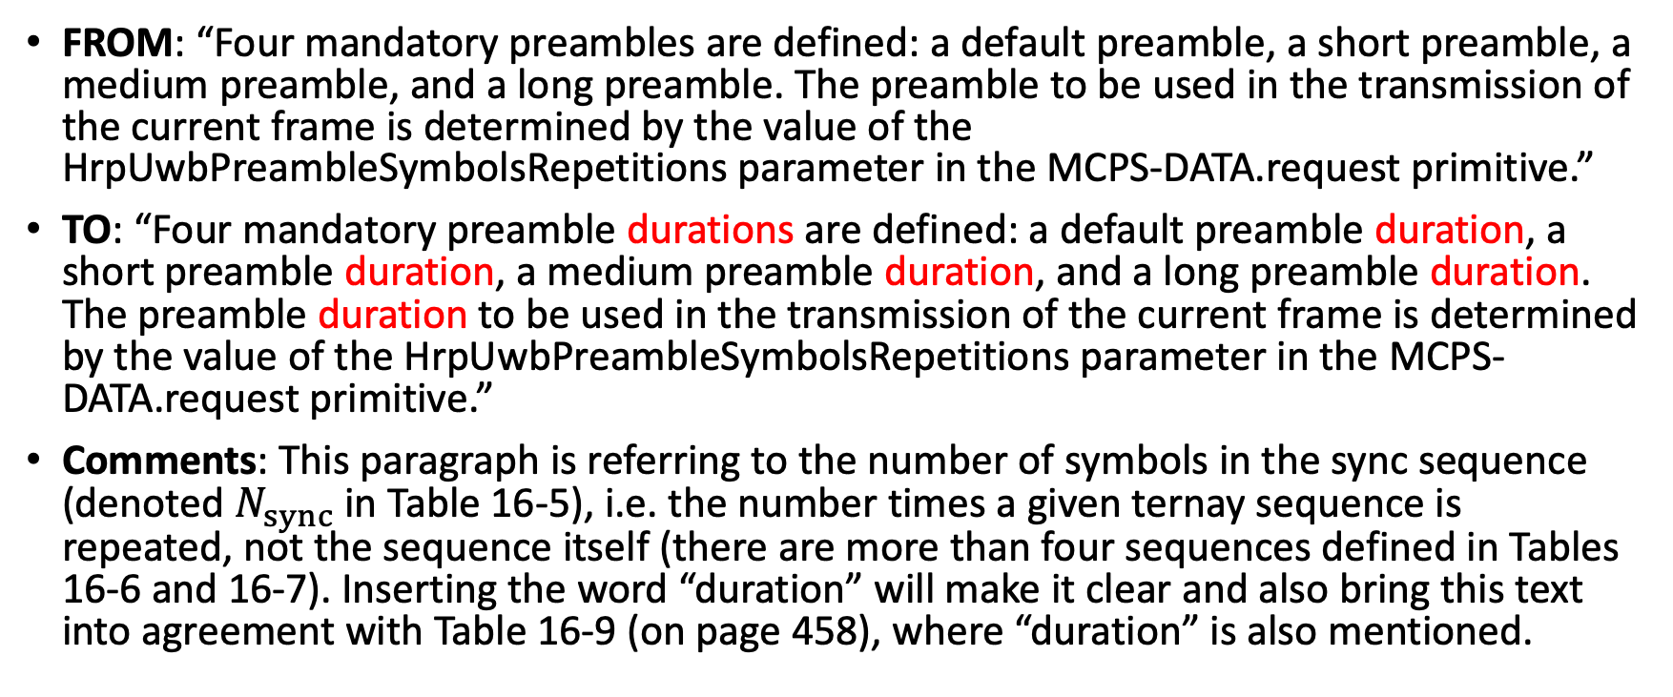
Page 454: 1st paragraph of 16.5.4
FROM: “Four mandatory preambles are defined: a default preamble, a short preamble, a medium preamble, and a long preamble. The preamble to be used in the transmission of the current frame is determined by the value of the HrpUwbPreambleSymbolsRepetitions parameter in the MCPS-DATA.request primitive.”
TO: “Four mandatory preamble durations are defined: a default preamble duration, a short preamble duration, a medium preamble duration, and a long preamble duration. The preamble duration to be used in the transmission of the current frame is determined by the value of the HrpUwbPreambleSymbolsRepetitions parameter in the MCPS-DATA.request primitive.”
Comments: This paragraph is referring to the number of symbols in the sync sequence (denoted $N_{sync}$ in Table 16-5), i.e. the number times a given ternay sequence is repeated, not the sequence itself (there are more than four sequences defined in Tables 16-6 and 16-7). Inserting the word “duration” will make it clear and also bring this text into agreement with Table 16-9 (on page 458), where “duration” is also mentioned.

Slide 5
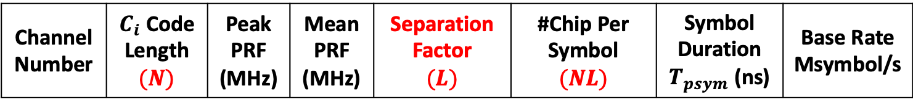
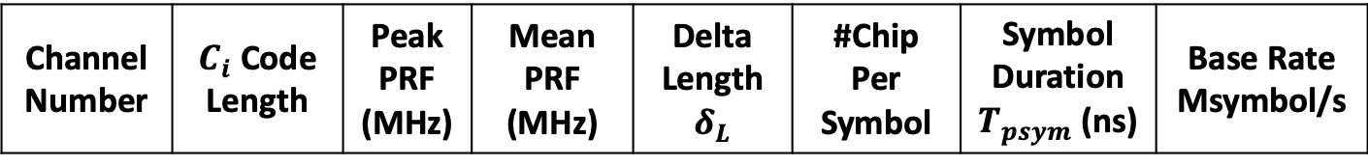
Page 452: Table 16-4 (change 1 of 3)
Channel Number | $C_{i}$ Code Length | Peak PRF (MHz) | Mean PRF (MHz) | Delta Length $$δ_{L}$$ | #Chip Per Symbol | Symbol Duration $T_{psym}$ (ns) | Base Rate Msymbol/s
From:
To:
Comments: Adds clarity to formula on page 456, and Figure 16-5 on page 457 (see next 2 slides).
Channel Number | $C_{i}$ Code Length $$(N)$$ | Peak PRF (MHz) | Mean PRF (MHz) | Separation Factor $$(L)$$ | #Chip Per Symbol $$(NL)$$ | Symbol Duration $T_{psym}$ (ns) | Base Rate Msymbol/s

Slide 6
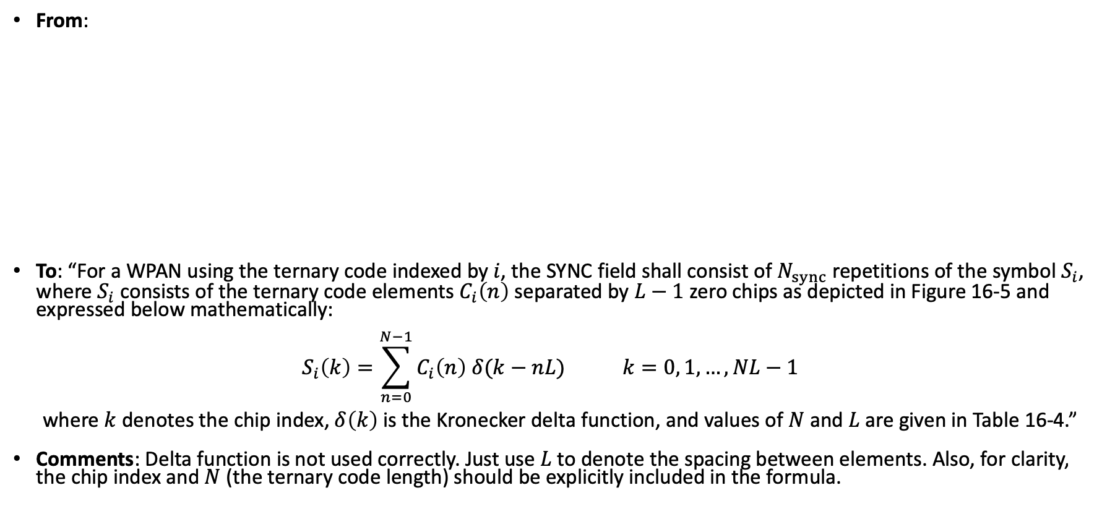
Page 456: Equation (change 2 of 3)
From:
To: “For a WPAN using the ternary code indexed by $i$, the SYNC field shall consist of $N_{sync}$ repetitions of the symbol $S_{i}$, where $S_{i}$ consists of the ternary code elements $C_{i}\left(n\right)$ separated by $L−1$ zero chips as depicted in Figure 16-5 and expressed below mathematically:
$$S_{i}\left(k\right)=\sum_{n=0}^{N−1}{C_{i}\left(n\right) δ(k−nL)} k=0, 1, …, NL−1$$
where $k$ denotes the chip index, $δ\left(k\right)$ is the Kronecker delta function, and values of $N$and $L$ are given in Table 16-4.”
Comments: Delta function is not used correctly. Just use $L$ to denote the spacing between elements. Also, for clarity, the chip index and $N$ (the ternary code length) should be explicitly included in the formula.

Slide 7
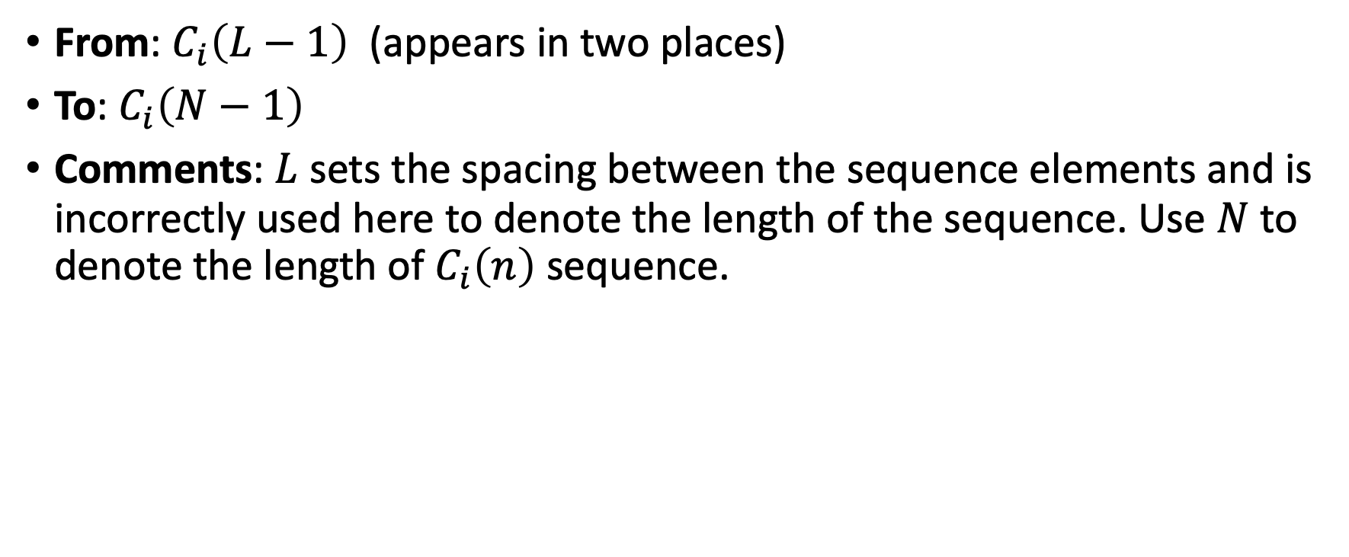
Page 457: Figure 16-5 (change 3 of 3)
From: $C_{i}\left(L−1\right)$ (appears in two places)
To: $C_{i}\left(N−1\right)$
Comments: $L$ sets the spacing between the sequence elements and is incorrectly used here to denote the length of the sequence. Use $N$ to denote the length of $C_{i}\left(n\right)$ sequence.

Slide 8
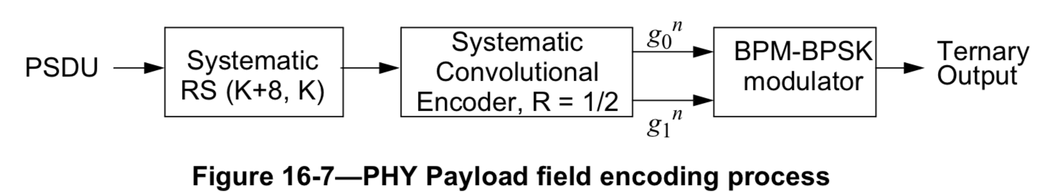
Page 458: Figure 16-7
FROM:
TO:
Comments: for consistency with the PPDU encoding process as described in Section 16.2.1 (page 447) and Tables 16-1 and 16-2 (page 448).
PHR bits encoded as described in Section 16.2.6
Systematic Convolutional Encoder, R = 1/2
PSDU
Systematic
RS (K+8, K)
(rest of the figure is correct)
Tail bits

Slide 9
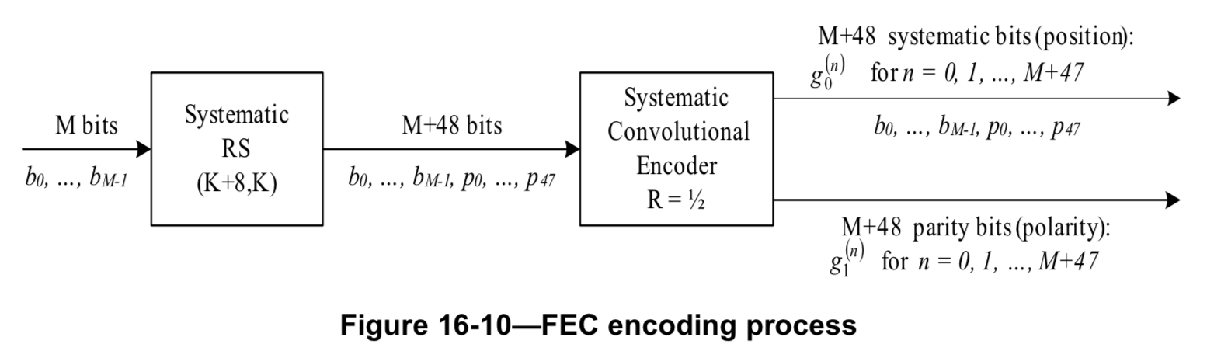

Page 461: Figure 16-10
FROM:
TO:
Comments: for consistency with the PPDU encoding process as described in Section 16.2.1 (page 447) and Tables 16-1 and 16-2 (page 448).
PHR bits encoded as described in Section 16.2.6
Systematic Convolutional Encoder, R = 1/2
M bits
Systematic
RS (K+8, K)
(rest of the figure is correct)
$b_{0}$, …, $b_{M−1}$
Tail bits

