Slide 1
Project: IEEE P802.15 Working Group for Wireless Personal Area Networks (WPANs)
Submission Title: Tunnel Road Accidents Position Localization and Navigation Solution Using IoT Lighting Devices VLC Link
Date Submitted: January 2019
Source: Jaesang Cha (SNUST), Juphil Cho (Kunsan Univ.), Donghoon Hyun (Korea Polytechnic Univ.), Kiyun Kim (Myongji College), Yongkyu Yoon (University of Florida), Hyeongho Lee (Netvision Telecom Inc., Korea Univ.), Yoonkwan Kim (The Catholic Univ.), Minseok Oh (Kyonggi Univ.), Jinyong Choi (Shinhan Bank), Sungdoo Kang (Feelux Co., Ltd.), Changsoo Lee (L&S LED Co., Ltd.), Sooyoung Chang (SYCA), Vinayagam Mariappan (SNUST)
Address: Contact Information: +82-2-970-6431, FAX: +82-2-970-6123, E-Mail: chajs@seoultech.ac.kr
Re:
Abstract: This documents introduce the V2I VLC Link design consideration for VAT. This proposed VLC Communication Link used for drone patrolling service using IoT lighting devices to identify the tunnel road accidents position localization and navigation. This VAT to operate on the application services like ITS, ADAS, IoT/IoL, drone using watch security services, and etc.
Purpose: To provided concept models of VLC technology solution for Vehicular Assistant Technology (VAT) Interest Group
Notice: This document has been prepared to assist the IEEE P802.15. It is offered as a basis for discussion and is not binding on the contributing individual(s) or organization(s). The material in this document is subject to change in form and content after further study. The contributor(s) reserve(s) the right to add, amend or withdraw material contained herein.
Release: The contributor acknowledges and accepts that this contribution becomes the property of IEEE and may be made publicly available by P802.15.
Slide 1

Slide 2
Contents
Need for Tunnel Road Accidents Position Localization Solution
IoT Lighting Device based VLC Link for Drone Patrol Service
Conclusion
Slide 2

Slide 3
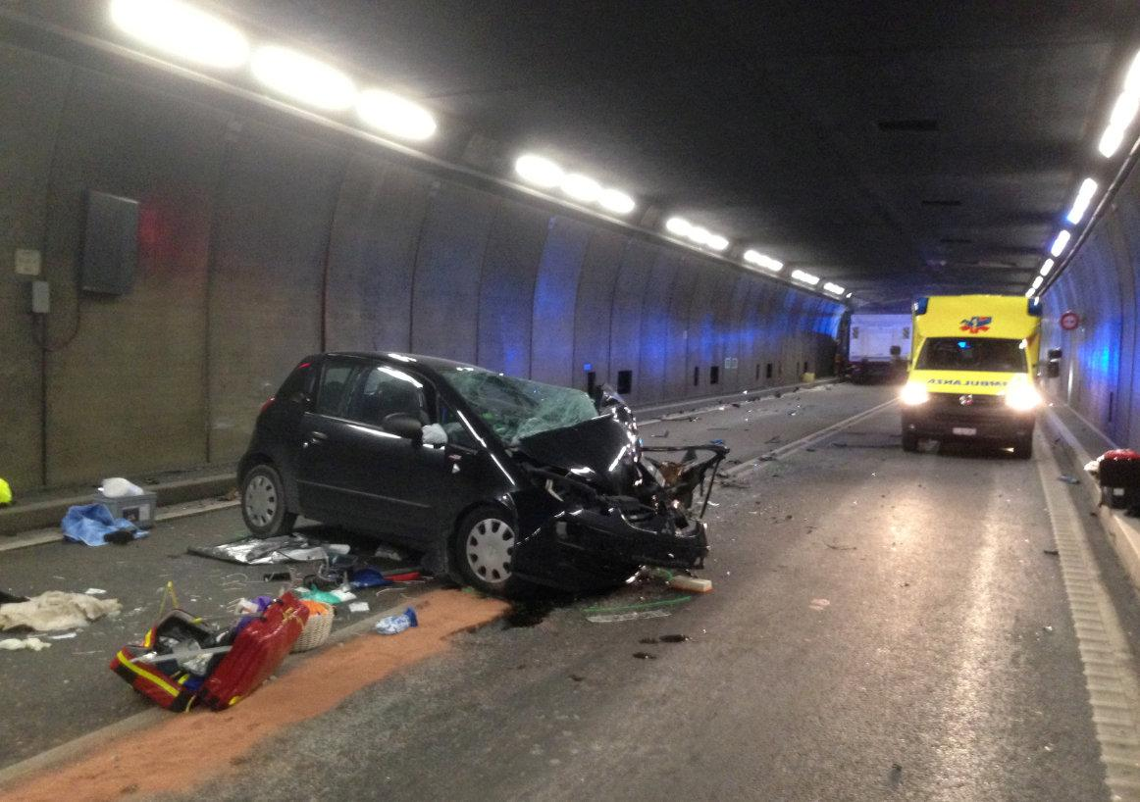
Need for Tunnel Road Accidents Position Localization Solution
Need position localization solution to aid and traffic controls
Needs
With dramatic accidents in tunnels over the recent years, safety and security in tunnels has become a focus point all over the world.
If any accidents happened in the tunnel road it is impossible to get location of accident place, because of the close area GPS system is not working in the tunnel.
Nowadays drones are used for many kind of services in many spheres like security, patrol, delivery, public crowd monitoring etc.
Drones can be used to find the precise accidents position using Lighting devices installed in tunnels.
Basic Concept
Uses the Tunnel Lighting System and the Camera Connected on Drone to enable VLC Link for communication to get location informations
Tunnel lighting system provides the navigation, and location information for drone based position localization and Navigation
VLC Links avoids any communication interferences and provides secure and precise location Information
< Tunnel Road Accidents >
Slide 3

Slide 4
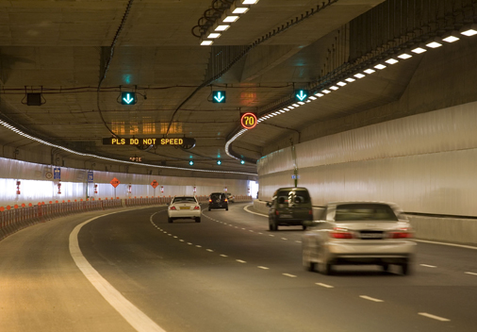
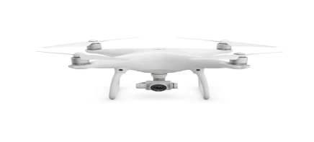
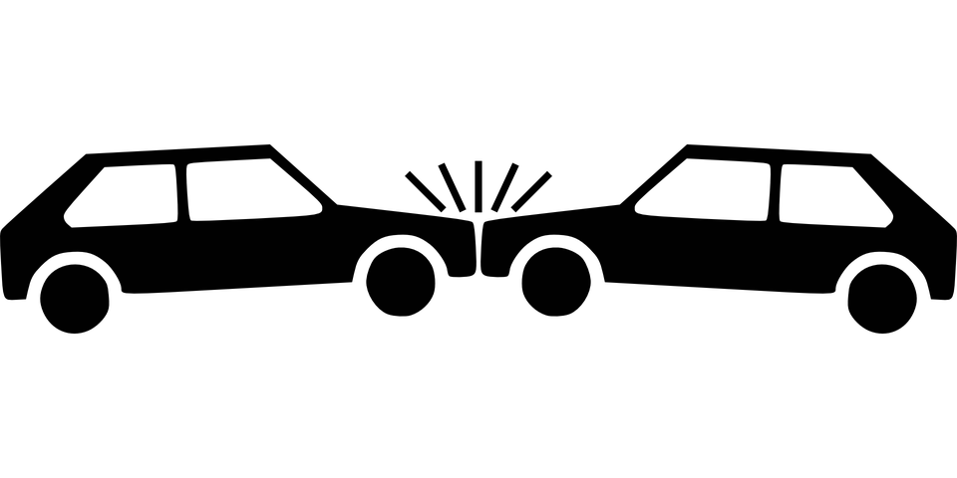
IoT Lighting Device based VLC Link for Drone Patrol Service
Lighting Devices to provide Location Information
< Tunnel Road Light based VLC Link for Patrol Service >
Provides precise tunnel road accidents location information
Helps to precise position location for first AID and traffic Controls
IoT Tunnel Road Lighting System Based VLC Link for Patrol Service Using Drone
Tx : Street Lighting System
Rx : PD / CMOS Image Sensor
Day-Night Communication Mode
Modulations :
OOK, VPPM, Offset-VPWM, Multilevel PPM, Inverted PPM, Subcarrier PPM, DSSS SIK etc.
Data Rate : 1K ~ 1Mb/s and Distance : 2m ~ 100m
Slide 4

Slide 5
Conclusion
Proposed the Tunnel Road Accidents Position Localization and Navigation Solution for Drone Patrol Service Using IoT Lighting Devices VLC Link
Proposed system uses the Tunnel Road Lighting System and the Camera connected on the Drone to enable VLC Link to get accidental position informations inside the tunnel roads.
This system make it easier for traffic police to figure out the exact traffic accident location in the tunnel or closed areas, where GPS is not working.
Used to locate position of accidents, automatic navigation to aid, and traffic control inside and outside of the tunnel area.
Slide 5

