Slide 1
Project: IEEE P802.15 Working Group for Wireless Personal Area Networks (WPANs)
Submission Title: Onward Transportation Container Management Solution Using High Speed Optical Wireless Communications Technology
Date Submitted: January 2019
Source: Jaesang Cha, Minwoo Lee, Deokgun Woo (SNUST), Kaewon Choi(SKKU), Sooyoung Chang (SYCA) , Vinayagam Mariappan (SNUST)
Address: Contact Information: +82-2-970-6431, FAX: +82-2-970-6123, E-Mail: chajs@seoultech.ac.kr
Re:
Abstract: This documents introduce the high speed optical wireless communications link model proposed to introduce the possibility of using light communication for cloud connected container management solution. This proposed solution can be used as a part of a port vehicle based container management system.
Purpose: To provided concept models of the high speed optical wireless/light communications solution for Vehicular Assistant Technology
Notice: This document has been prepared to assist the IEEE P802.15. It is offered as a basis for discussion and is not binding on the contributing individual(s) or organization(s). The material in this document is subject to change in form and content after further study. The contributor(s) reserve(s) the right to add, amend or withdraw material contained herein.
Release: The contributor acknowledges and accepts that this contribution becomes the property of IEEE and may be made publicly available by P802.15.
Slide 1

Slide 2
Contents
Needs for Onward Transportation Container Management Solution
Container Management Solution using High Speed OWC Technology
Conclusion
Slide 2

Slide 3
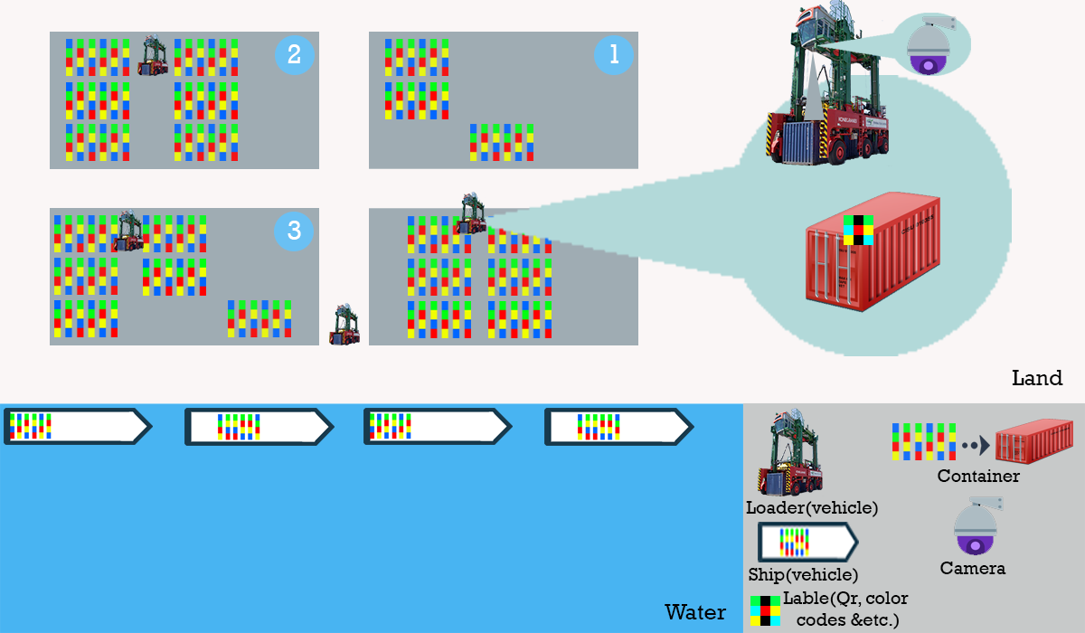
Needs for Onward Transportation Container Management Solutions
Needs
Work with materials in hazardous environments is better automated with the help of robots and lift trucks, reducing the emergency risks associated with the movement of cargo.
Maximum separation of transport operations by adopting Management system.
When each container is marked, it is possible to manage cargo efficiently by monitoring program on-line and it gives opportunity working day-and-night
< View from the top of the waterfront >
Slide 3

Slide 4
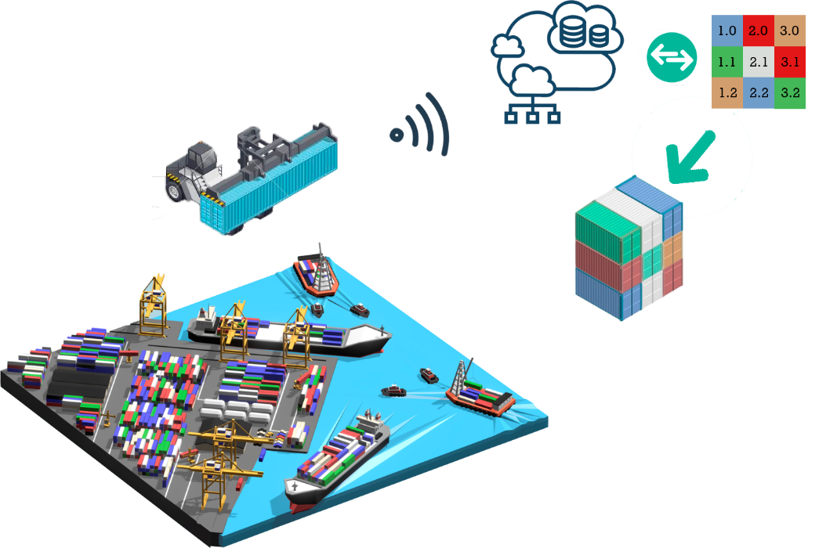
Container Management Solution Using High Speed OWC Technology
High Speed OWC Link Based Cloud Connected Container Management Solutions
Modulations :
QR-Code, Color Code and etc.
Day-Night Communication Mode
Rx : Cloud Connected Camera in Vehicle
Tx : Distribution label
Data Rate : 1K ~ 5Mb/s
Online system provides opportunity for continuously managing of the remaining containers in real time
Actual time management system for managing the remaining amount containers in distribution place using labelling and cloud network of distribution centre.
< High Speed OWC Link Based Container Management System >
Slide 4

Slide 5
Conclusion
Proposed the Cloud Connected Management System using high speed optical wireless communications technology
Passively inspecting the gives good opportunity for the continuously fluctuating containers in the distribution port
The propose method provides efficient container management on-line through Cloud Connected camera communication which attached to vehicle and labeling containers
Slide 5

