Slide 1
Project: IEEE P802.15 Working Group for Wireless Personal Area Networks (WPANs)
Submission Title: LiFi / CamCom Technology for Automatic Operation Control Solution of Electric Train Systems
Date Submitted: January 2019
Source: Jaesang Cha (SNUST), Kaewon Choi (Sungkyunkwan Univ.), Sangwoon Lee (Namseoul Univ.), Jinyoung Kim (Kwangwoon Univ.), Jeonggon Kim (Korea Polytechnic Univ.), Chanhyeong Jeong (RAPA), Sooyoung Chang (SYCA), Vinayagam Mariappan (SNUST)
Address: Contact Information: +82-2-970-6431, FAX: +82-2-970-6123, E-Mail: chajs@seoultech.ac.kr
Re:
Abstract: This documents introduce the V2I LiFi/CamCom Link design consideration for VAT. This proposed LiFi/CamCom Link for Automatic Operation Control Solution of Electric Train Systems. This VAT solution is to operate on the application services like ITS, ADAS, IoT/IoL, etc. on road condition. Also this can be used for LEDIT, Digital Signage with connected information services etc.
Purpose: To provided concept models of LiFi/CamCom technology solution for Vehicular Assistant Technology (VAT) Interest Group
Notice: This document has been prepared to assist the IEEE P802.15. It is offered as a basis for discussion and is not binding on the contributing individual(s) or organization(s). The material in this document is subject to change in form and content after further study. The contributor(s) reserve(s) the right to add, amend or withdraw material contained herein.
Release: The contributor acknowledges and accepts that this contribution becomes the property of IEEE and may be made publicly available by P802.15.
Slide 1

Slide 2
Contents
Need for Automatic Operation Control in Electric Train
LiFi / CamCom Link for Automatic Control of Electric Train Systems
Conclusion
Slide 2

Slide 3
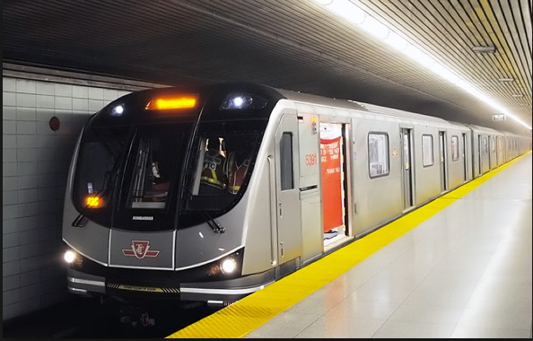
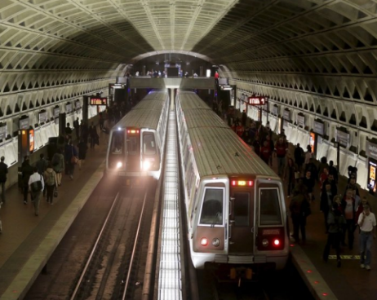
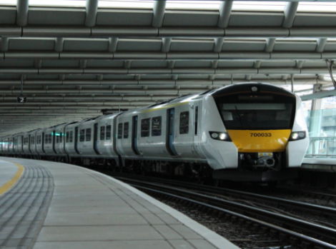
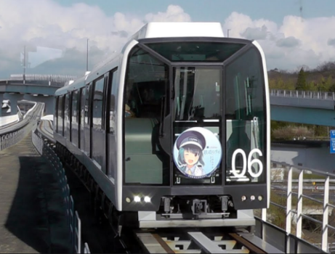
Need for Automatic Operation Control in Electric Train
Needs
Currently, the system of electric trains in the world is mainly a manned train system. In order to reduce the cost of hiring workers and moving towards a fully automated society, it is essential to practice the train system automatically now and in the future.
Electric trains have a great speed, especially for high-speed trains.
To stop at the train stations accurately requires the ability to transmit and receive information very quickly and accurately.
Light is known to be capable of transmitting data at very high speeds. This is necessary for locating and controlling self-driving electric train.
Basic Concept
Use a led light installed on both side of the rails at the position near the train station and LED lights placed above opposite the train head at the train stations.
The light emitted from the LEDs will contain the corresponding coordinate information.
The cameras installed on the hull after receiving light from LEDs will analyze the beam and send the train's location information to information control stations.
< The train moves into the station>
<Self-driving electric train>
Slide 3

Slide 4
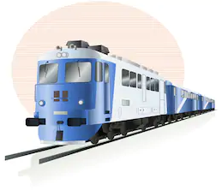
LiFi / CamCom Link for Automatic Control of Electric Train Systems
LED lamp
V2X LiFi/CamCom Link
Tx : Head Lights
Rx : PD / Camera
Day-Night Communication Mode
Modulations :
OOK, VPPM, Offset-VPWM, Multilevel PPM, Inverted PPM, Subcarrier PPM, DSSS SIK etc.
Data Rate : 1K ~ 1Mb/s
Supported LoS (Line of Sight)
Available Distance : 2m ~ 200m
Signal required to stop the train, position signal,….
1001001010101010
Camera
Camera
1001001010101010
Signal required to stop the train, position signal,….
Train station
< Self-driving Electric Train Control System Using LiFi/CamCom Link >
※ Use the LED light to transmit control signals to the train via camera. After the train receives the transmitted signal, it will analyze and execute as required.
Slide 4

Slide 5
Conclusion
Proposed the LiFi / CamCom Technology for Automatic Operation Control Solution of Electric Train Systems
Uses the lighting system installed on both sides of the rail and LED lights placed above opposite the train head at the train stations and electric train front side camera
LiFi / CamCom Link to connect trains to each other and connect trains to the central control room
Reduce labor costs and build a modern automation society
Slide 5

