Slide 1
Project: IEEE P802.15 Interest Group for Wireless Personal Area Networks (WPANs)
Submission Title: Increasing data rate in optical V2X communication
Date Submitted: January 2019
Source: Minh Duc Thieu, Yeong Min Jang [Kookmin University].
Contact: +82-2-910-5068 E-Mail: yjang@kookmin.ac.kr
Re:
Abstract: A summary considerations of the challenges of increasing data rate in optical V2X communication
Purpose: To summary challenges when increasing data rate in optical V2X communication system
Notice: This document has been prepared to assist the IEEE P802.15. It is offered as a basis for discussion and is not binding on the contributing individual(s) or organization(s). The material in this document is subject to change in form and content after further study. The contributor(s) reserve(s) the right to add, amend or withdraw material contained herein.
Release: The contributor acknowledges and accepts that this contribution becomes the property of IEEE and may be made publicly available by P802.15.

Slide 2
A summary considerations of the challenges of increasing data rate in optical V2X communication

Slide 3
Introduction
It is highly desirable to increase the data rate for vehicle OWC/OCC applications. The high data rate transmission can enable the capability to send longer message in shorter time.
It is very usefull for vehicles when moving, especially moving in high-speed.
Currently, for outdoor applications, the data rate of existing photodiode-based VLC systems for long distance communication are lower than 100 kbps.
We still have the trade off between communication distances and data rates.

Slide 4
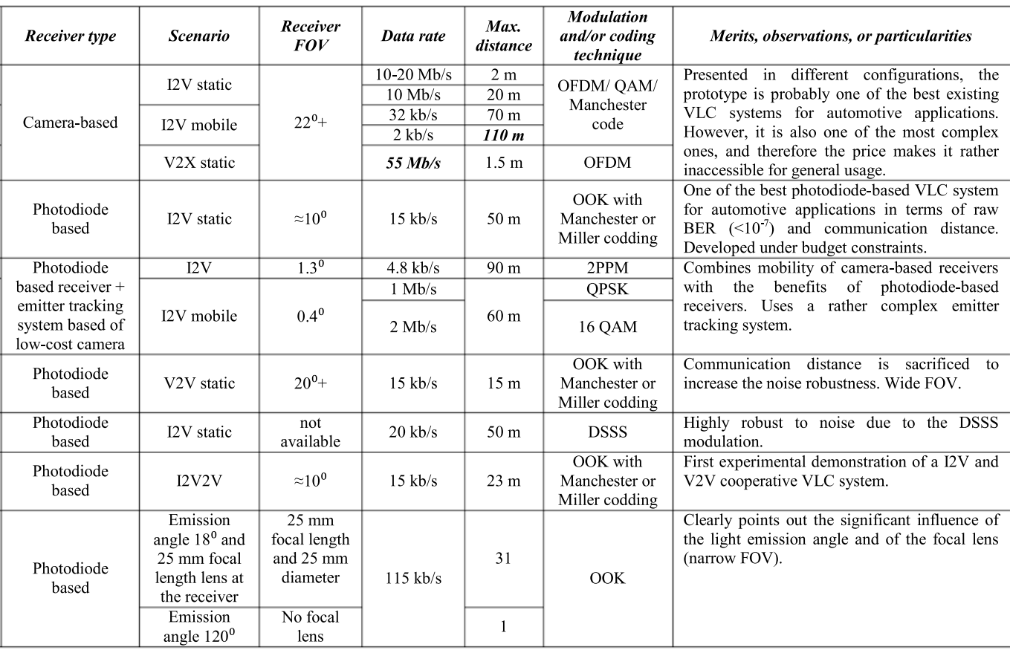
Challenges of increasing data rate (1)
Technical characteristics for some of the most optical V2X system prototypes [1]

Slide 5
Challenges of increasing data rate (2)
The IEEE 802.11p standard specifies data rates from 3 to 27 Mb/s. However, it is very difficult to clearly define the required data rate in specific vehicular communication applications.
The lower data rates in long range vehicular applications also depend on the fact that LEDs used in these applications are high power. Therefore, the switching time is slower [1].

Slide 6
References
[1] Alin-Mihai Cailean, Mihai Dimian, "Current Challenges for Visible Light Communications Usage in Vehicle Applications: A Survey," IEEE Communication Surveys & Tutorials, vol. 19, no. 4, pp. 2681-2703, 2017.

