Slide 1
Project: IEEE P802.15 Working Group for Wireless Personal Area Networks (WPANs)
Submission Title: [MAC for Secure Ranging]
Date Submitted: [15 January 2019]
Source: [Ayman Naguib (Apple) , Robert Golshan (Apple), Alexandar Krebs (BMW), Thomas Reisinger (Continental) ]
Re: [Input to the Task Group]
Abstract: [Presentation, enhancements to 802.15.4 for secure ranging, ranging integrity]
Purpose: []
Notice: This document has been prepared to assist the IEEE P802.15. It is offered as a basis for discussion and is not binding on the contributing individual(s) or organization(s). The material in this document is subject to change in form and content after further study. The contributor(s) reserve(s) the right to add, amend or withdraw material contained herein.
Release: The contributor acknowledges and accepts that this contribution becomes the property of IEEE and may be made publicly available by P802.15.

Slide 2
Hopping in Block-Based Ranging:
Justification and Reasoning

Slide 3
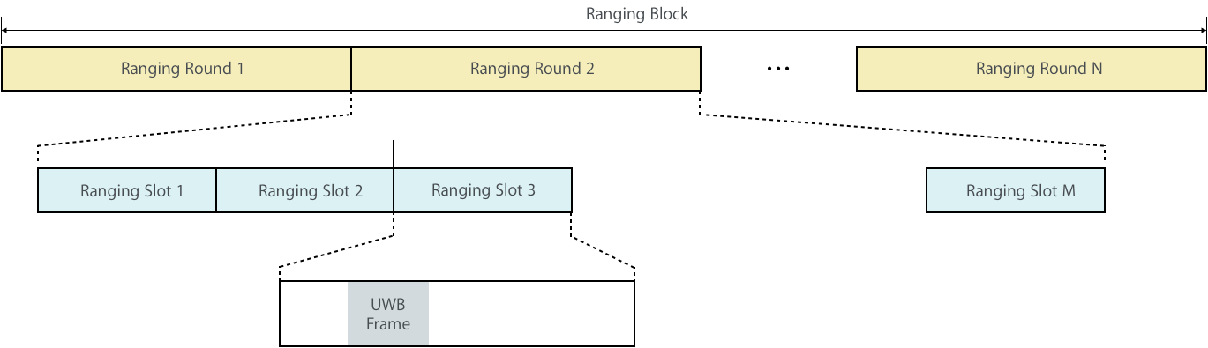
Block Structure

Slide 4
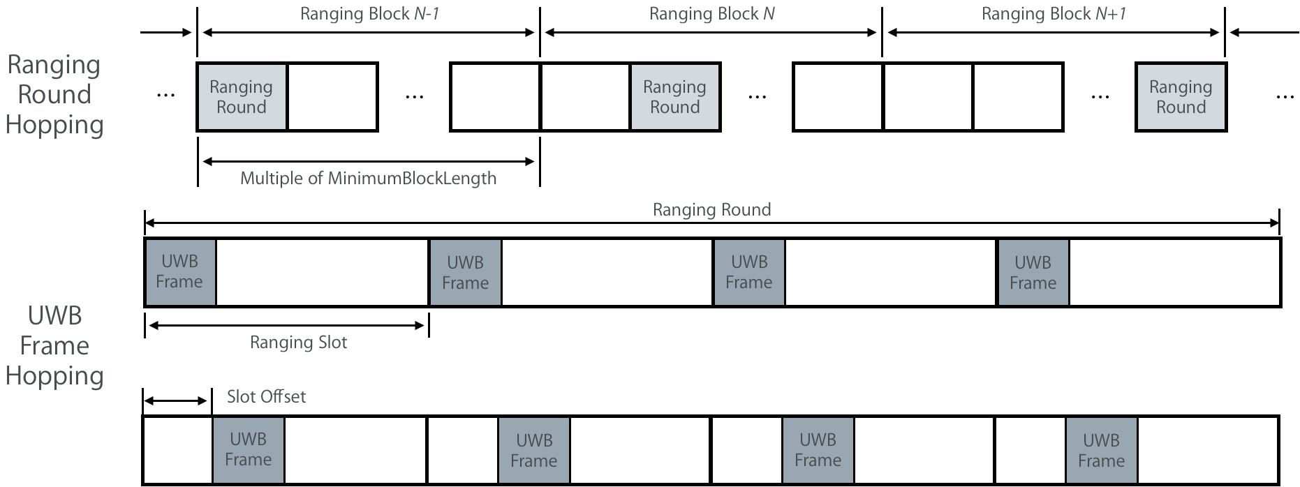
Hopping Modes -1

Slide 5
Hopping Modes - 2
Different hopping mechanisms to manage/align interference:
  Round hopping within a block
    ✓︎ No Hopping ✓︎ Uniform random hopping ✓︎ Random Walk hopping
  UWB packet hopping within a slot
    ✓︎ No Hopping ✓︎ Uniform random hopping
Proposed text provides the hooks necessary to support hopping. However, it does not:
  Define hopping patterns to be used and how these pattern are shared among RDEVs
  Criteria for triggering hopping
  Criteria for selecting which hopping mode to use (URH vs RWH)

Slide 6
Hopping Modes - 3
Why random walk hopping? Shouldn’t we just use uniform random hopping?
With the current block structure and hopping definitions in the proposed text, what happens if a ranging exchange is lost due to interference and/or collision? Do the ranging devices become out of synch and have to start all over ?

Slide 7
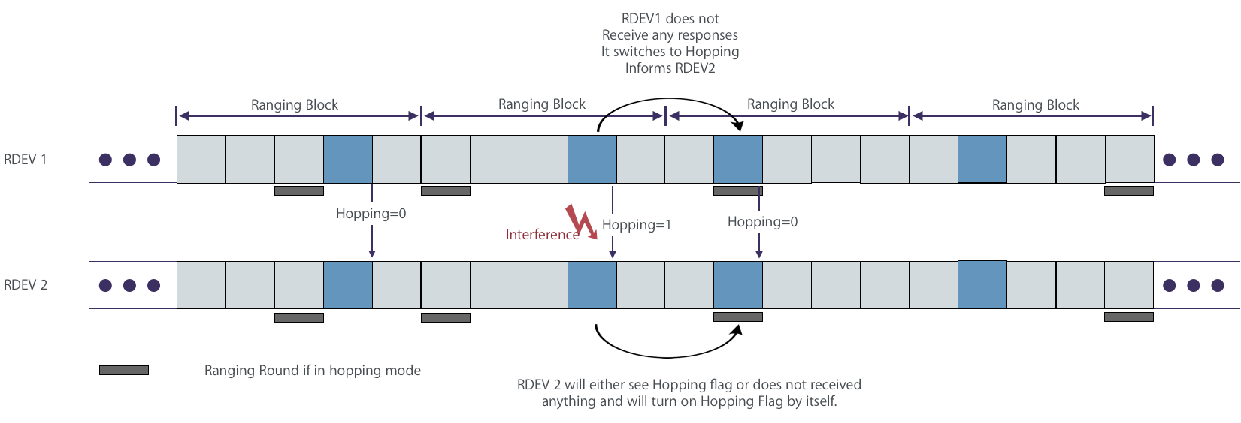
Ranging Failure and Hopping – Example 1
No loss in sync between RDEVs

Slide 8
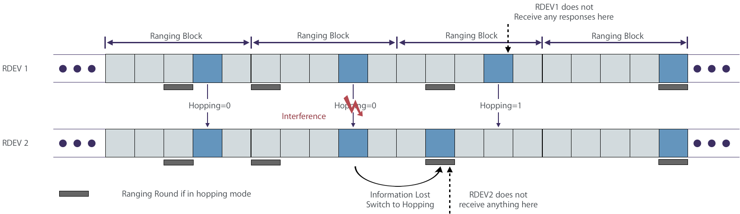
Ranging Failure and Hopping – Example 2
Sync between RDEVs is lost for 1 ranging round only

Slide 9
Why Different Hopping Modes? - 1
Uniform random hopping will work fine for some of the cases
Uniform random hopping, however, will result in a MAC sampling noise in use cases where RDEVs are expected to move at a varying speed:
  Uniform random hopping can results in non-uniform sampling in both location and velocity which may degrade the localization algorithm.
Proposed MAC design addresses this by adding random walk hopping option.

Slide 10
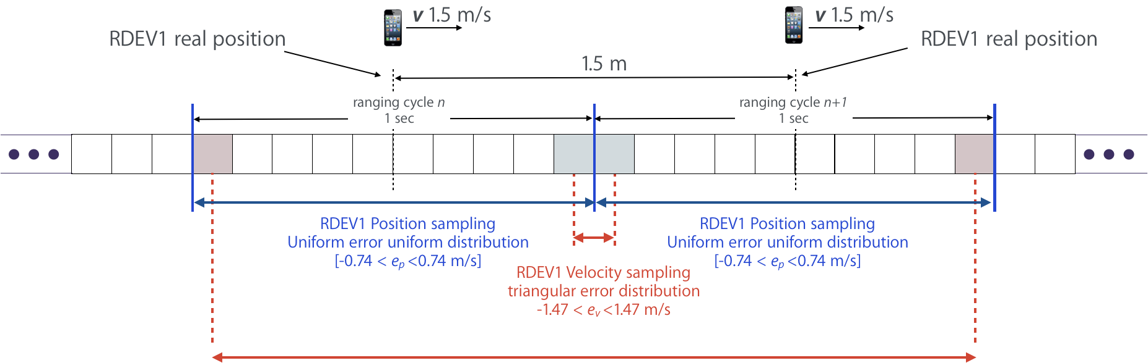
Why Different Hopping Modes? - 2
Ranging Frequency (Hz) | Trilateration |  |  | 1st Order Prediction
 | Uniform error distribution |  |  | Triangular error distribution
 | 𝝁_{e} [e_{min},e_{max}] 𝝈_{e} |  |  | 𝝁_{e} [e_{min},e_{max}] 𝝈_{e}
0.05 | 0 | ±14.88m | 8.65m | 0 | ±29.97m | 12.24m
0.3 | 0 | ±2.49m | 1.43m | 0 | ±4.97m | 2.03m
1 | 0 | ±0.74m | 0.42m | 0 | ±1.47m | 0.6m
5 | 0 | ±10.24m | 0.14m | 0 | ±0.47m | 0.19m
20 | 0 | ±0.02m | 0.01m | 0 | ±0.05m | 0.02m

