Slide 1
Project: IEEE P802.15 Working Group for Wireless Personal Area Networks (WPANs)
Submission Title: [PHY/MAC enhancements for Secure Ranging Devices]
Date Submitted: [16 January 2019]
Source: David Barras [3db Access, Switzerland],
Huan-Bang Li, Kenichi Takizawa, Fumihide Kojima [NICT, Japan],
Hisashi Nishikawa [Global Interface Technologies Japan, Japan]
Boris Danev [3db Access, Switzerland],
Bernd Baer [Marquardt, Germany],
Peter Sauer [Microchip Technology, Germany].
Re: [Changes proposal for the LRP UWB PHY]
Abstract: [Contribute to a proposal to the enhanced impulse radio group w.r.t. the LRP UWB PHY ]
Purpose: [To open a discussion on LRP band allocation in regards to the recent & future regulation change]
Notice: This document has been prepared to assist the IEEE P802.15. It is offered as a basis for discussion and is not binding on the contributing individual(s) or organization(s). The material in this document is subject to change in form and content after further study. The contributor(s) reserve(s) the right to add, amend or withdraw material contained herein.
Release: The contributor acknowledges and accepts that this contribution becomes the property of IEEE and may be made publicly available by P802.15.

Slide 2
Scope
Open discussion on LRP band allocation
Motivation
Enhancing interoperability & fitting upcoming regulation changes

Slide 3
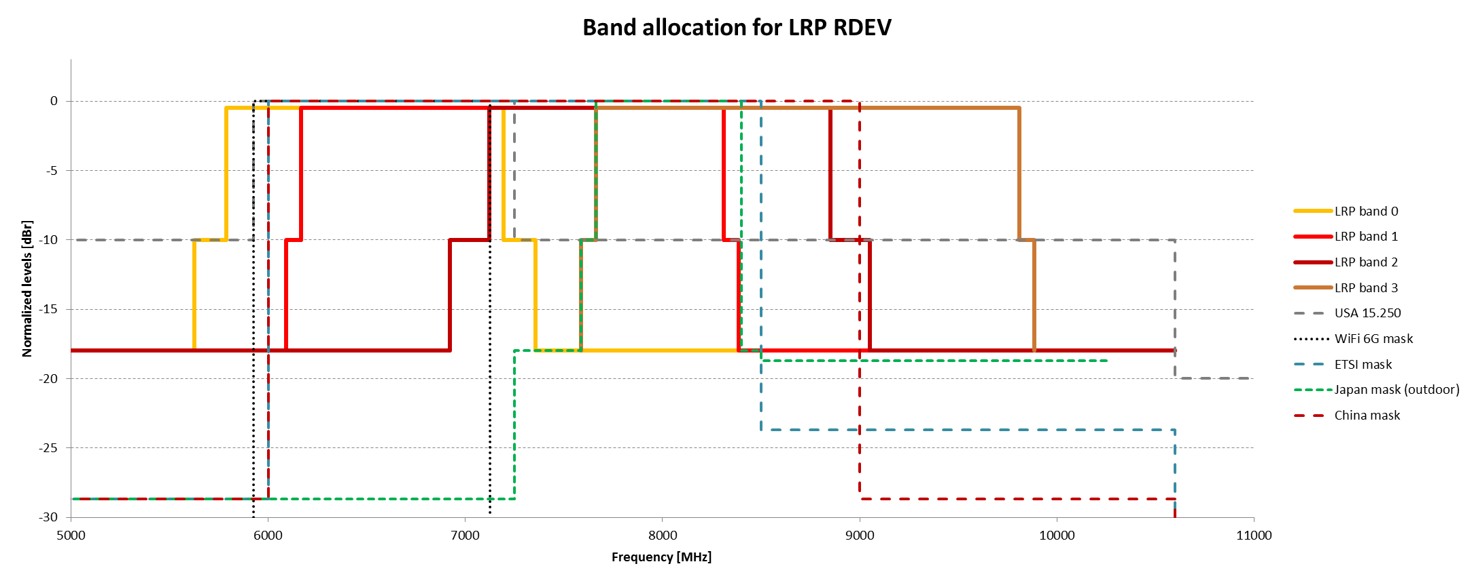
Channel frequencies and bandwidth
    Band allocation as per 802.15.4 – 2015 and 15-8-0432
    Some of these bands are no longer optimally fitting recent regulations changes & proposals
    Does recent & future regulation changes force band allocation of 4z to adapt ?

Slide 4
LRP SRDEV Frequency Allocation (1/2)
4z is an opportunity to propose new LRP SRDEV bands to optimally cover and match worldwide regulations, while keeping the “wideband” channels as is
  6 channel w/ BW>600 MHz, SRDEV band 2 same fc than LRP band 2 and HRP band 9
  Channel separation: 652.8 MHz (= 17∙ 38.4 MHz)

Slide 5
LRP SRDEV Frequency Allocation (2/2)
Worldwide compliance:
  SRDEV 0 starts at f_{L}>6000 MHz and thus matches all UWB regulations
  SRDEV 0 covers optimally FCC 15.250 (but can be affected by 6 GHz RLAN)
  SRDEV 0…2 cover optimally EU regulation (outdoor automotive only)
  SRDEV 0…3 cover China regulation (outdoor)
  SRDEV 2 for Japan outdoor
SRDEV bands: | 0 | 1 | 2 | 3 | 4 | 5
f_{c} [MHz] BW [MHz]* | 6681.6 620 | 7334.4 620 | 7987.2 620 | 8640 620 | 9292.8 620 | 9945.6 620
USA | x (outdoor) | x (indoor) | x (indoor) | x (indoor) | x (indoor) | x (indoor)
ETSI | x | x | x
China | x (outdoor) | x (outdoor) | x (outdoor) | x (outdoor)
Japan |  |  | x (outdoor)
* mask for channel not fully defined yet

Slide 6
Summary
LRP UWB already agreed to have a large bandwidth channel allocation in the motion-carried baseline. That feature must be kept for applications seeking channels with large bandwidth. Previous LRP wideband channels are kept.
In parallel to large bandwidth channel allocation, LRP UWB will develop a “small bandwidth” channel allocation, which may enhance SRDEV interoperability and compliance with recent and upcoming regulation changes.
The “small bandwidth” plan is as shown in slide 5 using channel separation of 652.8 MHz (= 17 * 38.4 MHz) and aligning center channel SRDEV2 to LRP2 & HRP9, the minimum bandwidth of 400 MHz is kept.
All proposed bands are defined as non-mandatory and their use by RDEV or SRDEV may depend on the region where they operate.

Slide 7
Q&A

Slide 8
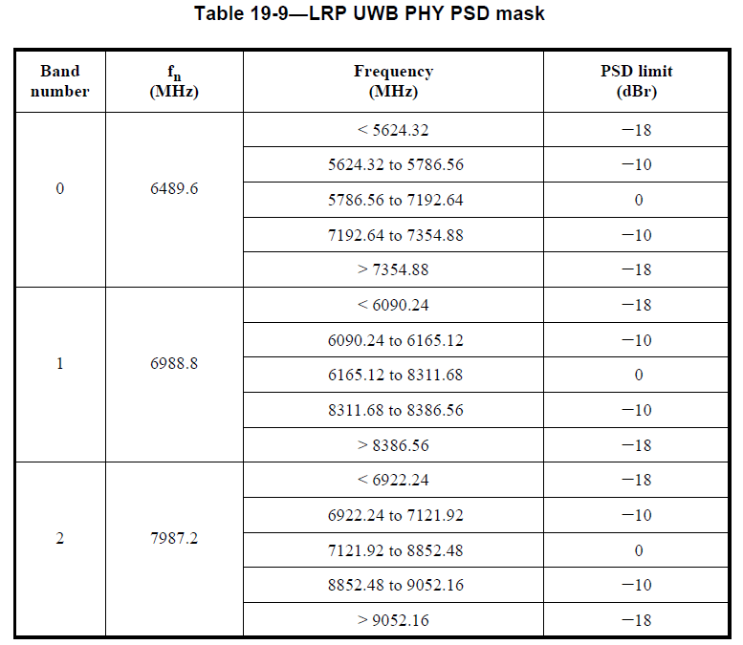
APPENDIX – LRP “wideband” channels
Actual status (802.15.4 – 2015 )
and 15-18-0432 doc contribution
3 | 8486.4 | <7587.84 | -18
 |  | 7587.84 to 7662.72 | -10
 |  | 7662.72 to 9809.28 | 0
 |  | 9809.28 to 9884.16 | -10
 |  | > 9884.16 | -18

Slide 9
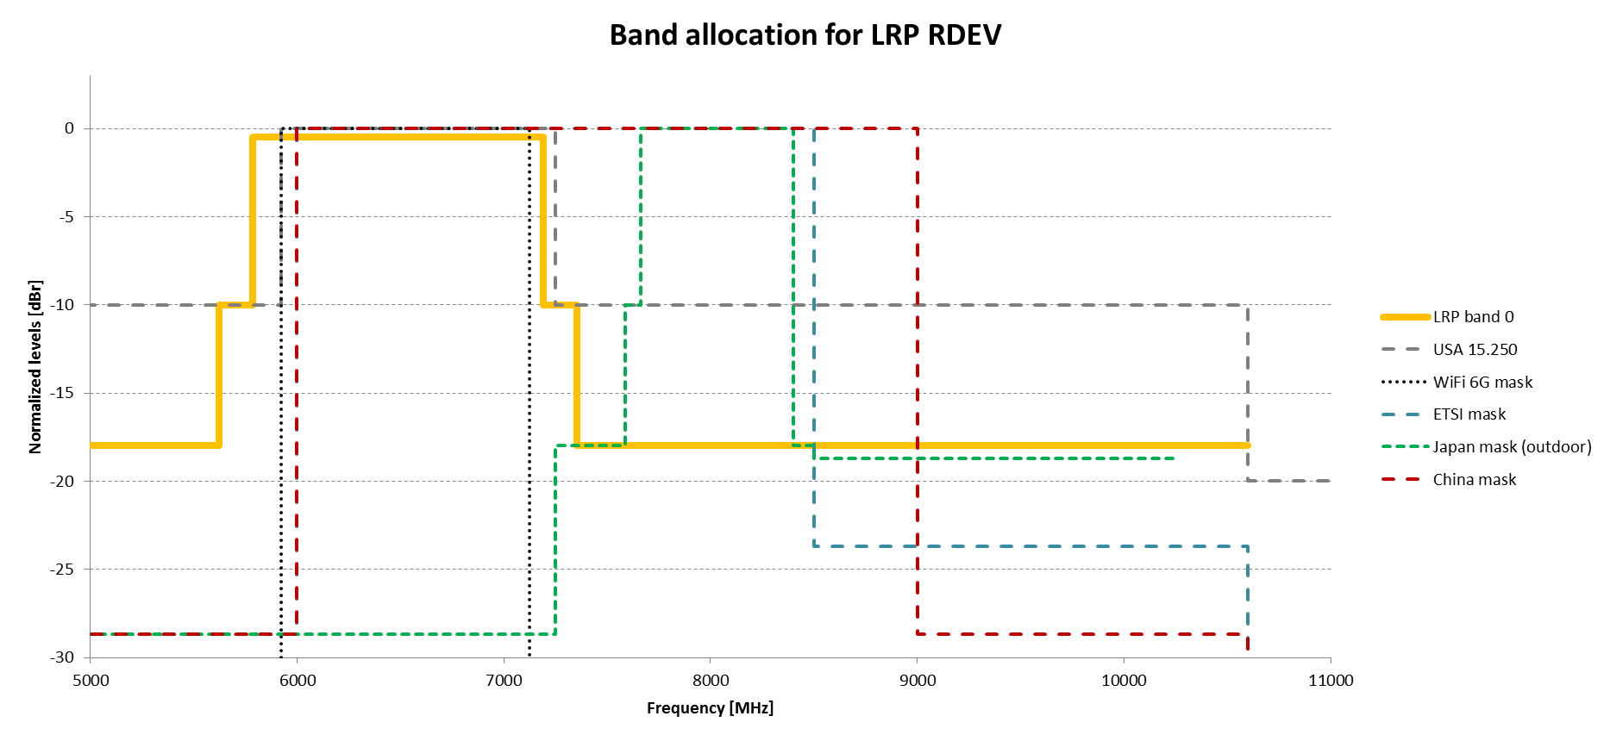

Slide 10
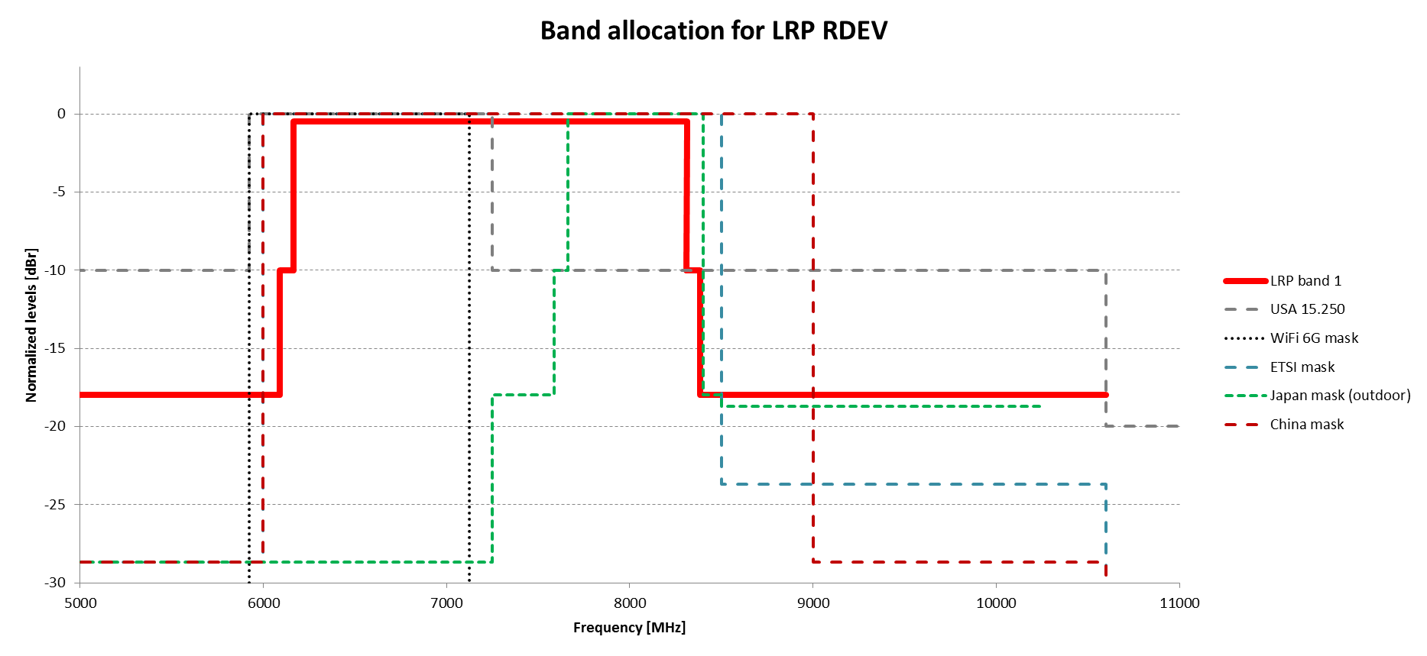

Slide 11
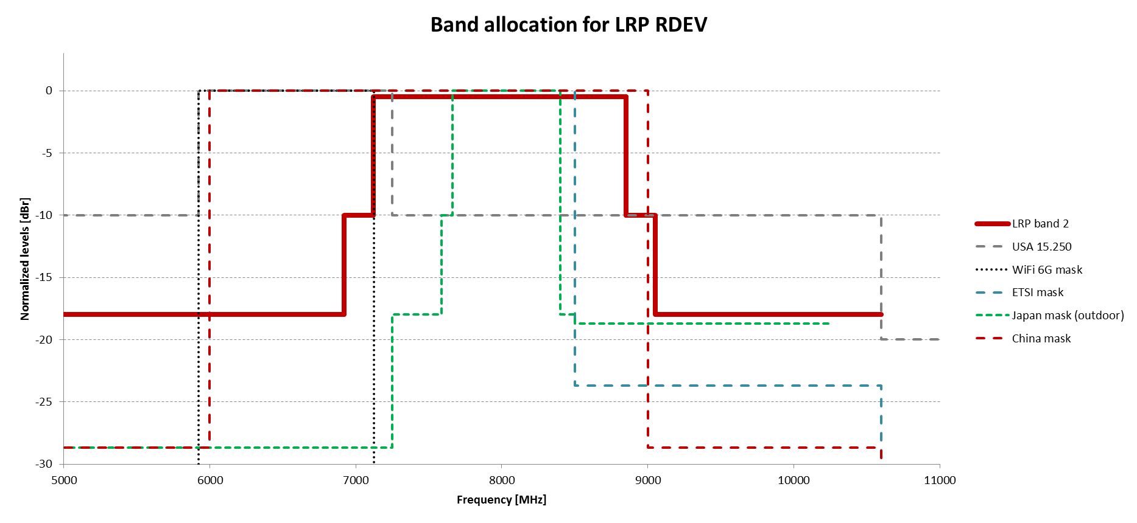

Slide 12
