Slide 1
Project: IEEE P802.15 Working Group for Wireless Personal Area Networks (WPANs)
Submission Title: [Rate 1/4 LDPC interleaver proposal]
Date Submitted: [14 January, 2019]
Source: [Johannes Wechsler] Company [Fraunhofer Institute for Integrated Circuits IIS]
Address [Nordostpark 84, Nuremberg, 90411, Bavaria]
Voice:[ +49 911 58061-3334], FAX: [+49 911 58061-3299], E-Mail:[johannes.Wechsler@iis.fraunhofer.de]
Re: [Proposal of LDPC (Low Density Parity Check) Code for LPWA – additional, IEEE 802.15-18-0399-00-004w]
Abstract: [Proposal of a new interleaver for the proposed Rate 1/4 LDPC code to improve radio-burst erasure performance.]
Purpose: [Show performance of new interleaver for LDPC code to incorporate these in the draft.]
Notice: This document has been prepared to assist the IEEE P802.15. It is offered as a basis for discussion and is not binding on the contributing individual(s) or organization(s). The material in this document is subject to change in form and content after further study. The contributor(s) reserve(s) the right to add, amend or withdraw material contained herein.
Release: The contributor acknowledges and accepts that this contribution becomes the property of IEEE and may be made publicly available by P802.15.

Slide 2
Rate 1/4 LDPC interleaver proposal
Johannes Wechsler
Fraunhofer IIS

Slide 3
Outline
Iterative Decoding
Current Interleaver
Proposal for new interleaver for Rate 1/4 LDPC
Simulation results

Slide 4
Iterative Decoding
Performance degradation at low SNR due to short SHR
Channel estimation difficult with little known symbols
Low symbol rates of LPWA won’t allow quasi static channels over the complete packet due to the long on air time
Iterative decoding
Allow partially decoding of the first bits after the SHR
Use these bits to run another round of channel estimation
Run the iteration multiple times until decoding is complete
→ Improve FEC performance due to better LLR estimation at low SNR

Slide 5
Current circularly shifted block interleaver proposed for all FEC
sub-packet 1
sub-packet 2
sub-packet 3
sub-packet 4
sub-packet J-1
sub-packet J
p₀
p₀
p₀
p₀
p₀
p₀
p₁
p₁
p₁
p₁
p₁
p₁
SHR
p_{M-2}
p_{M-2}
p_{M-2}
p_{M-2}
p_{M-2}
p_{M-2}
p_{M-1}
p_{M-1}
p_{M-1}
p_{M-1}
p_{M-1}
p_{M-1}
c₀
c₁
c₂
c₃
c_{J-2}
c_{J-1}
c_{2J-1}
c_{J}
c_{J+1}
c_{J+2}
c_{2J-3}
c_{2J-2}
c_{3J-2}
c_{3J-1}
c_{2J}
c_{2J+1}
c_{3J-4}
c_{3J-3}
c_{4J-3}
c_{4J-2}
c_{4J-1}
c_{3J}
c_{4J-5}
c_{4J-4}
c_{IJ-2}
c_{IJ-1}
c_{(I-1)J+1}
c_{(I-1)J+2}
c_{IJ-4}
c_{IJ-3}

Slide 6
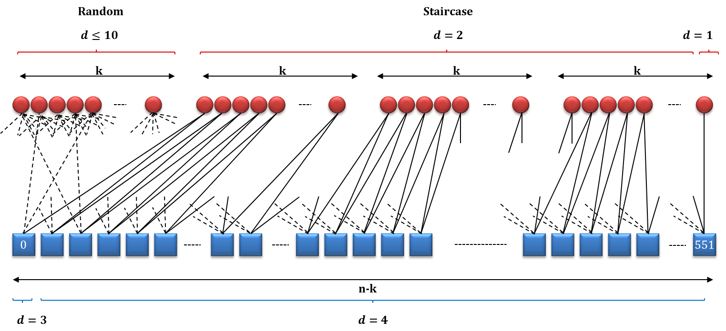
LDPC Code in detail
736 variable nodes:
552 check nodes:

Slide 7
LDPC Structure
First k = 184 bits represent systematic part
Connection from variable to check nodes “random”
Remaining 3 * k = 552 bit represent redundancy
Connection from variable to check nodes in “staircase” structure
Iterative decoding of LDPC not possible with current interleaver
First check nodes don’t necessarily get information from the first bits after the SHR
Staircase will allow iterative decoding, as they introduce a “step-by-step structure”

Slide 8
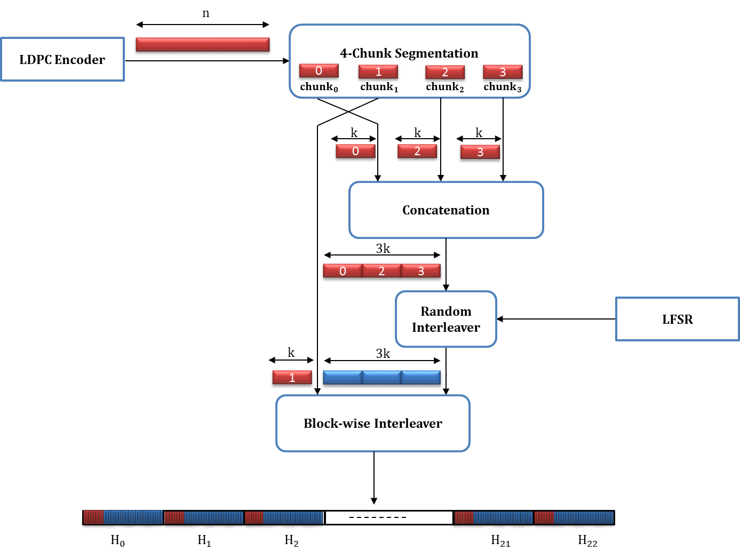
Proposed Hybrid Interleaver

Slide 9
Proposed Hybrid Interleaver
Split codeword in 4 chunks
Bring 184 staircase variable node bits of chunk one to the front
Spread these bits in a block interleaver fashion in pairs of two over the radio-bursts
Bit 0,1 go to burst 0
Bit 2,3 go to burst 1
…
Combine remaining variable node bits to one block
Pseudo randomly scramble this block
Fill remaining bits of the radio bursts with these bits
Bit 0,1…23 of the scrambled block go to burst 0
Bit 24,25,…,47 of the scrambled block go to burst 1
…

Slide 10
Performance Comparison 0 erased radio-bursts

Slide 11
Performance Comparison 1 erased radio-bursts

Slide 12
Performance Comparison 2 erased radio-bursts

Slide 13
Performance Comparison 4 erased radio-bursts

Slide 14
Performance Comparison 8 erased radio-bursts

Slide 15
Performance Comparison 10 erased radio-bursts

Slide 16
Performance Comparison 12 erased radio-bursts

Slide 17
Performance Comparison 14 erased radio-bursts

Slide 18
Performance Comparison 15 erased radio-bursts

Slide 19
Performance Comparison 16 erased radio-bursts

Slide 20
Conclusion
Performance of proposed interleaver beats current block interleaver for LDPC codes
~1dB gain when 15 radio-bursts are erased
Allows for iterative decoding schemes for LDPC FEC

Slide 21
Thank you!
Any questions or suggestions?

Slide 22
TG Motion #
Move to incorporate the usage of the newly proposed Interleaver for the Rate 1/4 LDPC code into the draft.
Moved by:
Seconded by:
Motion

