Slide 1
Project: IEEE P802.15 Working Group for Wireless Personal Area Networks (WPANs)
Submission Title: [Proposal of extra control IEs for IEEE 802.15.4z MAC]
Date Submitted: [02 January, 2019]
Source: [Zheda Li, Aditya Vinod Padaki, Mingyu Lee, Seongah Jeong, Boon Loong Ng, Jack Lee (Samsung)]
Re: [Input to the Task Group]
Abstract: [Presentation, possible inclusion in IEEE 802.15.4z MAC]
Purpose: [Presentation, possible inclusion in IEEE 802.15.4z MAC]
Notice: This document does not represent the agreed views of the IEEE 802.15 Working Group. It represents only the views of the participants listed in the “Source(s)” field above. It is offered as a basis for discussion and is not binding on the contributing individual(s) or organization(s). The material in this document is subject to change in form and content after further study. The contributor(s) reserve(s) the right to add, amend or withdraw material contained herein.
Release: The contributor acknowledges and accepts that this contribution becomes the property of IEEE and may be made publicly available by P802.15.

Slide 2
Contents
0. General Descriptions of Ranging
Reference: “IEEE 802.15.4z MAC for Ranging”, Jack Lee, etc. Doc: <15-18-0621-00-004z>.
Determine Role of Initiator(s)/Responder(s)
Ranging Scheduling IE
Contention Period IE
NHD ranging control and procedures

Slide 3
General Descriptions for Ranging

Slide 4
Ranging Methods
Ranging Methods of IEEE 802.15.8 are reused
SS-TWR
DS-TWR (w/ three messages)

Slide 5
Ranging Round & Ranging Block
Ranging Round
Ranging Round refers to the completion of the entire ranging event between the initiator(s) and the responder(s) of the UWB network
Ranging Round consists of multiple Ranging Slots
Ranging Block
Ranging Block refers to a time frame for secure ranging
Ranging Block consists of multiple Ranging Rounds
Ranging Block
Ranging Round 1
Ranging Round 2
Ranging Round 3
Ranging Round 4
Ranging Round N
Ranging
Slot 1
Ranging
Slot 2
Ranging
Slot 3
……
Ranging
Slot M

Slide 6
Numerology
TU is defined as the minimum MAC time step in PHY units
Slot is defined as integer number of TUs
Round is defined as integer number of Slots
Block length is defined as integer multiple of MinimumBlockLength
MinimumBlockLength is defined as an integer number of TUs

Slide 7
Ranging Round
Ranging Round consists of one or more polling periods (PP) and one or more ranging response periods (RRP)
PP is the period used by the initiator(s) to communicate to the responder(s)
RRP is the period used by responder(s) to communicate to the initiator(s)
<SS-TWR>
RCF
Ranging Control Frame : Sent by controller
RCF
P₁
R₁
R₂
R₃
R_{N}
PP
RRP
P_{m}
Polling message m: Sent by initiator m
<DS-TWR>
RCF
P₁
R₁
R₂
R₃
R_{N}
P’₁
R_{n}
Response from device n: Sent by responder n
PP
RRP
PP
P’_{m}
Reply final poll message m: Sent by Initiator m
<Many-to-Many (M2M) DS-TWR>
RCF
P₁
P₂
P₃
P_{M}
R₁
R₂
R₃
R_{N}
P’₁
P’₂
P’₃
P’_{M}
PP
RRP
PP

Slide 8
Ranging Configuration (1/2)
Ranging Control Frame is to set Ranging parameters
Ranging Control Frame shall be sent at the beginning of the active Ranging Round(s)
Two device types for ranging control
Ranging Controller
- The device that defines and controls the ranging parameters by sending a Ranging Control Frame
Ranging Controlee
The device that utilizes the ranging parameters received from the ranging controller.
There can be one or more controlees managed by the controller.
Controller
Controlee
Ranging Control Frame

Slide 9
Ranging Configuration (2/2)
Two device types for ranging
Initiator
- Device initiates ranging by sending a Poll
Responder
- Device responds to Poll received from Initiator
Controller
Controlee
Controller
Controlee
Ranging Control Frame
Ranging Control Frame
Initiator
Responder
Responder
Initiator
Poll
Poll

Slide 10
Determine Role of Initiator(s)/Responder(s)

Slide 11
Ranging Control IE
Reference: “IEEE 802.15.4z MAC for Ranging”, Jack Lee, etc. Doc: <15-18-0621-00-004z>.
Poll mode works: Unicast
Poll mode cannot work: Multicast/M2M
Controller shall be able to determine any device to be the initiator/responder
Parameters | Size | Value | Description
Poll Mode | 1 bit | 0: Controller 1: Controlee | Indicates whether a Controller (0) or a Controlee (1) will be the initiator.
Secure Mode | 2 bits | 00: Normal 01: Secure w/o Payload 10: Secure w Payload 11: Reserved | Indicates whether the ranging frame has no STS with payload (0), STS without Payload(1), STS with Payload(2)
Cast Mode | 2 bits | 00: Unicast 01: Multicast 10: Broadcast 11: Many-2-Many | Indicates whether the transmission is Unicast (00), Multicast (01), Broadcast (10), or Many-to-Many (11).
Multicast Mode | 1 bit | 0: Contention 1: Scheduled | Indicates whether the ranging is contention based (0) or scheduled (1). Applies when Cast Mode is 01 or 11.
Ranging Mode | 1 bit | 0: SS-TWR 1: DS-TWR | Indicates if the ranging is SS-TWR (0) i.e., no final reply poll; or DS-TWR (1) i.e., includes a final reply poll.
Time Structure Indicator | 1 bit | 0: Invoking Interval Update IE 1: Invoking Interval Update IE and Block Structure IEs | Indicates if the Interval IE is invoked (0) i.e., Interval based mode; or Interval Update IE and Block Structure Block Structure IEs are invoked (1) i.e., Block based mode
MinimumBlockLength | TBD | # of TU | Specifies the length (duration) of minimum length of Ranging Block
Multiplier for MinimumBlockLength | TBD | Integer | Indicates the multiplier for MinimumBlockLength to calculate the length of Ranging Block
Length of Ranging Slot | TBD | # of TU | Specifies the length (duration) of each Ranging Slot
Length of Ranging Round | TBD | # of slots | Specifies the length (duration) of Ranging Round
# of Ranging Rounds | TBD | integer | Specifies the number of Ranging Rounds in a Ranging Block
Deferred | 1 bit | 0: No need to use deferred frame 1: Need to use deferred frame | Indicates whether the deferred frame is required or not

Slide 12
Inclusion of Initiator/Responder List (IRL) IE in RC frame/pre-poll
Content fields of Initiator/Responder List (IRL) IE
IRT Table Length: number of rows in IRT Table=number of devices
Initiator/responder table (IRT)
Each row of IRT Table
Address of device+ initiator indicator
Octets : 1 | Variable
IRT Table Length | IRT
Octets : 2/6/8 | Bits: 1
Address field | 0: responder; 1: initiator
Notes:
- RRTM은 DS-TWR의 3번째

Slide 13
Ranging Scheduling IE

Slide 14
Current Ranging Scheduling IE
Reference: “IEEE 802.15.4z MAC for Ranging”, Jack Lee, etc. Doc: <15-18-0621-00-004z>.
Applicable for the use case with one initiator and multiple responders, while the initiator is the controller.
Not applicable for use cases: there can be more than one initiators, and controller can also be a responder.
Parameters | Size | Value | Description
Address/ID | Variable | MAC address or Group ID | Gives the schedule of the responders by specifying the MAC address or group ID in the sequential order of the schedule when Multicast Mode is 1

Slide 15
Modified Ranging Scheduling (RS) IE
Content fields of RS IE:
RS Table Length indicates the row of RS Table, which is the number of time slots used for scheduling.
Ranging Scheduling (RS) Table:
Each row of RS Table
First octet indicates the slot index, while the next octet is the address of the assigned device.
RCF/Pre-poll conveys RS IE
Scheduling for one or more active rounds
Octets : 1 | Variable
RS Table Length | RS Table
Octets : 1 | Octets: 2/6/8 | Bits: 1
Slot index | Address field | 0: responder 1: initiator

Slide 16
Contention Period IE

Slide 17
Configuration of Poll/Response Periods for Contention-Based Ranging
Contention-based M2M ranging:
Broadcast ranging is a special case: one initiator
Configurations:
Option 1: after the RC-frame, let one round to be the contention period for all initiators and responders.
Option 2: after the RC-frame, divide a round into multiple contention periods, e.g., P-R (SS-TWR), P-R-P (DS-TWR).
<SS-TWR>
RCF
P1
R1
R₂
R₃
R_{N}
PP
RRP
<DS-TWR>
RCF
P₁
R₁
R₂
R₃
R_{N}
P’₁
PP
RRP
PP
<Many-to-Many (M2M) DS-TWR>
RCF
P₁
P₂
P₃
P_{M}
R₁
R₂
R₃
R_{N}
P’₁
P’₂
P’₃
P’_{M}
PP
RRP
PP
Notes:
- RRTM은 DS-TWR의 3번째

Slide 18
Inclusion of Contention Period IE in the RC frame/pre-poll
Contention period (CP) IE
CP Table Length indicates the number of rows in CP Table, i.e., the number of PP/RRP
Contention Period (CP) Table:
Each row of CP Table
First bit indicates PP or RRP
Later two octets indicate the start index and end index of time slot
Octets : 1 | Variable
CP Table Length | CP Table
Bits: 1 | Octets : 1 | Octets : 1
0: PP 1: RRP | Time-slot index to start | Time-slot index to end
Notes:
- RRTM은 DS-TWR의 3번째

Slide 19
NHD Ranging Control and Procedures

Slide 20
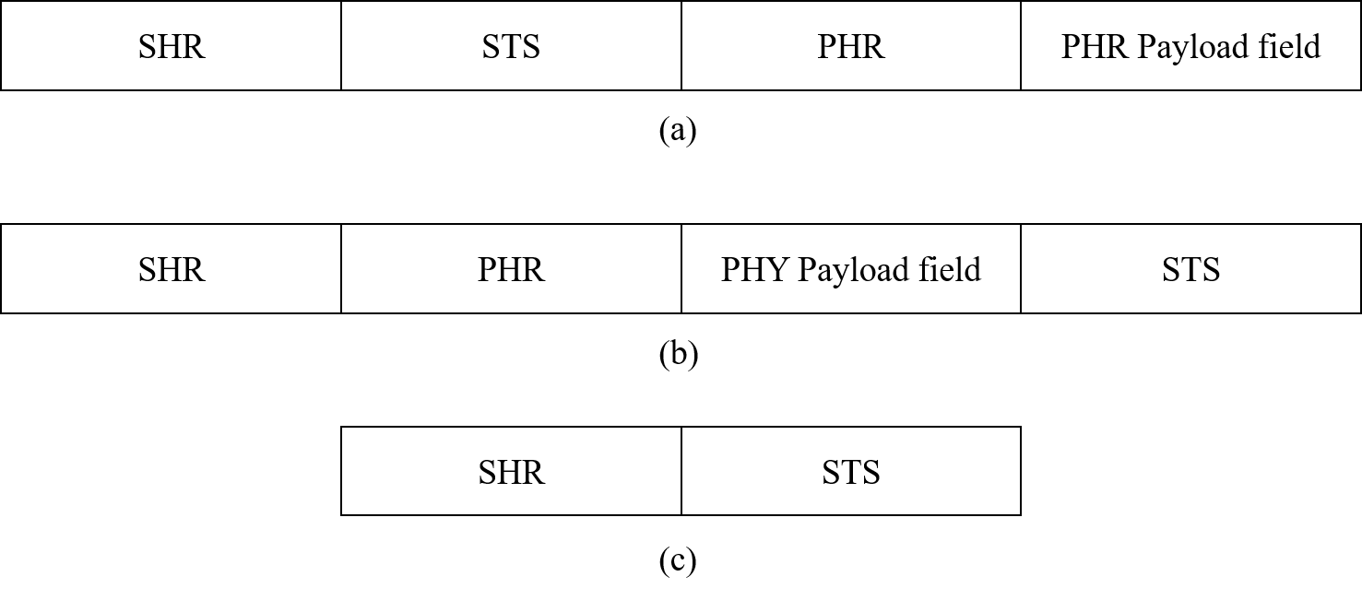
PPDU Format of Secure Ranging
Reference: “HRP UWB PHY enhanced mode consensus”, Billy Verso, etc. Doc.: <15-18-0477-00-004z>
Normal secure ranging: format (a) and (b)
NHD (No Header or Data) secure ranging: format (c)
To support NHD secure ranging, new control IEs and ranging procedures shall be included.

Slide 21
NHD Ranging Request AOA IE
NHD Ranging Request AOA (NRRA) IE can be used in RC frame/pre-poll to indicate a request of AOA from a requester to a provider.
For scheduled unicast/multicast/M2M ranging, NRRA IE content shall include address fields for both requester and provider, respectively.
For contention-based broadcast/M2M mode, NHD ranging is not applicable, and no need to use this IE.
Octets : 0/2/6/8 | Octets : 0/2/6/8
Requestor Address | Provider Address

Slide 22
NHD Ranging Request Reply Time IE
NHD Ranging Request Reply Time (NRRRT) IE can be used in RC frame/pre-poll to indicate a request of reply time from a requester to a provider.
For scheduled unicast/multicast/M2M ranging, NRRRT IE content shall include address fields for both requester and provider, respectively.
For contention-based broadcast/M2M mode, NHD ranging is not applicable, and no need to use this IE.
Octets : 0/2/6/8 | Octets : 0/2/6/8
Requestor Address | Provider Address

Slide 23
NHD Ranging Request Round-Trip Measurement IE
NHD Ranging Request Round-Trip Measurement (NRRRTM) IE can be used in RC frame/pre-poll to indicate a request of round-trip measurement from a requester to a provider.
For scheduled unicast/multicast/M2M ranging, NRRRTM IE content shall include address fields for both requester and provider, respectively.
For contention-based broadcast/M2M mode, NHD ranging is not applicable, and no need to use this IE.
Octets : 0/2/6/8 | Octets : 0/2/6/8
Requestor Address | Provider Address

Slide 24
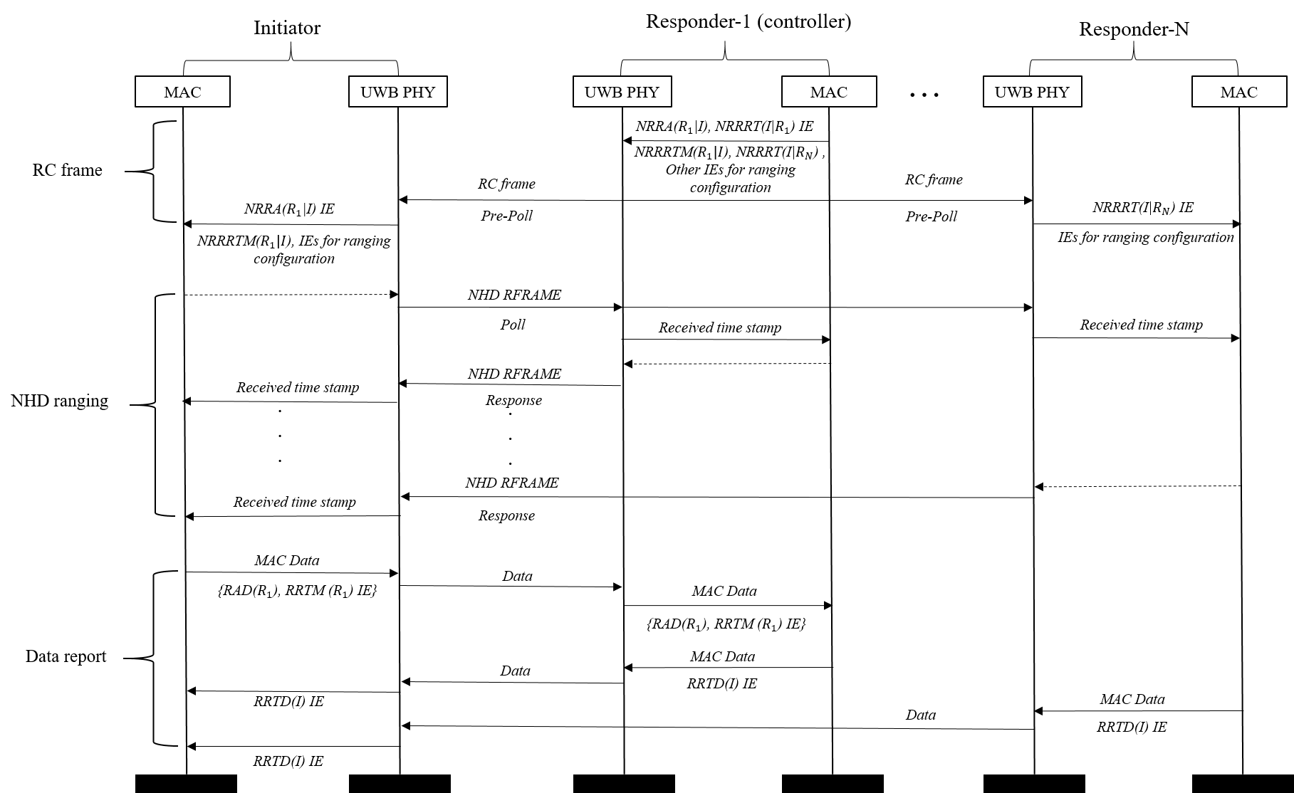
Message exchange chart: NHD multicast SS-TWR
Assumption: controller knows the requests of other devices.
A round: RC frame/pre-poll, NHD ranging, and data report period.
Device transmits the requested data via scheduled time slot within the data report period.
Existed time-stamp IEs in IEEE 802.15.8 can be used in the data report period.

Slide 25
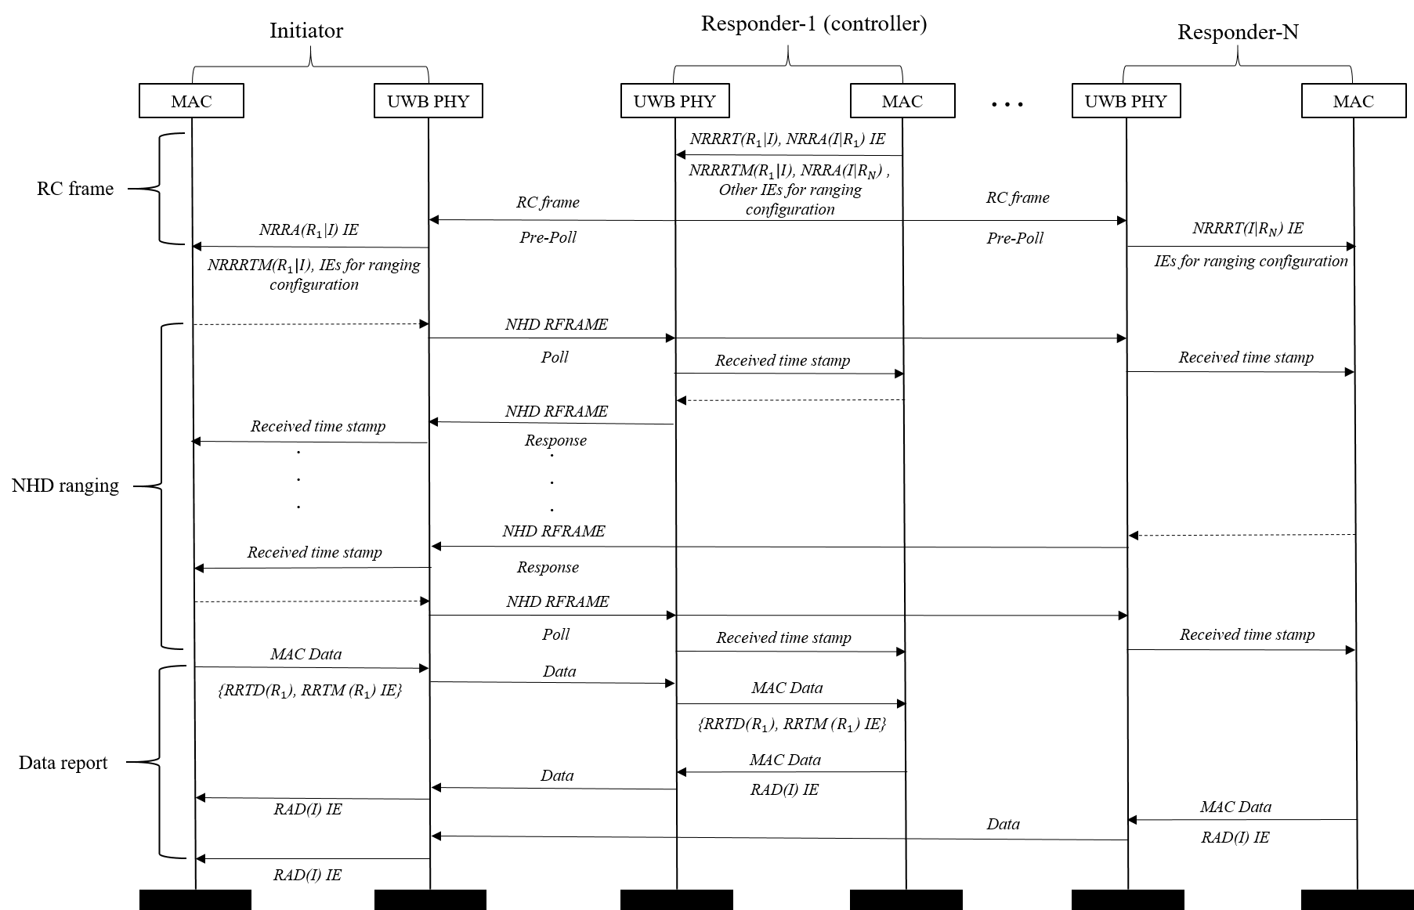
Message exchange chart: NHD multicast DS-TWR
Similar procedure: a second poll is included.
Procedures for multicast NHD SS-TWR/DS-TWR can be directly generalized to M2M use case, which are omitted here

