Slide 1
Project: IEEE P802.15 Working Group for Wireless Personal Area Networks (WPANs)
Submission Title: [IEEE 802.15.4z MAC for Ranging]
Date Submitted: [20 December, 2018]
Source: [Jack LEE (Samsung), Mingyu Lee (Samsung), Zheda Li(Samsung), SeongAh Jeong (Samsung), Aditya Vinod Padaki (Samsung), Ayman Naguib (Apple), Tushar Shar (Apple), Robert Golshan (Apple), Brima Ibrahim (NXP), Frank Leong (NXP), Rias Al-kadi (NXP), Hendrik Ahlendorf(NXP), Diwakar Subraveti(NXP)]
Re: [Input to the Task Group]
Abstract: [Presentation, possible inclusion in IEEE 802.15.4z MAC]
Purpose: [Presentation, possible inclusion in IEEE 802.15.4z MAC]
Notice: This document does not represent the agreed views of the IEEE 802.15 Working Group. It represents only the views of the participants listed in the “Source(s)” field above. It is offered as a basis for discussion and is not binding on the contributing individual(s) or organization(s). The material in this document is subject to change in form and content after further study. The contributor(s) reserve(s) the right to add, amend or withdraw material contained herein.
Release: The contributor acknowledges and accepts that this contribution becomes the property of IEEE and may be made publicly available by P802.15.

Slide 2
Contents
General Descriptions for Ranging
Ranging IEs for Configuration
Ranging IEs for SS-TWR/DS-TWR
Examples of Ranging Message Sequences
Use Cases of SS-TWR
Use Cases of DS-TWR

Slide 3
General Descriptions for Ranging

Slide 4
Ranging Methods
Ranging Methods of IEEE 802.15.8 are reused
SS-TWR
DS-TWR (w/ three messages)

Slide 5
Ranging Round & Ranging Block
Ranging Round
Ranging Round refers to the completion of the entire ranging event between the initiator(s) and the responder(s) of the UWB network
Ranging Round consists of multiple Ranging Slots
Ranging Block
Ranging Block refers to a time frame for secure ranging
Ranging Block consists of multiple Ranging Rounds
Ranging Block
Ranging Round 1
Ranging Round 2
Ranging Round 3
Ranging Round 4
Ranging Round N
Ranging
Slot 1
Ranging
Slot 2
Ranging
Slot 3
……
Ranging
Slot M

Slide 6
Numerology
TU is defined as the minimum MAC time step in PHY units
Slot is defined as integer number of TUs
Round is defined as integer number of Slots
Block length is defined as integer multiple of MinimumBlockLength
MinimumBlockLength is defined as an integer number of TUs

Slide 7
Ranging Round
Ranging Round consists of one or more polling periods (PP) and one or more ranging response periods (RRP)
PP is the period used by the initiator(s) to communicate to the responder(s)
RRP is the period used by responder(s) to communicate to the initiator(s)
<SS-TWR>
RCF
Ranging Control Frame : Sent by controller
RCF
P₁
R₁
R₂
R₃
R_{N}
PP
RRP
P_{m}
Polling message m: Sent by initiator m
<DS-TWR>
RCF
P₁
R₁
R₂
R₃
R_{N}
P’₁
R_{n}
Response from device n: Sent by responder n
PP
RRP
PP
P’_{m}
Reply final poll message m: Sent by Initiator m
<Many-to-Many (M2M) DS-TWR>
RCF
P₁
P₂
P₃
P_{M}
R₁
R₂
R₃
R_{N}
P’₁
P’₂
P’₃
P’_{M}
PP
RRP
PP

Slide 8
Ranging Configuration (1/2)
Ranging Control Frame is to set Ranging parameters
Ranging Control Frame shall be sent at the beginning of the active Ranging Round(s)
Two device types for ranging control
Ranging Controller
- The device that defines and controls the ranging parameters by sending a Ranging Control Frame
Ranging Controlee
The device that utilizes the ranging parameters received from the ranging controller.
There can be one or more controlees managed by the controller.
Controller
Controlee
Ranging Control Frame

Slide 9
Ranging Configuration (2/2)
Two device types for ranging
Initiator
- Device initiates ranging by sending a Poll
Responder
- Device responds to Poll received from Initiator
Controller
Controlee
Controller
Controlee
Ranging Control Frame
Ranging Control Frame
Initiator
Responder
Responder
Initiator
Poll
Poll

Slide 10
Ranging Modes : Interval based Mode
Ranging block length is multiple of MinimumBlockLength, and can be adjusted
There can be multiple active ranging rounds within a ranging block.
Ranging Interval is multiple of MinimumBlockLength plus multiple of length of slot
Interval based Mode
Ranging Interval
Multiple of
MinimumBlockLength
Multiple of
length of slot
Ranging Block
Ranging Block
Ranging Round 1
Ranging Round N
Ranging Round 1
Ranging Round M
* Ranging Block = Multiple of MinimumBlockLength

Slide 11
Ranging Modes : Block based Mode
Ranging block length is multiple of MinimumBlockLength, and can be adjusted
Time schedule for next active ranging round is repeatedly transmitted block-by-block: block, round, and slot index for the next active ranging round to start
Referring to the selected ranging block and the selected ranging round, the active ranging round of a block starts with a randomly selected slot offset
Active
Inactive
Block based Mode
Multiple of Ranging block length
Ranging Block 1
Ranging Block 2
Ranging Block N
Ranging Round
round
Ranging Round
Ranging Block
= Multiple of MinimumBlockLength
slot offset
Scheduled time for next active ranging round

Slide 12
Ranging IEs for Configuration

Slide 13
Ranging IEs for Configuration
IE Name | Acronym
Ranging Control IE | RC IE
Ranging Interval Update IE | RIU IE
Ranging Round Start IE | RRS IE
Next Ranging Round IE | RNRR IE
Ranging Block Update IE | RFU IE
Ranging Scheduling IE | RS IE
Ranging Next Channel and Preamble IE | RNCP IE
Ranging Max Retransmission IE | RMR IE
Ranging STS Index IE | RSI IE

Slide 14
Ranging Control IE
Parameters | Size | Value | Description
Poll Mode | 1 bit | 0: Controller 1: Controlee | Indicates whether the device to send the poll is a Controller (0) or a Controlee (1)
Secure Mode | 2 bits | 00: Normal 01: Secure w/o Payload 10: Secure w Payload 11: Reserved | Indicates whether the ranging frame has no STS with payload (0), STS without Payload(1), STS with Payload(2)
Cast Mode | 2 bits | 00: Unicast 01: Multicast 10: Broadcast 11: Many-2-Many | Indicates whether the transmission is Unicast (00), Multicast (01), Broadcast (10), or Many-to-Many (11).
Multicast Mode | 1 bit | 0: Contention 1: Scheduled | Indicates whether the ranging is contention based (0) or scheduled (1). Applies when Cast Mode is 01 or 11.
Ranging Mode | 1 bit | 0: SS-TWR 1: DS-TWR | Indicates if the ranging is SS-TWR (0) i.e., no final reply poll; or DS-TWR (1) i.e., includes a final reply poll.
Time Structure Indicator | 1 bit | 0: Invoking Interval Update IE 1: Invoking Interval Update IE and Block Structure IEs | Indicates if the Interval IE is invoked (0) i.e., Interval based mode; or Interval Update IE and Block Structure Block Structure IEs are invoked (1) i.e., Block based mode
MinimumBlockLength | TBD | # of TU | Specifies the length (duration) of minimum length of Ranging Block
Multiplier for MinimumBlockLength | TBD | Integer | Indicates the multiplier for MinimumBlockLength to calculate the length of Ranging Block
Length of Ranging Slot | TBD | # of TU | Specifies the length (duration) of each Ranging Slot
Length of Ranging Round | TBD | # of slots | Specifies the length (duration) of Ranging Round
# of Ranging Rounds | TBD | integer | Specifies the number of Ranging Rounds in a Ranging Block
Deferred | 1 bit | 0: No need to use deferred frame 1: Need to use deferred frame | Indicates whether the deferred frame is required or not

Slide 15
Ranging Interval Update IE
Parameters | Size | Value | Description
Multiplier for MinimumBlockLength | TBD | Integer | Indicates the multiplier for MinimumBlockLength to calculate the Ranging Interval
Multiplier for Length of Ranging Slot | TBD | Integer | Indicates the multiplier for Length of Ranging Slot to calculate the Ranging Interval

Slide 16
Ranging Block Structure IEs : Ranging Round Start IE
Parameters | Size | Value | Description
UWB_Session_ID | 4 | 0 - (2³²-1) | ID of the UWB ranging session
Ranging_Block | 2 | 0 - 65535 | Index of current ranging block
Hopping_Mode | 1 | 0:No Hopping 1:Hopping | Hop mode for the current ranging block as set from the ranging exchange in the previous ranging block
Round_Index | 2 | 0-65535 | The ranging round index for the current ranging block as set from the ranging exchange in the previous ranging block
Slot_Offset | 1 | -127-128 | slot offset of the ranging round in the current block. The setting of Slot_Offset shall maintain the active ranging round within a block.

Slide 17
Ranging Block Structure IEs : Next Ranging Round IE
Parameters | Size | Value | Description
UWB_Session_ID | 4 | 0 - (2³²-1) | ID of the UWB ranging session
Ranging_Block | 2 | 0 - 65535 | Index of next ranging block
Hopping_Mode | 1 | 0:No Hopping 1:Hopping | Hop mode for the next ranging block
Round_Index | 2 | 0-65535 | The ranging round index for the next ranging block
Slot_Offset | 1 | -127-128 | slot offset of the ranging round in the next block

Slide 18
Ranging Block Structure IEs : Ranging Block Update IE
Parameters | Size | Value | Description
UWB_Session_ID | 4 | 0 - (2³²-1) | ID of the UWB ranging session
Updated_Block_Multiplier | 1 | Range = 1 to 255 T_Block = N *Min_Block ms Time Range =48ms to X2 ms | Updated Block Multiplier. Value must be greater than or equal to Min block multiplier set by initiator at session setup.
Round_Length_Update | TBD | # of TU | Updated Round Length
Relative_Block_Index | 2 | 0 - 0xFFFF | Index of first ranging block with updated block length relative to current block

Slide 19
Ranging Scheduling IE
Parameters | Size | Value | Description
Address/ID | Variable | MAC address or Group ID | Gives the schedule of the responders by specifying the MAC address or group ID in the sequential order of the schedule when Multicast Mode is 1

Slide 20
Ranging Next Channel and Preamble IE
Parameters | Size | Value | Description
Next Channel Index | 4 | Channel Index | Specify the channel index of next ranging block
Next Preamble Index | 1 | Channel Index | Specify the preamble index of next ranging block

Slide 21
Ranging Max Retransmission IE
Parameters | Size | Value | Description
Max # of Retransmissions | TBD | integer | specifies the maximum number of retries for response when Casting Mode is 10

Slide 22
Ranging STS Index IE
Parameters | Size | Value | Description
STS_Index | 4 | 0 - (2³²-1) | Index to STS used for the current message
Note: For non-secure STS-based ranging, a similar IE is to be added for plaintext broadcast of STS (key,seed)

Slide 23
Ranging IEs for SS-TWR/DS-TWR

Slide 24
Ranging IEs for SS-TWR/DS-TWR
IE Name | Acronym
Ranging Request Reply Time IE | RRRT IE
Ranging Reply Time Instantaneous IE | RRTI IE
Ranging Reply Time Deferred IE | RRTD IE
Ranging Round Trip Measurement IE | RRTM IE
Ranging Time-of-Flight IE | RTOF IE
Ranging Report Control Double-sided TWR IE | RRCDT IE
Ranging Report Control Single-sided TWR IE | RRCST IE
Ranging Time Report Double-sided TWR IE | RTRDT IE
Ranging Time Report Single-sided TWR IE | RTRST IE
Ranging Request AoA IE | RRA IE
Ranging AoA Instantaneous IE | RAI IE
Ranging AoA Deferred IE | RAD IE

Slide 25
Ranging Request Reply Time IE
Ranging Request Reply Time (RRRT) IE is used as part of a ranging exchange to request a ranging reply time from the remote device participating in the ranging exchange
If RRRT IE is used to request reply time value of a specific device, RRRT IE content shall include MAC address or device ID of target destination.
Otherwise, RRRT IE has a zero-length content field.
Octets : 0/2/8
Device ID/MAC Address

Slide 26
Ranging Reply Time Instantaneous IE
Ranging Reply Time Instantaneous (RRTI) IE content shall be time difference between the receive time of most recently received RFRAME with RRRT IE from a particular source and the transmit time of the RFRAME containing the IE.
Ranging Reply Time Instantaneous IE is appropriate for use where the device is able to accurately pre-determine the transmission time of the frame containing the IE, complete the calculations of time duration between the upcoming transmission and the last received RFRAME in time, and insert this RRTI IE into the transmitted frame.
When RRTI IE is used in multicast/broadcast/M2M frame (e.g., multicast/broadcast/M2M DS-TWR ranging), RRTI IE content shall include MAC address or device ID of source who requests ranging reply time.
In multicast/broadcast/M2M DS-TWR, a device may receive multiple ranging frames with RRRT IE from different devices, so it can embed RRTI IEs, distinguished by address field, into one ranging/data frame, and send it to devices requesting ranging reply time.
Octets : 4 | Octets : 0/2/8
RX to TX Reply Time | Device ID/MAC Address

Slide 27
Ranging Reply Time Deferred IE
Ranging Reply Time Deferred (RRTD) IE content shall be time difference between the receive time of most recently received RFRAME with RRRT IE from a particular source and the transmit time of the responding RFRAME transmitted most recently before the frame containing this IE.
Ranging Reply Time Deferred IE is employed as part of completing two-way ranging exchanges, and used in the case where the device cannot determine the reply time until after the reply has been sent, and in this case the RRTD IE carries the reply time in a subsequent frame.
When RRTD IE is used in multicast/broadcast/M2M frame (e.g., multicast/broadcast/M2M DS-TWR ranging), RRTD IE content shall include MAC address or device ID of source who requests ranging reply time.
Octets : 4 | Octets : 0/2/8
RX to TX Reply Time | Device ID/MAC Address

Slide 28
Ranging Round Trip Measurement IE
Ranging Round Trip Measurement (RRTM) IE content shall be time difference between the transmit time of the RFRAME initiating a round trip measurement and the receive time of the response RFRAME per source address that completes a round trip measurement.
This IE is employed as part of completing double-sided two-way ranging exchange.
When RRTM IE is used in multicast/broadcast frame (e.g., multicast/broadcast DS-TWR ranging), RRTM IE content shall include MAC address or device ID of source of received RFRAME.
Octets : 4 | Octets : 0/2/8
TX to RX round trip time | Device ID/MAC Address

Slide 29
Ranging Time-of-Flight IE
Ranging Time-of-Flight (RTOF) IE is used after a SS-TWR exchange or DS-TWR exchange to report the resultant time-of-flight estimate to the far end if this is requested
When RTOF IE is used in multicast/broadcast/M2M frame (e.g., multicast/broadcast/M2M SS-TWR ranging), RTOF IE content shall include MAC address or device ID of the end that requests time-of-flight.
Octets : 4 | Octets : 0/2/8
Time of Flight | Device ID/MAC Address

Slide 30
Ranging Report Control SS-TWR IE
Ranging Report Control SS-TWR (RRCST) IE is used to control the SS-TWR exchange with the remote device
Address field is for the case where each responder may have different requirements of ranging results from different initiators
Octets : 1 | Octets : 0/2/8
Control Info | Device ID/MAC Address
Control Info value | Meaning
0 | This frame indicates that the responding end does not require TX-to-RX round-trip time and ranging result
1 | This frame indicates that the responding end requires TX-to-RX round-trip time at the end of exchange
2 | This frame indicates that the responding end requires ranging result at the end of exchange

Slide 31
Ranging Time Report SS-TWR IE
Ranging Time Report SS-TWR (RTRST) IE is used after SS-TWR exchange for initiator to report its round trip time estimate to the requesting responder if this is requested so that the responder can calculate the ToF
This is the case when RRCST(1) IE is used
Address field is for the case with many responders to distinguish target responder
Octets : 4 | Octets : 0/2/8
TX to RX round trip time | Device ID/MAC Address

Slide 32
Ranging Report Control DS-TWR IE
Ranging Report Control DS-TWR (RRCDT) IE is used to control the DS-TWR exchange with the remote device
Address field is for the case where each initiator may have different requirements of ranging results from different responders
Octets : 1 | Octets : 0/2/8
Control Info | Device ID/MAC Address
Control Info value | Meaning
0 | This frame is initiating DS-TWR and indicates that the initiating end does not require 1st reply time, 2nd TX-to-RX round-trip time or the ranging result
1 | This frame is initiating DS-TWR and indicates that initiating end requires 1st reply time and 2nd TX-to-RX round-trip time at the end of exchange
2 | This frame is initiating DS-TWR and indicates that initiating end requires ranging result at the end of exchange
3 | This frame is continuing the DS-TWR, forming the request for the 2nd TX-to-RX round-trip measurement

Slide 33
Ranging Time Report DS-TWR IE
Ranging Time Report DS-TWR (RTRDT) IE is used after DS-TWR exchange for responder to report its reply time estimate and round trip time estimate to the initiator so that initiator can calculate the time-of-flight
This is the case When RRCDT(1) IE is used
Address field is for the case with many initiators to distinguish target initiator
Octets : 4 | Octets : 4 | Octets : 0/2/8
RX to TX reply time | TX to RX round trip time | Device ID/MAC Address

Slide 34
Ranging Request AoA IE
Ranging Request AoA (RRA) IE is used as part of a ranging exchange to request a AoA from the remote device participating in the ranging exchange
For scheduled multicast/M2M ranging, if RRA IE is used in poll to request AoA value of a specific device, RRA IE content shall include MAC address or device ID of destination of transmitted RFRAME.
Otherwise, RRA IE has a zero length Content field, e.g., for unicast or broadcast ranging.
Octets : 0/2/8
Device ID MAC Address

Slide 35
Ranging AoA Instantaneous IE
Ranging AoA Instantaneous (RAI) IE content shall be the AOA estimation at the device receiving RFRAME with RRA IE and the address of source who requests this AOA estimation.
RAI IE is appropriate for use where the device is able to complete the AOA estimation based on the received RFRAME with RRA IE in time, and insert RAI IE in the responding RFRAME.
When RAI IE is used in multicast/broadcast/M2M frame (e.g., multicast/broadcast/M2M DS-TWR ranging), RAI IE content shall include MAC address or device ID of source of received RFRAME with RRA IE.
Octets : 2 | Octets : 0/2/8
AoA | Device ID/MAC Address

Slide 36
Ranging AoA Deferred IE
Ranging AoA Deferred (RAD) IE content shall be the AOA estimation at the device receiving RFRAME with RRA IE and the address of source who requests this AOA estimate
RAD IE is employed as part of completing two-way ranging exchanges, and used in the case where the device cannot determine the AoA until after the reply has been sent, and in this case the RAD IE carries the AoA in a subsequent frame.
When RAD IE is used in multicast/broadcast frame (e.g., multicast/broadcast DS-TWR ranging), RAD IE content shall include MAC address or device ID of source of received RFRAME with RRA IE.
Octets : 2 | Octets : 0/2/8
AoA | Device ID/MAC Address

Slide 37
Examples of Ranging Message Sequences

Slide 38
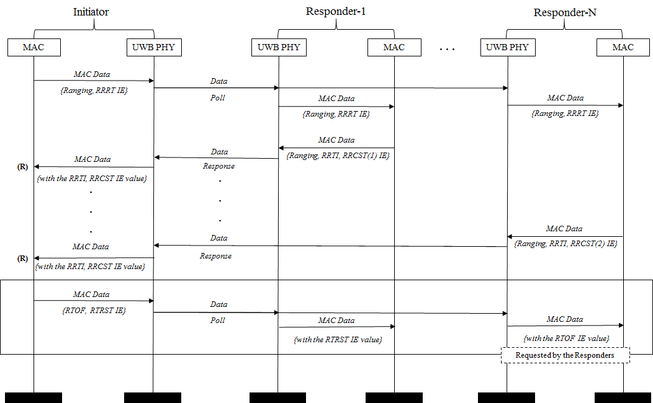
Multicast/Broadcast SS-TWR

Slide 39
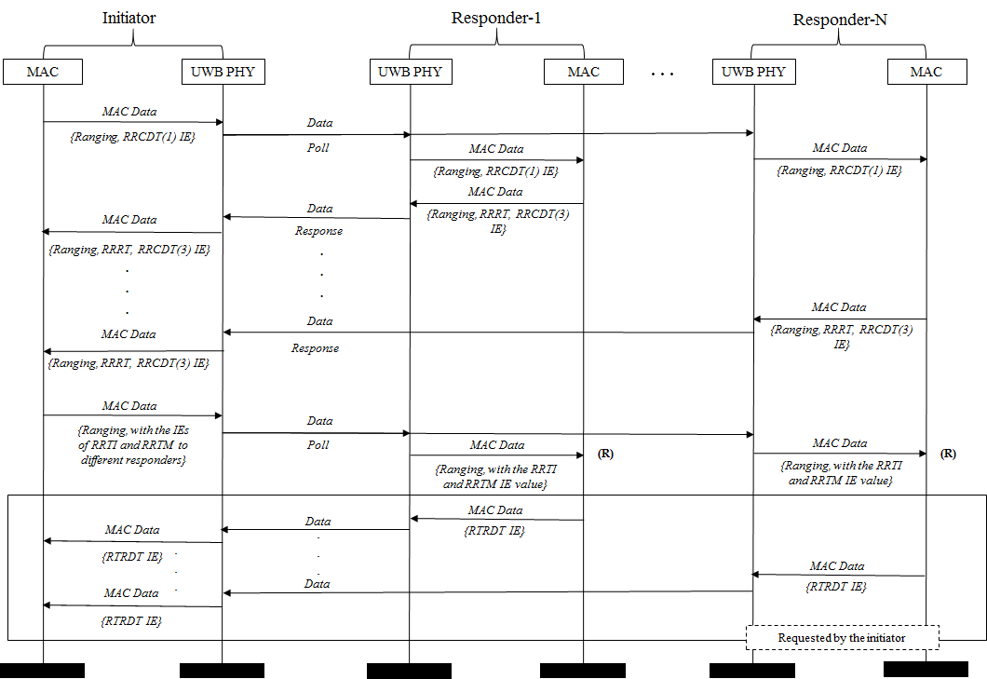
Multicast/Broadcast DS-TWR

Slide 40
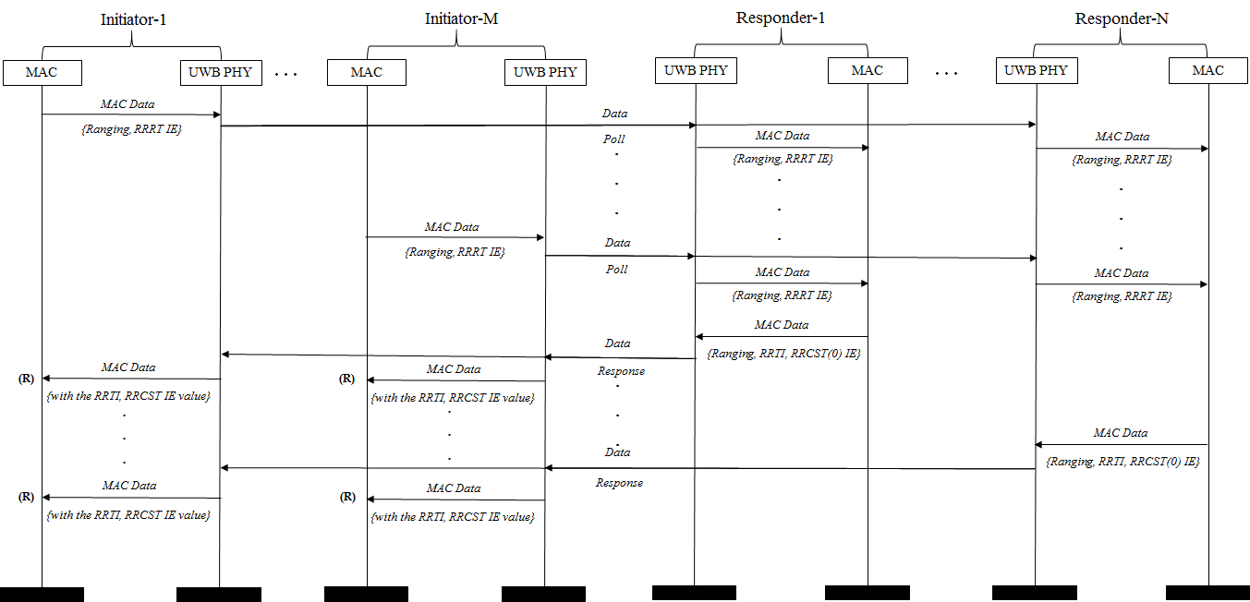
Many-to-Many SS-TWR

Slide 41
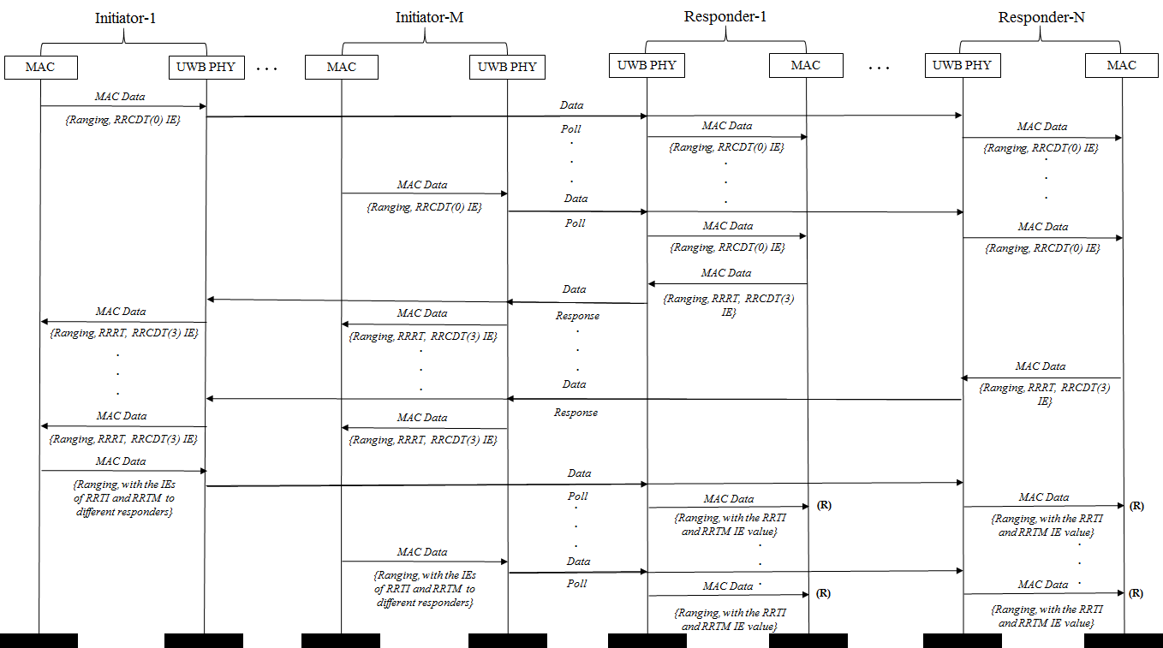
Many-to-Many DS-TWR

Slide 42
Use Cases of SS-TWR

Slide 43
Use Case 1
December 2018
This frame is initiating a SS-TWR and indicates that both initiating end and responding end do not require the ranging result.
If there is no Ranging Control frame for the current ranging round, this ranging round follows the ranging configuration in the last Ranging Control frame.
Ranging Control IE
Poll Mode | Secure Mode | Cast Mode | Multicast Mode | Ranging Mode | Time Structure Indicator | Minimum Block Length | Length of Ranging Slot | Length of Ranging Round | # of Ranging Rounds | Deferred
Bits: 1 | 2 | 2 | 1 | 1 | [TBD] | TBD | TBD | TBD | TBD | 1
0: Controller 1: Controlee | 00: Normal 01: Secure w/ Payload 10: Secure w/o Payload | 00: Unicast 01: Multicast 10: Broadcast 11: Many-2-Many | 0: Contention 1: Scheduled | 0: SS-TWR 1: DS-TWR | 0: Invoking Interval Update IE 1: Invoking Interval Update IE and Block Structure IEs | # of TU | # of TU | # of Ranging Slots | integer | 0: No need to use deferred frame 1: Need to use deferred frame
Ranging Frames with IEs
Poll : -
Response : -
Jack LEE (Samsung) et. al.

Slide 44
Use Case 2
December 2018
This frame is initiating a SS-TWR and requests that the responding end send the ranging results in its response frame, and the responding end does not require ranging result from the initiating end.
Ranging Control IE
Poll Mode | Secure Mode | Cast Mode | Multicast Mode | Ranging Mode | Time Structure Indicator | Minimum Block Length | Length of Ranging Slot | Length of Ranging Round | # of Ranging Rounds | Deferred
Bits: 1 | 2 | 2 | 1 | 1 | [TBD] | TBD | TBD | TBD | TBD | 1
0: Controller 1: Controlee | 00: Normal 01: Secure w/ Payload 10: Secure w/o Payload | 00: Unicast 01: Multicast 10: Broadcast 11: Many-2-Many | 0: Contention 1: Scheduled | 0: SS-TWR 1: DS-TWR | 0: Invoking Interval Update IE 1: Invoking Interval Update IE and Block Structure IEs | # of TU | # of TU | # of Ranging Slots | integer | 0: No need to use deferred frame 1: Need to use deferred frame
Ranging Frames with IEs
Poll : Ranging Request Reply Time IE or Ranging Request AoA IE
Response : Ranging Reply Time Instantaneous IE or Ranging AoA IE & Ranging Report Control Single-sided TWR (0) IE
Jack LEE (Samsung) et. al.

Slide 45
Use Case 3
December 2018
This frame is initiating a SS-TWR and requests that the responding end send the ranging results at the end of the exchange, and the responding end does not require ranging result from the initiating end.
Ranging Control IE
Poll Mode | Secure Mode | Cast Mode | Multicast Mode | Ranging Mode | Time Structure Indicator | Minimum Block Length | Length of Ranging Slot | Length of Ranging Round | # of Ranging Rounds | Deferred
Bits: 1 | 2 | 2 | 1 | 1 | [TBD] | TBD | TBD | TBD | TBD | 1
0: Controller 1: Controlee | 00: Normal 01: Secure w/ Payload 10: Secure w/o Payload | 00: Unicast 01: Multicast 10: Broadcast 11: Many-2-Many | 0: Contention 1: Scheduled | 0: SS-TWR 1: DS-TWR | 0: Invoking Interval Update IE 1: Invoking Interval Update IE and Block Structure IEs | # of TU | # of TU | # of Ranging Slots | integer | 0: No need to use deferred frame 1: Need to use deferred frame
Ranging Frames with IEs
Poll : Ranging Request Reply Time IE or Ranging Request AoA IE
Response : -
Additional Response: Ranging Reply Time Deferred IE or Ranging AoA Deferred IE
* Ranging Report Control Single-sided TWR (0) IE can be included in any response message
Jack LEE (Samsung) et. al.

Slide 46
Use Case 4 - 6
December 2018
Use Case 4 : This frame is initiating a multicast SS-TWR and indicates that the initiating end does not require the ranging result, and the responding ends do not require ranging result from the initiating end.
Use Case 5 : This frame is initiating a multicast SS-TWR and requests that the responding end send the ranging results in its response frame, and the responding ends do not require ranging result from the initiating end.
Use Case 6 : This frame is initiating a multicast SS-TWR and requests that the responding end send the ranging results at the end of the exchange, and the responding ends do not require ranging result from the initiating end.
Ranging Control IE
Poll Mode | Secure Mode | Cast Mode | Multicast Mode | Ranging Mode | Time Structure Indicator | Minimum Block Length | Length of Ranging Slot | Length of Ranging Round | # of Ranging Rounds | Deferred
Bits: 1 | 2 | 2 | 1 | 1 | [TBD] | TBD | TBD | TBD | TBD | 1
0: Controller 1: Controlee | 00: Normal 01: Secure w/ Payload 10: Secure w/o Payload | 00: Unicast 01: Multicast 10: Broadcast 11: Many-2-Many | 0: Contention 1: Scheduled | 0: SS-TWR 1: DS-TWR | 0: Invoking Interval Update IE 1: Invoking Interval Update IE and Block Structure IEs | # of TU | # of TU | # of Ranging Slots | integer | 0: No need to use deferred frame 1: Need to use deferred frame
Ranging Frames with IEs
For Use Case 4, 5 and 6, the same IEs are included in frame with Use Case 1, 2 and 3, respectively
Jack LEE (Samsung) et. al.

Slide 47
Use Case 7
December 2018
This frame is a Ranging Control frame for a multicast SS-TWR and the initiating end does not require the ranging results, and the responding ends do not require ranging result from the initiating end.
Ranging Control IE
Poll Mode | Secure Mode | Cast Mode | Multicast Mode | Ranging Mode | Time Structure Indicator | Minimum Block Length | Length of Ranging Slot | Length of Ranging Round | # of Ranging Rounds | Deferred
Bits: 1 | 2 | 2 | 1 | 1 | [TBD] | TBD | TBD | TBD | TBD | 1
0: Controller 1: Controlee | 00: Normal 01: Secure w/ Payload 10: Secure w/o Payload | 00: Unicast 01: Multicast 10: Broadcast 11: Many-2-Many | 0: Contention 1: Scheduled | 0: SS-TWR 1: DS-TWR | 0: Invoking Interval Update IE 1: Invoking Interval Update IE and Block Structure IEs | # of TU | # of TU | # of Ranging Slots | integer | 0: No need to use deferred frame 1: Need to use deferred frame
Ranging Frames with IEs
Ranging Control : Ranging Control IE
Poll : -
Response : -
Jack LEE (Samsung) et. al.

Slide 48
Use Case 8
December 2018
This frame is a Ranging Control frame for a multicast SS-TWR and requests that the responding end send the ranging results in its response frame, and the responding ends do not require ranging result from the initiating end.
Ranging Control IE
Poll Mode | Secure Mode | Cast Mode | Multicast Mode | Ranging Mode | Time Structure Indicator | Minimum Block Length | Length of Ranging Slot | Length of Ranging Round | # of Ranging Rounds | Deferred
Bits: 1 | 2 | 2 | 1 | 1 | [TBD] | TBD | TBD | TBD | TBD | 1
0: Controller 1: Controlee | 00: Normal 01: Secure w/ Payload 10: Secure w/o Payload | 00: Unicast 01: Multicast 10: Broadcast 11: Many-2-Many | 0: Contention 1: Scheduled | 0: SS-TWR 1: DS-TWR | 0: Invoking Interval Update IE 1: Invoking Interval Update IE and Block Structure IEs | # of TU | # of TU | # of Ranging Slots | integer | 0: No need to use deferred frame 1: Need to use deferred frame
Ranging Frames with IEs
Ranging Control : Ranging Control IE
Poll : Ranging Request Reply Time IE or Ranging Request AoA IE
Response : Ranging Reply Time Instantaneous IE or Ranging AoA IE & Ranging Report Control Single-sided TWR (0) IE
Jack LEE (Samsung) et. al.

Slide 49
Use Case 9
December 2018
This frame is a Ranging Control for a multicast SS-TWR and requests that the responding end send the ranging results at the end of the exchange, and the responding ends do not require ranging result from the initiating end.
Ranging Control IE
Poll Mode | Secure Mode | Cast Mode | Multicast Mode | Ranging Mode | Time Structure Indicator | Minimum Block Length | Length of Ranging Slot | Length of Ranging Round | # of Ranging Rounds | Deferred
Bits: 1 | 2 | 2 | 1 | 1 | [TBD] | TBD | TBD | TBD | TBD | 1
0: Controller 1: Controlee | 00: Normal 01: Secure w/ Payload 10: Secure w/o Payload | 00: Unicast 01: Multicast 10: Broadcast 11: Many-2-Many | 0: Contention 1: Scheduled | 0: SS-TWR 1: DS-TWR | 0: Invoking Interval Update IE 1: Invoking Interval Update IE and Block Structure IEs | # of TU | # of TU | # of Ranging Slots | integer | 0: No need to use deferred frame 1: Need to use deferred frame
Ranging Frames with IEs
Ranging Control : Ranging Control IE
Poll : Ranging Request Reply Time IE or Ranging Request AOA IE
Response :
Additional Response: Ranging Reply Time Deferred IE or Ranging AoA Deferred IE
* Ranging Report Control Single-sided TWR (0) IE can be included in any response message
Jack LEE (Samsung) et. al.

Slide 50
Use Case 10
December 2018
This frame is initiating a broadcast SS-TWR requiring that any responding device to send its identity (e.g. MAC address) but not the ranging results in its response frame, and the responding ends do not require ranging result from the initiating end.
Ranging Control IE
Poll Mode | Secure Mode | Cast Mode | Multicast Mode | Ranging Mode | Time Structure Indicator | Minimum Block Length | Length of Ranging Slot | Length of Ranging Round | # of Ranging Rounds | Deferred
Bits: 1 | 2 | 2 | 1 | 1 | [TBD] | TBD | TBD | TBD | TBD | 1
0: Controller 1: Controlee | 00: Normal 01: Secure w/ Payload 10: Secure w/o Payload | 00: Unicast 01: Multicast 10: Broadcast 11: Many-2-Many | 0: Contention 1: Scheduled | 0: SS-TWR 1: DS-TWR | 0: Invoking Interval Update IE 1: Invoking Interval Update IE and Block Structure IEs | # of TU | # of TU | # of Ranging Slots | integer | 0: No need to use deferred frame 1: Need to use deferred frame
Ranging Frames with IEs
Poll : -
Response : Ranging Report Control Single-sided TWR (0) IE
* MAC address of responder is contained in Addressing field of MHR of response message
Jack LEE (Samsung) et. al.

Slide 51
Use Case 11
December 2018
This frame is initiating a broadcast SS-TWR requiring that any responding device to send both its identity (e.g. MAC address) and ranging results in its response frame, and the responding ends do not require ranging result from the initiating end.
Ranging Control IE
Poll Mode | Secure Mode | Cast Mode | Multicast Mode | Ranging Mode | Time Structure Indicator | Minimum Block Length | Length of Ranging Slot | Length of Ranging Round | # of Ranging Rounds | Deferred
Bits: 1 | 2 | 2 | 1 | 1 | [TBD] | TBD | TBD | TBD | TBD | 1
0: Controller 1: Controlee | 00: Normal 01: Secure w/ Payload 10: Secure w/o Payload | 00: Unicast 01: Multicast 10: Broadcast 11: Many-2-Many | 0: Contention 1: Scheduled | 0: SS-TWR 1: DS-TWR | 0: Invoking Interval Update IE 1: Invoking Interval Update IE and Block Structure IEs | # of TU | # of TU | # of Ranging Slots | integer | 0: No need to use deferred frame 1: Need to use deferred frame
Ranging Frames with IEs
Poll : Ranging Request Reply Time IE or Ranging Request AoA IE
Response : Ranging Reply Time Instantaneous IE or Ranging AoA IE & Ranging Report Control Single-sided TWR (0) IE
* MAC address of responder is contained in Addressing field of MHR of response message
Jack LEE (Samsung) et. al.

Slide 52
Use Case 12
December 2018
This frame is initiating a broadcast SS-TWR requiring that any responding device identity (e.g. MAC address), and initiator requests ranging results in the deferred response frame.
Ranging Control IE
Poll Mode | Secure Mode | Cast Mode | Multicast Mode | Ranging Mode | Time Structure Indicator | Minimum Block Length | Length of Ranging Slot | Length of Ranging Round | # of Ranging Rounds | Deferred
Bits: 1 | 2 | 2 | 1 | 1 | [TBD] | TBD | TBD | TBD | TBD | 1
0: Controller 1: Controlee | 00: Normal 01: Secure w/ Payload 10: Secure w/o Payload | 00: Unicast 01: Multicast 10: Broadcast 11: Many-2-Many | 0: Contention 1: Scheduled | 0: SS-TWR 1: DS-TWR | 0: Invoking Interval Update IE 1: Invoking Interval Update IE and Block Structure IEs | # of TU | # of TU | # of Ranging Slots | integer | 0: No need to use deferred frame 1: Need to use deferred frame
Ranging Frames with IEs
Poll : Ranging Request Reply Time IE or Ranging Request AOA IE
Response :
Additional Response: Ranging Reply Time Deferred IE or Ranging AoA Deferred IE
* Ranging Report Control Single-sided TWR (0) IE can be included in any response message
* MAC address of responder is contained in Addressing field of MHR of response message
Jack LEE (Samsung) et. al.

Slide 53
Use Case 13
December 2018
This frame is a Ranging Control frame for a broadcast SS-TWR requiring that any responding device to send its identity (e.g. MAC address) but not the ranging results in its response frame, and the responding ends do not require ranging result from the initiating end.
Ranging Control IE
Poll Mode | Secure Mode | Cast Mode | Multicast Mode | Ranging Mode | Time Structure Indicator | Minimum Block Length | Length of Ranging Slot | Length of Ranging Round | # of Ranging Rounds | Deferred
Bits: 1 | 2 | 2 | 1 | 1 | [TBD] | TBD | TBD | TBD | TBD | 1
0: Controller 1: Controlee | 00: Normal 01: Secure w/ Payload 10: Secure w/o Payload | 00: Unicast 01: Multicast 10: Broadcast 11: Many-2-Many | 0: Contention 1: Scheduled | 0: SS-TWR 1: DS-TWR | 0: Invoking Interval Update IE 1: Invoking Interval Update IE and Block Structure IEs | # of TU | # of TU | # of Ranging Slots | integer | 0: No need to use deferred frame 1: Need to use deferred frame
Ranging Frames with IEs
Ranging Control : Ranging Control IE
Poll :
Response : Ranging Report Control Single-sided TWR (0) IE
* MAC address of responder is contained in Addressing field of MHR of response message
Jack LEE (Samsung) et. al.

Slide 54
Use Case 14
December 2018
This frame is a Ranging Control frame for a broadcast SS-TWR requiring that any responding device to send both its identity (e.g. MAC address) and the ranging results in its response frame, and the responding ends do not require ranging result from the initiating end.
Ranging Control IE
Poll Mode | Secure Mode | Cast Mode | Multicast Mode | Ranging Mode | Time Structure Indicator | Minimum Block Length | Length of Ranging Slot | Length of Ranging Round | # of Ranging Rounds | Deferred
Bits: 1 | 2 | 2 | 1 | 1 | [TBD] | TBD | TBD | TBD | TBD | 1
0: Controller 1: Controlee | 00: Normal 01: Secure w/ Payload 10: Secure w/o Payload | 00: Unicast 01: Multicast 10: Broadcast 11: Many-2-Many | 0: Contention 1: Scheduled | 0: SS-TWR 1: DS-TWR | 0: Invoking Interval Update IE 1: Invoking Interval Update IE and Block Structure IEs | # of TU | # of TU | # of Ranging Slots | integer | 0: No need to use deferred frame 1: Need to use deferred frame
Ranging Frames with IEs
Ranging Control : Ranging Control IE
Poll : Ranging Request Reply Time IE or Ranging Request AoA IE
Response : Ranging Reply Time Instantaneous IE or Ranging AoA IE & Ranging Report Control Single-sided TWR (0) IE
* MAC address of responder is contained in Addressing field of MHR of response message
Jack LEE (Samsung) et. al.

Slide 55
Use Case 15
December 2018
This frame is a Ranging Control frame for a broadcast SS-TWR requiring that any responding device to send its identity (e.g. MAC address) in its response frame and the ranging results at the end of the exchange. The responding ends do not require ranging result from the initiating end.
Ranging Control IE
Poll Mode | Secure Mode | Cast Mode | Multicast Mode | Ranging Mode | Time Structure Indicator | Minimum Block Length | Length of Ranging Slot | Length of Ranging Round | # of Ranging Rounds | Deferred
Bits: 1 | 2 | 2 | 1 | 1 | [TBD] | TBD | TBD | TBD | TBD | 1
0: Controller 1: Controlee | 00: Normal 01: Secure w/ Payload 10: Secure w/o Payload | 00: Unicast 01: Multicast 10: Broadcast 11: Many-2-Many | 0: Contention 1: Scheduled | 0: SS-TWR 1: DS-TWR | 0: Invoking Interval Update IE 1: Invoking Interval Update IE and Block Structure IEs | # of TU | # of TU | # of Ranging Slots | integer | 0: No need to use deferred frame 1: Need to use deferred frame
Ranging Frames with IEs
Ranging Control : Ranging Control IE
Poll : Ranging Request Reply Time IE or Ranging Request AOA IE
Response :
Additional Response: Ranging Reply Time Deferred IE or Ranging AoA Deferred IE
* Ranging Report Control Single-sided TWR (0) IE can be included in any response message
* MAC address of responder is contained in Addressing field of MHR of response message
Jack LEE (Samsung) et. al.

Slide 56
Use Case 16
December 2018
This frame indicates that the responding end requires TX-to-RX round-trip time at the end of exchange
Ranging Control IE
Poll Mode | Secure Mode | Cast Mode | Multicast Mode | Ranging Mode | Time Structure Indicator | Minimum Block Length | Length of Ranging Slot | Length of Ranging Round | # of Ranging Rounds | Deferred
Bits: 1 | 2 | 2 | 1 | 1 | [TBD] | TBD | TBD | TBD | TBD | 1
0: Controller 1: Controlee | 00: Normal 01: Secure w/ Payload 10: Secure w/o Payload | 00: Unicast 01: Multicast 10: Broadcast 11: Many-2-Many | 0: Contention 1: Scheduled | 0: SS-TWR 1: DS-TWR | 0: Invoking Interval Update IE 1: Invoking Interval Update IE and Block Structure IEs | # of TU | # of TU | # of Ranging Slots | integer | 0: No need to use deferred frame 1: Need to use deferred frame
Ranging Frames with IEs
Poll : Ranging Request Reply Time IE or Ranging Request AoA IE
Response : Ranging Reply Time Instantaneous IE or Ranging AoA IE & Ranging Report Control Single-sided TWR (1) IE
2nd Poll : Ranging Time Report Single-sided TWR (RTRST) IE
Jack LEE (Samsung) et. al.

Slide 57
Use Case 17
December 2018
This frame indicates that the responding end requires ranging result at the end of exchange
Ranging Control IE
Poll Mode | Secure Mode | Cast Mode | Multicast Mode | Ranging Mode | Time Structure Indicator | Minimum Block Length | Length of Ranging Slot | Length of Ranging Round | # of Ranging Rounds | Deferred
Bits: 1 | 2 | 2 | 1 | 1 | [TBD] | TBD | TBD | TBD | TBD | 1
0: Controller 1: Controlee | 00: Normal 01: Secure w/ Payload 10: Secure w/o Payload | 00: Unicast 01: Multicast 10: Broadcast 11: Many-2-Many | 0: Contention 1: Scheduled | 0: SS-TWR 1: DS-TWR | 0: Invoking Interval Update IE 1: Invoking Interval Update IE and Block Structure IEs | # of TU | # of TU | # of Ranging Slots | integer | 0: No need to use deferred frame 1: Need to use deferred frame
Ranging Frames with IEs
Poll : Ranging Request Reply Time IE or Ranging Request AoA IE
Response : Ranging Reply Time Instantaneous IE or Ranging AoA IE & Ranging Report Control Single-sided TWR (2) IE
2nd Poll : Ranging Time of Flight (RTOF) IE
Jack LEE (Samsung) et. al.

Slide 58
Use cases of DS-TWR
December 2018
Jack LEE (Samsung) et. al.

Slide 59
Use Case 1
December 2018
This frame is initiating DS-TWR and indicates that the initiating end does not require the ranging result.
If there is no Ranging Control frame for the current ranging round, this ranging round follows the ranging configuration in the last Ranging Control frame.
Ranging Control IE
Poll Mode | Secure Mode | Cast Mode | Multicast Mode | Ranging Mode | Time Structure Indicator | Minimum Block Length | Length of Ranging Slot | Length of Ranging Round | # of Ranging Rounds | Deferred
Bits: 1 | 2 | 2 | 1 | 1 | [TBD] | TBD | TBD | TBD | TBD | 1
0: Controller 1: Controlee | 00: Normal 01: Secure w/ Payload 10: Secure w/o Payload | 00: Unicast 01: Multicast 10: Broadcast 11: Many-2-Many | 0: Contention 1: Scheduled | 0: SS-TWR 1: DS-TWR | 0: Invoking Interval Update IE 1: Invoking Interval Update IE and Block Structure IEs | # of TU | # of TU | # of Ranging Slots | integer | 0: No need to use deferred frame 1: Need to use deferred frame
Ranging Frames with IEs
Poll : Ranging Report Control Double-sided TWR(0) IE
Response : Ranging Request Reply Time IE, Ranging Report Control Double-sided TWR(3) IE
2nd Poll : Ranging Reply Time Instantaneous IE, Ranging Round-trip Measurement IE
Jack LEE (Samsung) et. al.

Slide 60
Use Case 2
December 2018
This frame is initiating DS-TWR and requesting that the ranging result is sent back at end of exchange w/ Ranging Report Control Double-sided TWR(1)
Ranging Control IE
Poll Mode | Secure Mode | Cast Mode | Multicast Mode | Ranging Mode | Time Structure Indicator | Minimum Block Length | Length of Ranging Slot | Length of Ranging Round | # of Ranging Rounds | Deferred
Bits: 1 | 2 | 2 | 1 | 1 | [TBD] | TBD | TBD | TBD | TBD | 1
0: Controller 1: Controlee | 00: Normal 01: Secure w/ Payload 10: Secure w/o Payload | 00: Unicast 01: Multicast 10: Broadcast 11: Many-2-Many | 0: Contention 1: Scheduled | 0: SS-TWR 1: DS-TWR | 0: Invoking Interval Update IE 1: Invoking Interval Update IE and Block Structure IEs | # of TU | # of TU | # of Ranging Slots | integer | 0: No need to use deferred frame 1: Need to use deferred frame
Ranging Frames with IEs
Poll : Ranging Report Control Double-sided TWR(1) IE
Response : Ranging Request Reply Time IE, Ranging Report Control Double-sided TWR(3) IE
2nd Poll : Ranging Reply Time Instantaneous IE, Ranging Round-trip Measurement IE
Response : Ranging Report Time Report Double-sided TWR IE
Jack LEE (Samsung) et. al.

Slide 61
Use Case 3
December 2018
This frame is initiating DS-TWR and requesting that the ranging result is sent back at end of exchange w/ Ranging Report Control Double-sided TWR(2)
Ranging Control IE
Poll Mode | Secure Mode | Cast Mode | Multicast Mode | Ranging Mode | Time Structure Indicator | Minimum Block Length | Length of Ranging Slot | Length of Ranging Round | # of Ranging Rounds | Deferred
Bits: 1 | 2 | 2 | 1 | 1 | [TBD] | TBD | TBD | TBD | TBD | 1
0: Controller 1: Controlee | 00: Normal 01: Secure w/ Payload 10: Secure w/o Payload | 00: Unicast 01: Multicast 10: Broadcast 11: Many-2-Many | 0: Contention 1: Scheduled | 0: SS-TWR 1: DS-TWR | 0: Invoking Interval Update IE 1: Invoking Interval Update IE and Block Structure IEs | # of TU | # of TU | # of Ranging Slots | integer | 0: No need to use deferred frame 1: Need to use deferred frame
Ranging Frames with IEs
Poll : Ranging Report Control Double-sided TWR(2) IE
Response : Ranging Request Reply Time IE, Ranging Report Control Double-sided TWR(3) IE
2nd Poll: Ranging Reply Time Instantaneous IE, Ranging Round-trip Measurement IE
Response : Ranging Time of Flight IE
Jack LEE (Samsung) et. al.

Slide 62
Use Case 4
December 2018
This frame is initiating multicast DS-TWR and indicates that the initiating end does not require the ranging result
Ranging Control IE
Poll Mode | Secure Mode | Cast Mode | Multicast Mode | Ranging Mode | Time Structure Indicator | Minimum Block Length | Length of Ranging Slot | Length of Ranging Round | # of Ranging Rounds | Deferred
Bits: 1 | 2 | 2 | 1 | 1 | [TBD] | TBD | TBD | TBD | TBD | 1
0: Controller 1: Controlee | 00: Normal 01: Secure w/ Payload 10: Secure w/o Payload | 00: Unicast 01: Multicast 10: Broadcast 11: Many-2-Many | 0: Contention 1: Scheduled | 0: SS-TWR 1: DS-TWR | 0: Invoking Interval Update IE 1: Invoking Interval Update IE and Block Structure IEs | # of TU | # of TU | # of Ranging Slots | integer | 0: No need to use deferred frame 1: Need to use deferred frame
Ranging Frames with IEs
Poll : Ranging Report Control Double-sided TWR(0) IE
Response : Ranging Request Reply Time IE, Ranging Report Control Double-sided TWR(3) IE
2nd Poll: Ranging Reply Time Instantaneous IE, Ranging Round-trip Measurement IE
Jack LEE (Samsung) et. al.

Slide 63
Use Case 5
December 2018
This frame is initiating multicast DS-TWR and requesting that the ranging result is sent back at end of exchange
Ranging Control IE
Poll Mode | Secure Mode | Cast Mode | Multicast Mode | Ranging Mode | Time Structure Indicator | Minimum Block Length | Length of Ranging Slot | Length of Ranging Round | # of Ranging Rounds | Deferred
Bits: 1 | 2 | 2 | 1 | 1 | [TBD] | TBD | TBD | TBD | TBD | 1
0: Controller 1: Controlee | 00: Normal 01: Secure w/ Payload 10: Secure w/o Payload | 00: Unicast 01: Multicast 10: Broadcast 11: Many-2-Many | 0: Contention 1: Scheduled | 0: SS-TWR 1: DS-TWR | 0: Invoking Interval Update IE 1: Invoking Interval Update IE and Block Structure IEs | # of TU | # of TU | # of Ranging Slots | integer | 0: No need to use deferred frame 1: Need to use deferred frame
Ranging Frames with IEs
Poll : Ranging Report Control Double-sided TWR(1/2) IE
Response : Ranging Request Reply Time IE, Ranging Report Control Double-sided TWR(3) IE
2nd Poll: Ranging Reply Time Instantaneous IE, Ranging Round-trip Measurement IE
Response : Ranging Report Time Report Double-sided TWR IE or Ranging Time of Flight IE
Jack LEE (Samsung) et. al.

Slide 64
Use Case 6
December 2018
This frame is initiating multicast DS-TWR with additional report message for time stamp measurements and indicates that the initiating end does not require the ranging result
Ranging Control IE
Poll Mode | Secure Mode | Cast Mode | Multicast Mode | Ranging Mode | Time Structure Indicator | Minimum Block Length | Length of Ranging Slot | Length of Ranging Round | # of Ranging Rounds | Deferred
Bits: 1 | 2 | 2 | 1 | 1 | [TBD] | TBD | TBD | TBD | TBD | 1
0: Controller 1: Controlee | 00: Normal 01: Secure w/ Payload 10: Secure w/o Payload | 00: Unicast 01: Multicast 10: Broadcast 11: Many-2-Many | 0: Contention 1: Scheduled | 0: SS-TWR 1: DS-TWR | 0: Invoking Interval Update IE 1: Invoking Interval Update IE and Block Structure IEs | # of TU | # of TU | # of Ranging Slots | integer | 0: No need to use deferred frame 1: Need to use deferred frame
Ranging Frames with IEs
Poll : Ranging Report Control Double-sided TWR(0) IE
Response : Ranging Request Reply Time IE, Ranging Report Control Double-sided TWR(3) IE
2nd Poll :
Additional poll : Ranging Reply Time Deferred IE, Ranging Round-trip Measurement IE
Jack LEE (Samsung) et. al.

Slide 65
Use Case 7
December 2018
This frame is initiating multicast DS-TWR with additional report message for time stamp measurements and requesting that the ranging result is sent back at end of exchange
Ranging Control IE
Poll Mode | Secure Mode | Cast Mode | Multicast Mode | Ranging Mode | Time Structure Indicator | Minimum Block Length | Length of Ranging Slot | Length of Ranging Round | # of Ranging Rounds | Deferred
Bits: 1 | 2 | 2 | 1 | 1 | [TBD] | TBD | TBD | TBD | TBD | 1
0: Controller 1: Controlee | 00: Normal 01: Secure w/ Payload 10: Secure w/o Payload | 00: Unicast 01: Multicast 10: Broadcast 11: Many-2-Many | 0: Contention 1: Scheduled | 0: SS-TWR 1: DS-TWR | 0: Invoking Interval Update IE 1: Invoking Interval Update IE and Block Structure IEs | # of TU | # of TU | # of Ranging Slots | integer | 0: No need to use deferred frame 1: Need to use deferred frame
Ranging Frames with IEs
Poll : Ranging Report Control Double-sided TWR(1/2) IE
Response : Ranging Request Reply Time IE, Ranging Report Control Double-sided TWR(3) IE
2nd Poll :
Additional poll : Ranging Reply Time Deferred IE, Ranging Round-trip Measurement IE
Response : Ranging Report Time Report Double-sided TWR IE or Ranging Time of Flight IE
Jack LEE (Samsung) et. al.

Slide 66
Use Case 8 - 11
December 2018
Use Case 8 : This frame is a Ranging Control frame for multicast DS-TWR and indicates that the initiating end does not require the ranging result
Use Case 9 : This frame is a Ranging Control frame for multicast DS-TWR and requesting that the ranging result is sent back at end of exchange
Use Case 10 : This frame is a Ranging Control frame for multicast DS-TWR with additional report message for time stamp measurements and indicates that the initiating end does not require the ranging result
Use Case 11 : This frame is a Ranging Control frame for multicast DS-TWR with additional report message for time stamp measurements and requesting that the ranging result is sent back at end of exchange
Ranging Control IE
Poll Mode | Secure Mode | Cast Mode | Multicast Mode | Ranging Mode | Time Structure Indicator | Minimum Block Length | Length of Ranging Slot | Length of Ranging Round | # of Ranging Rounds | Deferred
Bits: 1 | 2 | 2 | 1 | 1 | [TBD] | TBD | TBD | TBD | TBD | 1
0: Controller 1: Controlee | 00: Normal 01: Secure w/ Payload 10: Secure w/o Payload | 00: Unicast 01: Multicast 10: Broadcast 11: Many-2-Many | 0: Contention 1: Scheduled | 0: SS-TWR 1: DS-TWR | 0: Invoking Interval Update IE 1: Invoking Interval Update IE and Block Structure IEs | # of TU | # of TU | # of Ranging Slots | integer | 0: No need to use deferred frame 1: Need to use deferred frame
Ranging Frames with IEs
For Use Case 8, 9, 10, and 11, the same IEs are included in frame with Use Case 4, 5, 6, and 7, respectively and the Ranging Control frame with Ranging Control IE is considered
Jack LEE (Samsung) et. al.

Slide 67
Use Case 12 - 15
December 2018
Use Case 12 : This frame is a Ranging Control frame for broadcast DS-TWR and indicates that the initiating end does not require the ranging result
Use Case 13: This frame is a Ranging Control frame for broadcast DS-TWR and requesting that the ranging result is sent back at end of exchange
Use Case 14 : This frame is a Ranging Control frame for broadcast DS-TWR with additional report message for time stamp measurements and indicates that the initiating end does not require the ranging result
Use Case 15 : This frame is a Ranging Control frame for broadcast DS-TWR with additional report message for time stamp measurements and requesting that the ranging result is sent back at end of exchange
Ranging Control IE
Poll Mode | Secure Mode | Cast Mode | Multicast Mode | Ranging Mode | Time Structure Indicator | Minimum Block Length | Length of Ranging Slot | Length of Ranging Round | # of Ranging Rounds | Deferred
Bits: 1 | 2 | 2 | 1 | 1 | [TBD] | TBD | TBD | TBD | TBD | 1
0: Controller 1: Controlee | 00: Normal 01: Secure w/ Payload 10: Secure w/o Payload | 00: Unicast 01: Multicast 10: Broadcast 11: Many-2-Many | 0: Contention 1: Scheduled | 0: SS-TWR 1: DS-TWR | 0: Invoking Interval Update IE 1: Invoking Interval Update IE and Block Structure IEs | # of TU | # of TU | # of Ranging Slots | integer | 0: No need to use deferred frame 1: Need to use deferred frame
Ranging Frames with IEs
For Use Case 12, 13 14, and 15, the same IEs are included in frame with Use Case 4, 5, 6, and 7, respectively and the Ranging Control frame with Ranging Control IE is considered
Jack LEE (Samsung) et. al.

