Slide 1
Project: IEEE P802.15 Working Group for Wireless Personal Area Networks (WPANs)
Submission Title: [HRP UWB PHY enhanced mode converged consensus]
Date Submitted: [14th November 2018]
Source: [Billy Verso (Decawave), Frank Leong (NXP Semiconductors), Jochen Hammerschmidt (Apple), Jaroslaw Niewczas (Decawave Ltd.), Brima Ibrahim (NXP Semiconductors), Tushar Shah (Apple) Alejandro Marquez (Apple), Thomas Reisinger (Continental), Daniel Knobloch (BMW)]
Address [Peter Street, Dublin 8, Ireland]
Voice:[+353.87.233.7323], E-Mail:[billy.verso (at) decawave.com]
Re: [HRP UWB PHY enhanced mode]
Abstract: [Describe the agreed UWB frame elements for the enhanced mode]
Purpose: [As a next step after the MIM consensus of 15-18-0375-00, and the consensus reached at the Waikoloa meeting on the more advanced enhanced modes as captured in 15-18-0477-00, this document represents a further converged consensus agreement on the HRP UWB PHY modulation enhancements]
Notice: This document has been prepared to assist the IEEE P802.15. It is offered as a basis for discussion and is not binding on the contributing individual(s) or organization(s). The material in this document is subject to change in form and content after further study. The contributor(s) reserve(s) the right to add, amend or withdraw material contained herein.
Release: The contributor acknowledges and accepts that this contribution becomes the property of IEEE and may be made publicly available by P802.15.

Slide 2
Introduction:
We have reached agreement on all key aspects of specification for the HRP UWB PHY for the 802.15.4z amendment as captured in the following slides
MIM was agreed at 64 MHz PRF
  Doc 15-18-0375-00-004z captures this consensus
There were open items with respect to the more enhanced modes where there are higher PRFs, longer sequences, additional SFD, new data modulations, etc.
  Doc 15-18-0477-00-004z gives the Waikoloa meeting consensus
This document specifies the consensus for these open items

Slide 3
MIM PHR decision
PHR at the data rate for MIM shall not be mandatory, it shall be optional

Slide 4
Preamble Symbol:
We have agreed:
A length 91 Ipatov symbol (with 81 non-zero elements)
We will choose a set of 8 suitable codes
The mandatory sequence lengths are:
  32, 64 symbols
The optional lengths are:
  16, 24, 48, 96, 128, 256

Slide 5
SFD:
We previously agreed a length 8 SFD: - - - + - - + -
It shall be mandatory to support SFD lengths of: 4, 8 and 16
It shall be optional to support SFD lengths of: 32
We now agree the following SFD patterns:
  Length 4 pattern = - - + -
  Length 16 pattern is TBD
  Length 32 pattern is TBD

Slide 6
Scrambled Timestamp Sequence (STS):
We previously agreed the AES-128 generation of the sequences and spreading by δL=8 for 64 MHz PRF and δL=4 for 128 MHz PRF
  We have agreed 1 µs (512 chip) gap at start and end of the sequence
  We have agreed one length 32768 chips (~65µs) for the 64MHz PRF MIM and 2 lengths 16384 chips (~32µs) & 32768 chips (~65µs) for 128MHz PRF
  “Longer lengths based on multiples of the 16384 chip unit as single and/or multiple segments (separated by gaps of 512 chips) shall be defined”
We now agree to have mandatory support for 1 and 2 segments, and optional support for 3 and 4 segments
  We intend to specify the interfaces associated with the separate segments as part of the MAC discussion
We agree that the mandatory segment lengths (for 128 MHz PRF) in multiples of 512 chips shall be: 32, 64 and 128
The segment length of 256 × 512 chips is optional

Slide 7
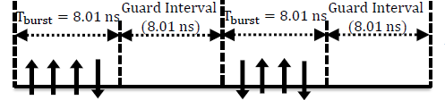
Data Modulation (1) for ~30 Mb/s mode
We have agreed:
256 MHz PRF with 8 pulses per coded bit, with the pulses on 2ns spacing separated into two groups of four as shown:
Using the 4a convolutional code (with [2,5] generator) and the mapping shown (right):
Then the sequence is scrambled using the 4a LFSR
Final bit value to pulse polarity mapping shall be as per 4a
Mandatory FEC: K=3+RS (~27 Mb/s)
G0 | G1 | PATTERN
0 | 0 | 0 0 0 0 <GAP> 0 0 0 0 <GAP>
1 | 0 | 1 1 1 1 <GAP> 0 0 0 0 <GAP>
0 | 1 | 1 1 1 1 <GAP> 1 1 1 1 <GAP>
1 | 1 | 0 0 0 0 <GAP> 1 1 1 1 <GAP>
Optional K=7 code without RS (~31.2 Mb/s) using convolution code generator polynomial [133,171] and same mapping as table above.

Slide 8
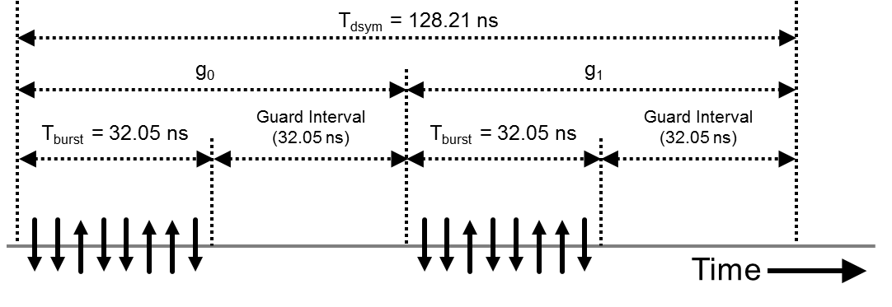
Data Modulation (2) for ~7 Mb/s mode
We have agreed:
128 MHz PRF with 16 pulses per coded bit, with the pulses on 4ns spacing separated into two groups of eight as shown:
Using the 4a convolutional code (with [2,5] generator) and the mapping shown (right):
Then the sequence is scrambled using the 4a LFSR.
Final bit value to pulse polarity mapping shall be as per 4a
Mandatory FEC: K=3+RS (~6.8 Mb/s)
G0 | G1 | PATTERN
0 | 0 | 0 0 0 0 0 0 0 0 <GAP> 0 0 0 0 0 0 0 0 <GAP>
1 | 0 | 1 1 1 1 1 1 1 1 <GAP> 0 0 0 0 0 0 0 0 <GAP>
0 | 1 | 1 1 1 1 1 1 1 1 <GAP> 1 1 1 1 1 1 1 1 <GAP>
1 | 1 | 0 0 0 0 0 0 0 0 <GAP> 1 1 1 1 1 1 1 1 <GAP>
Optional K=7 code without RS (~7.8 Mb/s) using convolution code generator polynomial [133,171] and same mapping as table above.

Slide 9
PHR
We now agree that the PHR shall be 19-bits formatted as shown:
  Ranging bit and SECDED encoding and functionality shall be as per 802.15.4-2015
  Payload length field shall be 10 bits, so max PHY payload is 1023 octets long
  In the frame formats with PHR, bits A1 and A0 shall be available for application specific use, and be signaled to or set by the higher layer, and zero when not being used for this purpose..
  In the optional frame format where the STS follows the payload, A1 and A0 shall be optionally available to specify an additional gap between the payload and the STS.

Slide 10
PHR Encoding
  PSDU and PHR shall use the same convolutional code
  For the mandatory K=3+RS code, in the case of zero length data field, the full 21 symbols of PHR shall be transmitted, including two leading data bits D0 and D1 set to 0 to form a tail. (See 802.15.4-2015 Table 16-1)
    For consideration: adding 2 tail bits (of bit value = 0) in all situations is under review
  For the optional K = 7 (no RS) code, 6 tail bits (of bit value = 0) shall be included, (giving a 25 symbol PHR), to allow the convolution code to return to the zero state, before starting any following data field.

Slide 11
General
To reduce the complexity of combining the different frame parameters, only some combinations of these shall be considered mandatory
For the St. Louis meeting we shall specify mandatory combinations of the frame parameters (i.e. the lengths of SYNC, SFD and STS fields and the data rate)
  other combinations of these parameters shall be considered non-mandatory
  As a guideline to this exercise we expect that the STS will be at least as long as the SYNC field, and for each SYNC length there will be constraints on the associated SFD lengths

