Slide 1
Project: IEEE P802.15 Working Group for Wireless Personal Area Networks (WPANs)
Submission Title:[ ETSI SmartBAN –SmartM2M joint meeting]
Date Submitted: [14 November 2018]
Source: [John R. Farserotu] [CSEM]
Address [Jaquet-Droz 1 Case Postale CH-2002 Neuchatel, Switzerland]
Voice:[+41-7935-66816],
Email:[john.farserotu@csem.ch]
Re: []
Abstract: [In order to collaborate with IEEE802.15 IG-DEP, joint activities of ETSI SmartBAN and SmartM2M will be introduced. This slides are copies of presentation in ETSI SmartBAN^-SmartM2M joint meeting in Sofia Antipolis, France on October 9, 2017.]
Purpose: [information]
Notice: This document has been prepared to assist the IEEE P802.15. It is offered as a basis for discussion and is not binding on the contributing individual(s) or organization(s). The material in this document is subject to change in form and content after further study. The contributor(s) reserve(s) the right to add, amend or withdraw material contained herein.
Release: The contributor acknowledges and accepts that this contribution becomes the property of IEEE and may be made publicly available by P802.15.

Slide 2
SmartBAN – SmartM2M joint meeting
ETSI, Sophia Antipolis
November 9 2017
John Farseroutu
Chair TC SmartBAN, ETSI
CESM, Switzerland
This slides are copies of presentation in ETSI Joint meeting between SmartBAN and SmartM2M, Sophia Antipolis on November 9, 2017

Slide 3
Outline
13:00 Opening and welcome
13:05 Approval of the agenda
13:10 SmartBAN overview / status
13:20 SmartM2M overview / status
13:30 Upper layer aspects and potential cooperation
14:10 Lower layer aspects and potential cooperation
14:45 Questions, roundtable and wrap-up
15:00 Close

Slide 4
Smart BAN motivation
SmartBAN started as academic research by European researchers
SmartBAN aims at a smart BAN design with improved and dedicated performance for medical, health improvement and sport and leisure applications, further to existing BAN standards
SmartBAN is built on attracted industrial attention
SmartBAN design features
Star concept + multi hub relay
Efficient MAC and PHY, yielding very low latency emerging messaging, very low energy consumption, very fast initial set up time, channel reassignment
Real-time radio channel assignment (subject of further research)
Smartness: Semantic approach, semantic interoperablity, heterogeneity management, IoT compliance
Automatic node discovery (e.g. semantic discovery of nodes, composition (e.g. semantic discovery of nodes
Slide 4

Slide 5
ETSI 103 378 SmartBAN open data model & ontology specification
SmartBAN data model divided into four main parts: (modularity purposes)
    WBAN (SmartBAN or BAN cluster in the TC SmartBAN context, this part of the ontology has been generalized for WSNs as MyOntoSens),
    Nodes (i.e. Hub, coordinator, sensors, actuators, relays),
    Process (i.e. processes, corresponding measurements and associated data),
    +
    Service (Semantic Web + Sensor as a Service strategies considered).
    Languages actually used for the SmartBAN data model formalization and management: OWL DL + JSON-LD, SPARQL for semantic query/search, SWRL for semantic rule integration and embedded semantic data analytics
SmartBAN
Core
Ontologies
=
data/semantic interoperability, discovery & composition, information reusability, embedded semantic analytics, automated control, modularity, extensibility, SaaS, WoT, BAN nodes & services discovery, new applications development scaling
SmartBAN
Service
Ontology
Slide 5

Slide 6
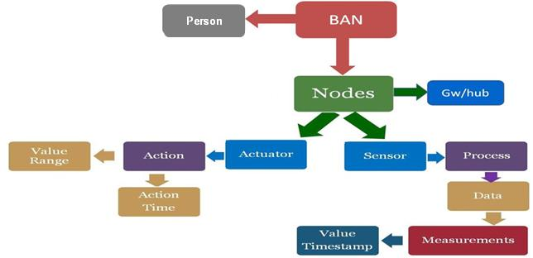
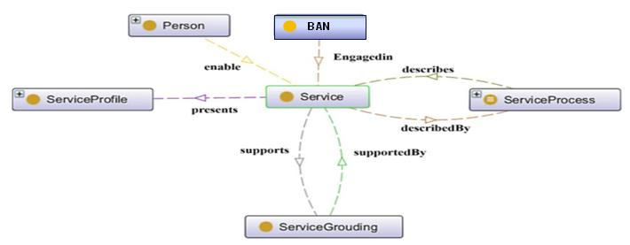
ETSI 103 378 SmartBAN open data model & ontology specification (Cont.)
SmartBAN Core Ontologies simplified view:
SmartBAN Service Ontology simplified view:
Slide 6

Slide 7
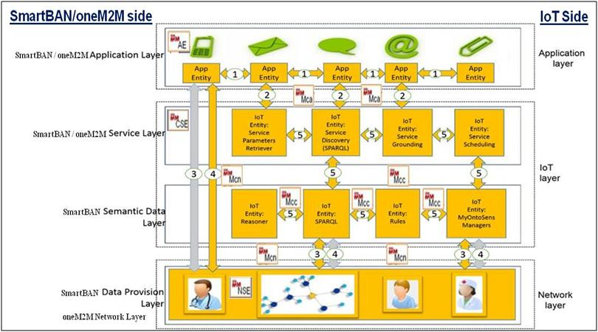
ETSI TR 103 327 SmartBAN reference architecture
Application Entities implementing a given SmartBAN application logic (e.g. data monitoring, patient evaluation result, patient notification...)
Device,
Syntactic, Network & Semantic
Interoperability
Generic entities related to service management functionalities
Entities mainly providing semantic and ontologies management functionalities + additional embedded intelligence related functionalities
Direct mapping between oneM2M Network Layer and SmartBAN Data Provision Layer and its generic Agents (equivalent to oneM2M NSEs),
oneM2M Service Layer and SmartBAN Service Layer and its generic Agents (equivalent to oneM2M CSEs),
oneM2M application layer and SmartBAN Application Layer and its application agents (equivalent to oneM2M AE).
Slide 7

Slide 8

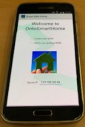
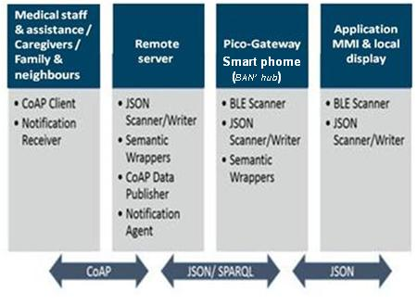
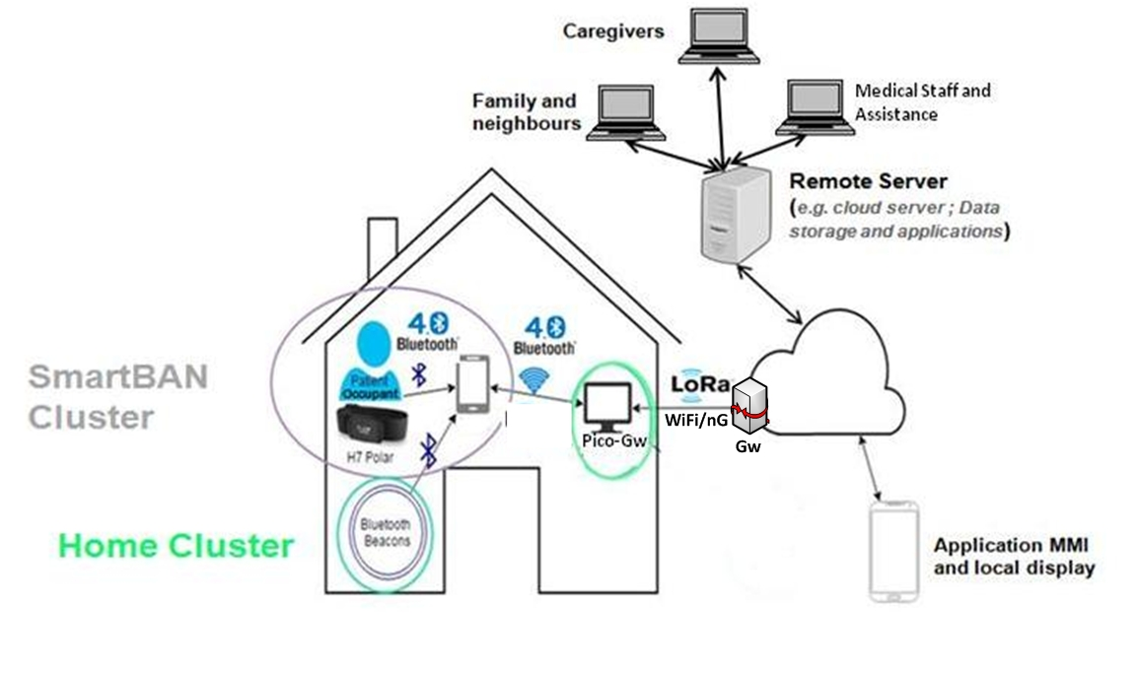


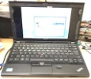

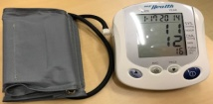
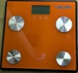
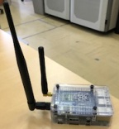
ETSI SmartBAN – CareWare EU project demonstrator
Elderly at home support & monitoring use case
H10
Polar
Samsung
Galaxy
S5
Samsung
Galaxy Tab
Arduino
Sensor
Emulator
TI
Sensor
Tag
Lenovo
X230
Pyle Arterial Blood
Pressure Monitor
Pyle Scale
Raspberry-PI 3
Local Server (semantic server ; Pico Gw): Gateway, data processing, semantic data creating, Local Cluster ontology management + local monitoring and control,
Remote Servers (e.g. cloud servers): data processing, semantic data creating, full ontology management , Caregivers/relatives’ coordination (monitoring and control purposes), notification management.
Slide 8

Slide 9
ETSI SmartBAN – CareWare EU project demonstrator (cont.)
Ontology/semantic related software used:
    Protégé for exploring, analyzing and testing the proposed ontology,
    JENA API for ontology creation, access, modification, reasoning (Pellet) & SPARQL query (server side, Raspberry-PI based Pico-GW),
    AndroJena (android version of JENA ; some reasoning limitations) + Fuseki (Smartphone-based BAN hub side),
    OWL-DL (server side, Raspberry-PI based Pico-GW), JSON-LD/CBOR (BAN side, Raspberry-PI based Pico-GW),
    SWRL for semantic rule-based embedded data analytic.
    IoT/oneM2M/communication related protocols used: HTTP/REST, CoAP, JSON, MQTT, LoRa, Bluetooth LE.
Slide 9

Slide 10
ETSI SmartBAN – CareWare EU project demonstrator (cont)
Few SWRL (Semantic Web Rule Language) rules used:
    Maximum Heart Rate exceeded:
      WBAN(?W), hasContact(?W, ?P), Contains(?W, ?S), usedFor(?S, HeartBeat), measures(?S, ?Mes), value(?Mes, ?mesure), MaxHR(?P, ?Q), hasValue(?Q, ?max), lessThan(?max, ?mesure) -> valid(?Mes, false)
      Fall detection
      WSN(?W), ComposedOf(?C, ?S), usedFor(?S, LinearAcceleration), hasData(LinearAcceleration, a), hasData(LinearAcceleration, az), hasMesurement(a, ?mesa1), hasMesurement(a, ?mesa2), hasOwner(?W, ?P), isFormedof(?W, ?C), uses(?P, ?C), Engagedin(?W, LinearAcceleration), TimeStamp(?mesa1, ?t1), TimeStamp(?mesa2, ?t2), value(?mesa1, ?val1), value(?mesa2, ?val2), greaterThan(?val2,9), lessThan(?val1,1), subtractDayTimeDurations (?t3,?t2,?t1), greaterThan(?t3,0), lessThan(?t3,1) ->hasStatus(?P,Falling)
    Node discovery query:
      SELECT ?WBAN ?Nodes ?Hub WHERE { ?WBAN full:Contains ?Nodes. ?WBAN full:ElectHub?Hub. }
Slide 10

Slide 11
Upper layer aspects and potential cooperation
  SmartM2M STF “SAREF extensions for Automotive, eHealth/Ageing-well and Water domains” (EC funding, beginning 2018?):
  BANs and SmartBAN TC (in particular TS 103 378 reference model) are mentioned as ‘to be addressed’ in STF document in a WI on eHealth / Ageing-well => SmartBAN involvement within this STF, in particular SmartBAN expert(s) funding by the STF, has to be discussed, adopted and scheduled during the joint meeting.
  SmartBAN TS 103 378 r1:
    SmartBAN reference model mapping and/or alignment with SAREF for “wellbeing for ageing well, wearables, eHealth, wellness, …” use cases => new STF ? Or included within SmartM2M STF “SAREF extensions…” for its specific use cases? This has to be raised during the joint meeting.
SmartBAN achievements usage on real use case(s):
  SmartBAN TS 103 378 & TR 103 327 was carried out on CareWare project ‘Elderly at home monitoring and support’ use case => interesting from a SmartM2M perspective?
Slide 11

Slide 12
Lower layer aspects and potential cooperation - Device, Radio, MAC, and Network definitions
M2M Device: A device that runs M2M Application(s) using M2M Service Capabilities. (Source: ETSI TS 102 690)
    This could be a SmartBAN node device?
    Can be connected directly to Network Domain via Access Network (WLAN etc.) −> Compare to relaying to other bands as discussed in the SmartBAN MAC rev.
  M2M Area Network. (Source: ETSI TS 102 690)
    Provides connectivity between M2M Devices and M2M Gateways.
      E.g. Zigee, Bluetooth. BAN defined by TC SmartBAN?
    M2M Gateway. (Source: ETSI TS 102 690)
      Gateway that runs M2M Application(s) using M2M Service Capabilities.
      Acts as a proxy between M2M Devices and the Network Domain.
      SmartBAN Hub?
Possible to combine SmartBAN PHY / MAC (and Marc’s WIs) and SmartM2M specifications as ETSI’s IoT solution?
Slide 12

Slide 13
Questions, roundtable and wrap-up
Are there potential areas for cooperation? If so, what?
Is it possible to combine the work done in TC SmartBAN and TC SmartM2M into ETSI’s IoT solution covering layers from physical through application?
Joint SmartBAN-SmartM2M workshop in 2018?
Slide 13

Slide 14
Thank you for your attention!
Slide 14

Slide 15
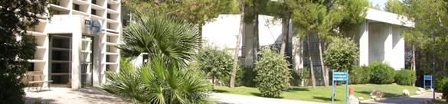
ETSI TC SmartBAN
ETSI Technical Committee (TC) Smart BAN (SmartBAN) was approved March 2013.
It is responsible for the development of ETSI standards, specifications and reports etc. supporting SmartBAN technologies in e.g. health, wellness, sport, smart living and other application domains.
SmartBAN covers communication and associated physical layer, network layer, security, QoS and also provision of generic applications and services (e.g. web) for standardisation in the area of BAN technologies.
SmartBAN takes a comprehensive view from PHY/MAC to higher layer system aspects (e.g. heterogeneity management, data transfer, coexistence, interaction).
www.hermes-europe.net/‎
Use what exists, fill in the gaps and make it work better
Slide 15
Notes:
European Telecommunications Standards Institute (ETSI), > 800 members from 68 countries setting global standards for ICT.
SmartBAN is an ETSI Technical Committee (TC), approved in March 2013.
It is responsible for the development of ETSI standards, specifications and reports etc. supporting SmartBAN technologies in e.g. health, wellness, sport, smart living and other application domains.
SmartBAN covers communication and associated physical layer, network layer, security, QoS and also provision of generic applications and services (e.g. web) for standardisation in the area of BAN technologies.
It takes a comprehensive view from PHY/MAC to higher layer system aspects (e.g. heterogeneity management, data transfer, coexistence, interaction).
SmartBAN is supported by the Hermes Partnership, a network of leading institutes in wireless and IoT networks in Europe
Hermes is perticipating via CSEM, one of the founding partners of SmartBAN

Slide 16


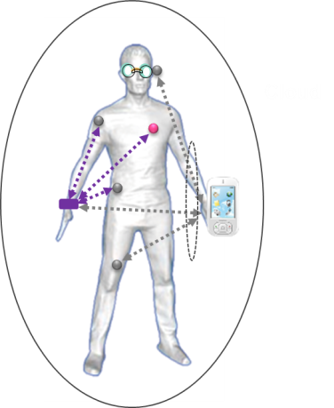


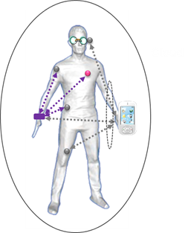
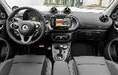

SmartBAN in the IoT – where are we today?
The work of TC SmartBAN is documented in the following ETSI Technical Specifications (TS) and Technical Reports (TR):
  TS: SmartBAN Unified data representation formats, semantic and open data model
  TS: SmartBAN Data representation and transfer, service and application; standardized interfaces, APIs and infrastructure for heterogeneity MGT
  TR: SmartBAN Measurements and Modelling of SmartBAN RF environment
  TS: Low complexity MAC and routing for SmartBAN
  TS: Enhanced, ultra-low power PHY for SmartBAN.
To be defined: smart control, network management, application to M-Band, security, SmartBAN implant comm
Backbone, dedicated cloud, infrastructure network…
…
Notes:
Here we see a kind of conceptual overview of SmartBAN in the IoT. Wherever you are, at home, in you car.
The status of SmartBAN today is documented in the following ETSI Technical Specifications (TS) and Technical Reports (TR):
TS: SmartBAN Unified data representation formats, semantic and open data model (Marc Girod-Genet)
TS: SmartBAN Data representation and transfer, service and application; standardized interfaces, APIs and infrastructure for heterogeneity MGT
TR: SmartBAN Measurements and Modelling of SmartBAN RF environment (Matti Hamlainen, Lorenzo Mucchi)
TS: Low complexity MAC and routing for Smart BAN (Hiro Tanaka)
TS: Enhanced, ultra-low power PHY for Smart BAN (Hiro Tanaka)
3. Also to be defined, smart control, network management, application to M-Band, security, SmartBAN implant communication
4. Key differences / value added wrt other standards include: Lower complexity PHY/MAC (e.g. no spread spectrum)., low power PHY / MAC (e.g. long sleep times), Network (star concept + multi hub relay (planned), Robustness (FEC), Support for operation across heterogeneous networks (e.g. semantic interaoparbility, heterogeneity management) - Enhanced interoperability / connectivity opetions e.g. via bridge / relay, multi-radio
5. Added smarts include:Additional semantic and data analytic enablers (e.g. semantic discovery, reasoning / rules), Automatic node discovery (e.g. semantic discovery of nodes, composition)

Slide 17
Next steps for SmartBAN
Release of TR 103 394 - System Description SmartBAN
NWI on implant communication liason with ERM TG 30
Possible STF’s in ETSI
  Joint STF with SmartBAN and SmartM2M
  STF envisioned for merging and/or aligning the SmartBAN ontology with SAREF + oneM2M ontologies
  SmartBANs security and privacy
  Semantic discovery/annotation/binding mechanisms for constrained nodes/Things
Collaboration with ACTIVAGE e.g. on wearables, WBAN and semantic interoperability for Active & Healthy Ageing IoT
A SmartBAN workshop is planned at ETSI in the January-February timeframe 2018
Slide 17
Notes:
Release of TR 103 394 - System Description SmartBAN (Hiro Tanaka)
New Work Item (NWI) on implant communication liason with ERM TG 30
Possible Scientific Task Force (STF’s) in ETSI (Marc Girod-Genet)
Joint STF with SmartBAN and SmartM2M wrt semantic uinteroperability
STF envisioned for merging and/or aligning the SmartBAN ontology with SAREF + oneM2M ontologies (SAREF = Smart Appliances REFerence ontology)
SmartBANs security and privacy
Semantic discovery/annotation/binding mechanisms for constrained nodes/Things
3. We also of course envision collaboration with ACTIVAGE e.g. on wearables, WBAN and semantic interoperability for AHA Active & Healthy Ageing IoT (John Farserotu)
4. I would also like to take this occasion to announce that a SmartBAN workshop is planned at ETSI in the Jan-Feb timeframe 2018 and a joint meeting with ETSI TC SmartM2M is also planned to coincide with this event
5. Your participation is welcome! (John Farserotu, Marcello Pagnozzi, Ad de Ridder,)

