Slide 1
MAC address assignment in IEEE 802.11 through IEEE 802.11aq
Antonio de la Oliva (UC3M, IDCC)
aoliva@it.uc3m.es
On behalf of the IEEE 802.1CQ group

Slide 2
IEEE 802.1CQ Scope
As defined in the PAR:
“This standard specifies protocols, procedures, and management objects for locally-unique assignment of 48-bit and 64-bit addresses to ports in IEEE 802 networks”
Actually, we are working on mechanisms for the distribution of Local MAC addresses (in the 802c defined SAI space) including stateful and stateless procedures, on a per-technology basis.

Slide 3
802c quadrants
Specification of the use of the SAI quadrant for SLAP address assignments is reserved for the standard forthcoming from IEEE P802.1CQ.

Slide 4
Scenarios
Functional Scenarios
Stateless/Statefull Assignment of addresses to End-stations
802.11
802.3
VMs/Containers
802.15 (if expertise appears)
Stateless/Statefull Assignment of addresses to Bridges/APs
Including Assignment of groups of addresses
Statefull Assignment of pools of addresses to Proxies from Servers
Network Scenario
Hypervisor scenario
Container scenario
WLAN scenario

Slide 5
Motivation for a specific mechanism in IEEE 802.11
MAC address is part of the state information required for the association and security in WLAN
Any modification of MAC address in WLAN forces a new association and security association establishment
If MAC assignments are required in a given network, it is required to discover the address in pre-association

Slide 6
Motivation for a specific solution for .15
Different business use cases can be enabled by Smart assignment of MAC addresses
48 bit address assignment
Hierarchical MACs for heterogeneous sensors
Meaningful addresses associated to sensor clases
Is IEEE 802.15 MAC addresses assigned in pre-associated state?

Slide 7
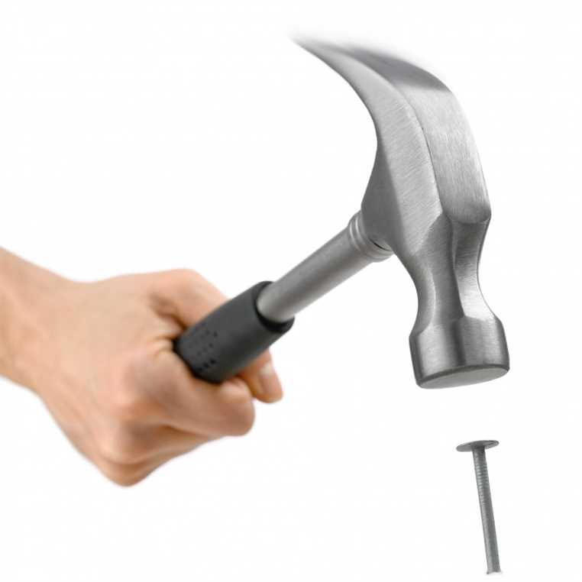
Does DHCPv6 solve the issue?
Existing infrastructure: protocol, network, tools
Servers already know how to manage and assign resources
Protocol easily extensible
Tomek and Bernie are in DHC WG co-chairs and …

Slide 8
IA_LL Option
0 1 2 3
0 1 2 3 4 5 6 7 8 9 0 1 2 3 4 5 6 7 8 9 0 1 2 3 4 5 6 7 8 9 0 1
+-+-+-+-+-+-+-+-+-+-+-+-+-+-+-+-+-+-+-+-+-+-+-+-+-+-+-+-+-+-+-+-+
| OPTION_IA_LL | option-len |
+-+-+-+-+-+-+-+-+-+-+-+-+-+-+-+-+-+-+-+-+-+-+-+-+-+-+-+-+-+-+-+-+
| IAID (4 octets) |
+-+-+-+-+-+-+-+-+-+-+-+-+-+-+-+-+-+-+-+-+-+-+-+-+-+-+-+-+-+-+-+-+
| T1 (4 octets) |
+-+-+-+-+-+-+-+-+-+-+-+-+-+-+-+-+-+-+-+-+-+-+-+-+-+-+-+-+-+-+-+-+
| T2 (4 octets) |
+-+-+-+-+-+-+-+-+-+-+-+-+-+-+-+-+-+-+-+-+-+-+-+-+-+-+-+-+-+-+-+-+
. .
. IA_LL-options .
. .
+-+-+-+-+-+-+-+-+-+-+-+-+-+-+-+-+-+-+-+-+-+-+-+-+-+-+-+-+-+-+-+-+
IAID identifies instance of IA_LL option to allow for many
T1 is renewal time (from “now” in seconds)
T2 is rebinding time (from “now” in seconds)
IA_LL-options contains one or more IA_LL options

Slide 9
Why DHCP is not the solution for end user devices
Requires of a MAC address to perform the request
Requires of a complete IP stack and complex management
IEEE 802.1CQ assumes it to be a perfect match for Proxy LAAP to LAAP Server communication

Slide 10
Conclusion
IEEE 802.1CQ is working towards the definition of a LAAP (Local Address Assignment Protocol) to assign 48/64 bit addresses in the SAP quadrant
We are looking at several use cases in the wired and Wireless world
Work in IEEE 802.11 shows that technology specific hooks are needed due to the special treatment of the MAC address in association and authentication processes
With this presentation we are calling for participation from IEEE 802.15 WG

