Slide 1
Project: IEEE P802.15 Working Group for Wireless Personal Area Networks (WPANs)
Submission Title: Vehicle Front Windows based In-Vehicle Highway Rest Area Ordering Solution Using OWC Link
Date Submitted: November 2018
Source: Jaesang Cha (SNUST), Hyoungkyu Song (Sejong Univ.), Minho Lee, Jonghyeok Lee (SNUST), Youngmin Kim (Ire front Co., Ltd.), Sooyoung Chang (SYCA), Vinayagam Mariappan (SNUST)
Address: Contact Information: +82-2-970-6431, FAX: +82-2-970-6123, E-Mail: chajs@seoultech.ac.kr
Re:
Abstract: This documents introduce the V2I OWC Link design consideration for VAT. This proposed OWC technology for In-Vehicle Highway Rest Area Ordering Solution using Vehicle Front Window. This VAT solution is to operate on the application services like ITS, ADAS, IoT/IoL, etc. on road condition. Also this can be used for LEDIT, Digital Signage with connected information services etc.
Purpose: To provided concept models of VLC technology solution for Vehicular Assistant Technology (VAT) Interest Group
Notice: This document has been prepared to assist the IEEE P802.15. It is offered as a basis for discussion and is not binding on the contributing individual(s) or organization(s). The material in this document is subject to change in form and content after further study. The contributor(s) reserve(s) the right to add, amend or withdraw material contained herein.
Release: The contributor acknowledges and accepts that this contribution becomes the property of IEEE and may be made publicly available by P802.15.
Slide 1

Slide 2
Contents
Need for In-Vehicle Highway Rest Area Ordering Solution
Vehicle Front Windows based OWC Link for In-Vehicle Ordering Solution
Conclusion
Slide 2

Slide 3
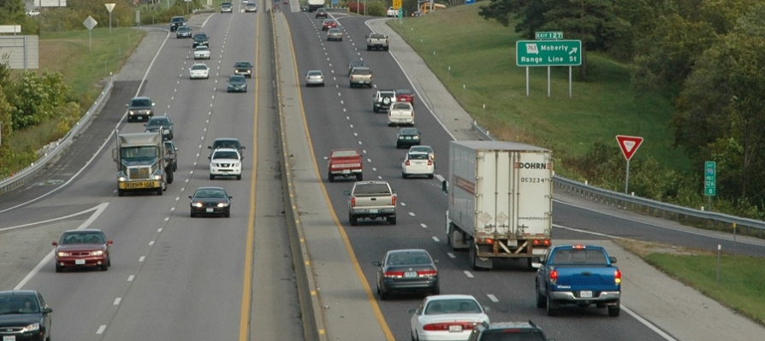
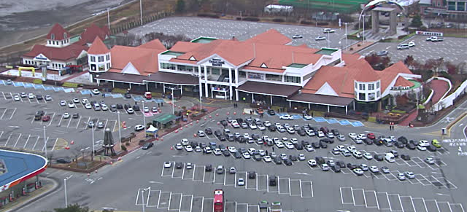
Need for In-Vehicle Highway Rest Area Ordering Solution
Needs
  There are many waiting vehicles in the rest area in highway on peak hours, weekends, and festival days
  Takes time to get the food order arrival at the rest area when go to rest area in the highway.
  Need In-Vehicle ordering solution while driving on high ways
Basic Concept
  Use the front window as transparent display to transmit the 2D color coded information like order, vehicle specific information etc.
  Highway Installed CCTV Cameras used as OWC Receiver to take In-Vehicle Order
  Helps to give advance order and deliver the food on vehicle arrival in the rest area without any delay
  < Highway Rest Area Scenario >
Slide 3

Slide 4


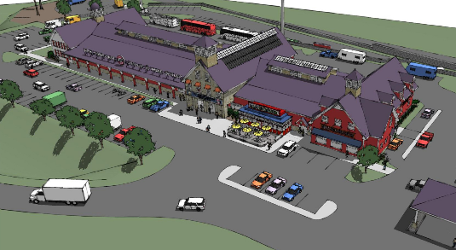

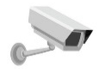
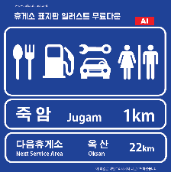



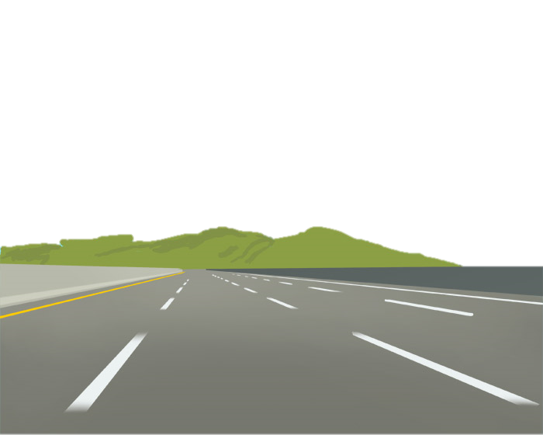

Vehicle Front Windows based OWC Link for In-Vehicle Ordering Solution
In-Vehicle Ordering Solution for Highway Driving Using OWC Link
  Tx : Vehicle Front Window
  Rx : Highway CCTV Camera
  Day-Night Communication Mode
  Modulations
    VTASC, SS2DC, OOK, VPPM, Offset-VPWM, Multilevel PPM, Inverted PPM, Subcarrier PPM, DSSS SIK etc.
  Data Rate : 1K ~ 1Mb/s
  Supported LoS (Line of Sight)
  Available Distance : 2m ~ 200m
  Camera
  Highway Rest Area Ordering Solution
Rest Area
Next
  < OWC Link Model In-Vehicle Ordering Solutions >
※ This Transparent display based OWC technology proposed to do In-Vehicle restaurant ordering solution when drive through highways.
※ Allows driving persons take enough rest after food and helps to prevents accidents by restless driving.
Slide 4

Slide 5
Conclusion
Proposed the Vehicle Front Windows based In-Vehicle Restaurant Ordering Solution on Highways drive using OWC Link
In-Vehicle restaurant ordering solution used for remotely ordering food at a rest area based on the highway guide signs installed on the expressway and the car windows
This is vary efficient solution because no separate delay time occurs to receiver ordered foods.
The proposed solution does not to install additional device, so this is economical and the volume of usage of this technology is expected to be large
Allows driving persons take enough rest after food and helps to prevents accidents by restless driving
Slide 5

