Slide 1
Project: IEEE P802.15 Working Group for Wireless Personal Area Networks (WPANs)
Submission Title: LiFi/CamCom Link for Secured Military Aircrafts Communication
Date Submitted: November 2018
Source: Jaesang Cha (SNUST), Kaewon Choi (Sungkyunkwan Univ.), Sangwoon Lee (Namseoul Univ.), Jinyoung Kim (Kwangwoon Univ.), Jeonggon Kim (Korea Polytechnic Univ.), Chanhyeong Jeong (RAPA), Sooyoung Chang (SYCA), Vinayagam Mariappan (SNUST)
Address: Contact Information: +82-2-970-6431, FAX: +82-2-970-6123, E-Mail: chajs@seoultech.ac.kr
Re:
Abstract: This documents introduce the V2V LiFi/CamCom Link design consideration for VAT. This proposed LiFi/CamCom for secured communication between military aircrafts. This VAT to operate on the application services like ITS, ADAS, IoT/IoL, etc. on road condition. Also this can be used for LEDIT, Digital Signage with connected information services etc.
Purpose: To provided concept models of Light Communication based LiFi/CamCom solution for Vehicular Assistant Technology (VAT) Interest Group
Notice: This document has been prepared to assist the IEEE P802.15. It is offered as a basis for discussion and is not binding on the contributing individual(s) or organization(s). The material in this document is subject to change in form and content after further study. The contributor(s) reserve(s) the right to add, amend or withdraw material contained herein.
Release: The contributor acknowledges and accepts that this contribution becomes the property of IEEE and may be made publicly available by P802.15.
Slide 1

Slide 2
Contents
Needs for Secured Military Aircrafts Communication
LiFi / CamCom Link for Secured Military Aircrafts Communication
Conclusion
Slide 2

Slide 3
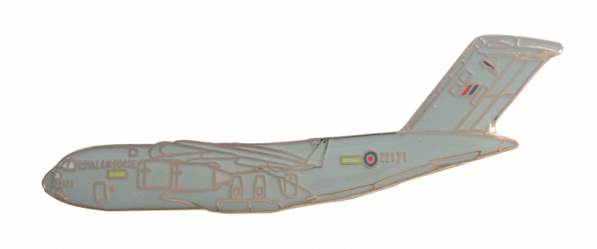
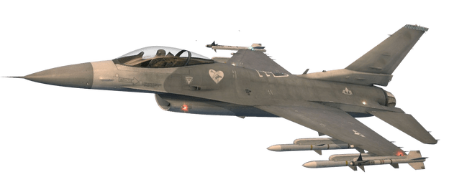
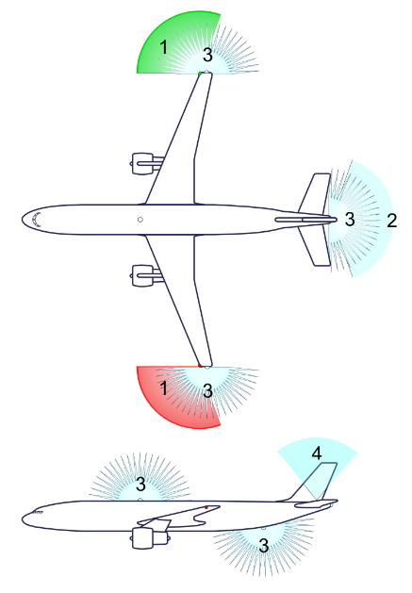
Needs for Secured Military Aircrafts Communication
Needs
Military aircraft uses the Light Signaling and RF based communication methods that is an effective way for aircraft to communicate
Military aircrafts communication includes command, control, intelligence communication
Military aircrafts and VIP persons air vehicles needs to communicate with escort airplanes secretly without interpreting by others
Needs to communicate secured manner
Basic Concept
Uses the Lighting System and the Camera Connected on aircrafts to enable LiFi/CamCom Link for communication
Lighting on the wings of aircraft or on the tail of plane
Navigation lights Aft light , Anti-collision strobe lights, Logo light
LiFi / CamCom Links avoids any communication interferences and provides more secure and safety communication between military aircrafts
< Military Aircrafts Communication Using RF >
< Aircrafts Lightings >
Navigation Lights 2) AFT Light
3) Anti-Collision Strobe Lights 4) Logo Light
GOOGLE
Slide 3

Slide 4
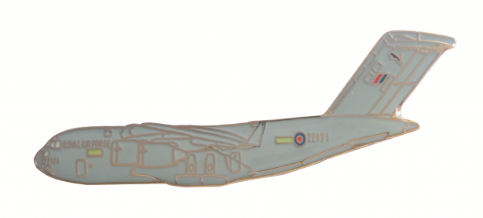
LiFi / CamCom Link for Secured Military Aircrafts Communication
Light Communication Based LiFi/CamCom Link for Secured Military Aircrafts Communication
Tx : Military Aircrafts Lighting Device
Rx : PD / CMOS Image Sensor
Day-Night Communication Mode
Modulations :
OOK, VPPM, Offset-VPWM, Multilevel PPM, Inverted PPM, Subcarrier PPM, DSSS SIK etc.
Data Rate : 1K ~ 1Mb/s
Supported LoS (Line of Sight)
Available Distance : 2m ~ 200m
360 Camera
360 Camera
360 Camera
< Military Aircrafts Communication Using LiFi/CamCom Link >
※ This LiFi/CamCom technology can be used in Military aircrafts communication system for secured information sharing between military aircrafts that includes command, control, intelligence communication through aircraft signaling lights.
Slide 4

Slide 5
Conclusion
Proposed the Secured Military Aircrafts Communication method using LiFi/CamCom Technology
Proposed system uses the Lighting System and the Camera connected on the wings of aircraft or on the tail of plane to enable LiFi/CamCom Link for communication between military aircrafts to make secure communication.
Used to send high speed command, control, intelligence communication through aircraft signaling lights which is not interpretable by third party or hackers
Slide 5

