Slide 1
Project: IEEE P802.15 Working Group for Wireless Personal Area Networks (WPANs)
Submission Title: Vehicle Tracking / Navigation Solution for ITS Service using IoT/IoL Technology
Date Submitted: November 2018
Source: Jaesang Cha (SNUST), Juphil Cho (Kunsan Univ.), Sangwoon Lee (Namseoul Univ.), Kiyun Kim (Myongji College), Yongkyu Yoon (University of Florida), Jonghyeok Lee (SNUST), Youngmin Kim (Ire front Co., Ltd.), Sooyoung Chang (SYCA), Jintae Kim (Fivetek Co., Ltd.), Kirak Jung (Namuga Co. Ltd.), Vinayagam Mariappan (SNUST)
Address: Contact Information: +82-2-970-6431, FAX: +82-2-970-6123, E-Mail: chajs@seoultech.ac.kr
Re:
Abstract: This documents introduce the V2X IoT/IoL Link design consideration for VAT. This proposed IoT/IoL Technology used for Vehicle Tracking / Navigation in ITS Service. This VAT to operate on the application services like ITS, ADAS, IoT/IoL, etc. on road condition. Also this can be used for LEDIT, Digital Signage with connected information services etc.
Purpose: To provided concept models of light communication based IoT/IoL solution for Vehicular Assistant Technology (VAT) Interest Group.
Notice: This document has been prepared to assist the IEEE P802.15. It is offered as a basis for discussion and is not binding on the contributing individual(s) or organization(s). The material in this document is subject to change in form and content after further study. The contributor(s) reserve(s) the right to add, amend or withdraw material contained herein.
Release: The contributor acknowledges and accepts that this contribution becomes the property of IEEE and may be made publicly available by P802.15.
Slide 1

Slide 2
Contents
Need for Vehicle Tracking / Navigation Solution
IoT/IoL Link for Vehicle Tracking / Navigation Solution
Conclusion
Slide 2

Slide 3
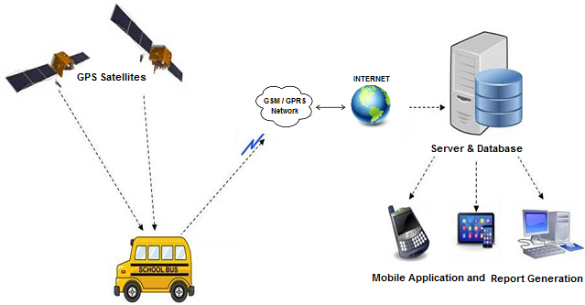
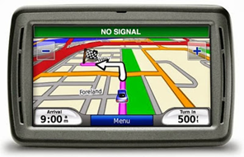
Need for Vehicle Tracking / Navigation Solution
Needs
GPS based vehicle tracking system provides the location of the object, that allows us to trace in detail the entire route of the vehicle and control of numerous other parameters.
Signal of Satellite navigation system under certain conditions may not reach the receiver or arrive with significant delays and distortions.
In the apartment located in a concrete building, tunnel or basement, it is almost impossible to determine the exact location.
Basic Concept
Street lighting system used as an access point which transmits the data between vehicle and operator or server
Vehicle receives data through Photo Detector or Camera updates the location information of vehicle.
Can be used under any weather conditions, any location (tunnel, underground, etc.)
No interference from other radio source
No need additional connection with operator
< Vehicle Tracking System >
< Vehicle Navigation System >
Slide 3

Slide 4
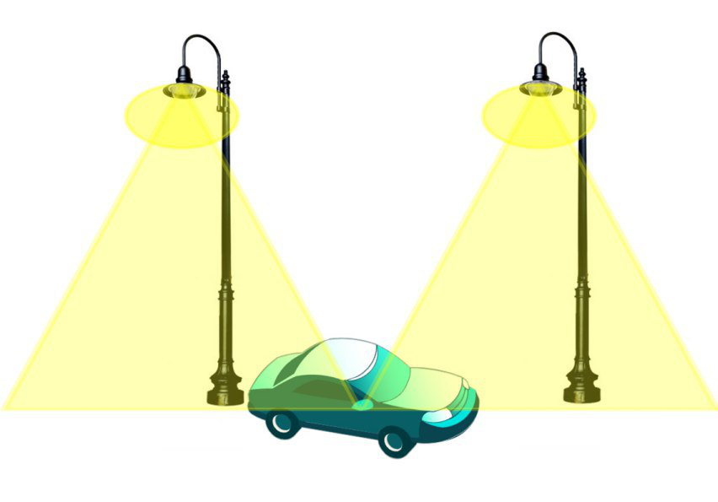
IoT/IoL Link for Vehicle Tracking/Navigation Solution
Access Point
Vehicle Tracking / Navigation Solution Using IoT / IoL Link
Tx : Street Lamp
Rx : Photo Detector / Image Sensor
Day-Night Communication Mode
Modulations
VTASC, SS2DC, OOK, VPPM, Offset-VPWM, Multilevel PPM, Inverted PPM, Subcarrier PPM, DSSS SIK etc.
Data Rate : 1K ~ 1Mb/s
Supported LoS (Line of Sight)
Available Distance : 2m ~ 200m
< V2X IoT/IoL Link for Vehicle Tracking / Navigation Solution >
Navigation information based on IoT/IoL connectivity link which allows to receive accurate location information
Vehicle Navigation system can get position information and other additional information services
Slide 4

Slide 5
Conclusion
Proposed the Vehicle Tracking / Navigation Solution for ITS Service using IoT/IoL Technology.
IoT/IoL navigation system is weather independent and allows to track the vehicle in a concrete building, tunnel or basement.
No need install additional communication channel between vehicle and operator or server.
Slide 5

