Slide 1
Project: IEEE P802.15 Working Group for Wireless Personal Area Networks (WPANs)
Submission Title: Object Features Based Automatic Drone Navigation Solution for Moving Object Tracking using IoT/IoL Communication Link
Date Submitted: November 2018
Source: Jaesang Cha (SNUST), Kwanjong Jang(Daejeon Dongbu Police Station), Minwoo Lee (SNUST), Sooyoung Chang (SYCA), Mariappan Vinayagam (SNUST)
Address: Contact Information: +82-2-970-6431, FAX: +82-2-970-6123, E-Mail: chajs@seoultech.ac.kr
Re:
Abstract: This documents introduce the V2V IoT/IoL communication Link design consideration for VAT. This proposed IoT/IoL communication Technology used for Moving Object Tracking using Drones in security services. This VAT to operate on the application services like ITS, ADAS, IoT/IoL, etc. on road condition. Also this can be used for LEDIT, Digital Signage with connected information services etc.
Purpose: To provided concept models of light communication based IoT/IoL solution for Vehicular Assistant Technology (VAT) Interest Group.
Notice: This document has been prepared to assist the IEEE P802.15. It is offered as a basis for discussion and is not binding on the contributing individual(s) or organization(s). The material in this document is subject to change in form and content after further study. The contributor(s) reserve(s) the right to add, amend or withdraw material contained herein.
Release: The contributor acknowledges and accepts that this contribution becomes the property of IEEE and may be made publicly available by P802.15.
Slide 1

Slide 2
Contents
Need for Drone Based Moving Object Tracking Solution
IoT/IoL Link for Object Feature based Object Tracking Using Drones
Conclusion
Slide 2

Slide 3
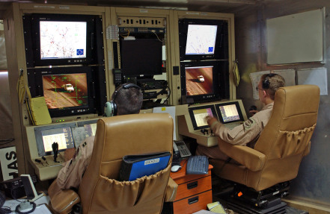
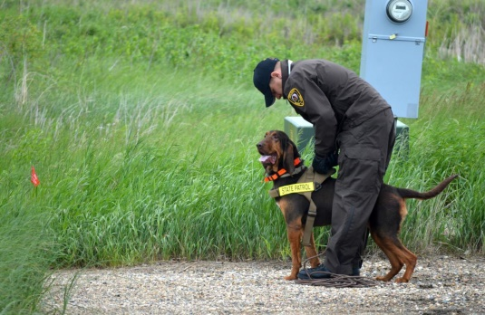
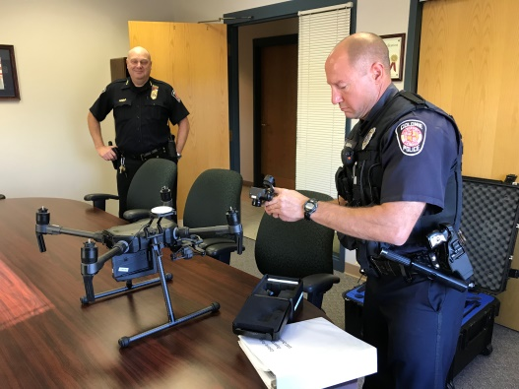
Need for Drone Based Moving Object Tracking Solution
Needs
Object Identification and Tracking is critical issue nowadays for public safety and security in common living areas
WatchGuard Security Service, Police and Army uses different methods to identify and track the object or person.
Very hard to identify and track objects in crowded condition, streets, building areas, deep trees grown areas since the possibility of occlusion is very high.
Drones based object identification and tracking can resolve this problem.
Basic Concept
Drones can self organize a dynamic tracking network without dependence on the location and duration of battery life
Uses the Drone front and back LED lights as a Transmitter and Camera connected on Drone as a receiver to get Object and navigation informations between Drones in Lighting Network.
No need additional infrastructure required to form Done Object Tracking network
GOOGLE
< Object Identification and Tracking Service Usage Scenario >
Slide 3

Slide 4
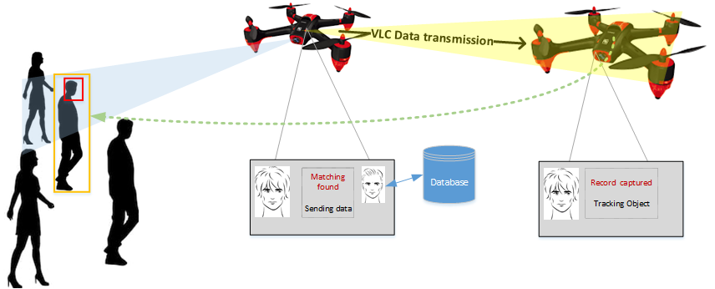
IoT/IoL Link for Object Feature based Object Tracking Using Drones
Moving Object Tracking based Drone Navigation Solution Using IoT / IoL Link
Tx : Drone Front and Back Lights
Rx : Drone Connected Image Sensor
Day-Night Communication Mode
Modulations
OOK, VPPM, Offset-VPWM, Multilevel PPM, Inverted PPM, Subcarrier PPM, DSSS SIK etc.
Data Rate : 1K ~ 1Mb/s
Supported LoS (Line of Sight)
Available Distance : 2m ~ 200m
< V2V IoT/IoL Link for Object Tracking based Drone Navigation Solution >
Object Features and Drone Navigation Information Transmitted through IoT/IoL communication link which allows to track the moving object dynamically without missing by occlusion
Allows to instantly identify object by received object features and required navigation informations
Improves the moving object tracking accuracy
Slide 4

Slide 5
Conclusion
Proposed the Object Features Based Automatic Drone Navigation Solution for Moving Object Tracking using IoT/IoL Communication Link.
Uses the Drone front and back LED lights as a Transmitter and Camera connected on Drone as a receiver
Object Features and Drone Navigation Information Transmitted through IoT/IoL communication link which allows to track the moving object without missing by occlusion.
No need OF any additional infrastructure drone based object tracking network using IoT/IoL link.
Slide 5

