Slide 1
Project: IEEE P802.15 Working Group for Wireless Personal Area Networks (WPANs)
Submission Title: IoT Street Lighting System based LiFi/OCC Link for Auto Navigation of Solution Drone Patrol Service
Date Submitted: November 2018
Source: Jaesang Cha (SNUST), Juphil Cho (Kunsan Univ.), Donghoon Hyun (Korea Polytechnic Univ.), Kiyun Kim (Myongji College), Yongkyu Yoon (University of Florida), Hyeongho Lee (Netvision Telecom Inc., Korea Univ.), Yoonkwan Kim (The Catholic Univ.), Minseok Oh (Kyonggi Univ.), Jinyong Choi (Shinhan Bank), Sungdoo Kang (Feelux Co., Ltd.), Changsoo Lee (L&S LED Co., Ltd.), Vinayagam Mariappan (SNUST)
Address: Contact Information: +82-2-970-6431, FAX: +82-2-970-6123, E-Mail: chajs@seoultech.ac.kr
Re:
Abstract: This documents introduce the V2I LiFi/OCC Link design consideration for VAT. This proposed LiFi/OCC technology used for drone patrolling service using LED street lamps . This VAT to operate on the application services like ITS, ADAS, IoT/IoL, drone using watch security services, and etc.
Purpose: To provided concept models of Light Communication based LiFi/OCC technology solution for Vehicular Assistant Technology (VAT) Interest Group
Notice: This document has been prepared to assist the IEEE P802.15. It is offered as a basis for discussion and is not binding on the contributing individual(s) or organization(s). The material in this document is subject to change in form and content after further study. The contributor(s) reserve(s) the right to add, amend or withdraw material contained herein.
Release: The contributor acknowledges and accepts that this contribution becomes the property of IEEE and may be made publicly available by P802.15.
Slide 1

Slide 2
Contents
Needs for Auto Navigation of WatchGuard Security Services
IoT Street Lighting based LiFi / OCC Link for Drone Patrol Service
Conclusion
Slide 2

Slide 3
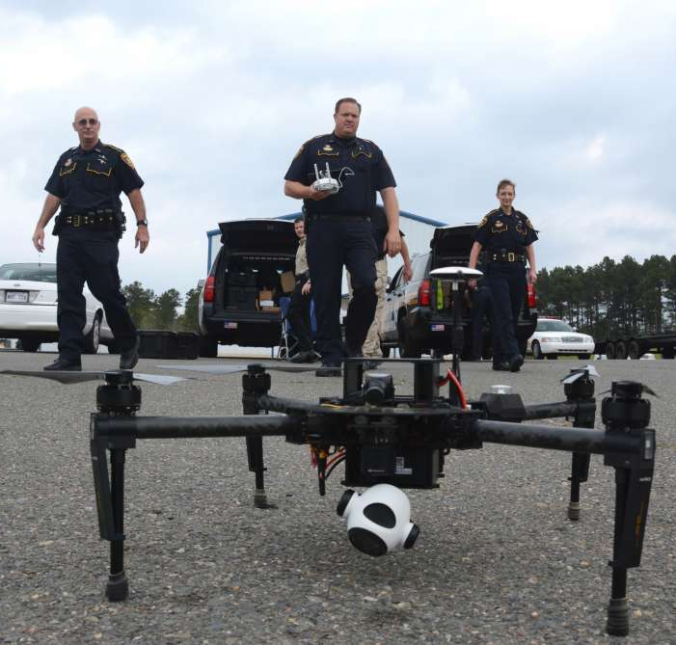
Needs for Auto Navigation of WatchGuard Security Services
Needs
Nowadays police officials and army troopers are successfully uses the drone services for the WatchGuard security services in different situations.
Navigation of security drone is always need full control of operator.
Auto navigation system for the patrol drones is needed, to make watch service officers work more effective since they can control more drones at the same time in case of emergency situations.
Basic Concept
Uses the Street Lighting System and the Camera Connected on Drone to enable LiFi / OCC Link for communication to get navigation informations
Street public lighting system provides the navigation, and location information for drone based patrol service
LiFi / OCC Links avoids any communication interferences and provides secure and precise location Information
GOOGLE
< Drone WatchGuard Security Services >
Slide 3

Slide 4
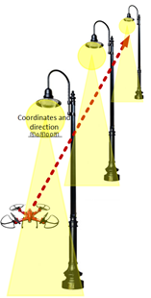
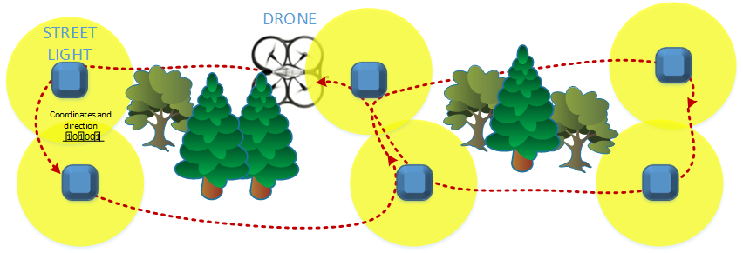
IoT Street Lighting based LiFi / OCC Link for Drone Patrol Service
IoT Street Lighting System Based LiFi/OCC Link for Patrol Service Using Drone
Tx : Street Lighting System
Rx : PD / CMOS Image Sensor
Day-Night Communication Mode
Modulations :
OOK, VPPM, Offset-VPWM, Multilevel PPM, Inverted PPM, Subcarrier PPM, DSSS SIK etc.
Data Rate : 1K ~ 1Mb/s
Supported LoS (Line of Sight)
Available Distance : 2m ~ 100m
Provides current location information, Routing path selection
Information on remaining distance till next controlling point
Pre loading command information for activities if next traveling point is available/reachable or not
< Street Light based LiFi/OCC Link for Patrol Service >
Slide 4

Slide 5
Conclusion
Proposed the Auto Navigation of Solution Drone Patrol Service using IoT Street Lighting System based LiFi/OCC Technology
Proposed system uses the Street Lighting System and the Camera connected on the Drone to enable LiFi/CamCom Link to get navigation informations to move on automatically.
Used for automatic navigation, locate position of security service WatchGuard drone and create optimized routes for the security service WatchGuard area.
Also used to preload the list of activities for WatchGuard Security Services
Slide 5

