Slide 1
Project: IEEE P802.15 Working Group for Wireless Personal Area Networks (WPANs)
Submission Title: Checkpoints Reporting Using IoT/IoL Technology for Drone based Guard Tour Solution
Date Submitted: November 2018
Source: Jaesang Cha (SNUST), Kwanjong Jang(Daejeon Dongbu Police Station), Minwoo Lee(SNUST), Beomhee Lee (SNUST), Sooyoung Chang (SYCA), Mariappan Vinayagam (SNUST)
Address: Contact Information: +82-2-970-6431, FAX: +82-2-970-6123, E-Mail: chajs@seoultech.ac.kr
Re:
Abstract: This documents introduce the V2I IoT/IoL Connectivity Link design consideration for VAT. This proposed IoT/IoL Connectivity Technology used for checkpoints reporting of Drone based Guard Tour System. This VAT to operate on the application services like ITS, ADAS, IoT/IoL, etc. on road condition. Also this can be used for LEDIT, Digital Signage with connected information services etc.
Purpose: To provided concept models of light communication based IoT/IoL solution for Vehicular Assistant Technology (VAT) Interest Group.
Notice: This document has been prepared to assist the IEEE P802.15. It is offered as a basis for discussion and is not binding on the contributing individual(s) or organization(s). The material in this document is subject to change in form and content after further study. The contributor(s) reserve(s) the right to add, amend or withdraw material contained herein.
Release: The contributor acknowledges and accepts that this contribution becomes the property of IEEE and may be made publicly available by P802.15.
Slide 1

Slide 2
Contents
Need for Drone Based Guard Tour Patrol Solution
Checkpoints Reporting IoT/IoL Link for Drone based Guard Tour Solution
Conclusion
Slide 2

Slide 3
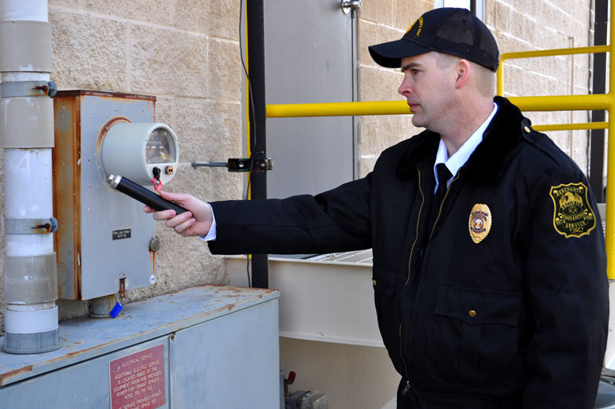
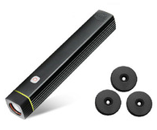
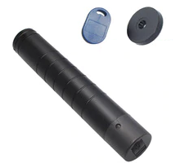
Need for Drone Based Guard Tour Patrol Solution
Needs
Human Guards patrol creates on environment of calm and order, as it discourages criminal activity.
Used for security guards patrolling, technicians monitoring climate-controlled environments, and correctional officers
Guard Tour patrol system is a system for logging the rounds of guards employees in a variety of situations.
Uses the three kind of technology GPS, GPRS,RFID for check points reporting
Human Guards limits vigilant the scheduled patrols by touring on defined route and does not record visual data
Also vigilant on raining, snowing , windy time is difficult and not efficient
Basic Concept
Drones based schedule autonomous patrol will provide more efficient surveillance than human guard based vigilant.
Uses the Drone front and back LED lights as a Transmitter and Photo detector or CCTV Camera based receiver at check points to reporting tour patrol.
< Security Guard Tour Patrol Checkpoints Reporting Scenario >
< Security Guard Tour Patrol Checkpoints RFID Tag >
Slide 3

Slide 4
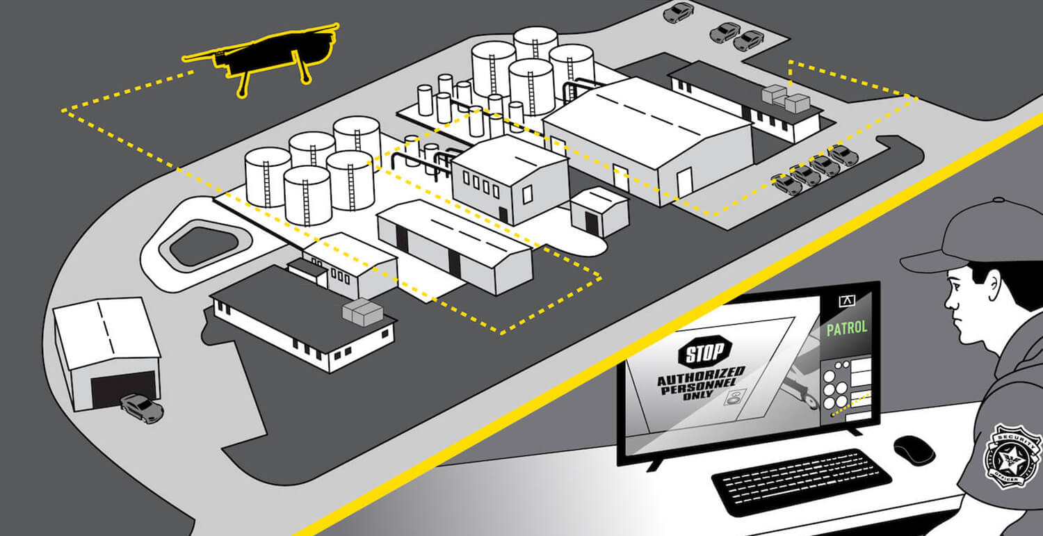
Checkpoints Reporting IoT/IoL Link for Drone
Based Guard Tour Solution
Checkpoints Reporting for Drone Based Guard Tour Solution Using IoT / IoL Link
Tx : Drone Front and Back Lights
Rx : PD / CCTV Image Sensor in Patrol Region
Day-Night Communication Mode
Modulations
OOK, VPPM, Offset-VPWM, Multilevel PPM, Inverted PPM, Subcarrier PPM, DSSS SIK etc.
Data Rate : 1K ~ 1Mb/s
Supported LoS (Line of Sight)
Available Distance : 2m ~ 200m
< V2I IoT/IoL Link for Checkpoints Reporting of Drone Based Guard Tour Solution >
Integrating Drone based guard with a computerized security system, security is made even more vigilant.
Drone guard tour patrol system is a system for logging the rounds of tour in a variety of situations such as security guards patrolling property, technicians monitoring climate-controlled environments.
Possible to record the scheduled patrols visual history for defined route in addition to guard tour
Slide 4

Slide 5
Conclusion
Proposed the Checkpoints Reporting Using IoT/IoL Technology for Drone based Guard Tour Solution.
Uses the Drone front and back LED lights as a Transmitter and PD or CCTV Camera connected in Guard Tour check points
Drone guard tour patrol system is a system for logging the rounds of tour in a variety of situations such as security guards patrolling property, technicians monitoring climate-controlled environments and store the guard tour visual record.
No need of any additional infrastructure drone based Guard Tour Solution using IoT/IoL link.
Slide 5

