Slide 1
Project: IEEE P802.15 Working Group for Wireless Personal Area Networks (WPANs)
Submission Title: IoT/IoL Technology for Indoor Firefighters Navigation Guidance Using LiDAR Drone
Date Submitted: November 2018
Source: Jaesang Cha (SNUST), Kwanjong Jang (Daejeon Dongbu Police Station), Minwoo Lee (SNUST), Beomhee Lee (SNUST), Sooyoung Chang (SYCA), Mariappan Vinayagam (SNUST)
Address: Contact Information: +82-2-970-6431, FAX: +82-2-970-6123, E-Mail: chajs@seoultech.ac.kr
Re:
Abstract: This documents introduce the V2V IoT/IoL Communication Link design consideration for VAT. This proposed IoT/IoL Technology used for Indoor Firefighters Navigation Guidance Using LiDAR Drone in Fire disasters. This VAT to operate on the application services like ITS, ADAS, IoT/IoL, etc. on road condition. Also this can be used for LEDIT, Digital Signage with connected information services etc.
Purpose: To provided concept models of light communication based IoT/IoL solution for Vehicular Assistant Technology (VAT) Interest Group.
Notice: This document has been prepared to assist the IEEE P802.15. It is offered as a basis for discussion and is not binding on the contributing individual(s) or organization(s). The material in this document is subject to change in form and content after further study. The contributor(s) reserve(s) the right to add, amend or withdraw material contained herein.
Release: The contributor acknowledges and accepts that this contribution becomes the property of IEEE and may be made publicly available by P802.15.
Slide 1

Slide 2
Contents
Need for Indoor Firefighters Navigation Guidance
LiDAR Drone IoT/IoL Link for Firefighters Navigation Guidance
Conclusion
Slide 2

Slide 3
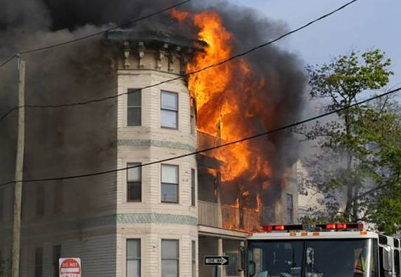
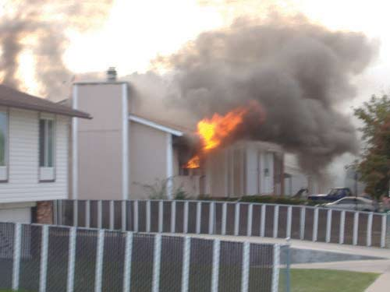
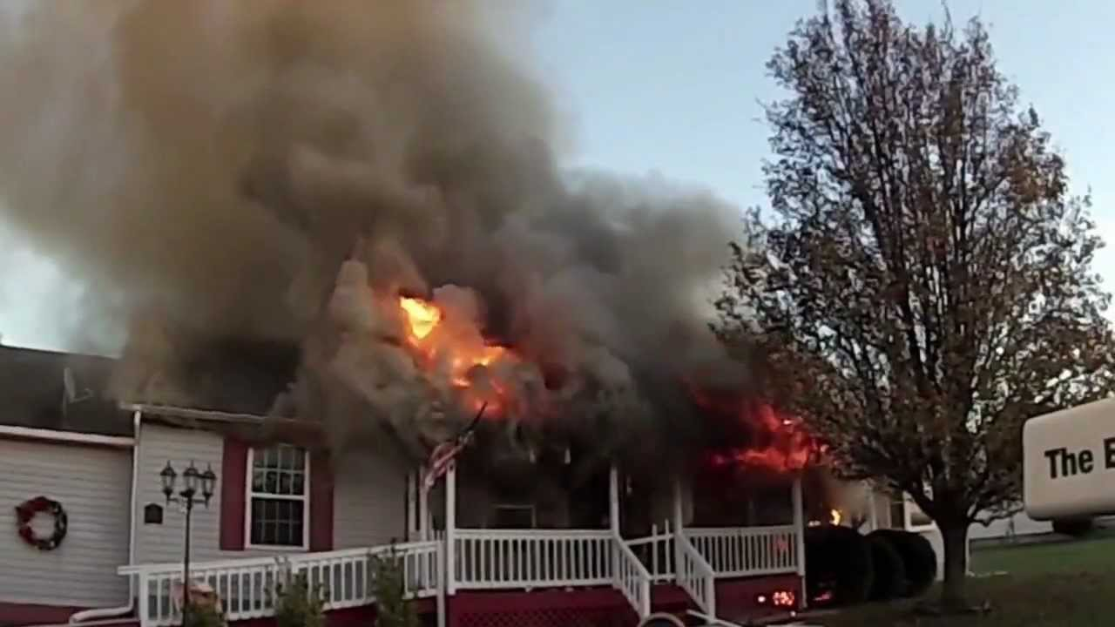
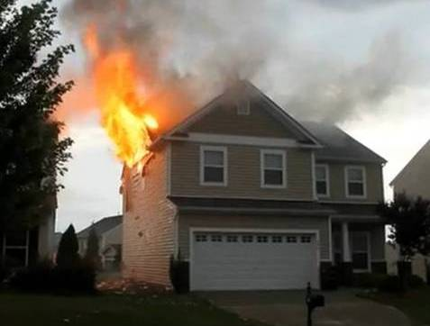
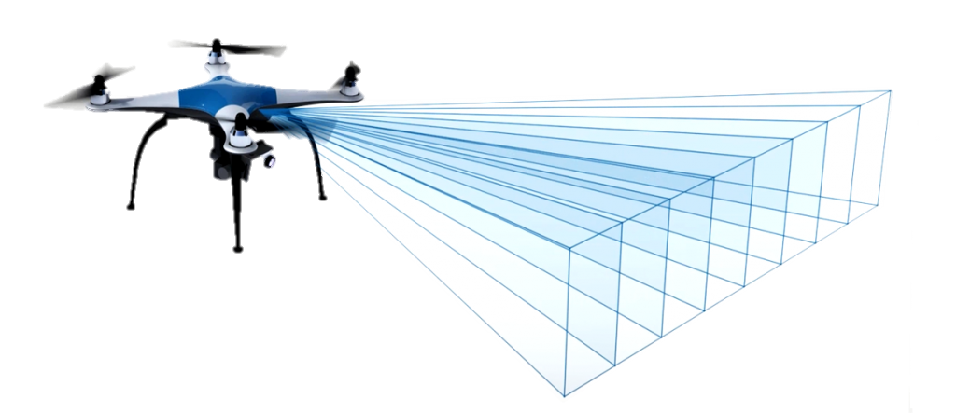
Need for Indoor Firefighters Navigation Guidance
Needs
Firefighting is to prevent the spread of and extinguish significant unwanted fires in buildings, vehicles, woodlands, etc. to protect lives, property and the environment
Major hazards associated with firefighting operations is the toxic environment created by combustible materials, falls and structural collapse.
Risks in firefighting are smoke, oxygen deficiency, elevated temperatures, and poisonous atmospheres
Very difficult for firefighters to know the condition in fire scenario so the robots are used for firefighting operations to know the conditions.
Drones already are helping emergency and disaster management programs, national weather service tracking and traffic management programs, among others.
GOOGLE
< Fire Disasters Scenario >
Basic Concept
LiDAR Drones used to trace the situation in fire zone and forward the fire scenario information to the firefighters for firefighting operations navigation guidance.
Uses the Drones LiDAR Laser Light as a Transmitter and firefighter helmets attached Camera / PD used as a as a receiver to get Object and navigation informations from Drones.
< LiDAR Drone Conceptualization >
Slide 3

Slide 4
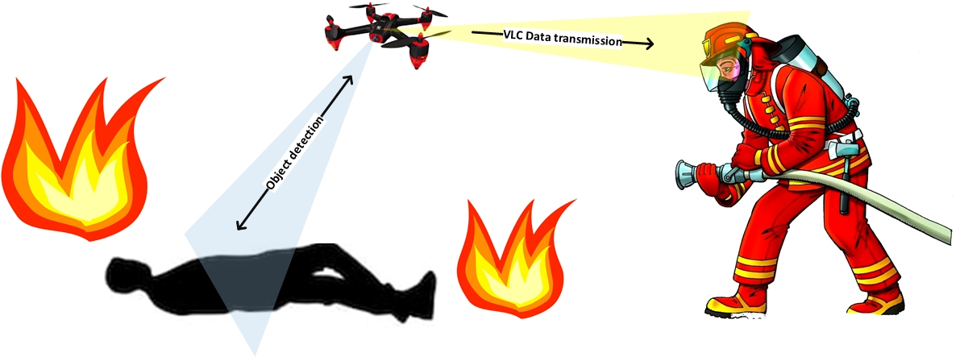
LiDAR Drone IoT/IoL Link for Firefighters Navigation Guidance
Drone based Firefighting Operation Navigation Solution Using LiDAR Laser Light IoT / IoL Link
Tx : LiDAR Drone Laser Lights
Rx : Firefighters Helmets Connected PD / Camera Image Sensor
Day-Night Communication Mode
Modulations
OOK, VPPM, Offset-VPWM, Multilevel PPM, Inverted PPM, Subcarrier PPM, DSSS SIK etc.
Data Rate : 1K ~ 1Mb/s
Supported LoS (Line of Sight)
Available Distance : 2m ~ 200m
< LiDAR Drone IoT/IoL Link for Firefighting Operations Navigation >
Laser lights works with distance with stability, precision, high sensitivity, and high speed.
High Intensity of Laser lights helps to transmit data efficiently on fired environment.
Protects firefighters from Firefighting operation accidents and locate exact location focus for aids.
Slide 4

Slide 5
Conclusion
Proposed the IoT/IoL Technology for Indoor Firefighters Navigation Guidance Using LiDAR Drone.
Uses the Drones LiDAR Laser Light as a Transmitter and firefighter helmets attached Camera / PD used as a as a receiver to get Object and navigation informations from Drones.
Protects firefighters from Firefighting operation accidents and locate exact location focus for aids.
Slide 5

