Slide 1
Project: IEEE P802.15 Working Group for Wireless Personal Area Networks (WPANs)
Submission Title: Automatic Navigation Solution for Driverless Airport Shuttle Bus Using IoT/IoL Embedded Lighting Devices
Date Submitted: November 2018
Source: Jaesang Cha (SNUST), Minwoo Lee (SNUST), Hyeongho Lee (Netvision Telecom Inc., Korea Univ.), Yoonkwan Kim (The Catholic Univ.), Minseok Oh (Kyonggi Univ.), Jinyong Choi (Shinhan Bank), Jintae Kim (Fivetek Co., Ltd.), Sungdoo Kang (Feelux Co., Ltd.), Changsoo Lee (L&S LED Co., Ltd.), Kirak Jung (Namuga Co. Ltd.), Vinayagam Mariappan (SNUST)
Address: Contact Information: +82-2-970-6431, FAX: +82-2-970-6123, E-Mail: chajs@seoultech.ac.kr
Re:
Abstract: This documents introduce the V2I VLC Link design consideration for VAT. This proposed VLC technology used for automatic navigation solution for driverless airport shuttle bus using IoT/IoL Embedded Lighting Devices . This VAT to operate on the application services like ITS, ADAS, IoT/IoL, drone using watch security services, and etc.
Purpose: To provided concept models of Light Communication based VLC technology solution for Vehicular Assistant Technology (VAT) Interest Group
Notice: This document has been prepared to assist the IEEE P802.15. It is offered as a basis for discussion and is not binding on the contributing individual(s) or organization(s). The material in this document is subject to change in form and content after further study. The contributor(s) reserve(s) the right to add, amend or withdraw material contained herein.
Release: The contributor acknowledges and accepts that this contribution becomes the property of IEEE and may be made publicly available by P802.15.
Slide 1

Slide 2
Contents
Needs for Automatic Navigation Solution for Driverless Airport Shuttle Bus
IoT/IoL Embedded Lighting Device based VLC Link
Conclusion
Slide 2

Slide 3
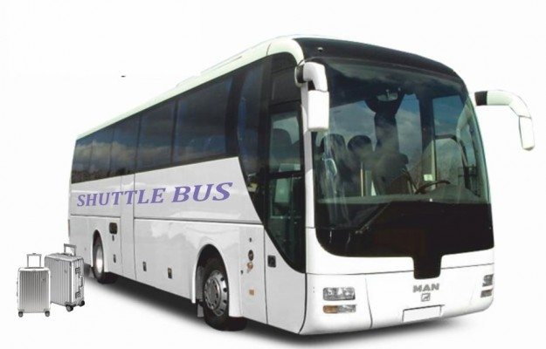
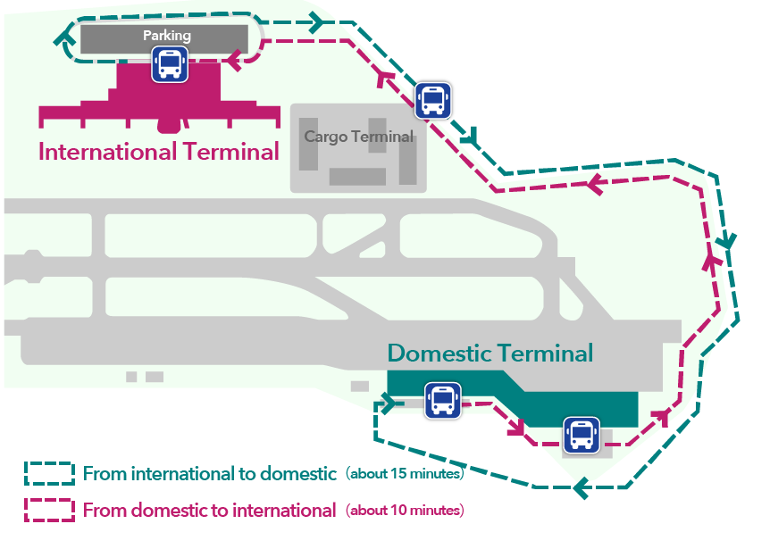
Needs for Automatic Navigation Solution in Driverless Airport Shuttle Bus
Needs
  Airport transportation automation is recent days International Airport Modernization trends
  Navigation of airport shuttle buses in control of shuttle bus operators.
  GPS based navigation Solution does not work effectively in Airport region due transpiration route is blend with building infrastructure.
  Auto navigation of civilian transport need to consider many factors and needs more attention and effective auto navigation methods
Basic Concept
  Uses the Airport Street Lighting and Terminal Infrastructure lighting system and the Camera Connected on Shuttles to enable VLC Link for communication to get navigation informations
  IoT/IoL embedded lighting system provides the navigation, and location information for shuttle bus navigation and control
  Lighting based VLC Links provides more secure and precise location Information
GOOGLE
< Airport Shuttle Bus Services >
< Airport Shuttle Bus Route Information in Airport Terminals >
Slide 3

Slide 4
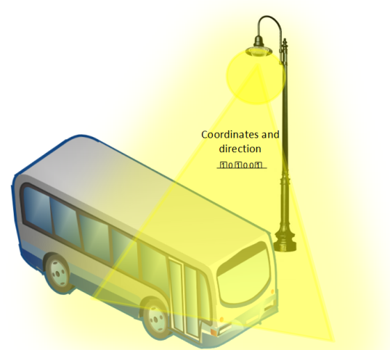
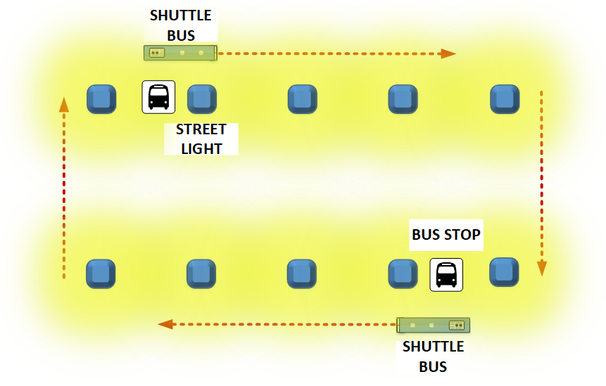
IoT/IoL Embedded Lighting Device based VLC Link
IoT/IoL Embedded Lighting System Based VLC Link for Airport Shuttle Bus Navigation
  Tx : Airport Street Lighting and Terminal Infrastructure lighting system
  Rx : PD / CMOS Image Sensor
  Day-Night Communication Mode
  Modulations :
    OOK, VPPM, Offset-VPWM, Multilevel PPM, Inverted PPM, Subcarrier PPM, DSSS SIK etc.
  Data Rate : 1K ~ 1Mb/s
  Supported LoS (Line of Sight)
  Available Distance : 2m ~ 100m
Provides precise location and Routing path Informations
Information Includes
  Remaining distance till next lighting point
  Preloaded command information for next travel point is available or not
  < IoT/IoL Embedded Lighting Device based VLC Link for Shuttle Bus Navigation >
Slide 4

Slide 5
Conclusion
Proposed the Automatic Navigation Solution for Driverless Airport Shuttle Bus Using IoT/IoL Embedded Lighting Devices as a Transmitter to create VLC Link to provide navigation information.
Proposed system uses the Airport Street Lighting and Terminal Infrastructure lighting system and the Camera connected on the Airport Shuttle bus to enable VLC Link to get navigation informations to move on automatically.
Used to automatically navigate to the next traveling point and create optimized routes for the airport shuttles.
Slide 5

