Slide 1
Project: IEEE P802.15 Interest Group for Wireless Personal Area Networks (WPANs)
Submission Title: Consideration for effects of mobility for OCC system using hybrid waveform
Date Submitted: November 2018
Source: Huy Nguyen, Minh Duc Thieu and Yeong Min Jang [Kookmin University].
Contact: +82-2-910-5068 E-Mail: yjang@kookmin.ac.kr
Re:
Abstract: This document discusses about the effects of mobility for OCC system using hybrid waveform
Purpose: To evaluate the effects of vehicle mobility for OCC system
Notice: This document has been prepared to assist the IEEE P802.15. It is offered as a basis for discussion and is not binding on the contributing individual(s) or organization(s). The material in this document is subject to change in form and content after further study. The contributor(s) reserve(s) the right to add, amend or withdraw material contained herein.
Release: The contributor acknowledges and accepts that this contribution becomes the property of IEEE and may be made publicly available by P802.15.

Slide 2
Consideration for effects of mobility for OCC system using hybrid waveform

Slide 3
Introduction
Hybrid waveform is currently applied to vehicular optical wireless communication (OWC)/optical camera communication (OCC) systems.
To track and differentiate interested light-sources among others (including the sun/stars and ambient lights, building lamps, etc.), RoI-signaling mode is indispensable to the OCC system operating in a challenging condition such as V2X
With using RoI-signal technique in OCC system, the computational cost can also be reduced
However, in the real environment, there are many challenges for this system need to consider.

Slide 4
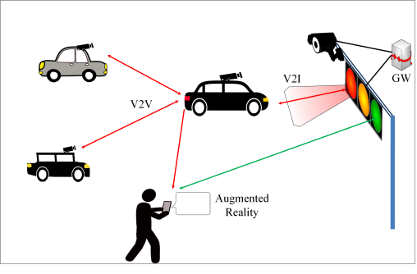
Scenario of vehicular OCC system using hybrid waveform
Scenario of vehicular OCC system using hybrid waveform [1]

Slide 5
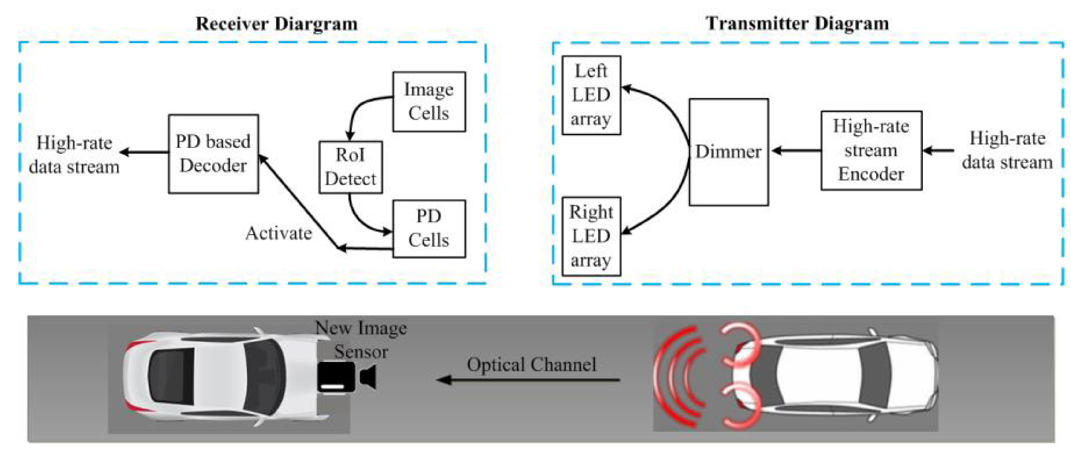
Reference architecture of Hybrid OCC/PD communication system
Reference architecture of Hybrid OCC/PD communication system base on RoI signaling technique[1]

Slide 6
Consideration for effects of mobility for OCC system
The vehicle is in stabilization due to the road condition and road curve. The image of the transmitter will be in unestimated offset movement in the image sensor
When the camera up/down movement is 1cm, the captured image is changed more than 20 pixel. RoI technique is not useful for this system.
In city traffic, when Tx and Rx are transmitting data, other vehicles can interrupt transmission.

Slide 7
The method to improve performance for OCC system
To reduce the mobility effects in OCC system, we need a equalization block in Rx to compensate mobility effects

Slide 8
References
[1] T. Nguyen et al., “Current Status and Performance Analysis of Optical Camera Communication Technologies for 5G Networks”, IEEE Access, vol. 5, March 2017, pp. 4574-4594.

