Slide 1
doc.: IEEE 15-18-0558-00-0vat
Project: IEEE P802.15 Working Group for Wireless Personal Area Networks (WPANs)
Submission Title: Cloud Server for connected Optical Camera Communication Vehicle Networks
Date Submitted: November 2018
Source: ThanhLuan Vu, Yeong Min Jang [Kookmin University].
Contact: +82-2-910-5068 E-Mail: yjang@kookmin.ac.kr
Re:
Abstract: This document contains the output of the Vehicular Assistant Technology (VAT) Interest Group, intended to describe the use cases, requirements, and technical feasibility of Optical Wireless Communications in 802.15.
Purpose: Press release announcing confirmation of VAT IG
Notice: This document has been prepared to assist the IEEE P802.15. It is offered as a basis for discussion and is not binding on the contributing individual(s) or organization(s). The material in this document is subject to change in form and content after further study. The contributor(s) reserve(s) the right to add, amend or withdraw material contained herein.
Release: The contributor acknowledges and accepts that this contribution becomes the property of IEEE and may be made publicly available by P802.15.
Submission

Slide 2
Introduction
Cloud Server for connected Optical Camera Communication Vehicle Networks developers and providers cloud-computing capabilities and an IT service environments at the edge of the mobile network and OCC.
This environment is characterized by:
Proximity
Ultra-low latency
High bandwidth
Real-time access to radio network information
Location awareness

Slide 3
Cloud Server for connected Optical Camera
Communication Vehicle Networks
The most important message type is the basic safety message.
Its major attributes are the following:
Temporary ID
Time
Latitude
Longitude
Elevation
Vehicle Size
Positional Accuracy
Speed and Transmission
Heading
Acceleration
Steering Wheel Angle
Brake System Status

Slide 4
Cloud Server based OCC for V2X
The system is decomposed into a backbone network connecting the central office (CO) to the various access points of the network (traffic lights, road signs, etc.).
The CO is responsible for coordinating and managing the information exchange between the vehicles and the infrastructure.
The backbone network can be implemented using existing wire-line or wireless technologies (fiber-to-the-x, ADSL, RF links, etc.).
The second part of the network is based on VLC technology and consists of the various V2I and V2V connections.

Slide 5
Connected OCC and 5G technologies inside the vehicle
Connected OCC and 5G technologies inside the vehicle

Slide 6
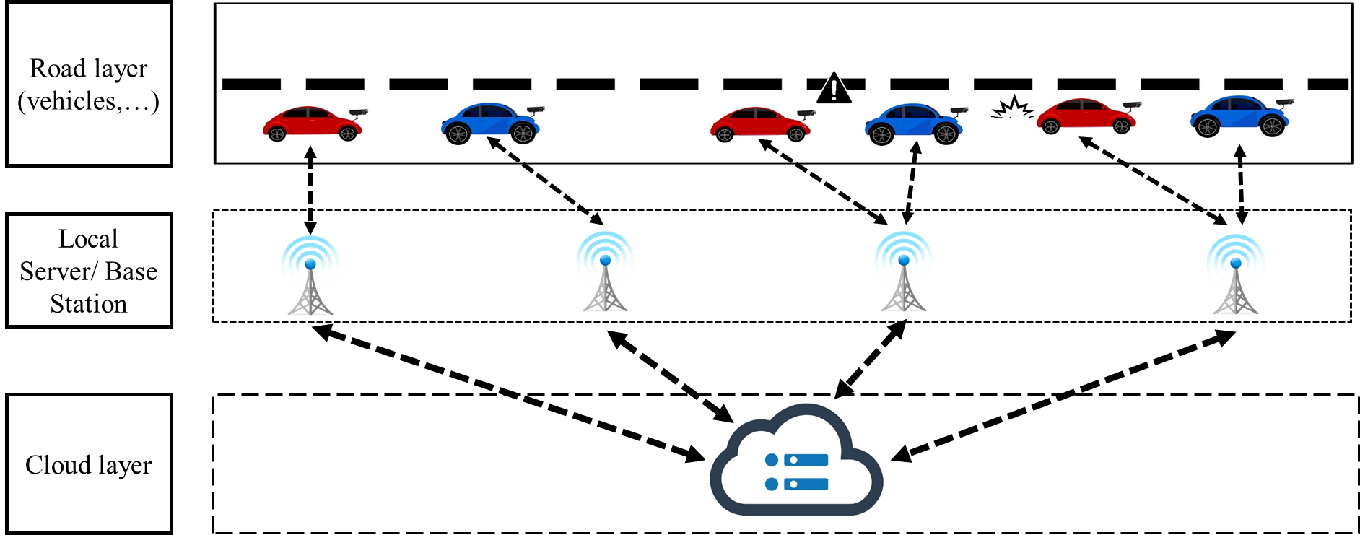
High level use cases
High level use cases

