Slide 1
Project: IEEE P802.15 Interest Group for Wireless Personal Area Networks (WPANs)
Submission Title: Technical considerations of low-rate modulation scheme in vehicular OCC system using hybrid waveform.
Date Submitted: November 2018
Source: Minh Duc Thieu, Trang Nguyen and Yeong Min Jang [Kookmin University].
Contact: +82-2-910-5068 E-Mail: yjang@kookmin.ac.kr
Re:
Abstract: A summary of technical considerations of low-rate modulation scheme for RoI-signaling in vehicular OCC system using hybrid waveform.
Purpose: To summary technical considerations of low-rate modulation scheme which is feasible for detecting Region-of-Interest in V2V communication
Notice: This document has been prepared to assist the IEEE P802.15. It is offered as a basis for discussion and is not binding on the contributing individual(s) or organization(s). The material in this document is subject to change in form and content after further study. The contributor(s) reserve(s) the right to add, amend or withdraw material contained herein.
Release: The contributor acknowledges and accepts that this contribution becomes the property of IEEE and may be made publicly available by P802.15.

Slide 2
Technical considerations of low-rate modulation scheme in vehicular OCC system using hybrid waveform

Slide 3
Introduction
RoI-signaling technique is applied in vehicular OCC system using hybrid waveform.
Detecting RoI can helps Rx camera identify the region of interest (RoI) to set up the communication link. When the RoI information is received by low-frame-rate Rx camera, high-rate data stream can be received by Rx high-frame-rate camera.
By deploying RoI-signaling technique, the computational cost of systems can also be decreased.
However, there are many challenges for this new technology need to consider carefully.

Slide 4
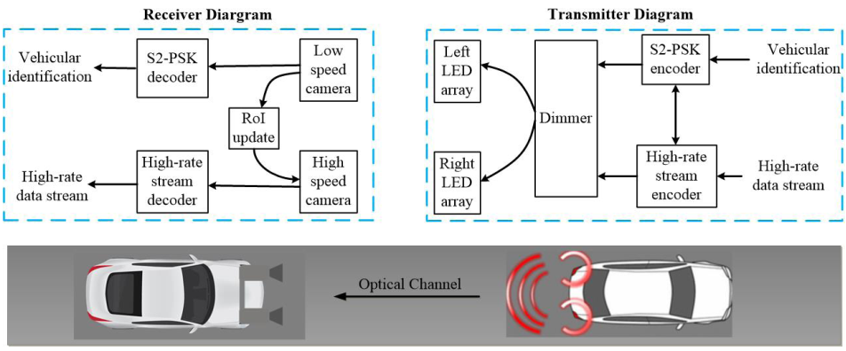
Reference architecture of vehicular OCC system using hybrid waveform
Reference architecture
Low-rate waveform
High-rate data stream
Reference architecture of vehicular OCC system using hybrid waveform [1]

Slide 5
Advantages of RoI-signaling techniques
Conventional computer vision (CV)-based concept for detecting light sources has many disadvantages compared to RoI-signaling techniques:
CV-based solution for object detection typically relies on the analyzing pattern images.
CV is based on two-dimensional image processing while the RoI-signaling technique is one-dimensional binary sequence processing. Thus, the computational complexity of image processing limits the processing frame rate of Rx.
The performance of CV-based object detection is poor when images are blurry.
Light intensity detected by receivers brings no information to Rx vehicles.

Slide 6
Technical considerations of low-rate data stream
Despite the potential of RoI-signaling technique. Many challenges for designing RoI-signaling waveforms need to consider as follows:
The capability to support a large range of multi-LEDs arrays in the market.
Illumination is still the most important purpose of the lighting system on vehicles. Thus, flicker-free to human eyes is a mandatory requirement. However, the safe frequency threshold (200Hz [2]) is higher than the typical camera frame rate. Then, the under-sampling concept is proposed as a solution for RoI-signaling waveform.
The capacity of retaining the acceptable performance of RoI-signaling demodulation under dimming.

Slide 7
References
[1] T. Nguyen et al., “Current Status and Performance Analysis of Optical Camera Communication Technologies for 5G Networks”, IEEE Access, vol. 5, March 2017, pp. 4574-4594.
[2] Sridhar Rajagopal, Richard. D. Roberts, Sang Kyu Lim, "IEEE 802.15.7 Visible Light Communication: Modulation and Dimming Support," IEEE Communication Magazine, March 2012.

