Slide 1
Project: IEEE P802.15 Interest Group for Wireless Personal Area Networks (WPANs)
Submission Title: AI supporting for Vehicular Optical Camera Communication System
Date Submitted: Nov. 2018
Source: Pham Tung Lam, Trang Nguyen and Yeong Min Jang [Kookmin University].
Contact: +82-2-910-5068 E-Mail: yjang@kookmin.ac.kr
Re:
Abstract : Introduce AI supporting for Vehicular Optical Camera Communication System
Purpose: To Introduce application of AI for Vehicular Optical Camera Communication System.
Notice: This document has been prepared to assist the IEEE P802.15. It is offered as a basis for discussion and is not binding on the contributing individual(s) or organization(s). The material in this document is subject to change in form and content after further study. The contributor(s) reserve(s) the right to add, amend or withdraw material contained herein.
Release: The contributor acknowledges and accepts that this contribution becomes the property of IEEE and may be made publicly available by P802.15.

Slide 2
AI supporting for Vehicular Optical Camera Communication System

Slide 3
Introduction
The purpose of the communication system incorporated into car (using existing light-emitting diode (LED) lights and ordinary cameras) is to add region-of-interest signaling functionality for cars via either their headlights or taillights. This function can be complete with a support of convolutional neural network, or AI (Artificial Intelligence).
The helpful information for safety purpose could be transmitted Vehicle to Vehicle and AI could take a role in decoding data from image frame.
AI can be apply for both Rolling shutter camera and Global shutter camera.
Kookmin University

Slide 4
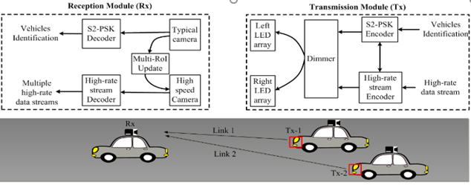
System Architecture
Kookmin University

Slide 5
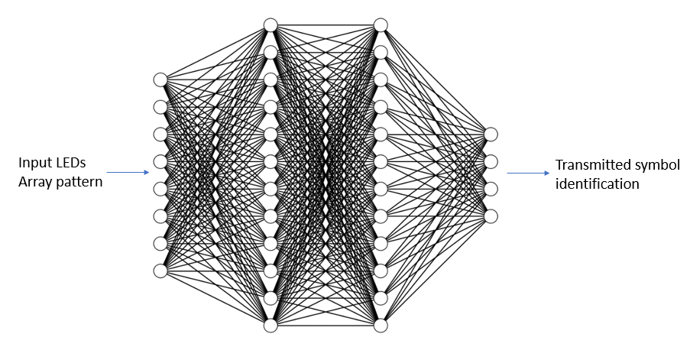
Neural network architecture for OCC
Mostly in OCC system, from RoI extracting to data decoding task can be referred to classification problem, so we can use a convolutional neural network and multilayer fully-connected neural network for OCC system
Kookmin University

Slide 6
Spatial 8-PSK Decoding
To decode a S2-PSK signal, the bit value is decided using the Spatial -XOR model from an image of two LEDs. This method represents a typical class of S2-PSK decoding algorithms. The output bit is 0 if the captured states of two LED Waveforms are in the same phase, and the output bit is one for other captured states
Kookmin University

Slide 7
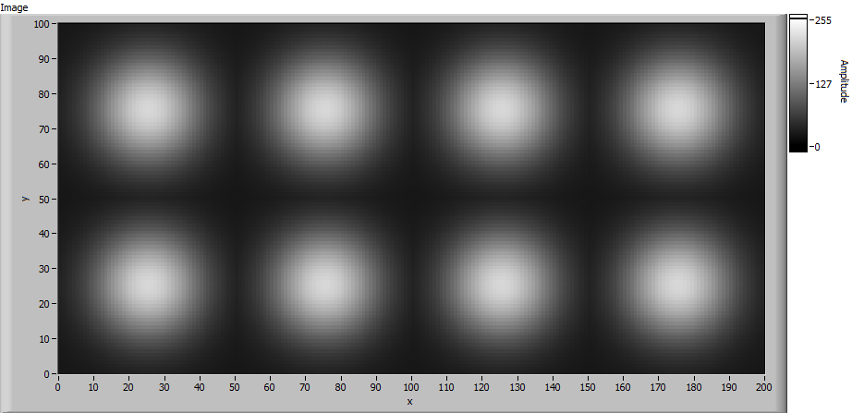
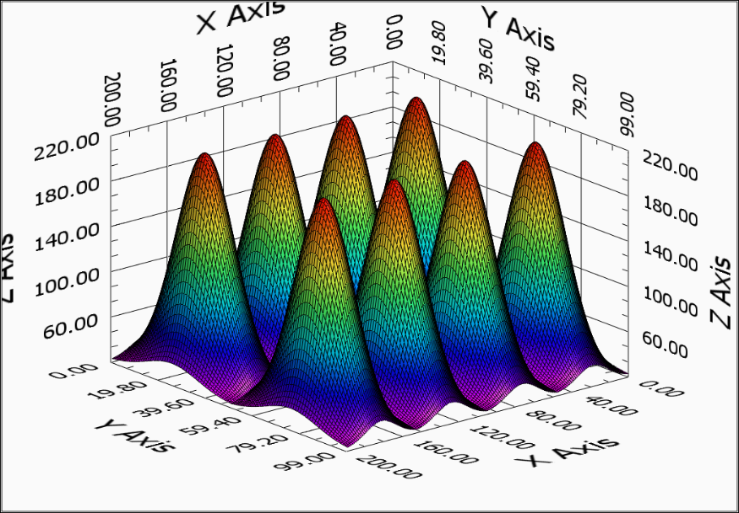
Data sampling
The LED Array samples are captured and intensity map is built up for feature extracting. From this data, training dataset for AI system be generate.
Kookmin University

Slide 8
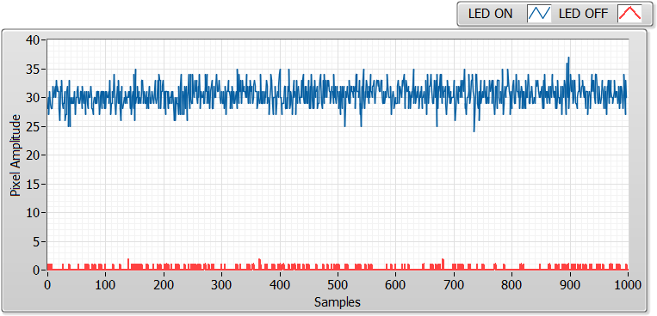
SNR Measurement
The practical measurement of pixel SNR is performed to confirm the satisfaction of pixel SNR for the desired BER value such as 10-4. Both the rolling shutter and the global shutter camera are used to measure pixel SNR.

Slide 9
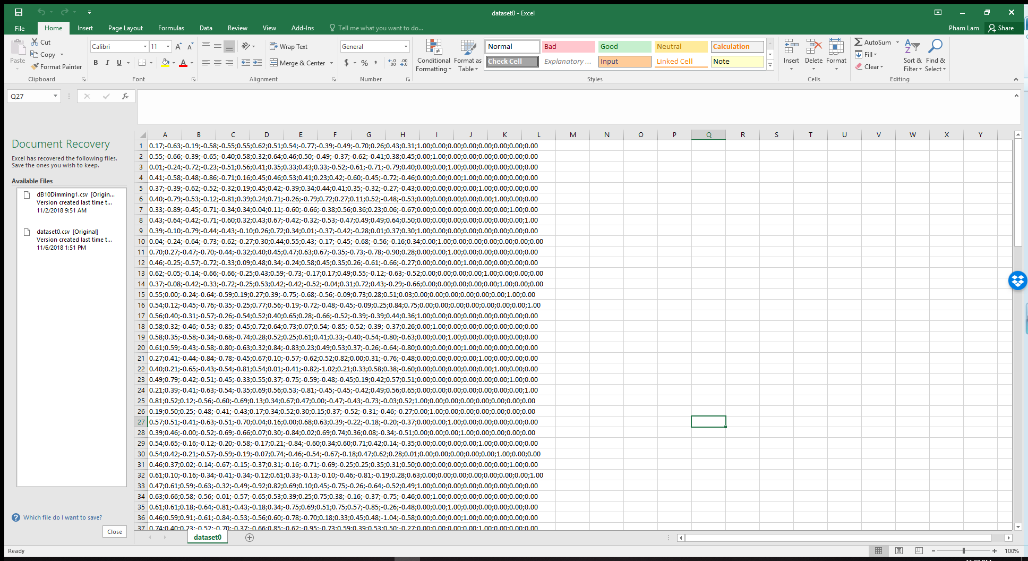
Data augmentation
From real value of intensity from LED array sampling and SNR measurement, a dataset been generate for training and evaluating AI performance in OCC system.

Slide 10
References
[1] Minh Duc Thieu, Trang Nguyen, Yeong Min Jang, “New Waveforms for Selective-RoI-Signaling High-rate Optical Camera Communication System”, Ubiquitous and Future Networks (ICUFN), July 2018.
[2] T. Nguyen, and et.al., "Region-of-Interest Signaling Vehicular System Using Optical Camera Communications" IEEE Access, 2017.

